Slide 1


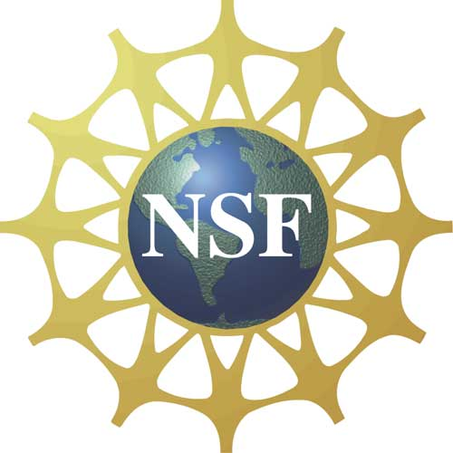

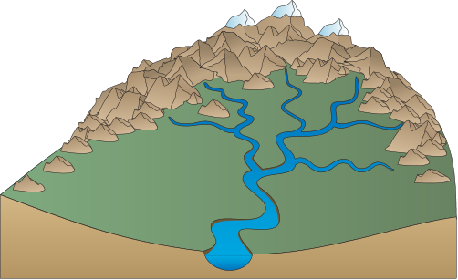
NH Informal Science Educators Network: Creating a Pipeline between Ecosystems-based Research and Informal Science Education in the Granite State
Kate Leavitt¹ and Will Broussard²
¹Seacoast Science Center, Rye, NH, ²Mount Washington Observatory, North Conway, NH
Abstract
NH EPSCoR’s Ecosystems and Society Project is a collaborative effort to study and broaden public understanding and appreciation for the complex interactions linking New Hampshire’s Climate, Land Use, Ecosystems and Society. Specifically, this project seeks to 1) better understand complex interactions among climate, land use, ecosystem function, and society, 2) build capacity for competitive research in interdisciplinary ecosystem-related natural and social sciences, 3) strengthen and diversify the STEM workforce pipeline in NH, and 4) strengthen management and policy decision capacity in New Hampshire regarding ecosystems and their services to, and interactions with, society. In order to strengthen and support these goals, a network of non-academic partner institutions, henceforth known as the “Informal Science Educator’s Network” will be developed and trained in various methods of delivering Ecosystems and Society research findings to diverse audiences. Network members and researchers will take part in a series of workshops to develop best practices for applying and translating ecosystems-based concepts and findings to their own educational programming, thus strengthening external stakeholder and student engagement with NH EPSCoR research while building understanding and appreciation for ecosystem-based concepts across New Hampshire.
Delivering Ecosystems & Society research findings through an Informal Education Network
Investigators
NH Informal Science Educators Network
INPUTS
Diverse Investigators
Interdisciplinary
Diverse Audiences
Diverse Approaches
ACTIVITIES
Integrative Workshops:
Research Scientists and Informal Education Directors
Naturalist trainings at 10 Informal Education Centers => network of translators familiar with Ecosystem-based approach
Overall objective
The informal science education effort will build the capacity of New Hampshire informal science educators so they are best positioned and trained to begin integrating an ecosystem-based approach into their educational programming. Development and of an informal education network that is connected to research institutions throughout the state will provide the mutual benefit of strengthening research infrastructure while providing professional development and networking opportunities for informal educators. The effort will be co-led by Seacoast Science Center (SSC) and Mt. Washington Observatory (MWO).
Diverse network reaches diverse audiences to increase ecosystem literacy and science identity
Strengthening research infrastructure by connecting investigators to viable network
Systems-based approach illustrates connections between land-use, watershed function and quality of life
OUTCOMES
AND
IMPACTS
“To build capacity for competitive research in interdisciplinary ecosystem-related natural and social sciences,” by improving research infrastructure.
“Strengthen and diversify the STEM NH pipeline,” by raising awareness, improving understanding and providing opportunities to learn about current ecosystem-related research in NH.
Better informed citizenry and policymakers, regarding ecosystems decisions.
Project objectives
Establish a state-wide network of informal science educators, comprised of representatives from 10 informal science education institutions.
Develop and implement pre- and post-assessment tools to determine the state of understanding and implementation of ecosystem-based concepts at Network institutions.
Train Network members in EPSCoR core concepts.
Facilitate integrative workshops connecting research scientists with informal education directors.
Coach Network members’ implementation.
Evaluate progress.
Disseminate results.
Dissemination of “…the science of interactions between ecosystems and society.”
Strategic Plan Objectives
Literature Cited
Nisbet, J., K. Gardner, C. Wake, W. McDowell, R. Howarth. 2013. Partnerships for Research and Education. A Strategic Plan for: Interactions Among Climate, Land Use, Ecosystems Services and Society. NH EPSCoR Internal Document.
Acknowledgements
This research was funded through the NSF NH EPSCoR program, grant number #1101245 .

