Slide 1
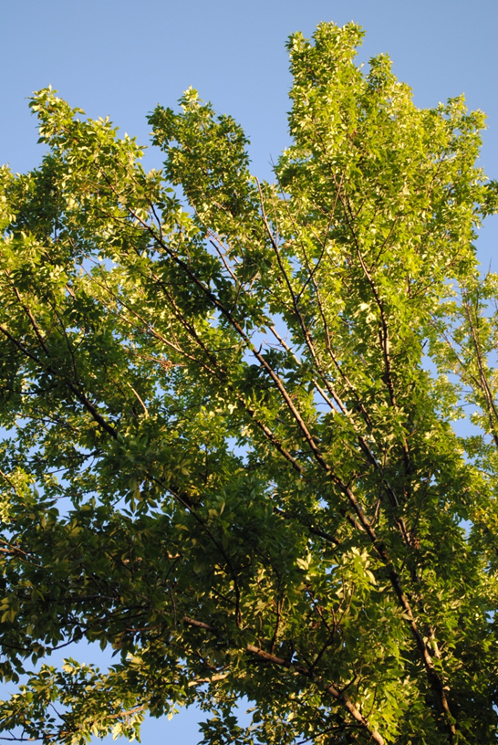
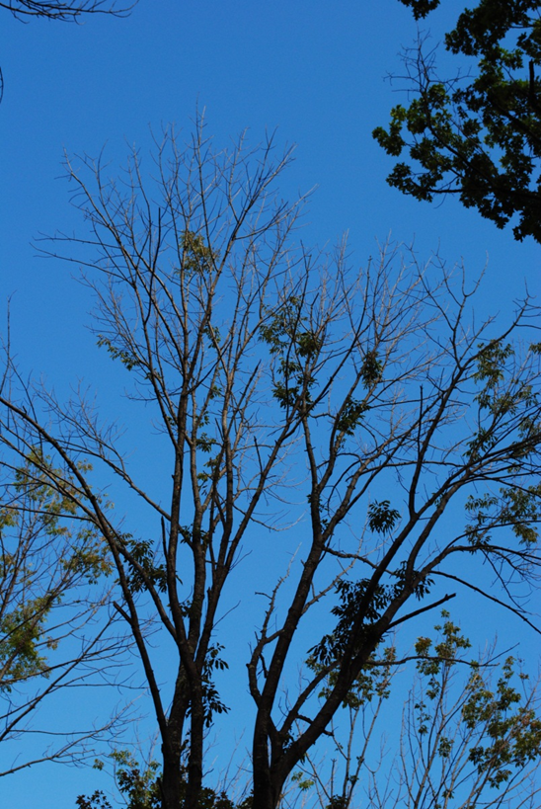
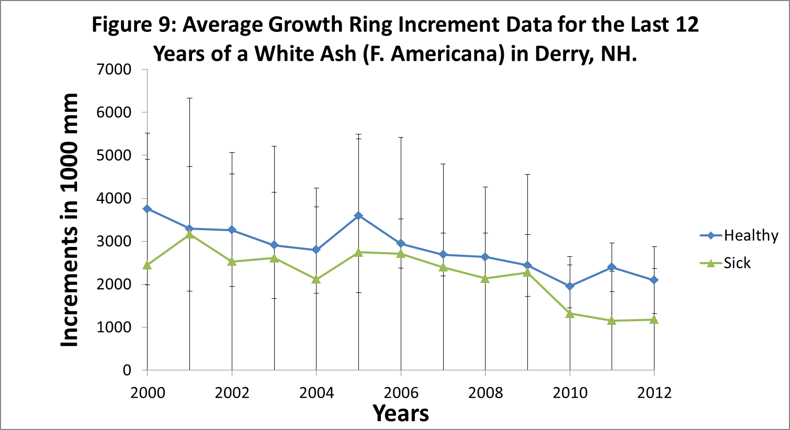
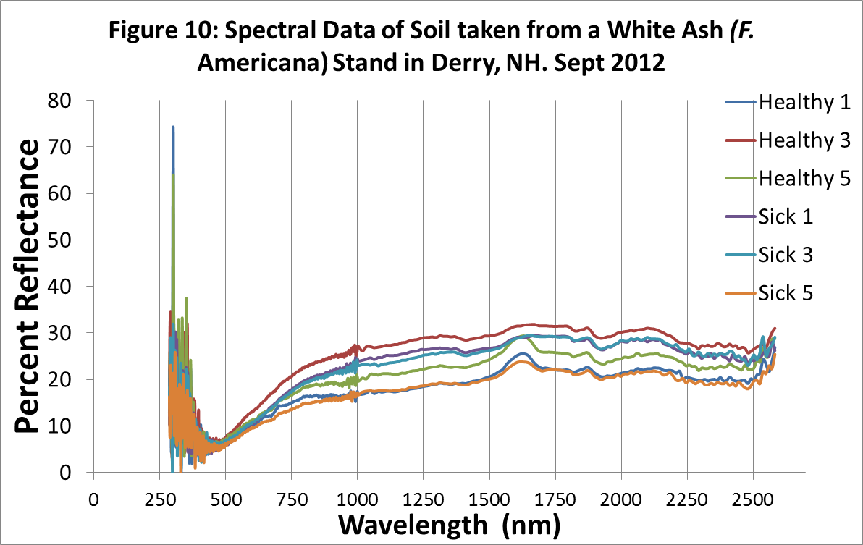
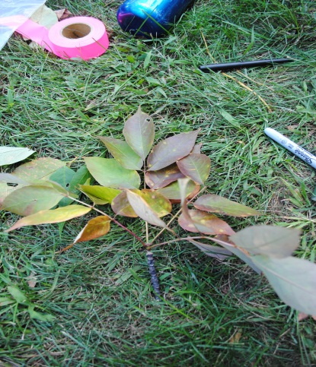
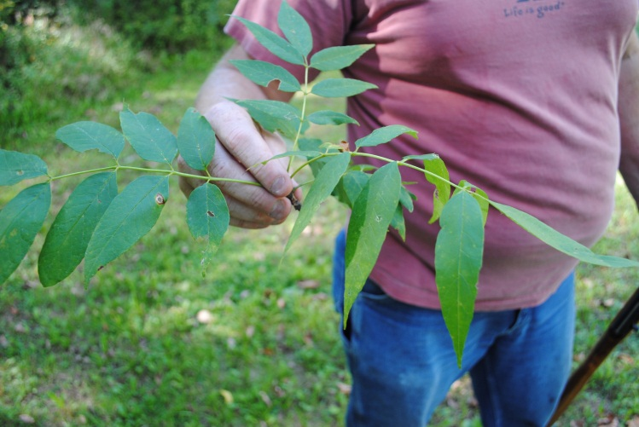
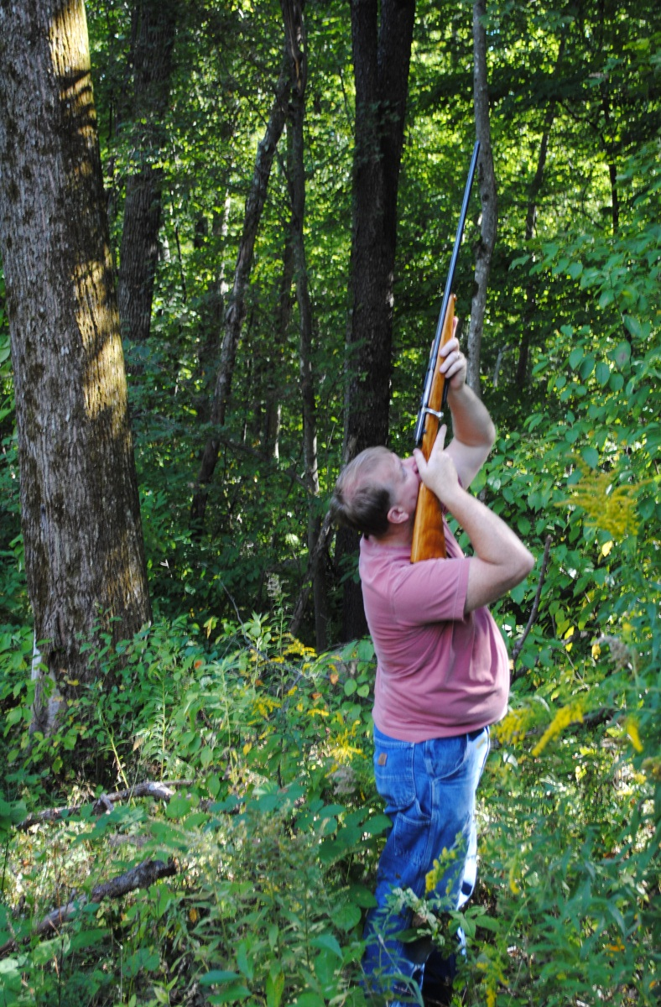
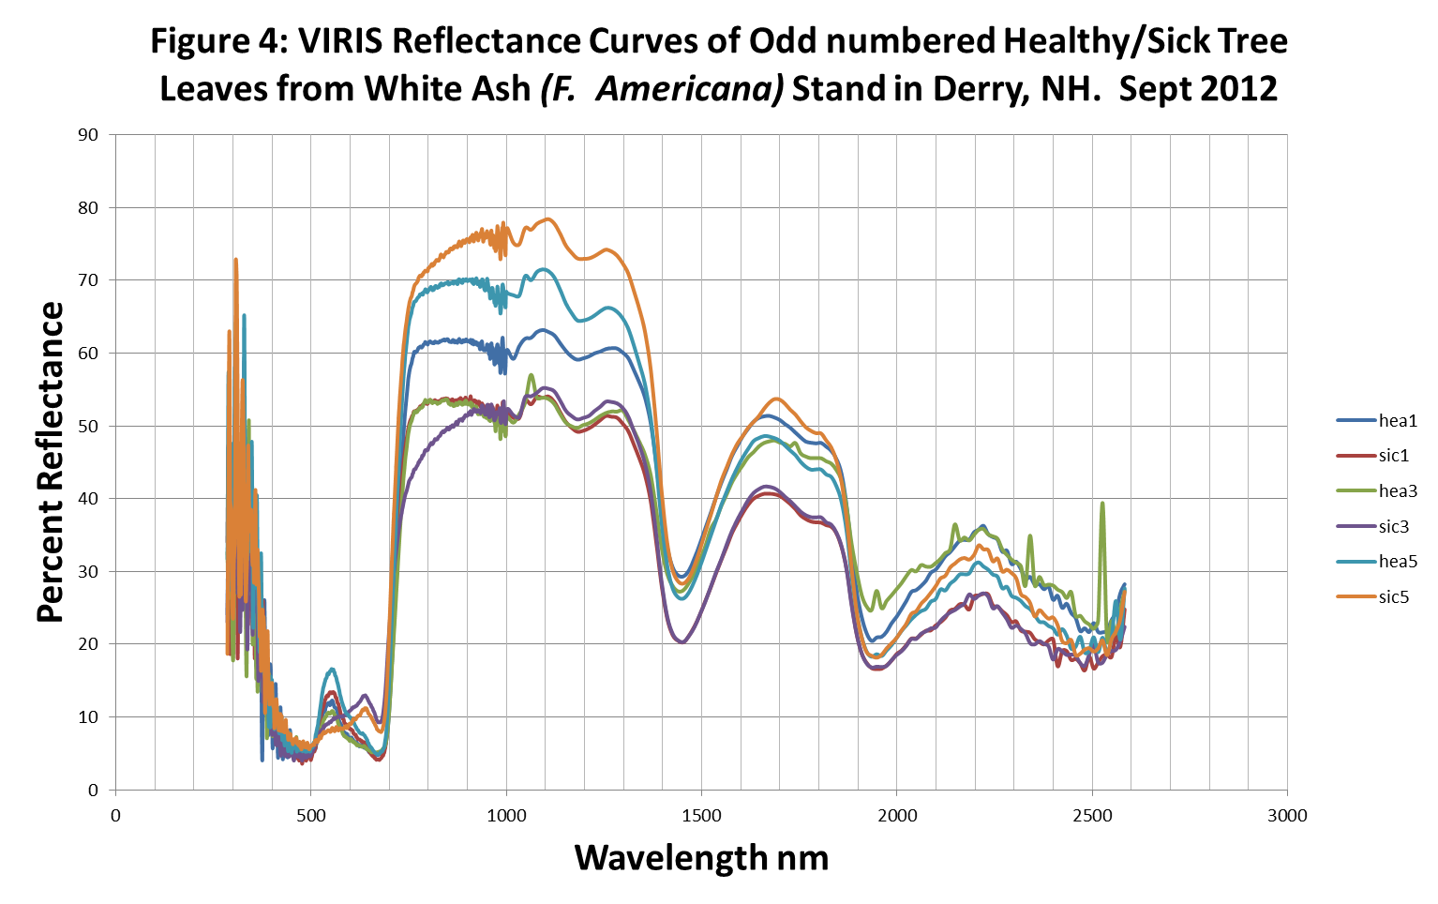
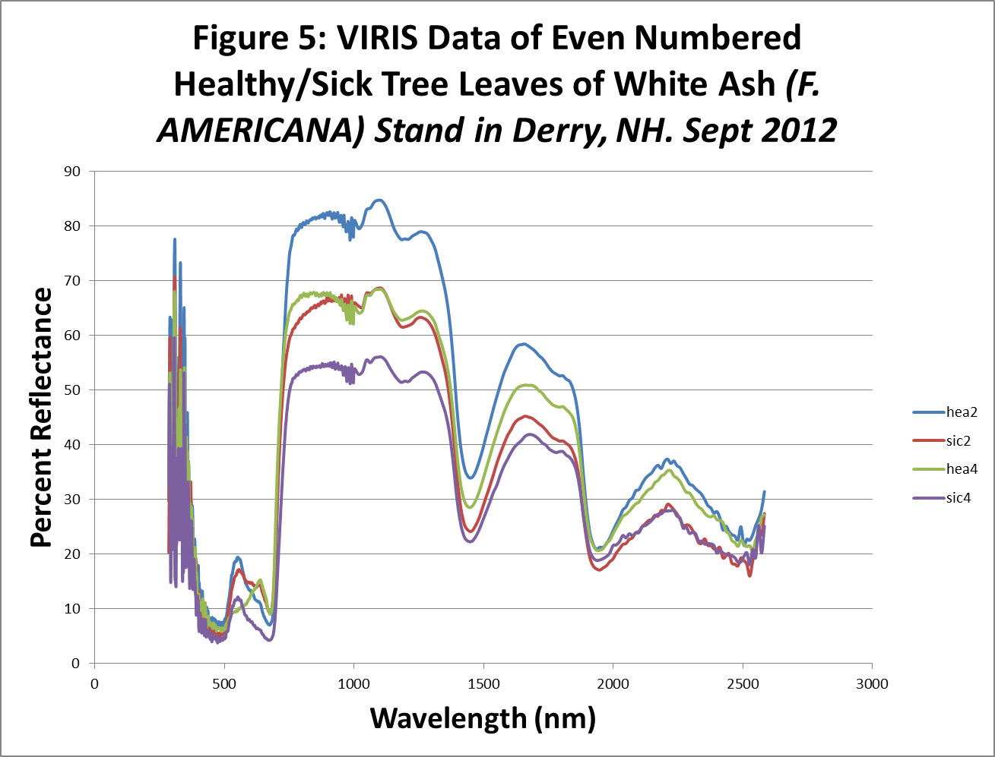
Decline of White Ash (Fraxinus Americana) in a Forest Stand Located in Derry New Hampshire.
Donald Tucker
University of New Hampshire, Durham, New Hampshire
Introduction
Methods
Findings:
Forest pests, pollution and climate change are an ever increasing stressor upon the forested landscape (Rozas and Garcia, 2012). It is possible that these stressors are responsible for what appears to be a decline in the overall health and subsequent death of white ash (Fraxinus Americana) in a forest stand located on Warner Hill Rd in Derry, NH. These trees are experiencing a decline in leaf production and with less leaf production the tree begins a slow death.
The owner has reported that this phenomena has been going on for approximately 3 years and tops of these trees are now dying back. White ash is very important forest species in New England. This tree was a leading landscape replacement in cities and towns for American elm (Ulmus Americana) after its demise from Dutch elm disease. Furthermore, ash trees are economically important for it is very strong and hard, being is used for farm implements, furniture, basket weaving, sporting goods products, pulp and firewood (Maine Forest Service 2008).
This study will be a four part analysis to determine what contributing factors are causing this decline within the stand.
The study area consist of a rectangle which is 264ft by 180ft.
Healthy tree level was set at ≥60% leaf structure within the crown and an unhealthy tree ≤40% leaf structure within the crown.
Leaves from 10 trees were collected stripped off the petiole and scanned under the Visible Infrared Intelligent spectrophotometer (VIRIS) to obtain spectral information to determine chlorophyll production level differences between healthy and unhealthy trees (Figures 1, 2 and 3).
Soil samples were taken utilizing a standard soil auger to an average depth of 15 inches. The samples weighed, dried, reweighed and then scanned by the VIRIS to obtain spectral signatures (Figure 10) of minerals/metals within the samples.
Utilizing a increment corer at DBH 6 trees 3 of each class were cored. A section of the core was cut away for use in the scanning electron microscope as seen in (Figure 6 , 7 and 8).
Core samples were sanded and a tree ring counter utilized to obtain age and determine growth rings size between healthy and unhealthy tree cores.
All tree DBH’s, estimated heights, soil moisture content and ages were averaged see (Table 1) below.
Figure 6. Tyloses in healthy tree.
Figure 7. Vessel element in sick tree. No fungi is present in this sample.
Figure 8. Vessel element fully closed by tyloses in sick tree.
Table 2. Information of leaf analysis from VIRIS scan of healthy and unhealthy trees from a white ash stand on Warner Hill Rd Derry, NH Sept 2012.
Conclusion
 | Tree Leaf Health Status
 | Healthy |  |  |  |  | Unhealthy
REIP | 722.4 | 702.3 | 717.7 | 697.6 | 712.3 | 705.4 | 696.1 | 693 | 717.7 | 700.7
NDVI | 0.841 | 0.804 | 0.813 | 0.692 | 0.842 | 0.826 | 0.692 | 0.623 | 0.828 | 0.767
TM54 | 0.796 | 0.689 | 0.86 | 0.724 | 0.665 | 0.719 | 0.665 | 0.804 | 0.729 | 0.688
NIR3/1 | 0.971 | 0.949 | 0.964 | 0.935 | 0.929 | 0.937 | 0.945 | 1.057 | 0.964 | 0.98
The results suggest that there is no clear reason based on the items researched in this study for the decline. The spectral differences between healthy and unhealthy leaves while having some differences there is not a significant enough change to suggest that hypothesis one can be supported. The soil spectral analysis does not suggest significant metal differences in the soils surrounding healthy and unhealthy trees and hypothesis two is disproven. The analysis of cellular tissue did not reveal any differences between the healthy and unhealthy trees as there was no fungi found within the cells of the unhealthy trees as expected as a cause of the damage. It was noted however that the unhealthy samples did have a 15% higher rate of tyloses within the cell structures than healthy. Lastly the tree core samples looking at the last 12 years of growth (beginning outside the period when the owner began
to notice the decline) did not reveal anything significant as the tree ring growth difference between the two was insignificant as the error overlapped one another. In an effort to get more data starting at the beginning of the growing season and collecting leaf samples throughout, may yield different results vice the leaves collected late in the summer/early fall. Further study on this decline is recommended to include a look at mycorrhizal activity critical to ash tree growth.
Witches broom present
Figure 2. Healthy Leaf Sample
Photos by: J. Tucker
Figure 1. Unhealthy Leaf Sample
Findings
Objectives and Hypotheses
Red Edge Inflection Point (REIP) depict that 3 of the 5 healthy trees are adequately photosynthesizing and all but one of the sick trees are not.
Soil spectral analysis indicates no significant differences between healthy and sick tree soil samples.
Cell tissue from healthy and unhealthy trees with SEM indicates tyloses presence in vessel elements; however, no evidence of fungi in any of the vessel elements.
The objective of this study was to determine indicators of disease state in healthy and sick ash trees.
We hypothesized that disease state in trees will be reflected by changes in spectral differences in leaves, cellular tissue differences, and evidence of slow or stunted growth in tree core samples.
Table 1. Mean Tree and Soil Moisture Data from White Ash Stand in Derry, NH. Sept, 2012
Acknowledgements: I wish to thank Martha Carlson for her help with the VIRIS scans and associated data. Dr. Barry Rock for his expertise in the SEM lab. Nancy Cherim for her time getting samples ready for the SEM. Dr. Tom Lee for his patience in training me to use the core increment system. Mr. and Mrs. Palmer for the use of their stand for this study, I only wish we could have found something. Lastly Jennifer Tucker for her camera skills.
 | Tree Health Status
 | Healthy | Unhealthy
DBH (in) n=10 | 13.7 | 15
Height (ft) n=10 | 77.8 | 78.4
Soil Weights n=6 | 1.48g | 2.12g
Soil Moisture Content | 16 % | 22%
Age n=6 | 52 | 52
Cited References:
Forest Service of Maine 2008. Forest Trees of Maine 14th ed.
Rozas, V. and I . Gonzalez, 2012. Too wet for Oaks? Inter-tree competition and recent persistent wetness predispose oaks to rainfall-induced dieback in Atlantic rainy forest. Global and Planetary Change 94-95 pp 62-71.
Figure 3. Collection Method

