Slide 1
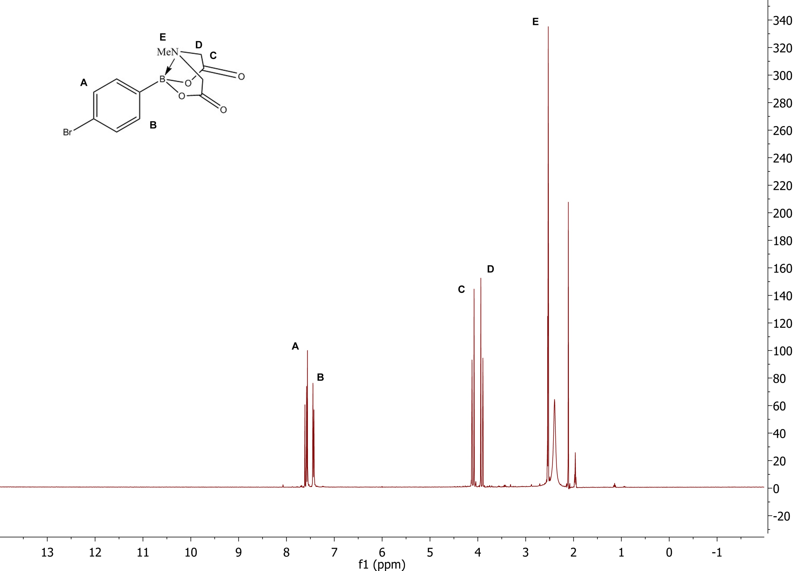
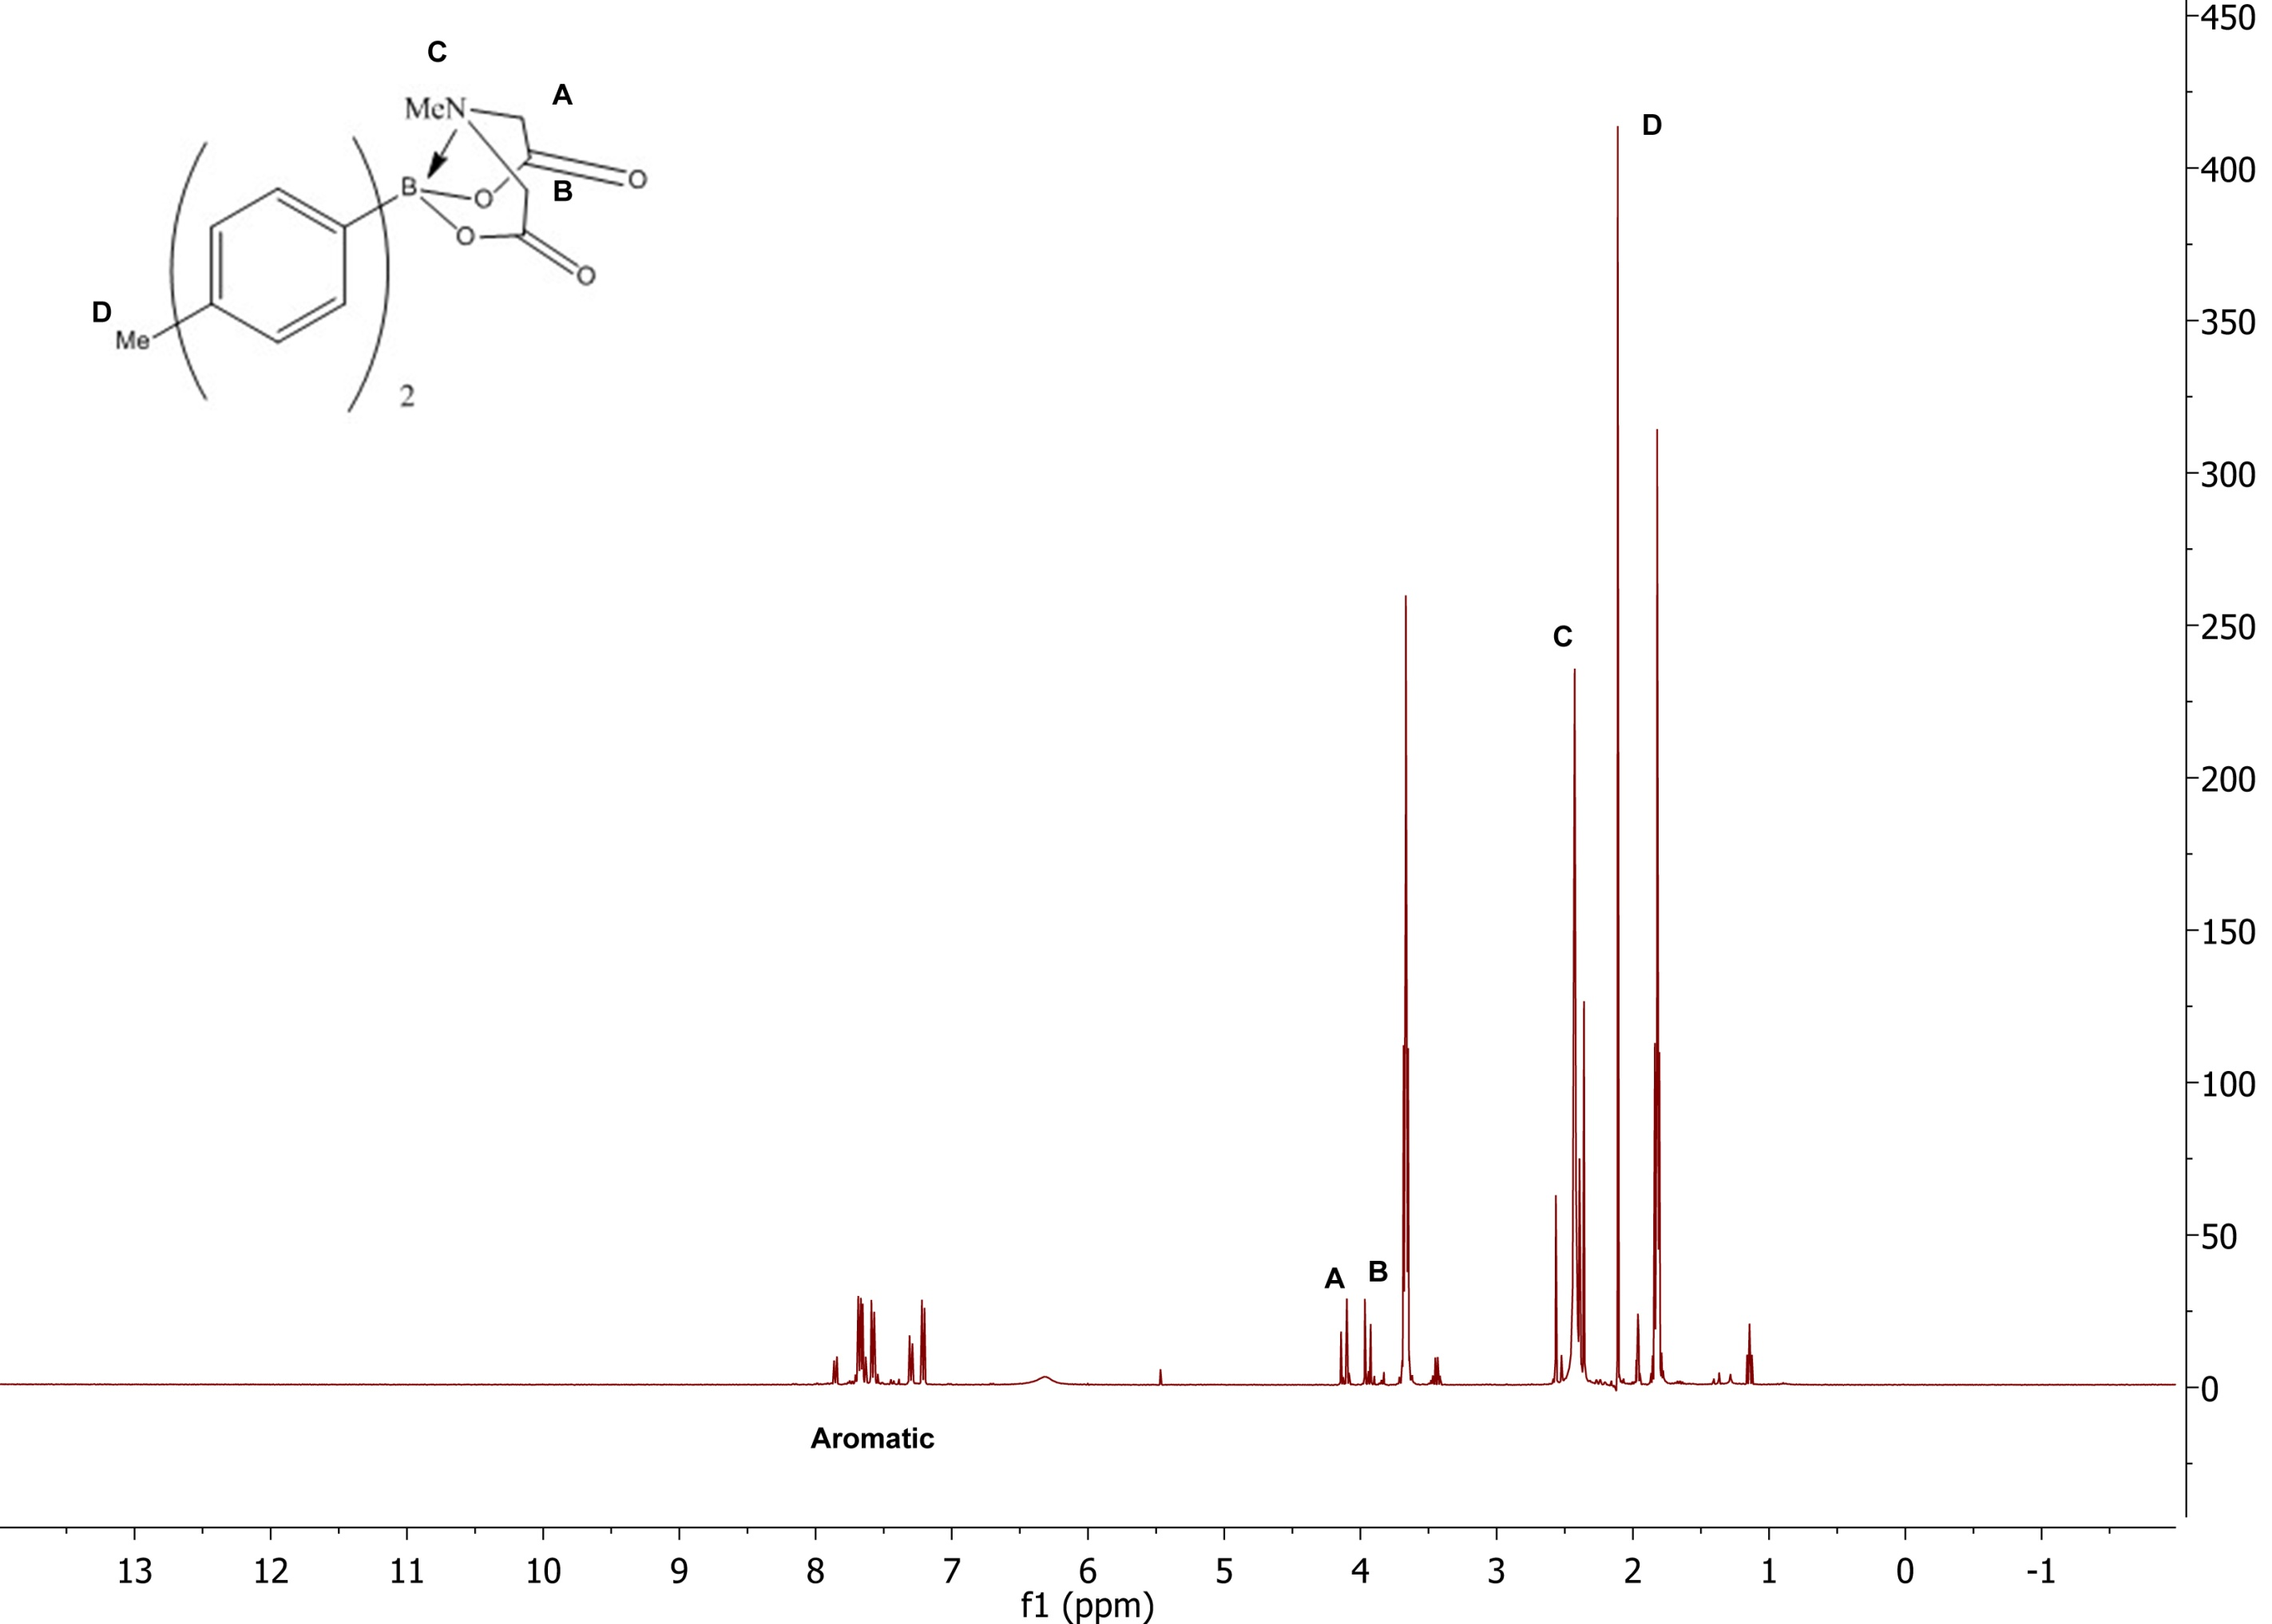
B-Protected Haloboronic Acids for Iterative Cross-Coupling
Eric Guinto; TA: Deepthi Bhogadhi
Department of Chemistry, University of New Hampshire, Durham, NH
12/02/2013
Introduction
This simple and efficient synthesis utilizes methodology from the Suzuki-Miyaura reaction to couple aryl halides in good yields. This modified iterative cross coupling is catalyzed by palladium and leads to the formation of a single carbon-carbon bond. Because of its wide range of applications, it has been utilized in the production of poly-olefins, styrenes, and substituted biphenyl structures boasting the ability to be scalable with cost efficiency in mind. The iterative cross coupling presents a systematic and flexible process that can be utilized by non-specialists to reach target bifunctional molecules with precision.
An integral part of this synthesis is the use of the methylimino diacetic acid (MIDA) protecting group which is unreactive to a wide variety of common synthetic agents. The protecting group is formed by reacting methylimino diacetic acid 2 with 4-bromophenylboronic acid 3. A study by Ballmer and coworkers revealed that aryl boronic acids are most commonly employed due to their stability however alkenyl boronic acids can also be used.¹ Heterocyclic boronic acids prove to be very unstable and are difficult to purify, store, and cross couple. Overall, this approach to cross coupling allows a systematic synthesis of small molecules ranging from natural products to pharmaceuticals by using a single reaction to bring together a collection of preassembled molecules.
Scheme 1:
Results and Discussion
Reductive methylation (Eschweiler-Clarke reaction) of Iminodiacetic acid 1 proceeds to methyliminodiacetic acid 2 with a release of carbon dioxide which drives the reaction in good yields (62.3%). NMR spectrum revealed no formation of a tertiary amine which was suspected to be a by-product. Complexation between 4-bromophenyl boronic acid 3 and the MIDA ester 2 was refluxed in a Dean Stark apparatus and recrystallized for an excellent yield of 4 Fig 1. 98%. The addition of the MIDA ester as a protecting group allowed cross-coupling of 4-bromophenylboronic MIDA ester 4 with p-tolylboronic acid to yield a single crude product, 4-(p-Tolyl)-phenylboronic acid MIDA ester 5 with a mass recovery of 61%.
Product 5 was confirmed by NMR analysis Fig 2. With practice of rigorous schlenk techniques, the yield can be improved and implemented on a larger scale. The overall yield for these three steps was 73% and represents an effective strategy for cross-coupling aryl halides.
Figure 1. NMR (CD₃CN) of purified
4-bromophenylboronic MIDA Ester 4.
Table 1. Synthesis of (2), (4), (5).
Step | Product | Yield
1-2 | Methylimino diacetic acid | 62.3%
3-4 | 4-Bromophenylboronic MIDA ester | 98%
4-5 | 4-(p-Tolyl)-phenylboronic acid MIDA ester | Crude - 61%
Future Work:
• Recrystallize product 5 for further synthesis.
• Complete intended synthesis of 4-(Phenyl-4-tolyl) pyridine.
Figure 2. NMR (CD₃CN) of crude
4-(p-Tolyl)-phenylboronic MIDA Ester 5.
Acknowledgements:
I would like to thank Sarah Joiner and Deepthi Bhogadhi for advice on techniques implemented during this synthesis as well as making this project possible.
References:
(1) Gillis, P. E.; Burke, D. M.. Iterative Cross-Coupling with MIDA Boronates: towards a General Strategy for Small-Molecule Synthesis . Aldrichimica Acta. 2009, 42.
(2) Zhang, J.; Moore, J. S.; Xu, Z.; Aguirre, R. A. J. Am. Chem. Soc. 1992, 114, 2273.
Young, J. K.; Nelson, J. C.; Moore, J. S.J. Am. Chem. Soc. 1994, 116, 10841.
Feuerbacher, N.; Vögtle, F.In Dendrimers; Vögtle, F., Ed.; Topics in Current Chemistry Series; Springer: Berlin,
1998; Vol. 197, pp 1–18.
(5) Gillis, E. P.; Burke, M. D. J. Am. Chem. Soc. 2007, 129, 6716.
Evans, D. A.; Fitch, D. M.; Smith, T. E.; Cee, V. J. Application of Complex Aldol Reactions to the Total Synthesis of Phorboxazole
B. J. Am. Chem. Soc. 2000, 122, 10033-10046.
Qizhong, Z.;, Bin Z.;, Liangjun S.;, Tiansheng J.;, Rener C.;, Tieqi D.;, Yuyuan Y.;, Jianfen S.;, Guoliang D.;,Deman H.;, Huajiang J.;,
Palladium-catalyzed highly regioselective 2-arylation of 2,x-dibromopyridines and its application in the efficient synthesis of a 17β-HSD1
inhibitor, Tetrahedron, 2013, 69,51, 10996-11003.

