Slide 1

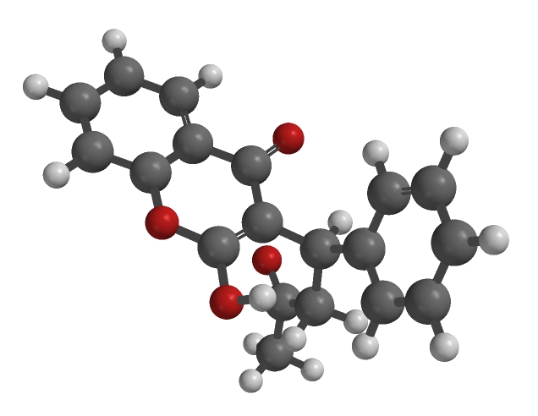
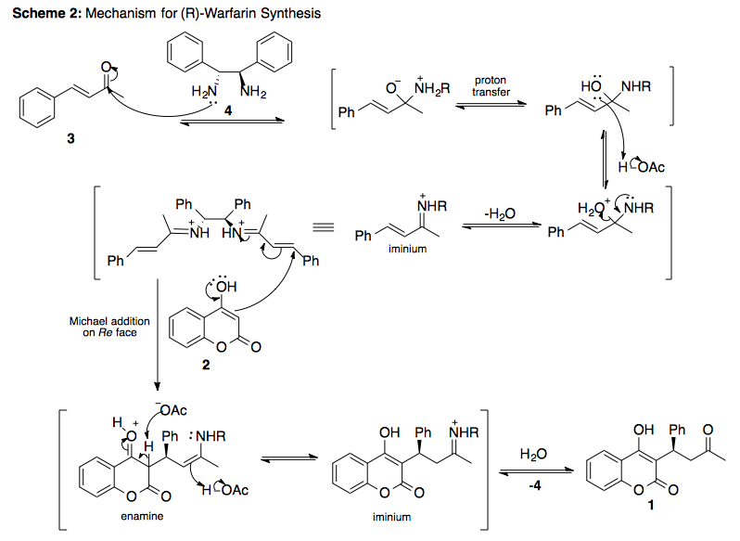
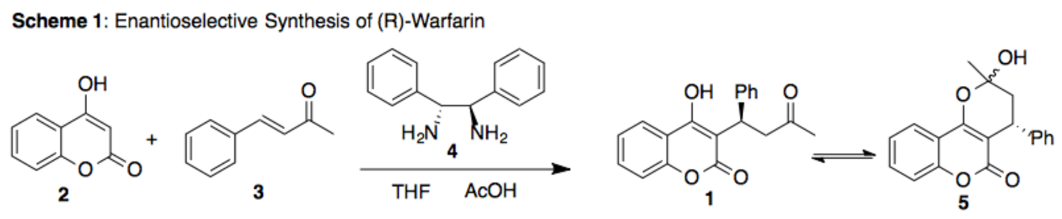
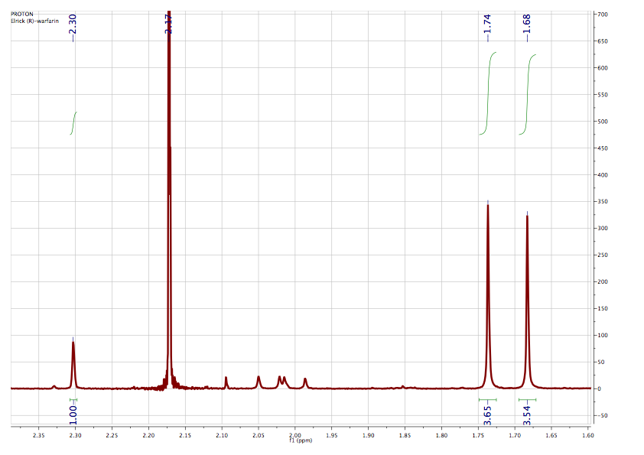
Enantioselective Synthesis of (R)-Warfarin
Meaghan Elrick
Department of Chemistry, University of New Hampshire, Durham, NH
December 5, 2013
Introduction:
Warfarin was first developed in 1948 as a rat poison, but can also be prescribed to humans as an anticoagulant medication. The name “Warfarin” was derived from its patent holder, Wisconsin Alumni Research Foundation (WARF), and a reactant used in its synthesis, 4-hydroxycoumarin.¹ Racemic warfarin has been used to treat patients for over half a century, more recently it has been shown that (S)-warfarin is 5 to 8 times more effective than its (R)-enantiomer. However, racemic and (S)-warfarin have been linked to a number of syndromes, so (R)-warfarin is recommended for weakened patients.² This observation created a demand for optically pure syntheses of the two enantiomers.
In the mechanism for this reaction (Scheme 2), the stereoselective step was the formation of the diimine intermediate, where the stereochemistry of 4 was conserved. The Si faces of the intermediate
sterically shield each other, which leaves Re faces exposed to nucleophilic attack by 2 during a Michael addition. The enamine formed tautomerized into its iminium ion, which is subsequently hydrolyzed to regenerate catalyst 4 and give the keto form of (R)-warfarin (1).³
Results and Discussion:
In this experiment, (R)-warfarin (1) was synthesized from 4-hydroxycoumarin (2), trans-4-phenyl-3-buten-2-one (3), and (R,R)-1,2-diphenylethylenediamine (4). The aforementioned reagents were combined with tetrahydrofuran and acetic acid, then allowed to react at room temperature without stirring for one week. After recrystallization with acetone, the product existed as a combination of keto (1) and ketal (5) isomers (Scheme 1).¹
Figure 1: Partial ¹H NMR Spectrum of (R)-Warfarin
Conclusion:
Enantioselective synthesis of (R)-warfarin is necessitated by its application as a prescription medication. In this experiment, (R)-warfarin (MP: 166.5 – 170.5°C) was produced with an enantiomeric excess of +82% after
Acknowledgements:
Thank-you Sarah Joiner Skraba for all of your help and support with this independent synthesis and throughout the semester.
recrystallization. The ratio of keto (1) to ketal (5) isomers of the product was 1:7, as determined by ¹H NMR (Figure 1) analysis of the keto methyl shift (δ2.30) and the two diastereomeric ketal methyl signals (δ1.68, 1.74).
References:
    1. Wong, T.; Sultana, C.; Vosburg, D. J. Chem. Educ. 2010, 87, 194 195.
    2. Dong, Z.; Wang, L.; Chen, X.; Liu, L.; Lin, L.; Feng, X. Eur. J. Org. Chem. 2009, 5192 5197.
    3. Kim, H.; Yen, C.; Preston, P.; Chin, J. Org. Lett. 2006, 8, 5239 5242.
    4. Sigma Aldrich. (R)-(+)-Warfarin. http://www.sigmaaldrich.com/catalog/product/sigma/uc213?lang=en&region=US (accessed Nov 6, 2013)
    5. Sigma Aldrich. 4-Hydroxycoumarin. http://www.sigmaaldrich.com/catalog/product/aldrich/h23805?lang=en&region=US (accessed Nov 6, 2013)

