Slide 1
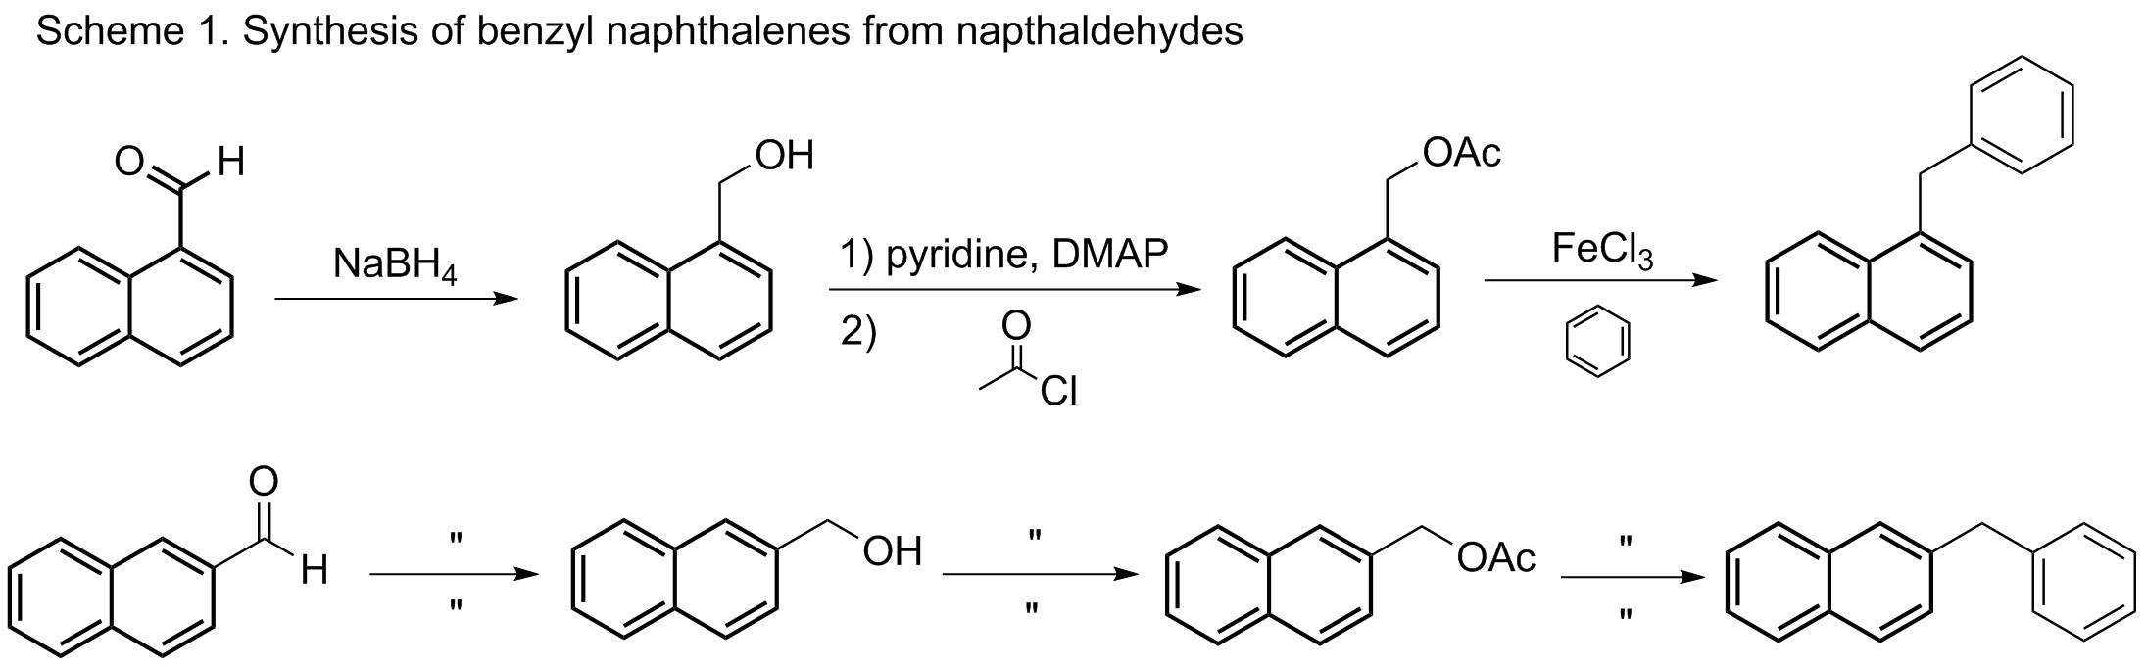
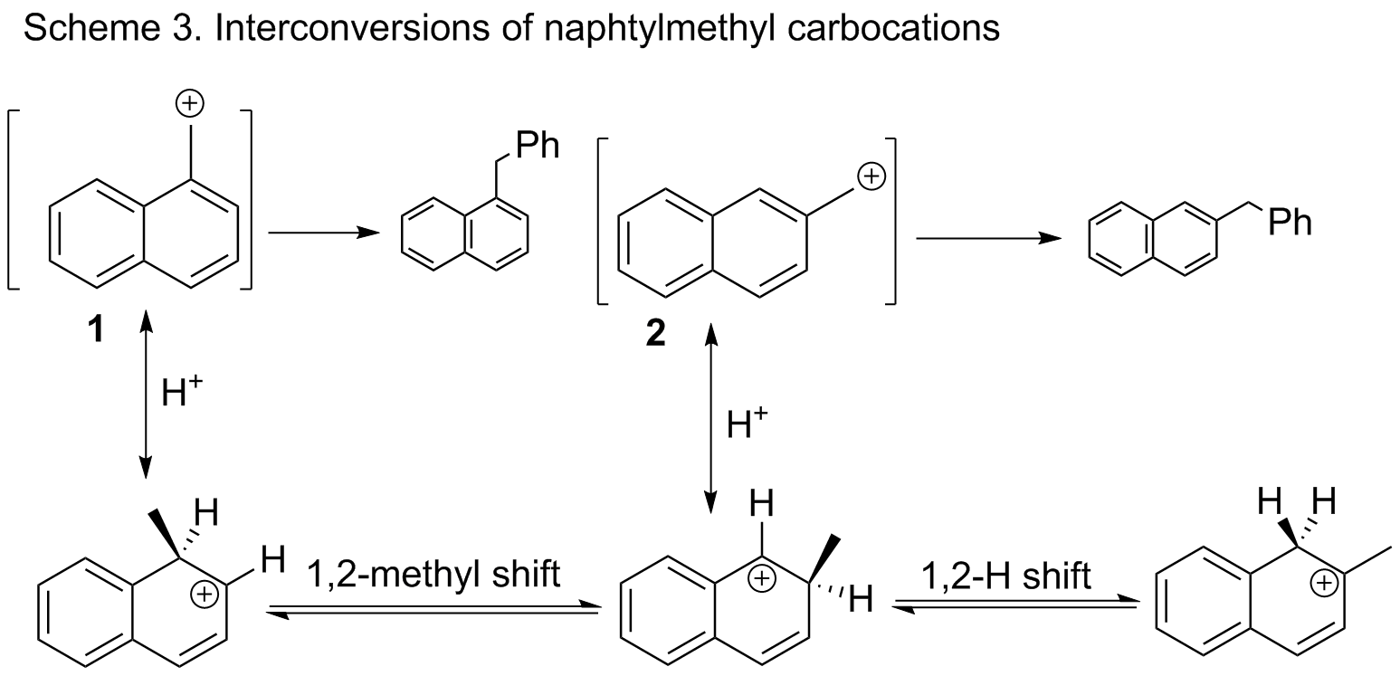
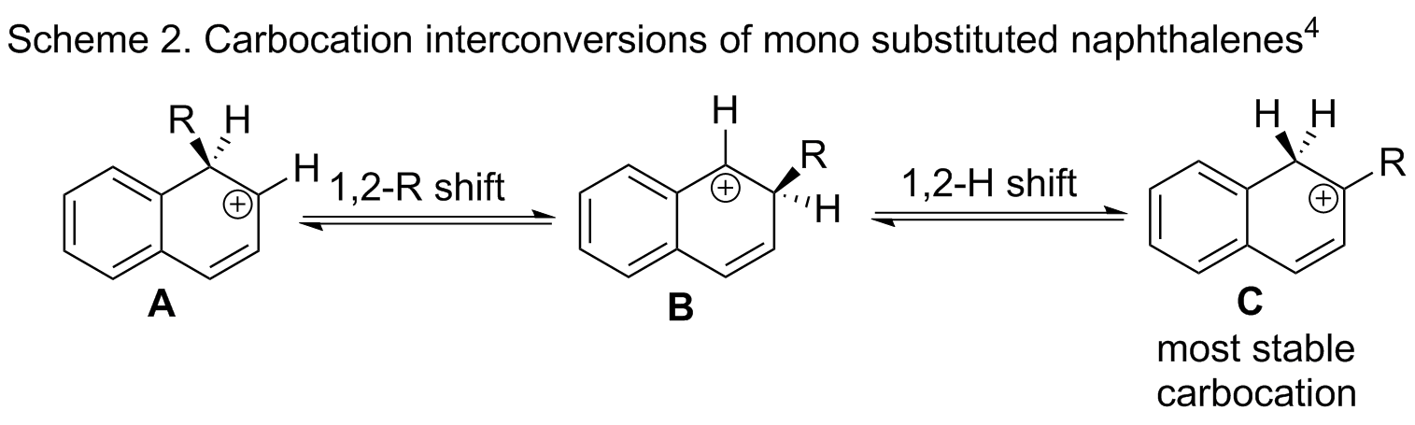
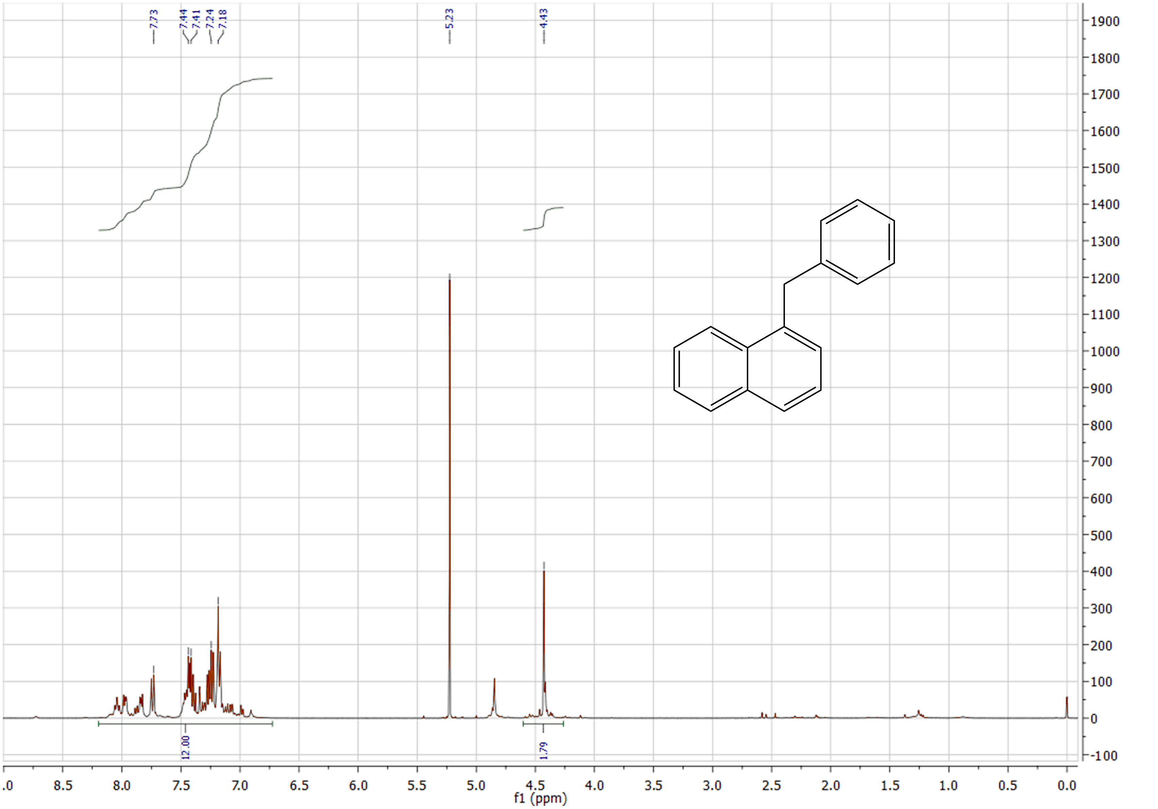
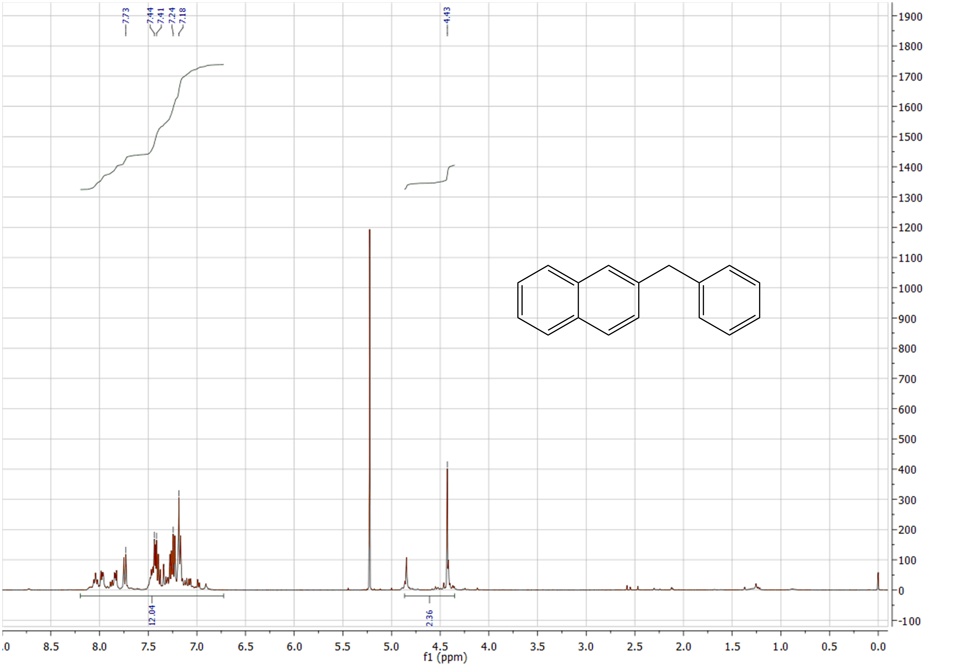
Competitive Synthesis of Benzyl Naphthalenes
David Waste
Department of Chemistry, University of New Hampshire, Durham, NH
December 5, 2013
Introduction: The rate at which isomers react under the same reaction conditions is an extremely useful tool for chemists to understand, and to utilize in the design of chemical syntheses. The synthesis of 1- and 2-
benzylnapthalene from their respective aldehydes (Scheme 1) was chosen due to its relative simplicity, use of
nonhazardous materials, and high yields of products from the first two reactions in order to allow the results of the third,
yield determining, reaction to best be seen.
Reactions of both compounds were run side-by-side under identical conditions , both aldehydes were first reduced to their respective alcohols, using sodium borohydride¹, followed by conversion of the hydroxyl group to an acetate ester. This step was performed using 4-Dimethylaminopyridine “DMAP” as a catalyst , along with acetyl chloride², to ensure a better leaving group for the final Friedel-Crafts reaction of both naphthylmethyl acetates, using iron(III) trichloride as a catalyst³.
Results and Discussion: As shown by Prof. Richard Johnson and his research group (Scheme 2), the most stable carbocation in a mono substituted naphthalene is structure C⁴. It can be seen that structures A and B appear very similar to resonance structures of the 1- and 2-naphthylmethyl carbocations (Scheme 3). 2-naphthylmethyl carbocation need only undergo a 1,2-hydride shift to form the most stable carbocation, while 1-naphthylmethyl carbocation must undergo both a 1,2-methyl and 1,2 hydride shift to do so. Using B3LYP density functional theory with 6-31G* in
the Spartan Student modeling program, it can be determined that due to this
difference in the transition states of each compound, there is a difference
of 2.24kcal/mol. Using the Arrhenius equation, this difference in
transition state energy is amounts to a product ratio of 2.5:1
2-benzylnaphthalene to 1-benzylnapthalene.
Conclusions: The result of this experiment brings two conclusions: Firstly, it supports the research of Prof. Johnson and his research group, that carbocation C is the most stable carbocation in mono substituted naphthalenes, and therefore an equilibrium exists between carbocations 1 and 2 of the Friedel-Crafts reaction and this stable carbocation, resulting in a difference in. Secondly, this reaction goes to show that chemists need pay close attention to the energies of transition states in the construction of reactions, to be able to judge the yields of those reactions. For this purpose, modeling programs, such as Spartan provide an important tool in a chemists arsenal, with which to construct and execute reactions
Acknowledgements: Special thanks to Prof. Johnson for his idea of the research project and answering any questions I had along the way, and Sarah Skraba, ensured we had everything we needed, ran NMR samples, and to make sure no one’s project went awry. Many thanks to both!
References:
(1) Lehman, John W. Operational Organic Chemistry, 2nd Edition, Pearson Education, 2009, 260-266.
(2) Erin C. Mcluaghlin. The Road Less Traveled: New Chemistry of Old Reactive Intermediates. PhD. Thesis, University of New Hampshire, Durham, NH, 2012. 43-44.
(3) Irina Iovel; Kristin Mertins; Jette Kischel; Alexander Zapf; Matthias Beller. An Efficient and General Iron-Catalyzed Arylation of Benzyl Alcohols and Benzyl Carboxylates. Angewandte Chemie International Edition. 2005, 44, 25, 3913–3917
(4) Richard P. Johnson, Sarah L. Skraba Joiner, Erin C. McLaughlin, Aida Ajaz. Scholl Reactions of Aryl Naphthalenes: Rearrangement Precedes Cyclization. University of New Hampshire, Durham, NH.Unpublished work, 2013

