Slide 1
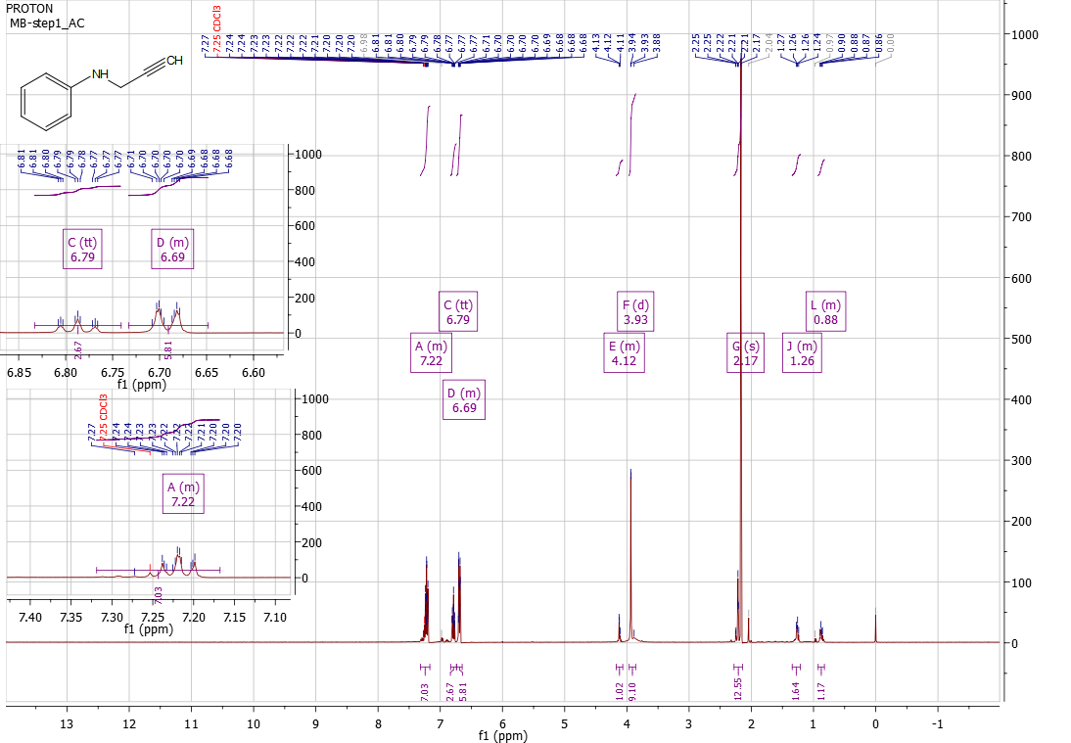
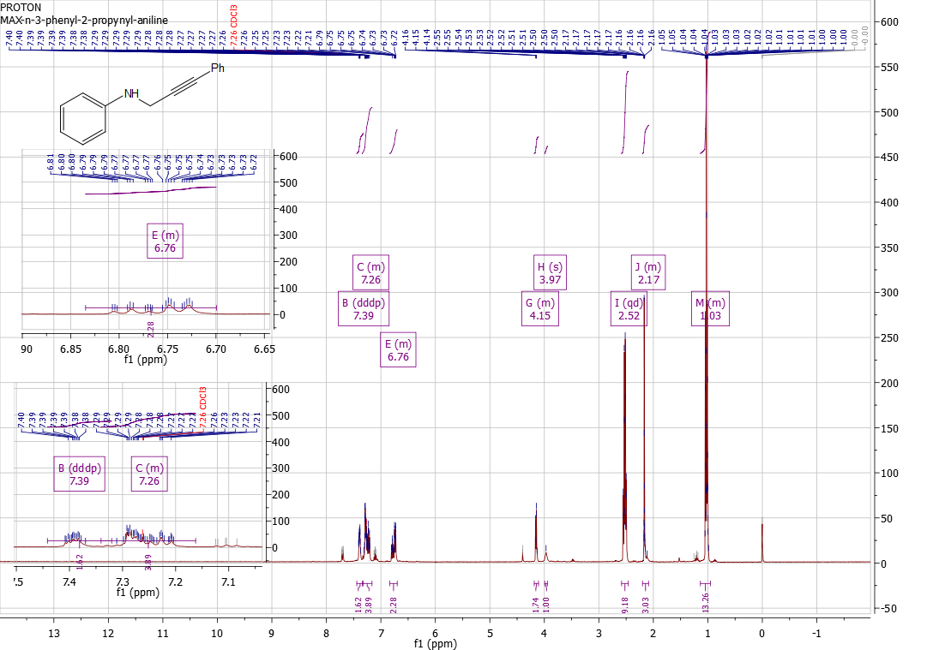
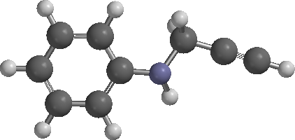
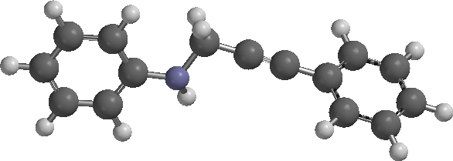
Synthesis of 3-Iodo-4-Phenylquinoline by Electrophilic Cyclization
Max Bilodeau
Department of Chemistry, University of New Hampshire, Durham, NH
December 1, 2013
Introduction
Schematics
Quinoline, a compound first found in coal tar residue, is a fairly inert and environmentally toxic compound. On its own, quinoline is fairly unreactive in various solvents over wide ranges of temperatures. However, quinoline derivatives have been shown to be useful in pesticide and antibiotic resistance capacities¹.
Quinoline derivatives can be synthesized from a quinoline feedstock, or from mild reaction conditions performed on aniline. These reactions convert the aniline to its 2-alkynyl derivative, and then on to the final desired substituted product. N-(2-propynyl)aniline, (3), was synthesized from aniline (1) and propargyl bromide (2) in (Scheme 1)². From the collected product, there was a 13.22 percent yield of the N-(2-propynyl)aniline (3).
N-(2-propynyl)aniline (3) then reacts with iodobenzene (4) in a solution of triethylamine, copper iodide and bis(triphenylphosphine)palladium dichloride to yield the phenyl substituted product, N-(3-phenyl-2-propynyl)aniline (5) (Scheme 2)².
The product of this reaction, N-(3-phenyl-2-propynyl)aniline (5) , can then be treated with iodine, sodium bicarbonate and a solution of acetonitrile to cyclize and substitute the compound into the desired product of 3-Iodo-4-Phenylquinoline (6) (Scheme 3)².
The Synthesized compounds 3 and 5 were analyzed by ¹H NMR and are in good agreement with the reported values².
Results and Discussion:
An ¹H NMR analysis was performed upon the synthesized product from step one of the reaction, N-(2-propynyl)aniline (3).
N-(2-propynyl)aniline (3). :¹H NMR (400 MHz, CDCl3) δ: 3.93 (d, 2 H), 6.69(m, 2 H), 6.79 (tt, 1H), 7.22 (m, 2 H)
The scale of this reaction was modified from the given, to the order of one-fifth of the given reagent amounts. After the purification of N-(2-propynyl)aniline (3), 0.873 grams of product was collected. From the starting amount of 50 mmol aniline, this was a 13.22 percent yield of desired product.
This loss of product comes from the reaction conditions employed, as well as allowing the reaction mixture to progress past the desired six hour stir time.
An ¹H NMR analysis was performed upon the synthesized product from step two of the reaction, N-(3-phenyl-2-propynyl)aniline (5).
N-(3-phenyl-2-propynyl)aniline (5). :¹H NMR (400 MHz, CDCl3) δ: 3.97 (s, 1 H), 4.15 (m, 2 H), 6.76 (m, 2H), 7.26 (m, 5 H), 7.39 (m, 2 H)
Conclusions:
The reaction, being scaled down, progressed much as described in the reaction outline. However, due to time restraints, the reaction purification was carried out on a much slower process than described. This step of the reaction yielded 0.831 g (6.61 mmol, 13.22 percent yield) of product that was analyzed using proton NMR.
The crude product from the second step, N-(3-phenyl-2-propynyl)aniline (5) was analyzed by ¹H NMR. The reported peaks are in good agreement with the reported values.
Through the reaction was not carried out to completion, the completed syntheses agreed with reported values of proton ¹H NMR peaks, as well as color of the products.
Future Work:
As the reaction was not carried to its completion, future work will be investigating the yield of the successive steps, mainly that proposed in Scheme 3. Work will also be used to investigate the purity of each product in each of the three suggested schemes. Any improvement in the synthesis of the products will be investigated, as well as other substitutions that may be made in the groups that will be attached to the final quinoline.
Acknowledgements:
Thanks to Dr. Weisman for project suggestion and to Deepthi Bhogadhi for all her help
References:
(1) Collin, G., Höke, H.; “Quinoline and Isoquinoline”, Ullman’s Encyclopedia of Industrial Chemistry, Weinheim, Wiley-VCH(2005)
(2) Chen, Y., Dubrovskiy, A., Larock, R. C. Synthesis of Quinolines by Electrophilic Cyclization of N-(2-Alkynyl)Anilines: 3-Iodo-4-Phenylquinoline. Org. Synth. 2012, 89, 294-306
N-(2-propynyl)aniline (3)
N-(3-phenyl-2-propynyl)aniline (5)

