Slide 1

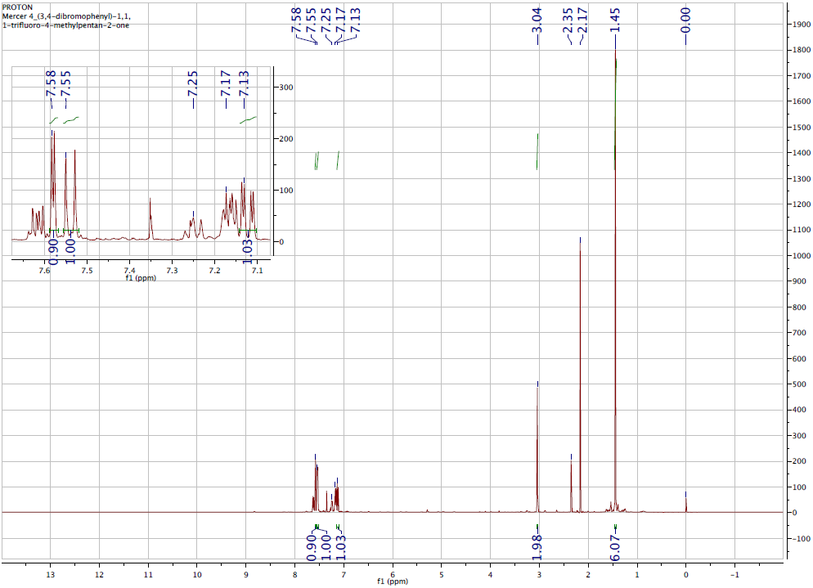
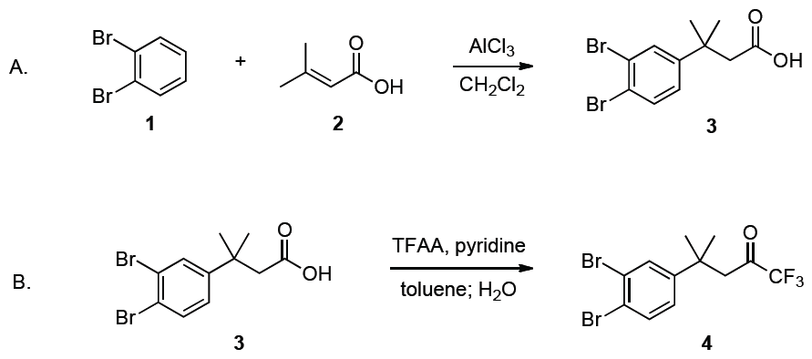
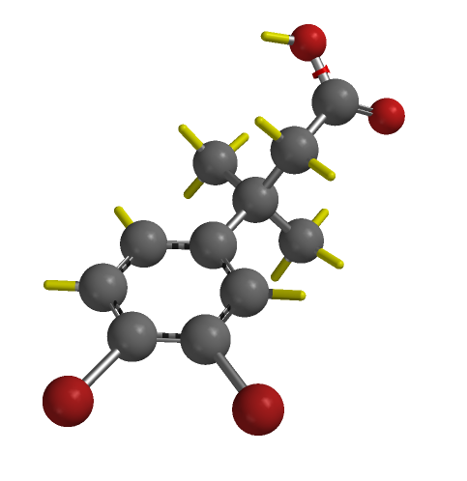
Adapted Zard Synthesis of Trifluoromethyl Ketones from Carboxylic Acids
Brandon Mercer
Department of Chemistry, University of New Hampshire, Durham, New Hampshire 03824
12/03/13
Introduction:
Trifluoromethyl substituents are used in modern drug development. These functional groups act as bioisosteres, which can adjust steric and electronic properties or inhibit metabolic degradation of attached molecules. Trifluoromethyl ketones (TFMKs) can act as enzyme inhibitors, but more importantly they are synthons for the production of trifluoromethylated compounds. The Zard procedure for synthesizing TFMKs is as follows: primary acid chlorides are reacted with trifluoroacetic anhydride (TFAA) and pyridine at room temperature in dichloromethane solvent, with subsequent hydrolysis and decarboxylation with the addition of water. The Zard procedure results in low yields when performed on hindered primary acid chlorides. However, high yields and conversions can be obtained from hindered substrates if Zard’s solvent is replaced with toluene and the reaction is heated to 60°C. An added benefit of this altered method is that carboxylic acids can be converted directly into TFMKs, without being converted into acid chlorides first. If the reaction is performed at 100°C, the conversion of secondary α-branched carboxylic acids, such as 3-(3,4-dibromophenyl)-3-methyl butanoic acid (3), to TFMKs is possible.
Figure 1: H NMR spectrum
Scheme 1: Two part synthesis
Table 1: H NMR data
Reference | Experimental
1.46 (s, 6H) | 1.45 (s, 6H)
3.05 (s, 2H) | 3.04 (s, 2H)
7.13 (dd, 1H) | 7.13 (dd, 1H)
7.55 (d, 1H) | 7.55 (d, 1H)
7.59 (d, 1H) | 7.58 (d, 1H)
Conclusions:
Following Zard’s procedure for the synthesis of trifluoromethyl ketones from carboxylic acids using toluene and increased reaction temperature instead of dichloromethane substantially increased yield. In this experiment the synthesis of 4 provided a yield greater than 100% due to the presence of multiple products including excess toluene. TLC confirmed the presence of multiple products. However, all product peaks on the H NMR spectrum corresponded to literature values for 4-(3,4-dibromophenyl)-1,1,1-trifluoro-4-methylpentan-2-one (4).
Results and Discussion:
In part A of this experiment, 3 was prepared via an aluminum chloride catalyzed Friedel-Crafts alkylation reaction between 1,2-dibromobenzene (1) and 2 in dichloromethane solvent. For part B, product 3 obtained from part A was dissolved in toluene then reacted with TFAA, pyridine, and water to give a TFMK, 4-(3,4-dibromophenyl)-1,1,1-trifluoro-4-methylpentan-2-one (4). The H NMR analysis of the final product confirmed its identity as TFMK 4.
Acknowledgements:
Thank you Sarah Joiner Skraba for the guidance and dedication working through this project. Thank you Dr. Arthur Greenberg for the opportunity to preform this experiment.
References:
¹Reeves, J.; Tan, Z.; Fandrick, D.; Song, J,; Yee, N.; Senanayake. Org. Synth. 2012, 89, 210 219
²(a) Boivin, J.; El Kaim, L.; Zard, S. Z. Tetrahedron Lett.1992, 33, 1285-1288; (b) Boivin, J.; El Kaim, L.; Zard, S. Z. Tetrahedron 1995, 51, 2573-2584; (c) Boivin, J.; El Kaim, L.; Zard, S. Z. Tetrahedron 1995, 51, 2585-2592.
³For ¹H-NMR data processing; MestRe Nova 8.1

