Slide 1
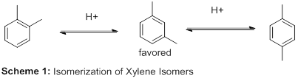
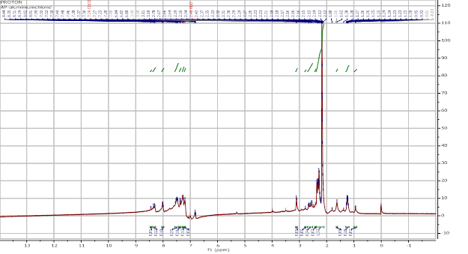
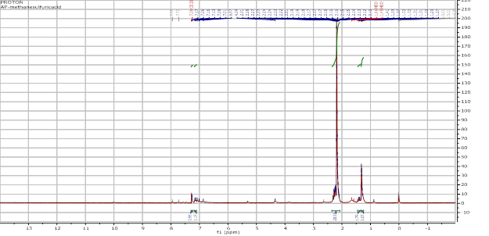
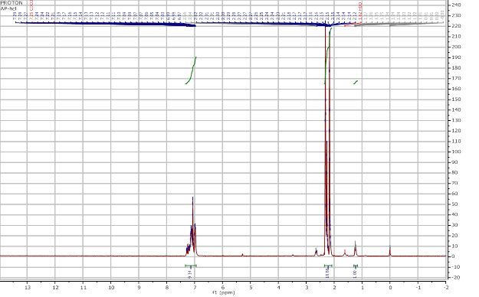
Isomerization of Xylene Isomers
Austin Power
Department of Chemistry, University of New Hampshire, Durham, NH
12/5/13
Introduction
Early after the discovery of Friedel-Crafts alkylation, it was observed that the meta isomer of substituted benzenes was formed instead of the ortho or para isomers in certain cases.¹ Through further testing, it was found that this was not a random occurrence and, in fact, happened under Friedel-Crafts reaction conditions for all substituted benzenes. Baddeley was the first to find evidence to support this² and offered a mechanism to show the rearrangement of a disubstituted benzene (Scheme 1). The mechanism was further clarified by Olah who thought that the meta distribution was the most stable cation.³
Microwave chemistry was discovered in the 1950’s but began being widely accepted and used in 1986.⁴ Until then, conventional methods were used. This involved the use of a furnace or oil bath that would heat the walls of the reactor by convection in order to heat up a sample. Once the entire furnace was heated, the sample would also become that temperature. While this did properly heat the reactor, the process took longer to heat the sample. Microwave reactors helped to increase the reaction time of these processes by heating the sample without heating the entire furnace or bath first.⁵
Results and Discussion
Three ¹H NMR spectra were taken for the trials: a spectrum of the proton shifts of xylene with aluminum chloride, a spectrum of the proton shifts of xylene with 1 M methanesulfonic acid (MSA), and a spectrum of the proton shifts of xylene with 1 M hydrochloric acid. If m-xylene was formed using the acids, there would be 4 distinct peaks at approximately 2.2 ppm, 6.9 ppm, 7.0 ppm, and 7.2 ppm. This is very different then the spectrum for o-xylene and p-xylene which would only have 2 peaks. This gives a clear indication to whether m-xylene was formed.
The ¹H NMR spectra all showed peaks in the relative areas that would be expected. The spectrum of o-xylene reacted with aluminum chloride had the most number of peaks. The other two spectra came out a lot “cleaner” leading to believe that the other two acids made higher concentrations of m-xylene. Each spectrum had a large peak around 2.2 ppm which would nothelp to differentiate between which formed the most m-xylene. The aromatic peaks show the differences. It appears that the largest and “cleanest” peaks are on the graph for o-xylene reacted with 1 M hydrochloric acid. This would mean that the o-xylene reacted with 1 M hydrochloric acid is the acid that gives the highest concentration of m-xylene.
¹H NMR of AlCl₃ Reaction
¹H NMR of 1 M MSA Reaction
¹H NMR of 1 M HCl Reaction
Conclusions
o-Xylene was reacted in a microwave reactor at 150 degrees Celsius for 15 minutes with three different acids. Using ¹H NMR spectroscopy, the acid that gives the most meta-distributed product could be found. The ¹H NMR spectrum of o-xylene reacted with 1M hydrochloric acid showed the cleanest and largest peaks which show that it formed the most m-xylene.
Acknowledgements
I would like to thank Sarah Skraba and Deepthi Bhogadhi for assisting me through every step of this project.
References:
Moyle, C.; Smith, L. I. J. Org. Chem. 1937, 2, 112-37
Baddeley, G.; Kenner, J. J. Chem. Soc. 1935, 303-9
Olah, G. A.; Meyer, M. W. J. Org. Chem. 1962, 27, 3682-3
Microwaves in organic synthesis, Andre Loupy (ed), Wiley-VCH, Weinheim, 2006, http://www.organic-chemistry.org/books/reviews/3527305149.shtm
The use of microwave ovens for rapid organic synthesis. Gedye, R.; Smith, F.; Westaway, K.; Ali, H.; Baldisera, L.; Laberge, L.; Rousell, J. J. Org Chem. 27, 3, 1986, 279-282

