Slide 1
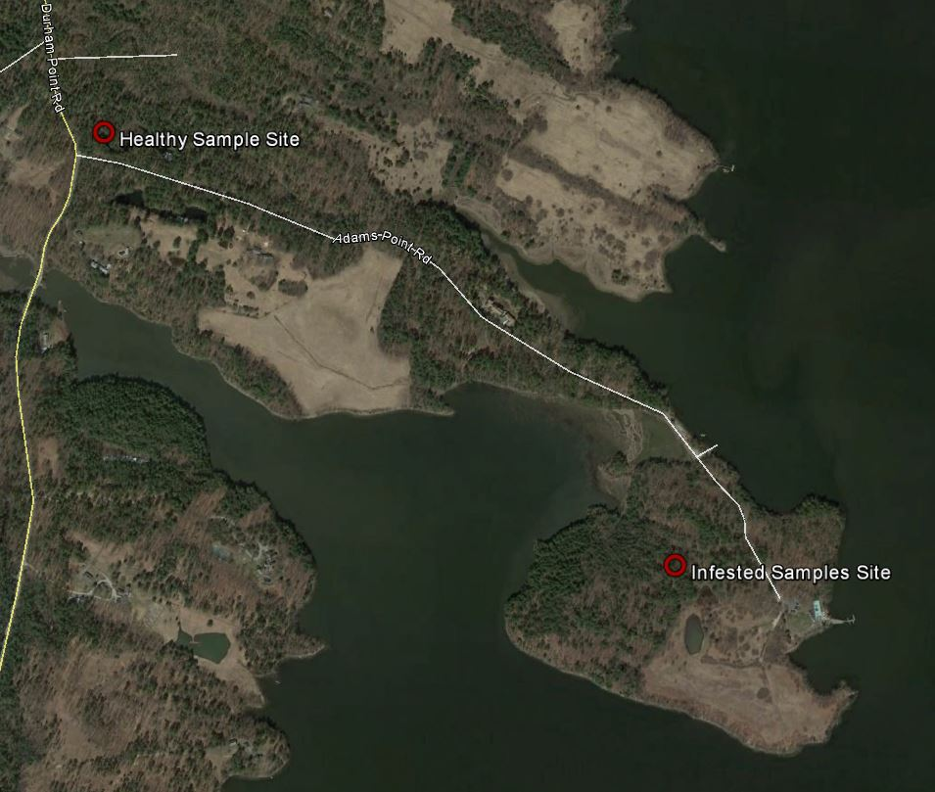
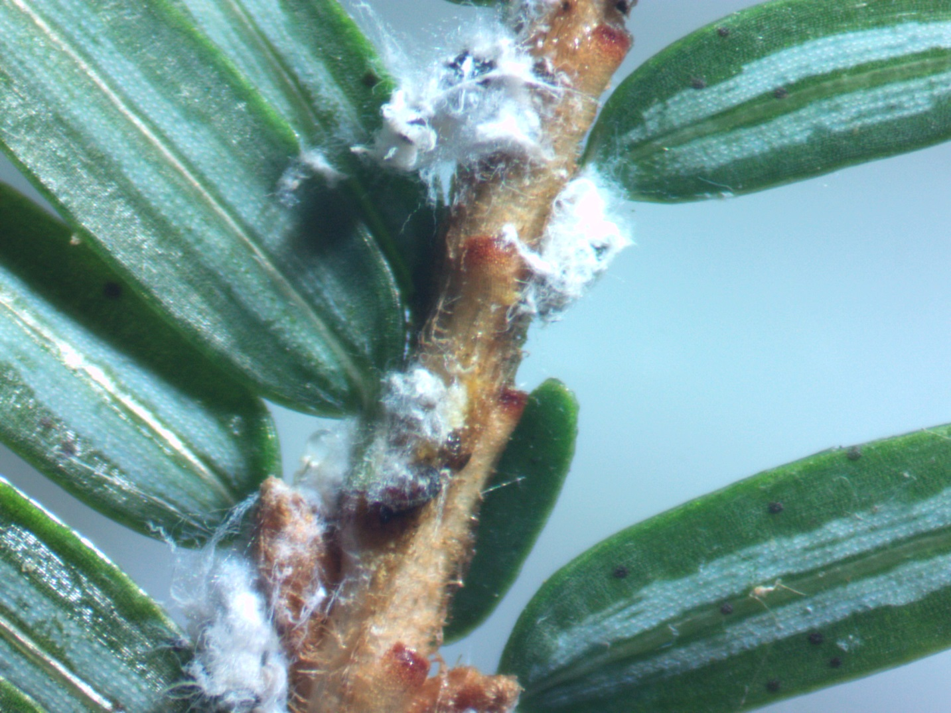
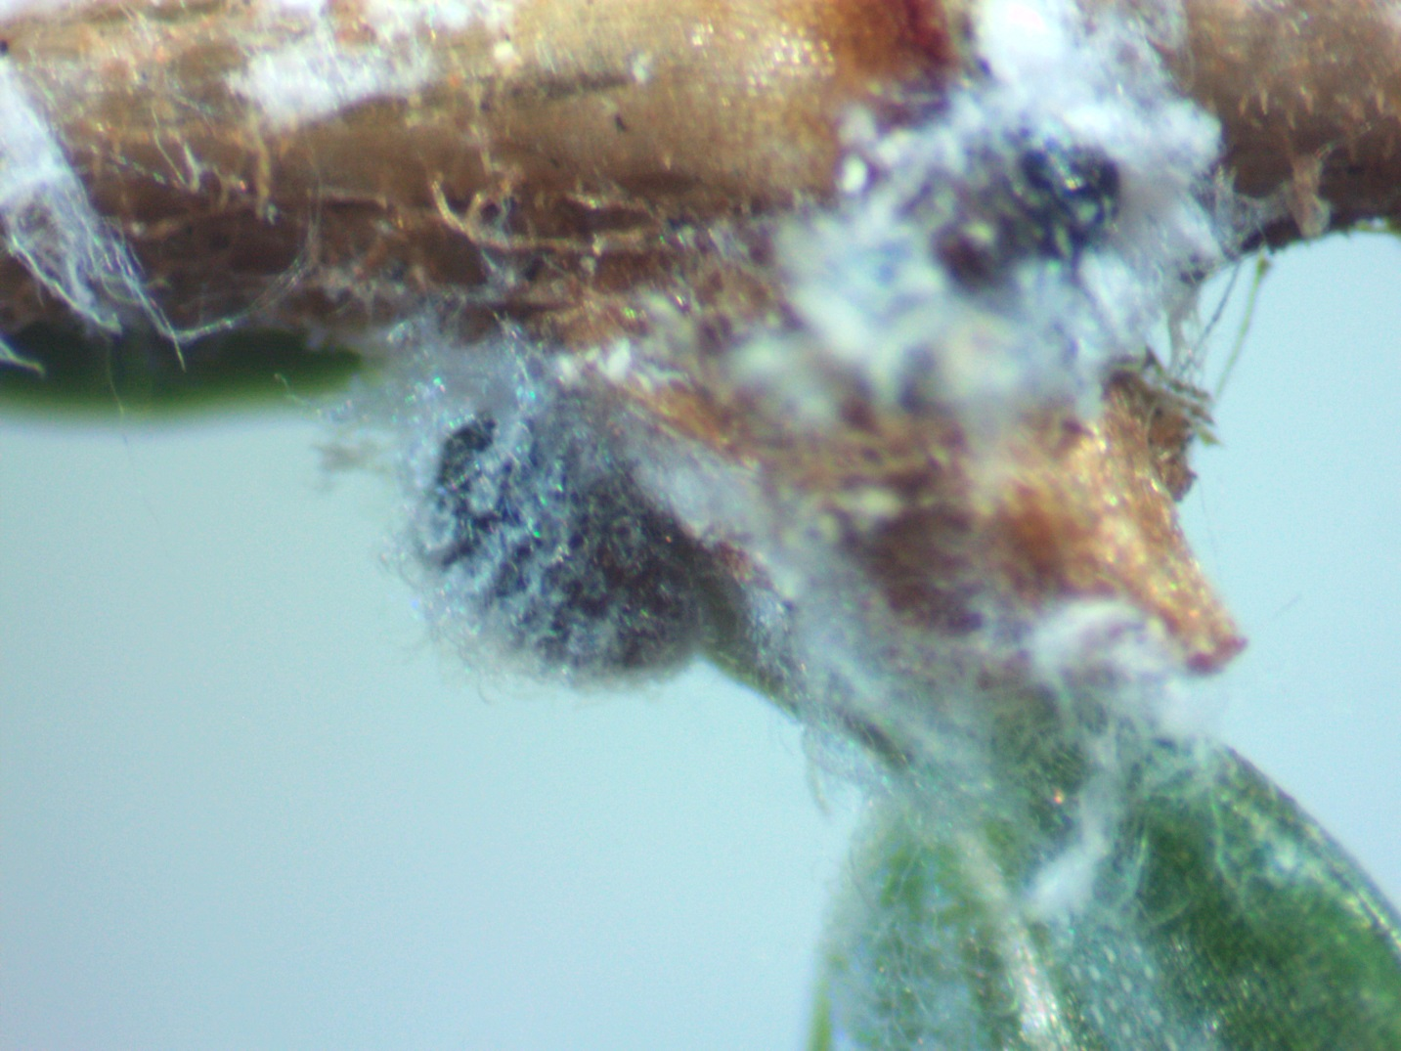
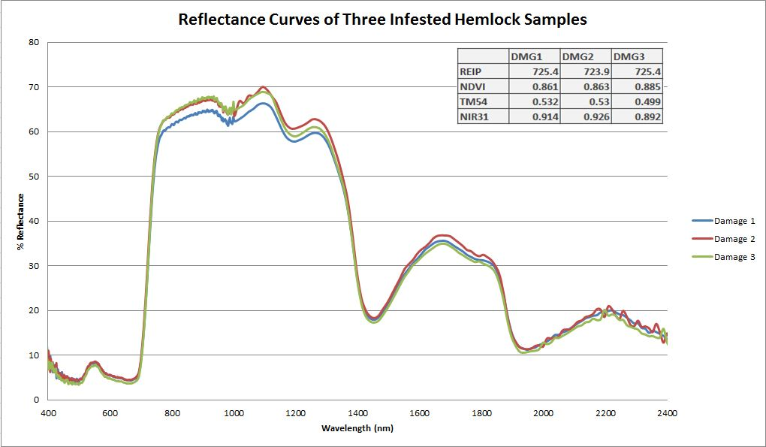
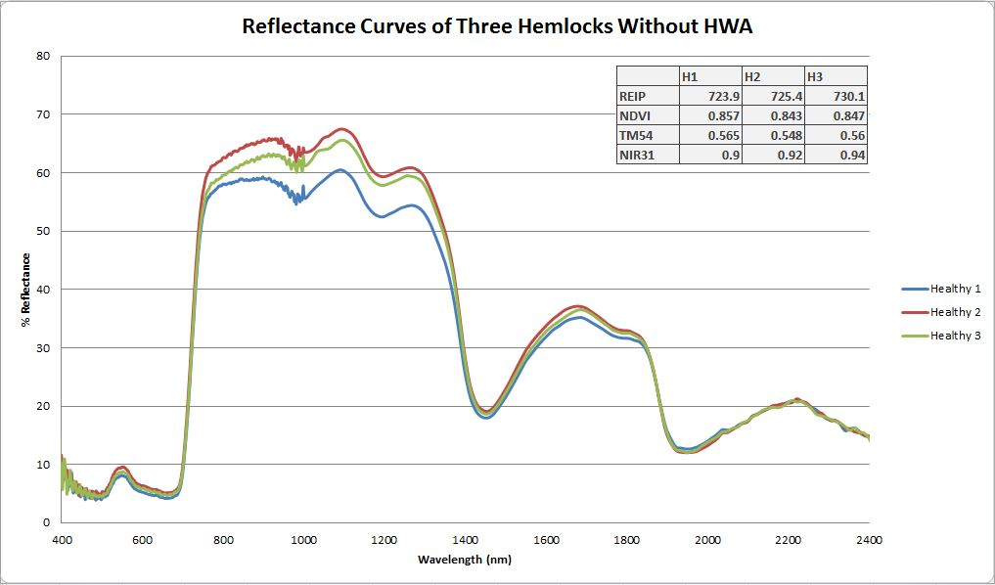
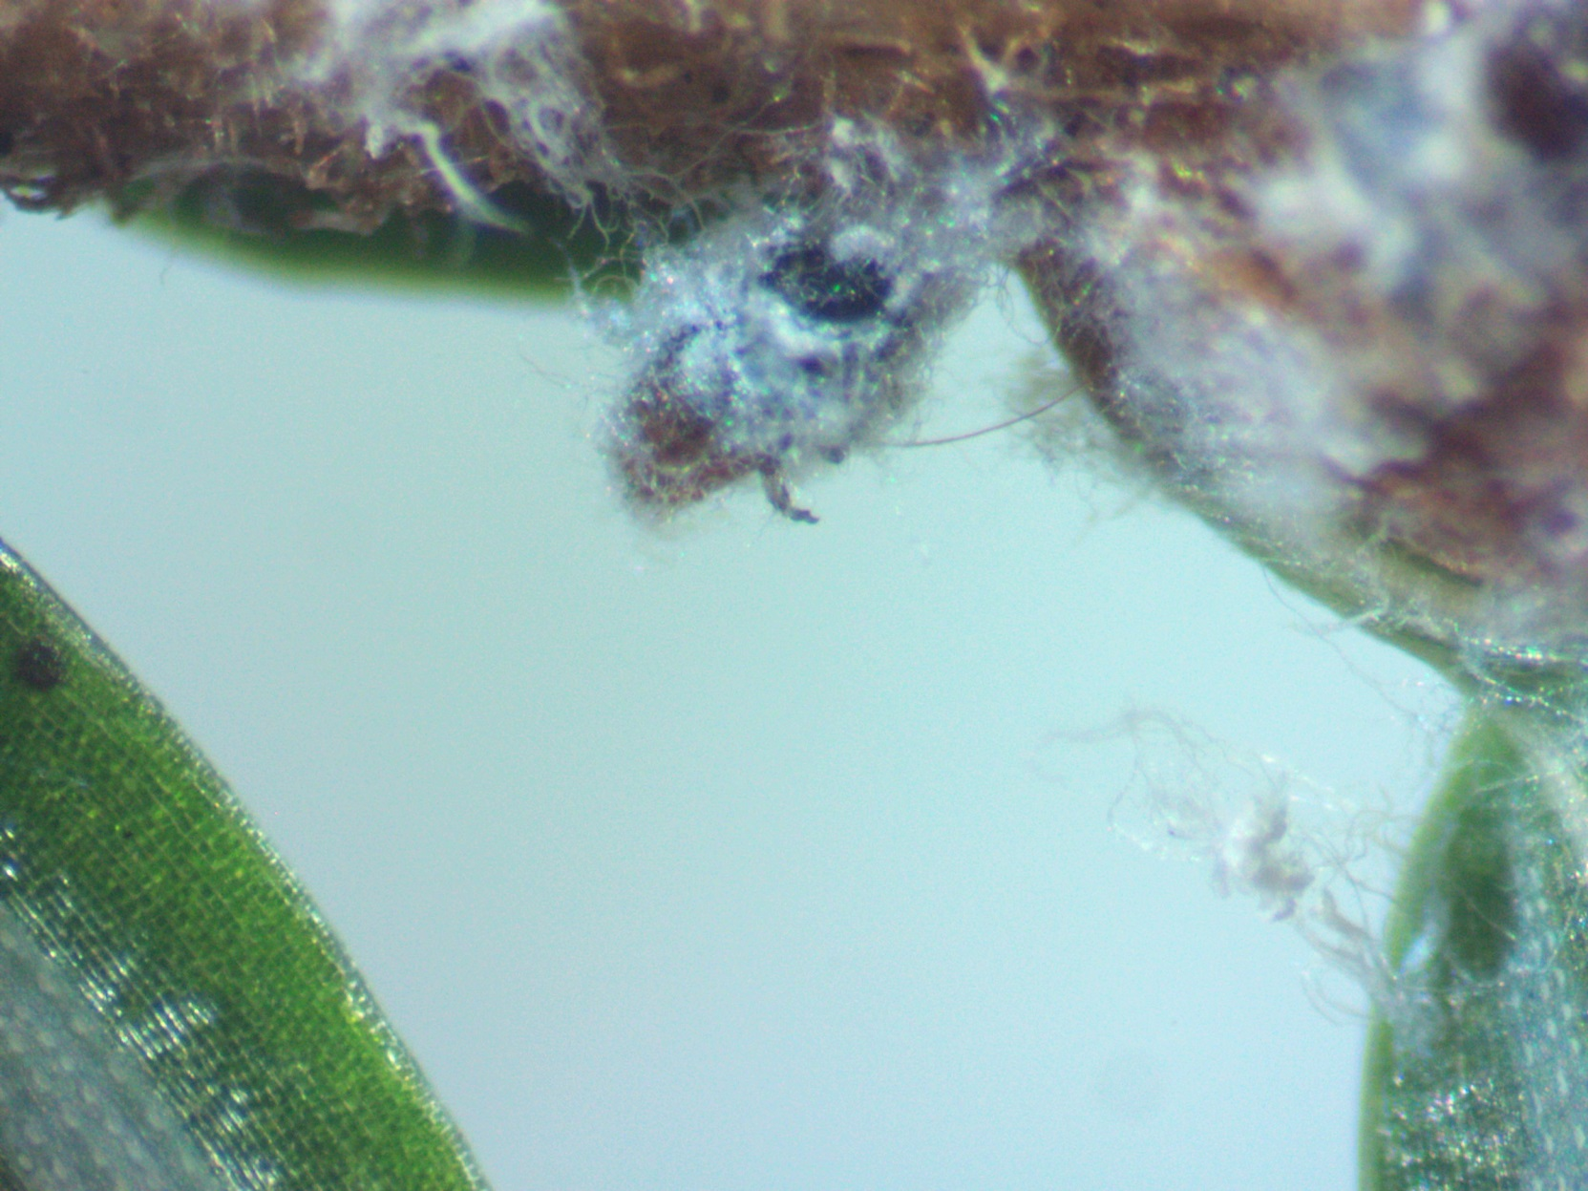
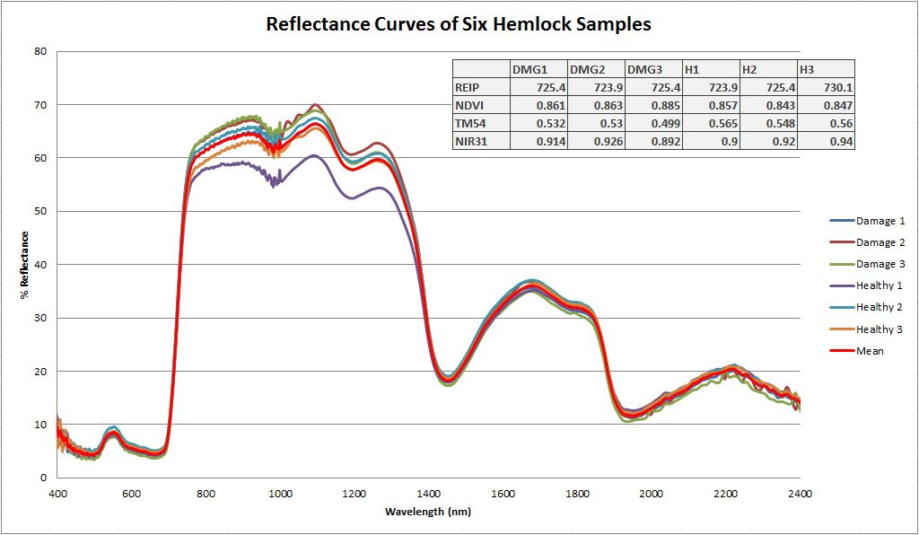
A Look at the Spectral Curves of Hemlocks Infested With Hemlock Woolly Adelgid
Cole Williams, Forestry Major, Department of Natural Resources
cju97@wildcats.unh.edu
Abstract
Hemlock woolly adelgid(HWA) poses a threat to eastern hemlock (Tsuga canadensis). It would be very beneficial if it could be detected remotely during its early levels of infestation. Hemlock is a critical component of the ecosystems it is found in; as a cover species it is used by a wide variety of wildlife. I used the VIRIS to try and recognize differences in the reflectance curves of trees infested with HWA versus those without signs of infestation. Stress from HWA infestation resembles any other stressor when analyzing spectral curves.
Introduction and Background
Hemlock woolly adelgid or HWA is an invasive pest to North America. HWA mainly targets all species of hemlock, but can also infest pine, spruce, and other conifers. HWA can cause severe health decline and mortality (Maine Forest Service). The insect is of great concern because hemlock is a major component of the eastern forests and upon infestation can die within four to ten years (USDA Forest Service). The destruction of hemlock within the New Hampshire forests is potentially devastating to our ecosystems.
In this project I hoped to find a significant difference in the spectral curves of infested trees versus trees with no presence of HWA. If there were a key difference in the patterns of spectral curves it would be possible to monitor the spread of HWA using LANDSAT data. Like most invasive pests, it is optimal to detect infested areas as early as possible.
In order to feed, HWA inserts its stylet into the vascular tissue at the base of a young needle. It is from here that HWA draws its sustenance. As more and more HWA feed on the tree it begins to lose needles and will eventually stop producing new needles altogether. It is possible that as HWA feeds it secretes a toxin through its saliva (Young et al). HWA doesn’t simply feed on the sap from the phloem of the hemlock as an aphid would. It reaches its stylet into the xylem ray parenchyma cells, where the tree stores carbohydrates and other nutrients (UNH Cooperative Extension). This is a potential explanation as to why HWA is as destructive as it is.
Hypothesis
I believe that the reflectance curves of infested trees will be very similar to those of trees with no HWA infestation.
Objectives
Collect and scan infested and unaffected samples while practicing appropriate procedures
Compare reflectance curves
Determine whether or not reflectance curves can be used to differentiate between infested and unaffected trees
Discussion
Analysis of these reflectance curves tells me that stress from HWA infestation is possibly detectable by looking at the shapes of the curves, but is not unique from other forms of stress. This means that the detection of HWA infestations using remote sensing may be possible, but ground truthing any results would be a necessity until further research has been done. None of the sampled hemlock demonstrated obvious damage to their remaining needles by observation. Each tree had an NIR of between .9 and 1, indicating a slowed growth due to either age or the presence of HWA. Five out of the six trees are not entirely healthy.
Conclusion
It may be possible to see a difference in the spectral curves of trees infested with HWA and truly healthy hemlocks.
Stress from HWA damage may resemble other tree stressors.
Methods
Sampling – I sampled by filling a one gallon Ziploc bag with foliage. I moistened some tissue to seal in with each bag to keep the samples from drying out.
Scanning – In order to scan each sample with the VIRIS I filled and compressed petri dishes with sample foliage from each tree. This ensured that there would be enough foliage from each tree to get an accurate scan. It was also important to properly align the sample underneath the scanning head of the VIRIS.
Data Analysis – I used Microsoft Excel to graph data from the VIRIS. This allowed me to compare the spectral curves of each tree.
Figure 1
Figure 5
Figure 6
Experimental Design
In this study I looked at six different eastern hemlocks on Adams Point Road in Durham, NH. I sampled the foliage of three different trees infested with HWA and three different trees which showed no signs of past or current infestations. The foliage was sampled from all around the lower limbs of the trees. All samples were collected on the 15th of November and Scanned on the 19th of November 2013.
Results
As displayed in figure 4, I noticed very little difference in the spectral curves of infested and non-infested hemlock trees. Only one of the three trees without infestation appeared to be entirely healthy. Two of the samples that showed no HWA may have had a previous infestation or were experiencing some other form of stress. The square shoulder in the NIR of “Healthy 1” indicates that this is the only tree in which photosystem II has yet to begin to shut down and is still properly functioning.
Figure 7
Figure 2
Figure 3
Figure 4
Works Cited
"Hemlock Woolly Adelgid - Forest Disturbance Processes - Northern Research Station - USDA Forest Service." Hemlock Woolly Adelgid - Forest Disturbance Processes - Northern Research Station - USDA Forest Service. United States Department of Agriculture, 20 July 2010. Web. 13 Nov. 2013. <http://www.nrs.fs.fed.us/disturbance/invasive_species/hwa/>.
"Hemlock Woolly Adelgid." (2004): 1-5. Extension.unh.edu. UNH Cooperative Extension, 2004. Web. 12 Nov. 2013. <https://extension.unh.edu/resources/files/Resource000550_Rep572.pdf>.
"Maine Forest Service: Maine ACF." Maine Forest Service: Maine ACF. Department of Agriculture, Conservation and Forestry, 2005. Web. 12 Nov. 2013. <http://www.state.me.us/doc/mfs/HWAOverview.htm>.
Young, Shields, and Graeme "Hemlock Woolly Adelgid (Homoptera: Adelgidae): Stylet Bundle Insertion and Feeding Sites." MORPHOLOGY, HISTOLOGY, AND FINE STRUCTURE 88.6 (1995): 828-35. Web. 12 Nov. 2013. <http://www.nrs.fs.fed.us/pubs/jrnl/1995/nrs_1995_young-r_001.pdf>.

