Slide 1
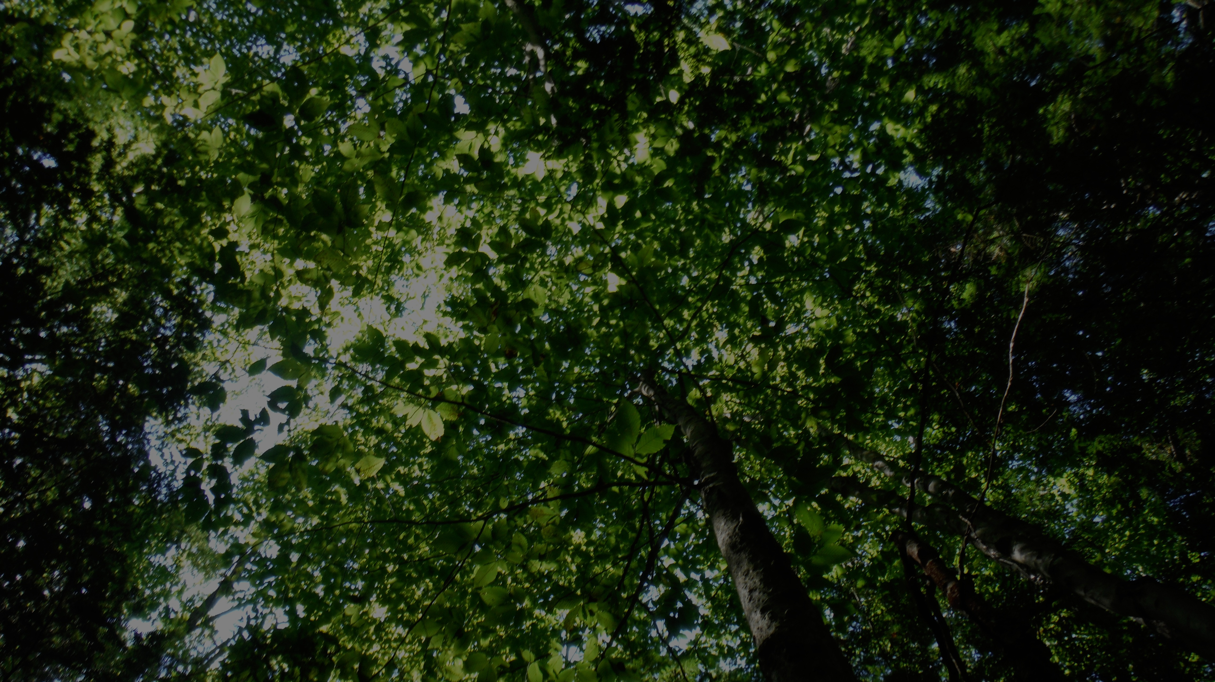
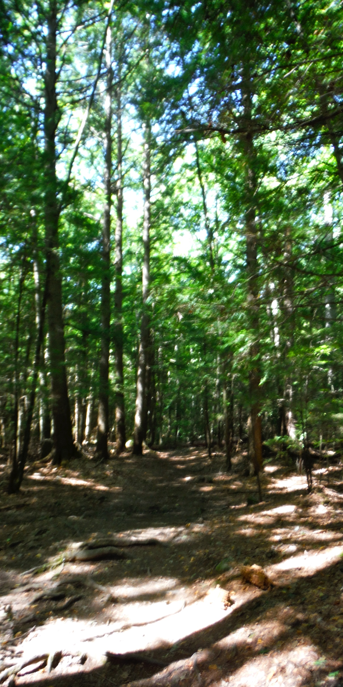
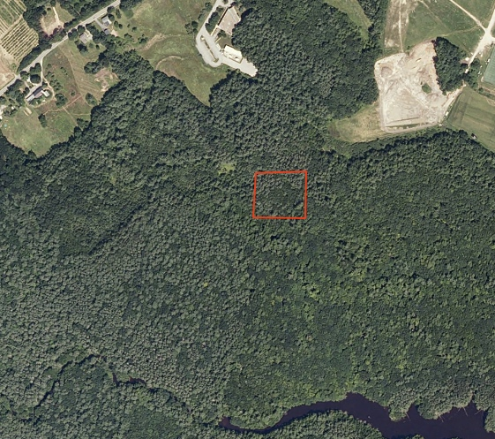
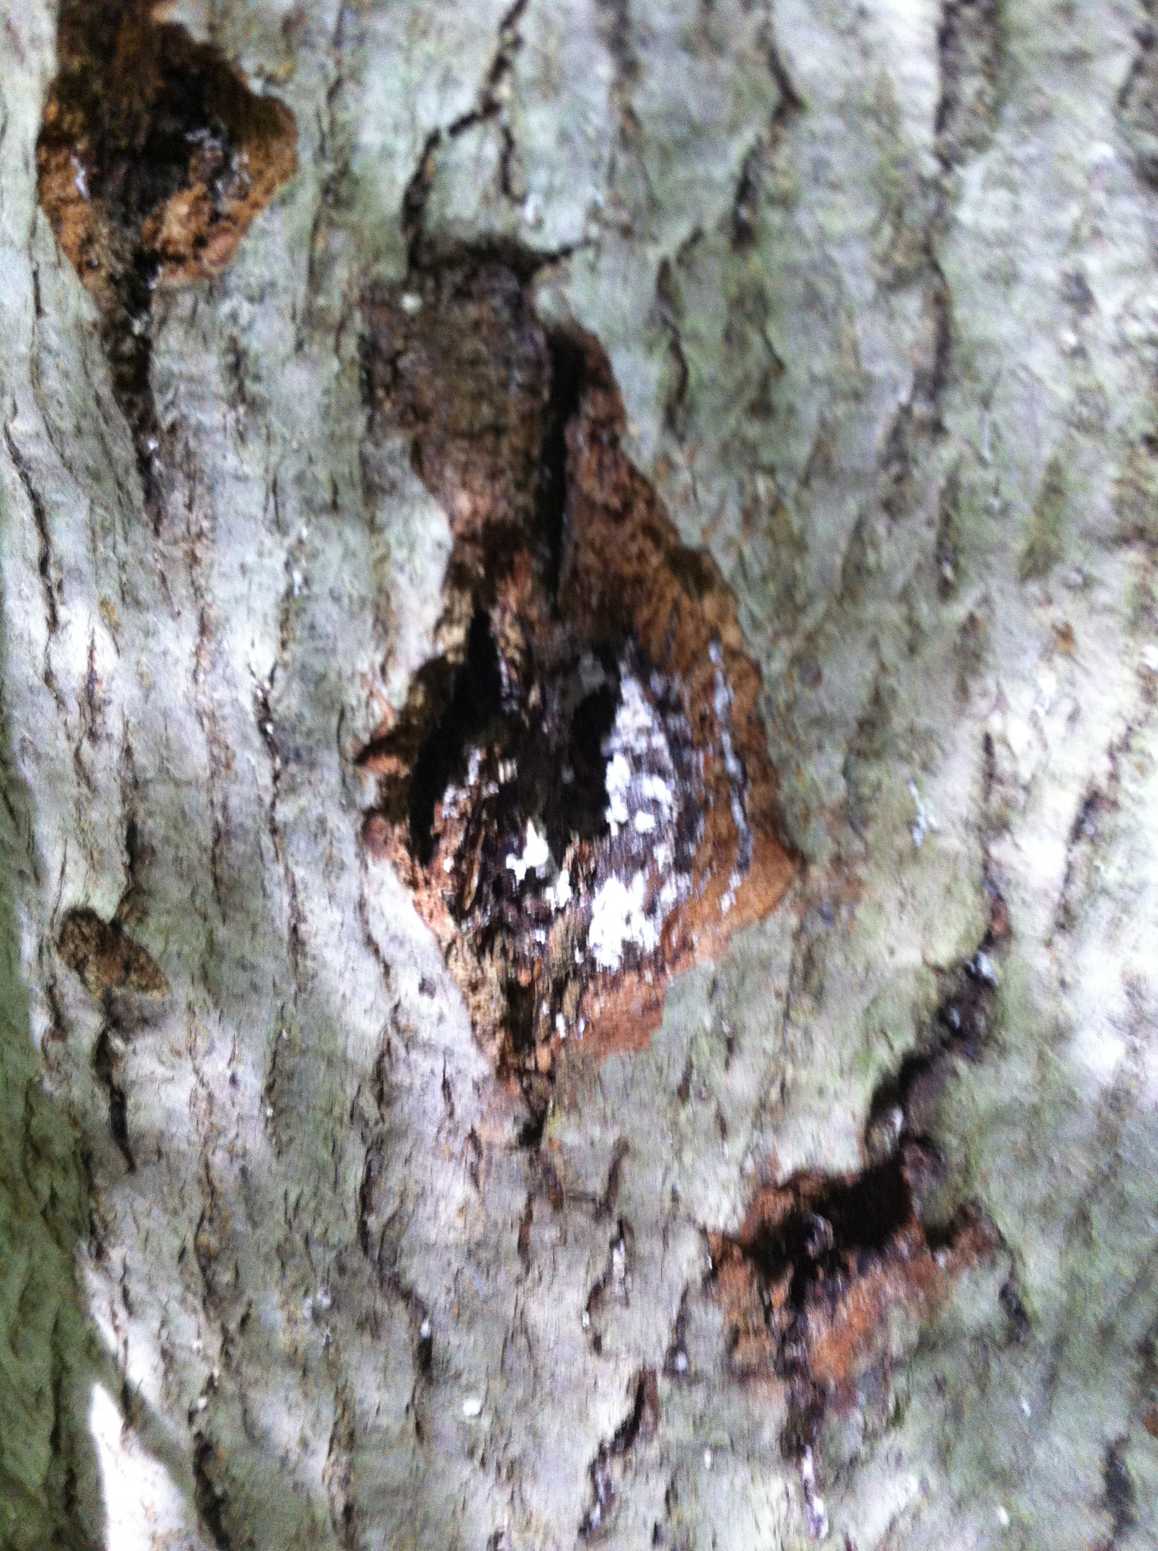
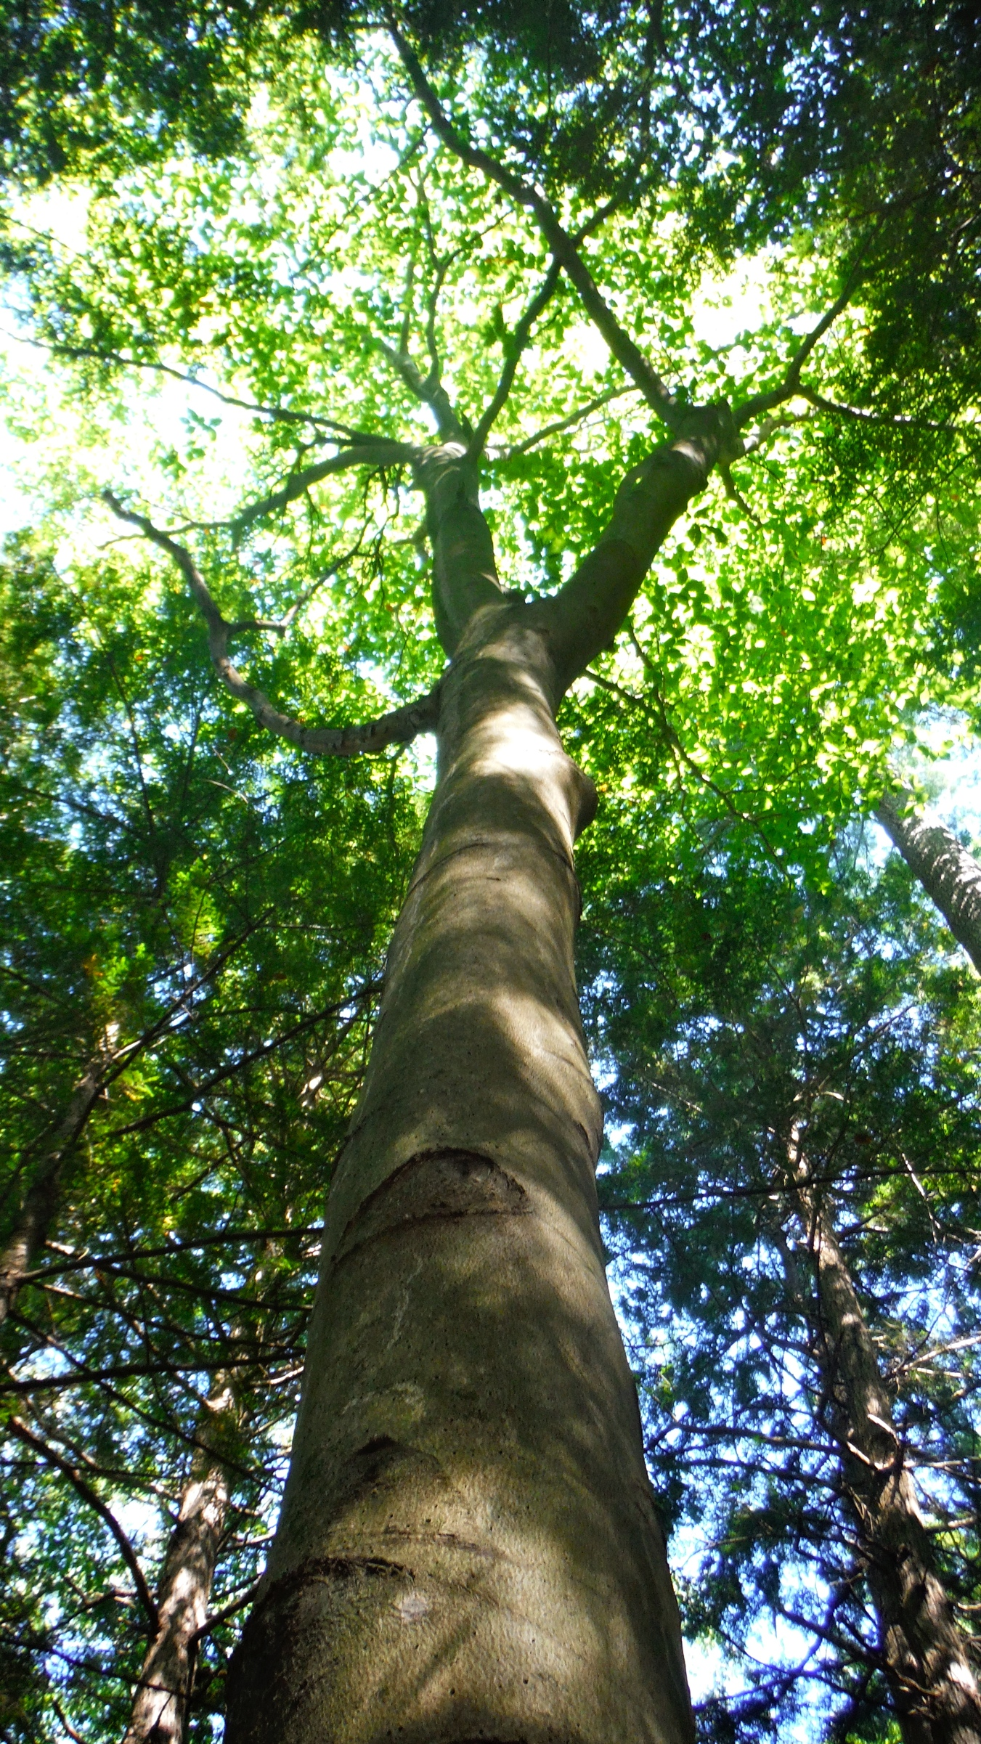
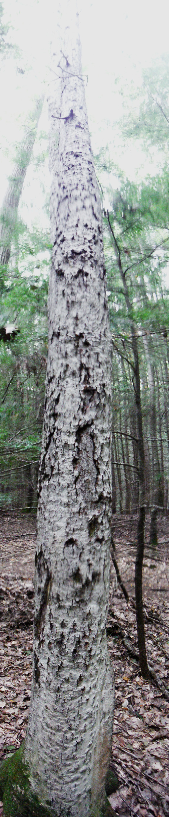
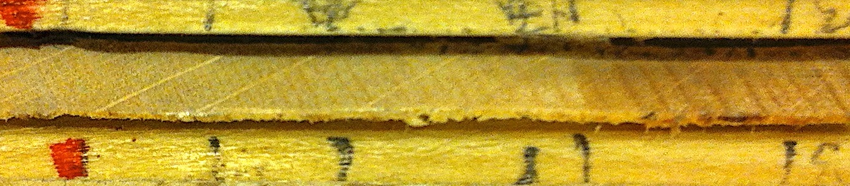
The Effects of Beech Bark Disease On Annual Tree Ring Growth
in College Woods of Durham, New Hampshire.
By: Paul Morris, Environmental Conservation Studies, Department of Natural Resources, pax36@wildcats.unh.edu
--Abstract--
--Discussion--
The external damage symptoms of beech bark disease is easy to find on many American Beech trees (Fagus grandifolia) across New England today. Its wide native range and dominance among other deciduous trees of North America is only paralleled to its importance for both wildlife and lumber industries alike for the region. For this reason, I have decided to peer deeper into our understanding of the effects the disease symptom complex. Specifically, I decided to study the annual radial growth of beech trees by extracting cores to examine the growth ring patterns within infected trees. Researching annual wood production of diseased beech during infection can prove an important indicator of how beech trees respond to the disease as well as indicating when the disease infected the tree. From my analysis of growth rings of sample trees, I have found that beech bark disease can reduce the annual radial growth of American beech trees.
The trends and patterns found during this study could have a number of explanations. figure 1 has proven my hypothesis relating disease to a reduction in radial growth, but this data must be examined critically. Looking closer at this figure, it is clear that that all samples have large standard deviations. Samples #1 and #3 have very similar average growth rates and have close overlapping in standard deviations. In hopes of understanding this trend, figure 2 shows that both control samples (#2 and #3) have steep reduction in growth to nearly half of the average growth of both the healthy trees in 1993 and again in 2004 . These outlying years widened standard deviation in average growth rate data from figure 1 and is one of the main reasons why figure 1 shows overlapping deviations between infected and uninfected tree samples. This could also be due to normal growth variations year to year that occur in beech trees. Further research would be beneficial to discover if other factors might explain this anomaly in the growth of the uninfected samples for 1993 and 2004.
Though it cannot be confirmed with certainty, it would appear that annual radial growth patterns could be used indicators of when beech bark disease invaded College Woods. Similar declining trends are in parallel between both of the diseased trees (#1 and #4) beginning 1964-65 followed by another decline 1976-78 as seen marked in figure 2. These patterns could be translated as the years the disease reached College Woods. Since the scale insect often must damage the tree before the Nectria fungus can colonize within the cambium, one scenario could be that the beech scale invasion was caused for the first decline in 1964-65. Deductive reasoning from this explanation would therefore suggest that the following decline in 1976-1978 could have been from an invasion of Nectria fungus during this time period. In a different scenario, it is possible that the beech scale and Nectria fungus came at the same times but in 2 separate intense waves between the lapse in time from 1965 to 1976.
Looking at figure 10, though the greatest outliers unusually wet and unusually dry year are clearly marked, they do not seem to correlate with similar trends in annual growth as seen in figure 2. Therefore I have concluded that annual precipitation totals patterns are not related with annual growth patterns of the trees sampled. Possible reasoning could be due to a proven resilience to the abnormal variations in precipitation totals. It is also possible that the limited scope of this precipitation data is simply not enough information to link this weather data with annual tree growth.
Figure 3. The study site outlined in red in College Woods of Durham, NH. 2009 NAIP 1-meter - RGB (source: nhwetlandsmapper.unh.edu).
Figure 5. The white wool-like wax excreted indicating the presence of beech scale in sample tree #1.
--Introduction--
Figure 9. The study site in College Woods of Durham, NH September 2013.
--Results--
The initial signs of the disease are onset by biotic stress caused by the beech scale insect (Cryptococcus fagisuga) that eats, lives, and reproduces within the bark and cambium of American beech trees as seen in figure 5 (Houston and O’Brien 1983). This subsequently exposes the vascular cambium to 3 types of pathogenic Nectria fungi including Nectria coccinea var. fagnita, Nectria galligena, and Nectria ochroleuca (Edmonds et al. 2011). The fungi damage the exposed cambium and bark resulting in cankers and tar colored decay of stems and bole of the trees over a number of years (Houston, D.R. 1994). The damage from both the beech scale and Nectria fungus results in the symptomology of beech bark disease. The disease has rapidly spread and has swept over the majority of the beech tree range across the eastern U.S. over the course of a century and often results in the mortality of these trees (Houston and O’Brien 1983). The external symptoms of the disease have been heavily studied and well documented but information on internal growth effects have been studied much less so. One of the few exceptions is a 1993 study conducted in the Hubbard Brook Forest within New Hampshire that had proven the disease can be linked to reductions in annual radial growth of beech (Gavin et al. 1993). Based on these findings conducted within close proximity to my study site within College Woods of Durham, New Hampshire, I have reason to believe beech bark disease causes a reduction in annual growth as a result of the damage inflicted (Gavin et al. 1993). I am testing to determine if the effects of beech bark disease in infected beech trees result in a reduction in size of the average annual growth rings in comparison to the average annual growth rings of uninfected beech trees. I also intend to determine if annual growth ring patterns can be used as indicators of when the disease arrived in College Woods. Correlations between annual growth patterns and precipitation will be analyzed to deduce involvement of this variable within my data results. My 3 main objectives I plan on accomplishing during this study are:
To measure tree core samples of beech infected with beech bark disease.
To measure tree core samples of control beech that are free of disease.
Analyze the patterns in annual growth rings to find significant correlations in both infected and uninfected tree samples over time .
Table 1. A timeline of the research study on beech bark disease in College Woods of Durham, NH, Fall 2013.
Date | Activity
9/4/2013 | Conducted survey of 100m plot in College Woods.
9/17/2013-9/21/2013 | Extracted cores from 4 sample trees.
9/24/2013 | Prepped and mounted tree core samples in laboratory.
11/18/2013 | Analyzed tree core samples with Velmex. Recorded measurements of each growth ring from bark to pith.
Figure 8. Sample tree #3 indicating healthy growth an no visible symptoms of beech bark disease.
As seen in figure 1., the trees that have been infected with beech bark disease have shown a reduction in average annual tree ring size compared to the uninfected trees. Figure 2 indicates the growth patterns by year as determined by measurements of annual tree rings sizes from the 4 tree cores collected. Significant correlations can be seen beginning in 1965 to 1966 in both of the diseased trees (#1 and #4) showing a dramatic decline in annual growth thereafter. Looking at the annual growth trends of the uninfected trees (#2 and #3), significant reductions in growth were recorded in 1993 and again in 2004 showing annual growth that is almost half of the average growth as seen in figure 2. Figure 10 shows annual precipitation accumulation totals with an average of 42.86 inches a year. 1941 and 2001 marked the driest years, 1954 and 2008 were the wettest years in terms of precipitation totals as seen in figure 10.
Figure 6. Sample #1 with visible exterior damage as a result of beech bark disease.
--Conclusion--
Though this study has proven correlations between annual tree growth patterns and the symptoms of beech bark disease, there are many more variables that could be taking part in the explaining year to year trends that were not analyzed in this study. The reputability of the data analyzed in this study is limited due to small sample size analyzed of only 4 trees. This was in part due to the difficulty of coring diseased trees as well as limited time to conduct study. This study could have also benefited from more detailed climatic weather data in order to better understand correlations with annual growth in beech trees. Nevertheless, the information in this study can prove to give meaningful insight into the effects of beech bark disease on the growth of American beech trees. Collecting information on internal symptoms is just as important as for external symptoms when locating indicators to the extent that beech bark disease can damage beech trees. With no signs of the disease slowing its spread, research must continue in order help predict impacts on ecosystems and industries that find great value in the health and survival of beech trees. Perhaps findings from this study could lead to further testing that could draw further broaden our scope of understanding into the symptoms of beech bark disease.
--Methods--
Tools:
Increment Corer – A hand tool that is used to drill and extract core samples from trees.
Velmex Digital Readout – Hardware used to record of tree ring measurements with fine precision.
Rapid Advance UniSlide – A mechanical hand crank sliding mount used for small and precise incremental measurements of tree core samples
Measure J2.6X software – The program that records the measurement data input from the Velmex into a spreadsheet on a PC.
Light Microscope – A magnification tool used to determine size of growth rings as seen through an eyepiece on the scope
Study Site & Experimental Design
For my study sight I chose a 100-meter plot in College Woods of Durham, New Hampshire. For my sample size, I chose 4 beech trees; 2 infected beech bark disease and 2 uninfected control with no visible disease. From each of the 4 sample trees, I extracted 1 core per tree at DBH. After the 4 cores were extracted, they were mounted onto wooden trays for analysis of tree rings in a laboratory.
References
Edmonds, Agee, and Gara 2005. “Forest Health and Protection”. Waveland Press. Long Grove, Illinois.
Gavin, D.G., and Peart, D.R. 1993. Effects of beech bark disease on the growth of American beech (Fagus grandifolia). Can. J. For. Res. 23: 1566-1575
Houston, D.R. 1994. Major new tree disease epidemics: beech bark disease. Annual Review of Phytopathology. 32: 75-87.
Houston, and O’Brien 1983. Beech Bark Disease. US Department of Agriculture, Forest Service. http://www.na.fs.fed.us/spfo/pubs/fidls/beechbark/fidl-beech.htm. Accessed November 27, 2013.
US Department of Energy 2013. “US Historical Climatology Network” http://cdiac.ornl.gov/epubs/ndp/ushcn/ushcn_map_interface.html. Accessed November 20, 2013.
Figure 7. A close up of the growth rings on the tree core from sample #1.
Notes:
omething that is much harder to see is the internal effects of the disease which is why I have decided to examine what impacts on internal growth.
Could precipitation patterns be involved that could explain variation in year to year tree ring growth? Could tree ring growth trends be used to pinpoint when the disease invaded College Woods? Beech bark disease has become and epidemic that has infected American beech trees across the eastern United States over the last century.
(summarize findings)

