Slide 1
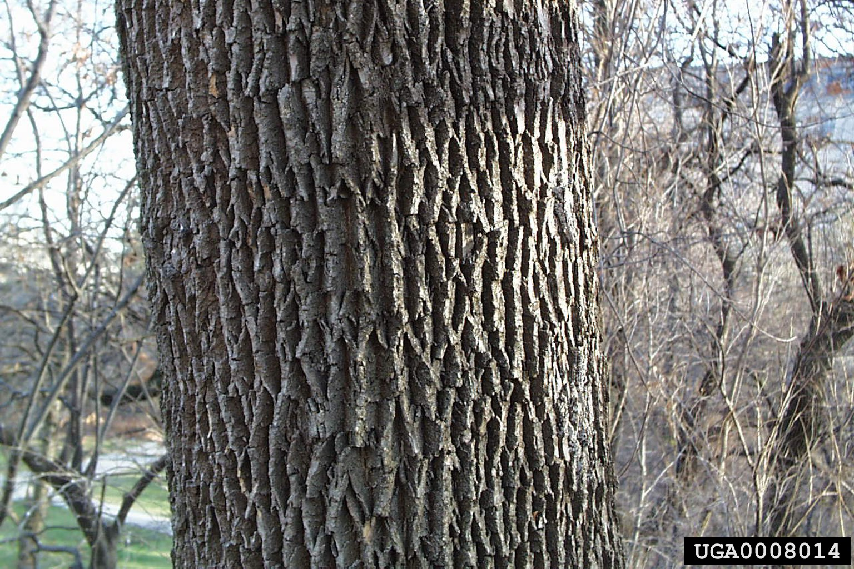
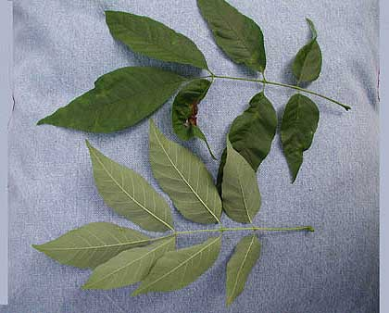

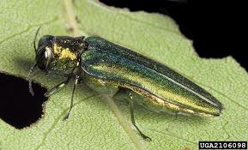

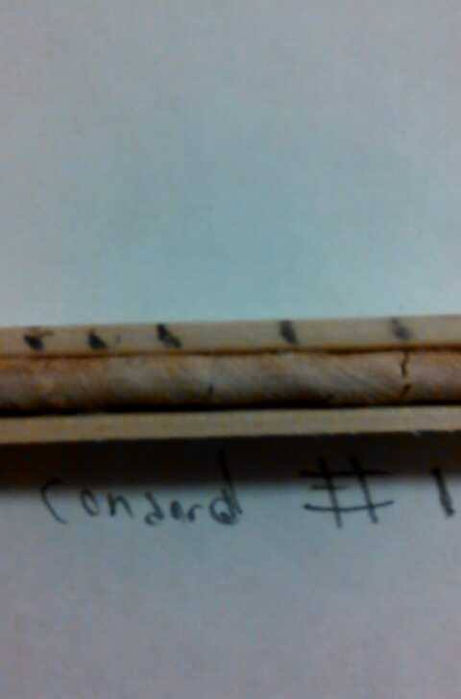
The Effects of Emerald Ash Borer on White Ash Trees (Fraxinus americana) in New Hampshire.
Elliot Doughty, Forestry, COLSA. ebq24@wildcats.unh.edu
Abstract.
Results
Disscussion
This project was designed to see if emerald ash borer could be found here in Durham, NH. Comparisons were done between sites in Concord, NH and Durham, NH. The results showed that the emerald ash borer was not found in any of the trees sampled from Concord, NH or Durham, NH. There is however still a possibility that these trees will be infested in the future.
After analyzing the data it was found that emerald ash borer was not found to be effecting any of the sampled trees. There were some strange changes in the annual growth rings of the core samples of Durham sample #1 and Concord sample #1. The changes From Durham #1 are seen between 1993 and 1998. The annual growth rings between these years are closer together compared to most other growth rings. The same results are found on Concord #1 between 1993 and 2003.
The changes in the annual growth rings between the dates noted on the Durham and Concord samples do not seem to be caused by emerald ash borer. These changes could be caused by other factors such as climate change, fungal disease, strange growth patterns, or other causes.
Introduction
Emerald ash borer has become a threat to many ash trees in some parts of the United States. It is a metallic green looking beetle that eats through the wood of the trees.¹ The beetle will bore paths in the inner bark of the trees and eat the tree from the inside out. Emerald ash borer has recently been found in Concord NH in 2013. The infested area has been quarantined but there is still a risk of the beetle spreading throughout New Hampshire. The hypothesis is that the ash trees from Concord will show signs of damage from the Emerald Ash Borer and will be a good comparison to the ash trees in Durham which are expected to be fully healthy.
Table. 1 Ages of sampled trees
Damage caused by emerald ash borer
2003—1998--1993
Conclusion
1998-----1993
Although there were some results found, there is not enough supporting evidence to show that this damage was caused by emerald ash borer. Some damaged areas which seemed to be holes caused by the Ash Borer were found on some of the trees sampled. This damage may be relatively new and may have not yet caused any damage in the growing patterns of these trees. The previous changes in the growth rings of Durham sample #1 and Concord sample #1 between the years that were noted were most likely caused by some other factors. Further studies should be done in these areas to see if emerald ash borer will eventually become a problem. This further research could be used to help prevent the spread of emerald ash borer.
Emerald Ash Borer.
Methods
Core Samples were taken from Ash trees in Concord, NH and Durham, NH.
Three core samples were taken from each town
Core samples were put into straws for easy transportation.
Core samples were analyzed using dendrochronology and any strange change in annual growth rings was recorded.
Figure 1. Durham sample #1
Figure 2. Concord sample #1
The other four samples taken showed normal growth ring patterns. There were no abnormal spacing amongst the rings on the other four samples.
References
Herms, D. McCullough, D. Smitley, D. Sadof, C. Williamson, R. Nixon, P. “Insecticide Options for Protecting Ash Trees from Emerald Ash Borer.” emeraldashborerinfo USDA Forest Service. Web. Nov. 13, 2013¹

