Slide 1
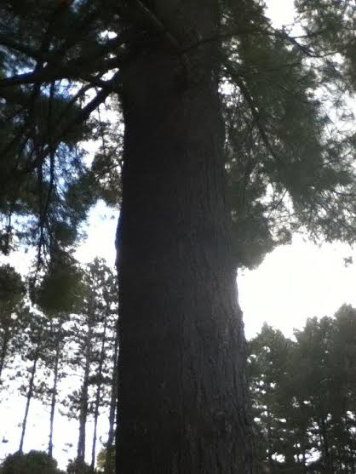
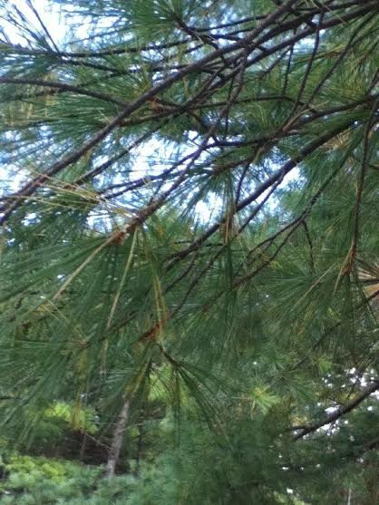
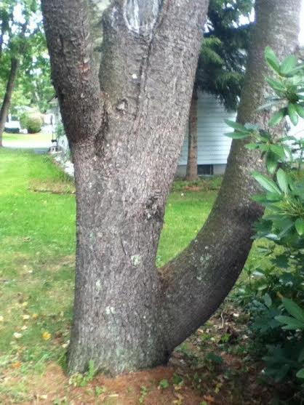
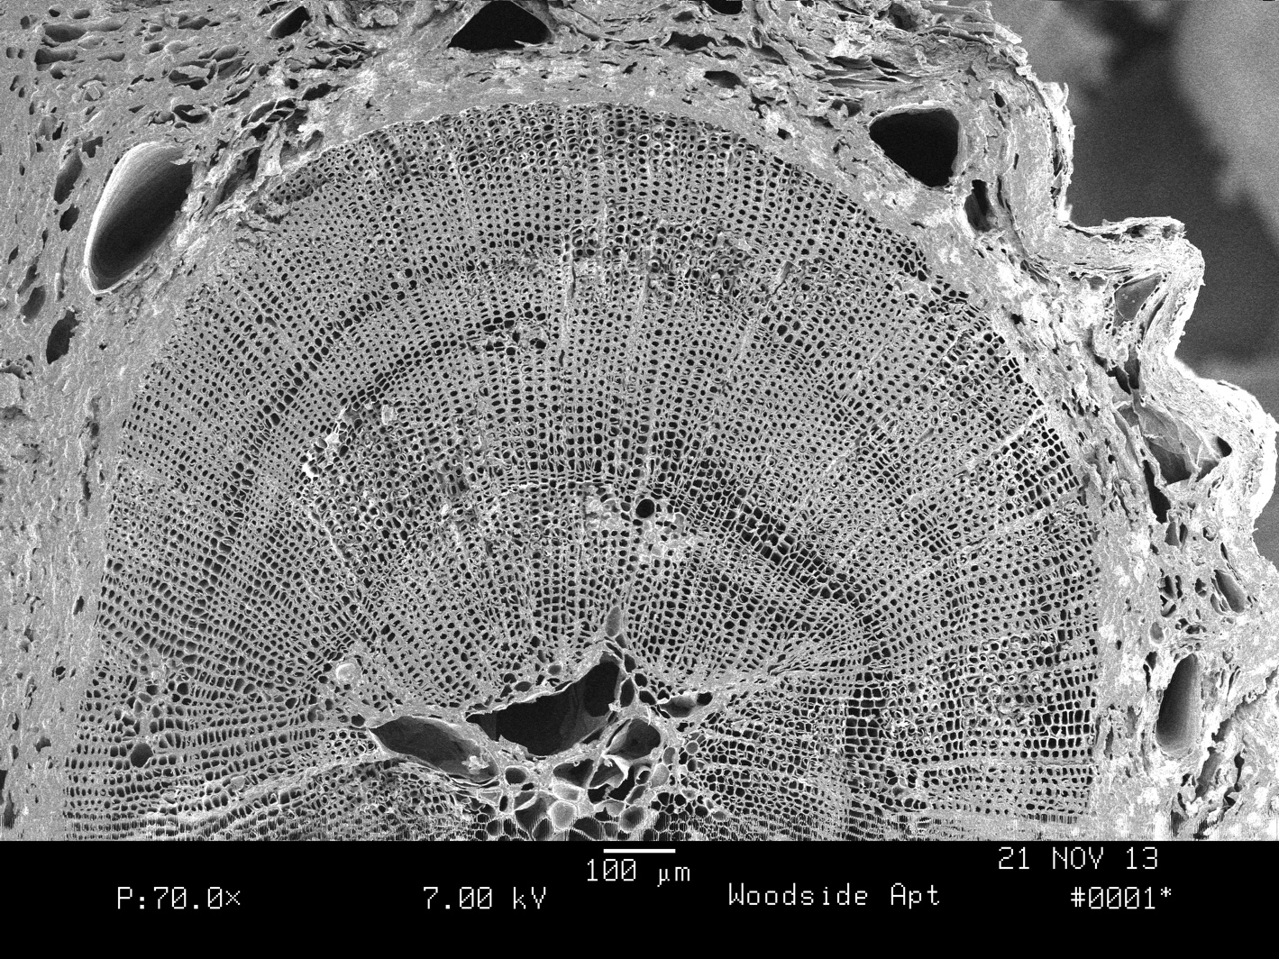
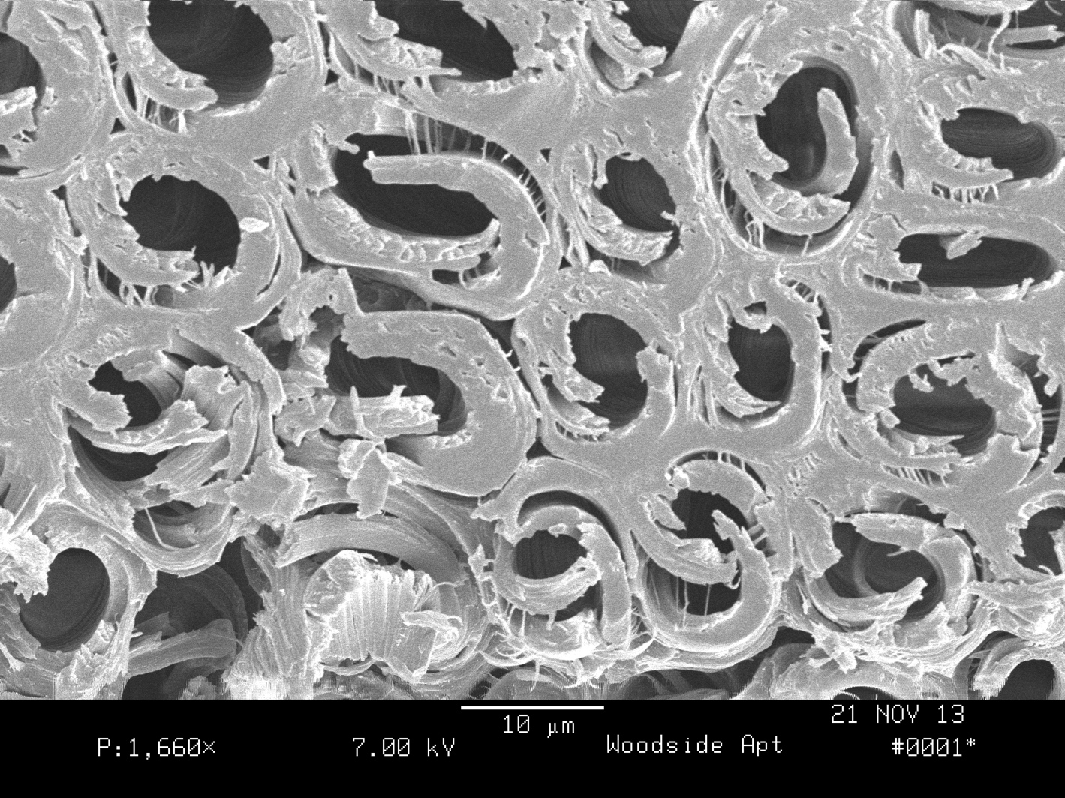
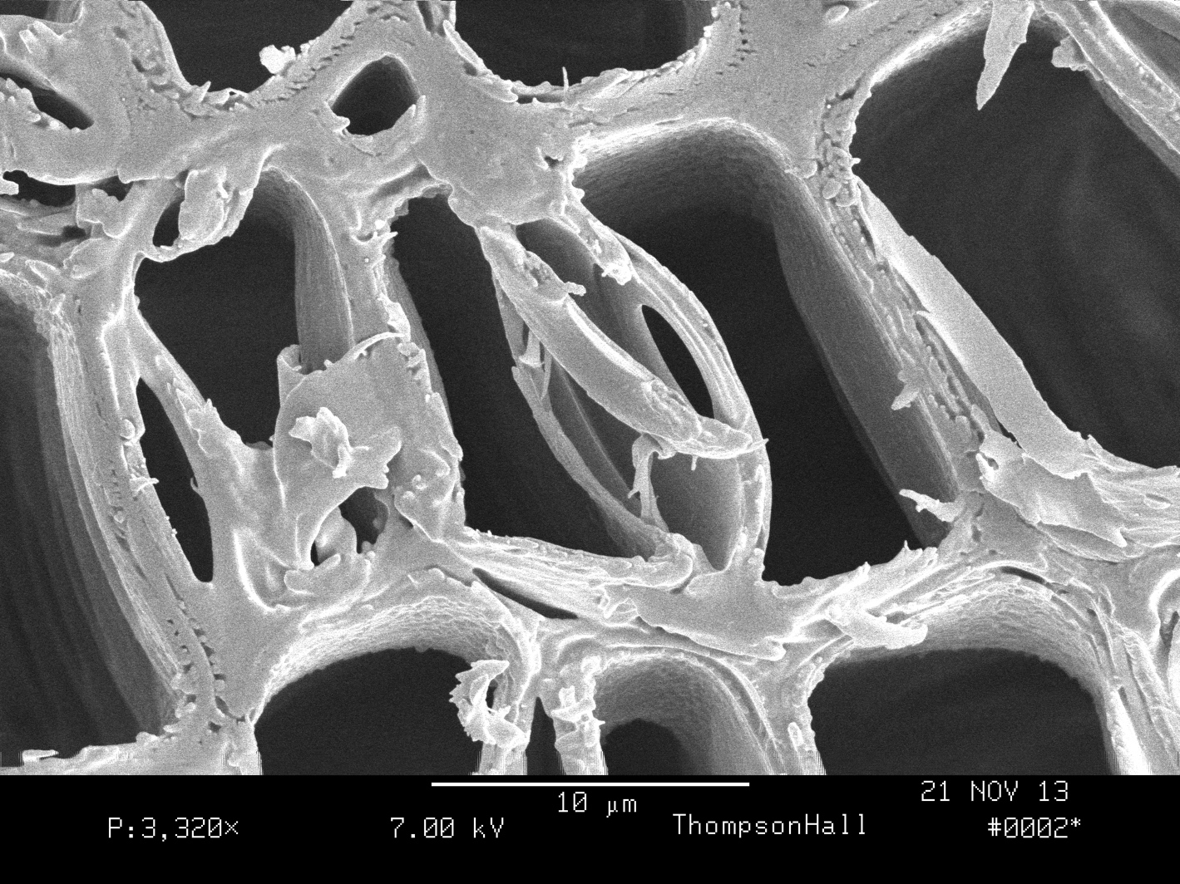
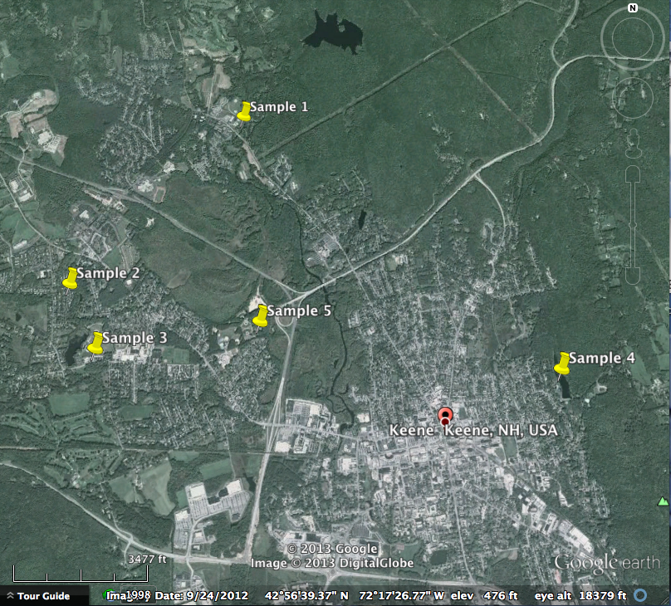
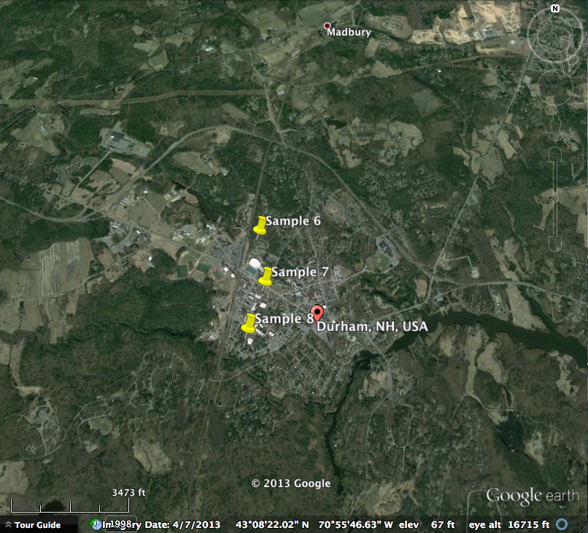

Impacts of Ozone Events on Eastern White Pine (Pinus strobus)
Growth in Keene, NH and Durham, NH
Meghan Thornton
B.S. Forestry, Department of Natural Resources & the Environment
mcb78@wildcats.unh.edu
Abstract
Results & Discussion
Historically, the towns of Keene and Durham, New Hampshire have higher levels of ground level ozone than other areas in the state, which is known to negatively impact forest health, especially for ozone sensitive species such as eastern white pine (Pinus strobus). This research presents a variety of environmental factors that contribute to the annual rate of growth in white pines in these two towns. Core samples from Keene show a general trend of reduced annual growth in 2005 and 2002, both years with elevated average ozone levels. 2010 and 2005, years of high precipitation, also demonstrated reduced annual growth. Core samples from Durham show a general trend of reduced annual growth in 2008, a year with elevated average ozone levels. Durham core samples demonstrated reduced growth in years of low precipitation, such as 2001 and 2012. Other factors, such as site location, have a significant impact on annual radial growth in eastern white pines, and further research is suggested to corroborate the data presented here.
Introduction
Ground level ozone is formed via chemical reactions with nitrous oxide, a byproduct of human activity, and volatile organic compounds (VOCs), which are primarily produced naturally, although some VOC sources are anthropogenic. Southern New Hampshire has higher ozone levels than other parts of the state. Keene has elevated ozone levels due to its close proximity to the Connecticut River, which acts as a conduit for coastal ozone pollution from cities in southern Connecticut and New York. The seacoast region of New Hampshire, including Durham, experiences elevated ozone levels due to currents bringing air pollution from Boston northward. Because of these periodic high concentrations of ground level ozone, there are ozone monitoring stations located in Keene and Portsmouth.
State programs, such as Forest Watch, have been assessing ozone impacts on eastern white pine needles for over 20 years, and foliar health decline, such as tip necrosis and chlorotic mottling, is observable in bad ozone years. Because eastern white pine is an ozone sensitive species, it serves at a good indicator of air quality in an area. However, there is not significant research on the affect of ozone damage on radial growth of eastern white pines in New Hampshire. Eastern white pine is an important timber species in New Hampshire, and reduced annual growth could have a significant impact on the timber industry and local economies. Past research shows that Jeffrey pines in California with ozone damage have less annual radial growth than those without ozone damage, and are also more sensitive to changes in precipitation patterns.
The objective of this project was to determine if ozone events had a significant impact on annual radial growth of eastern white pines in the southern New Hampshire towns of Durham and Keene. This was determined by measuring core samples in these areas. It was hypothesized that annual white pine growth in years with ozone events would be less than that in years of normal air quality. Size of annual rings was compared to historical annual precipitation and air quality data to see if reduced growth could be related to ozone events. Twigs from ozone event years were also examined to see if there was any structural damage caused by air pollution.
Image 1. A cross section of a 2011 twig from sample 6,
showing a false growth ring in 2012.
For all samples taken, it must be noted that site-specific characteristics have an impact on annual radial growth. However, general trends can be observed from core samples taken from both Keene and Durham. Of the Keene core samples, sample 1 came from from Court Street, adjacent to the Ashuelot River, sample 2, from a suburban backyard on Shadow Lane, sample 3, from Arch Street, adjacent to a parking lot, sample 4, from Robin Hood Park, adjacent to the reservoir, and sample 5, from Wheelock Park, adjacent to a baseball diamond. All trees experienced decreased radial growth in 2006, 2008, and 2010 (Figure 1). The reduced growth in 2006 is possibly due to a flooding event in October of 2005, a year in which annual precipitation was considerably greater than average. 2008 and 2010 were years with elevated average ozone levels, so it is possible this air pollution reduced annual growth. All samples, except for sample 5, had reduced growth in 2005, which was a year with elevated average ozone levels (Figure 1). Because the flooding event occurred in October, it is unlikely that the increased precipitation reduced 2005 annual growth. All samples experienced increased growth in 2007, potentially due to increased precipitation. Sample 2 experienced rapid radial growth in 2012 and 2013, and this is likely due to a microburst in 2012 that knocked down a neighboring eastern white pine, reducing competition (Figure 1).
Of the Durham core samples, sample 6 came from the forested area adjacent to the Woodside Apartments on Strafford Ave, sample 7 from Thompson Hall Lawn outside of DeMerrit Hall, and sample 8 off College Road adjacent to Phillbrook Dining Hall. Core samples were also taken from trees in College Woods and off Mill Road, but annual rings were not evident enough to be measured. All samples experienced reduced radial growth in 2001 and 2012, which were both years of low annual precipitation (Figure 2). In 2004, a year of high average ozone, all three samples actually experienced increased growth (Figure 2). In 2005, a year with high average ozone levels, samples 6 and 7 experienced reduced radial growth, and in 2008, another year with high average ozone layers, samples 7 and 8 experienced reduced radial growth (Figure 2). It is a possibility that site characteristics contribute to whether or not a tree is impacted by elevated ozone levels in any given year, as perhaps some sites are more vulnerable than others. Further understanding of the site locations would be necessary to verify this.
SEM images of the twigs did not reveal any structural damage from air pollution, possibly because they were 2011 twigs, a year in which average annual ozone levels were normal. Healthy tracheids could be viewed in sample 7 (Image 3). However, the SEM image of sample 6 revealed the presence of compression wood, caused by gravitational forces on the tree, which is when the secondary cell wall separates from the primary cell wall (Image 2). The wood then becomes gelatinous, losing structural integrity and therefore becoming useless as a timber product. There was also evidence of a false growth ring in 2012 on sample 6, the causes of which are unknown (Image 1). These images, coupled with the core sample data of annual radial growth, demonstrates the complex relationship of environmental variables and tree growth.
Image 2. An example of compression wood
on sample 6.
Materials & Methods
-5 core samples were taken from white pines in Keene, NH using an increment corer on 9/23/13, and the locations were chosen at random based upon accessibility.
-5 core samples were taken from white pines in Durham, NH using an increment corer on 11/27/13, and the locations were chosen at random based on accessibility. Unfortunately, rings on two of the samples were unreadable.
-Core samples were mounted on stands and sanded using four different grades of sand paper, and annual growth rings measured in mm by hand using a ruler.
-SEM images were taken on 11/21/13 of white pine twig cross sections from 2011 from two trees in Durham, NH, cut on 11/12/13 to assess if internal structural damage was present. Twig samples were frozen in liquid nitrogen, cut, mounted, and dried in a desiccating oven for two days to prevent resin bubbles.
Image 3. Lateral wall of tracheids in sample 7.
Conclusion
Keene, NH
Durham, NH
While the results demonstrate that there was reduced annual radial growth of eastern white pines in certain years with above average ozone levels, it should be taken into account that there are many variables that contribute to annual radial growth that were not considered in this project. For further research, and more definitive results, more samples should be taken from both towns, and site characteristics such as elevation, soil, and stand dynamics should be measured and considered more thoroughly. Ideally, a Velmex UniSlide would measure increment growth on the core samples, as opposed to using a ruler by hand, to reduce human error. The SEM could be used to examine more twig samples from pertinent ozone event years for any patterns in structural damage. Because of the importance of eastern white pine as a timber species in New Hampshire, further research on reduced annual radial growth due to ozone events would be prudent to prevent a potential hardship on the economy, as well as the loss of one of the state’s most majestic trees.

