Slide 1
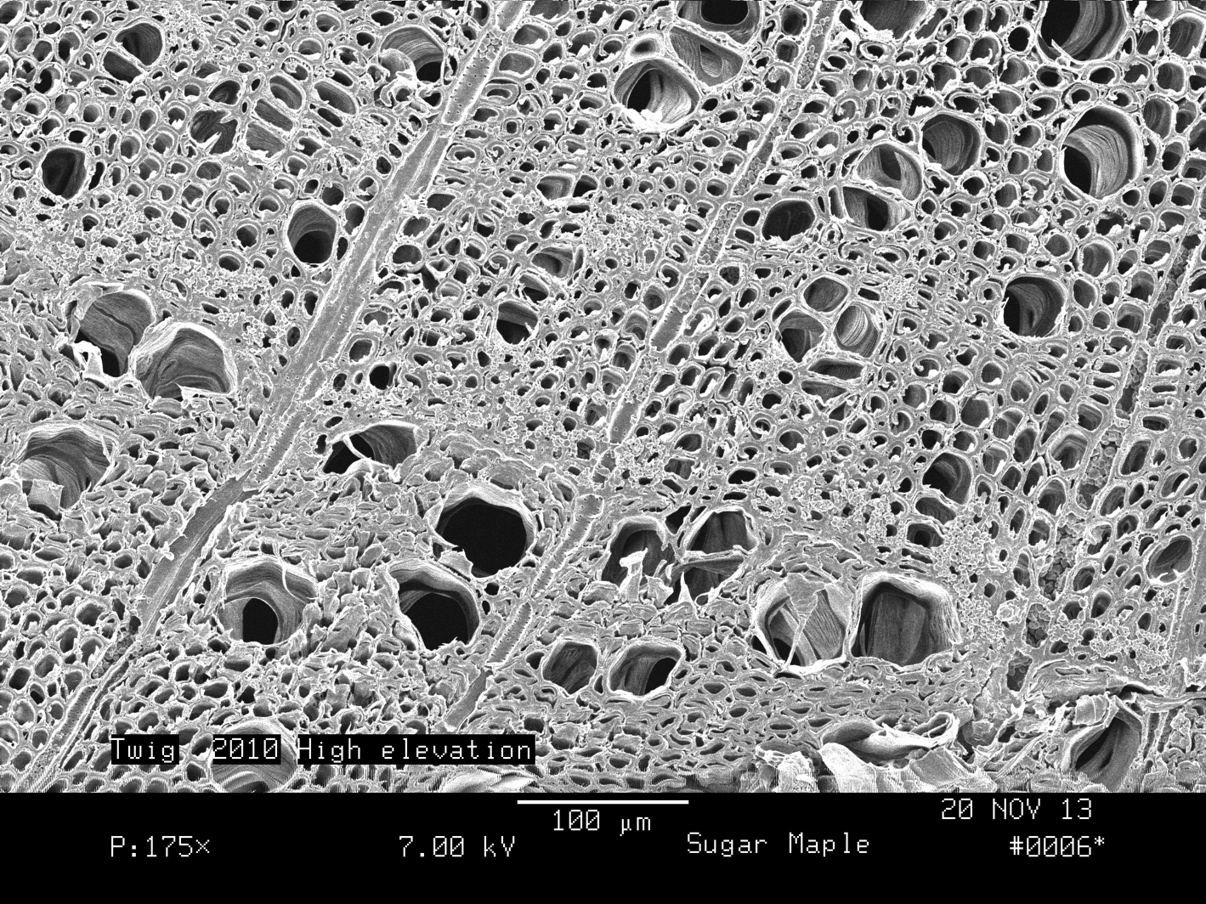
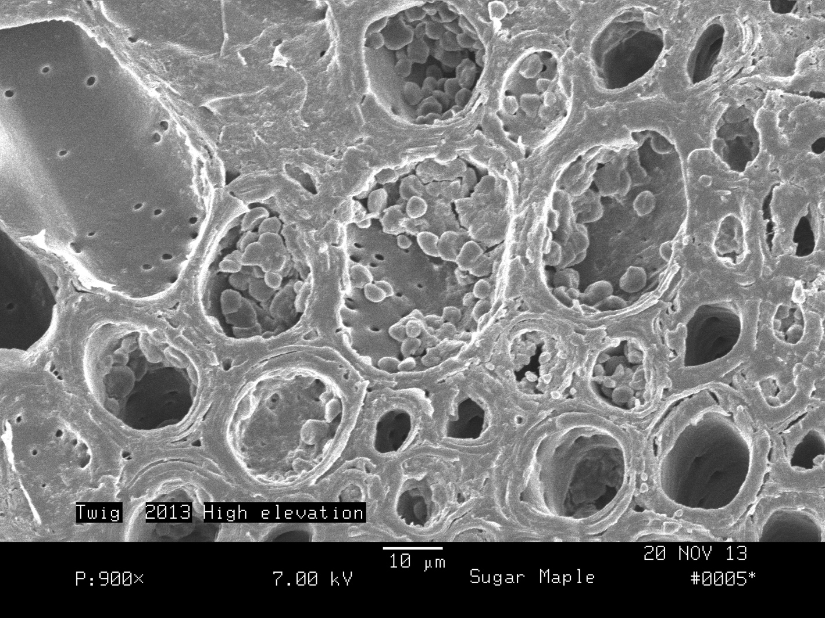
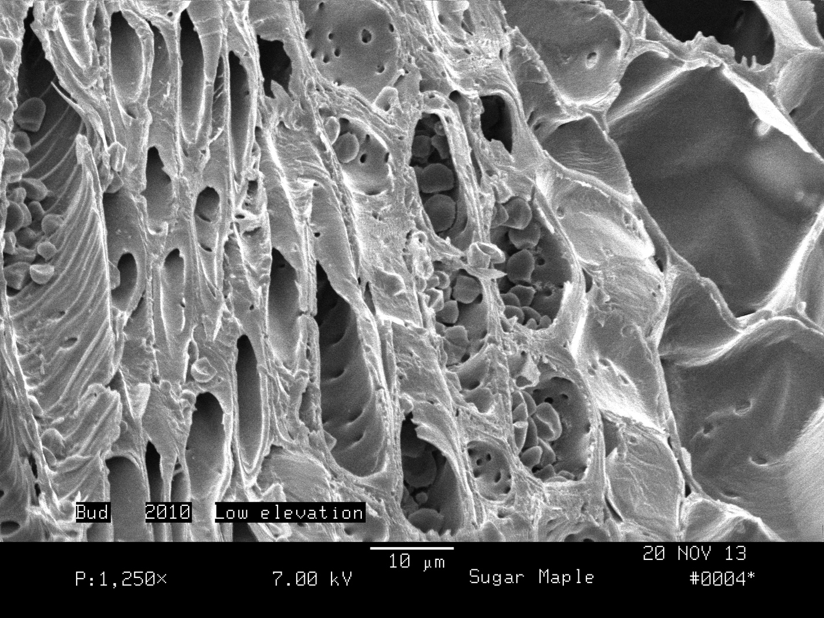
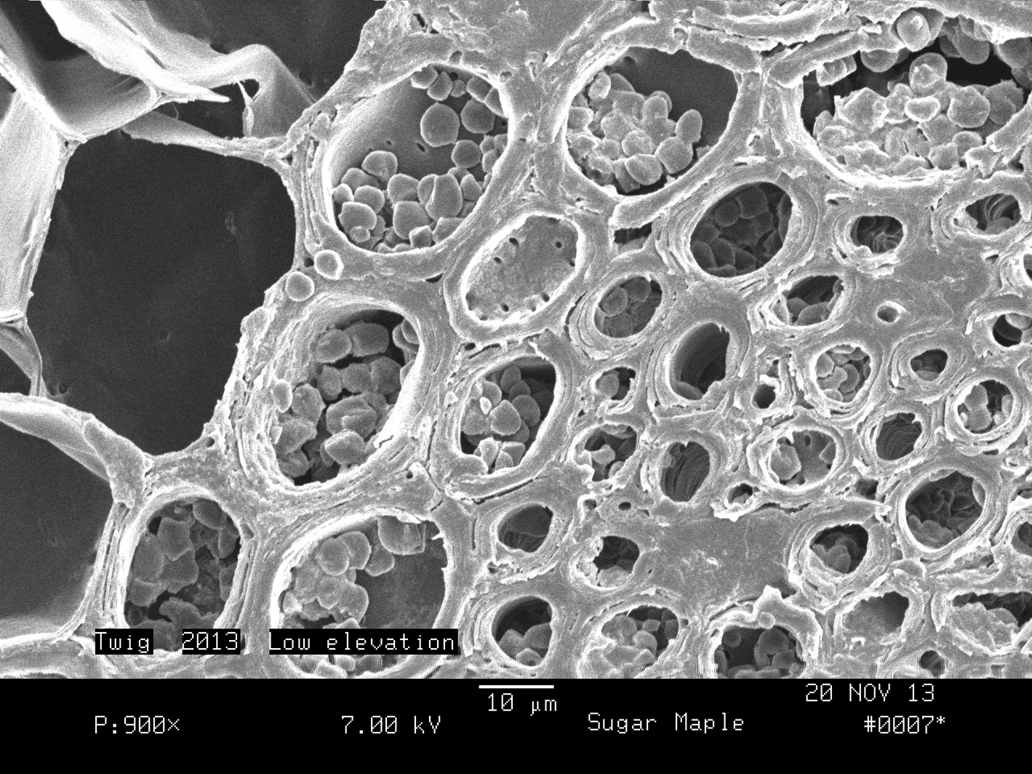
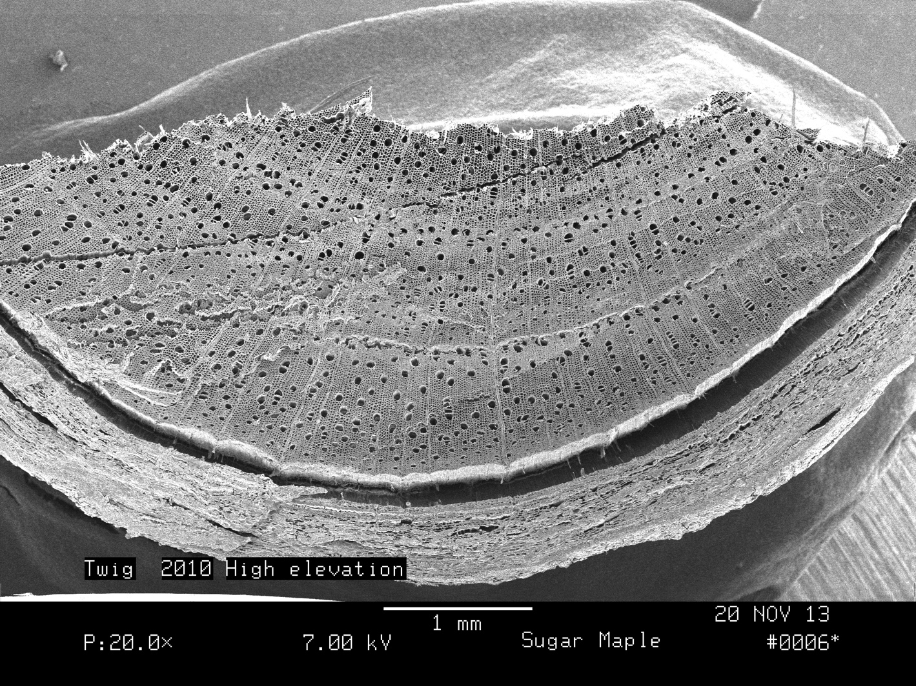

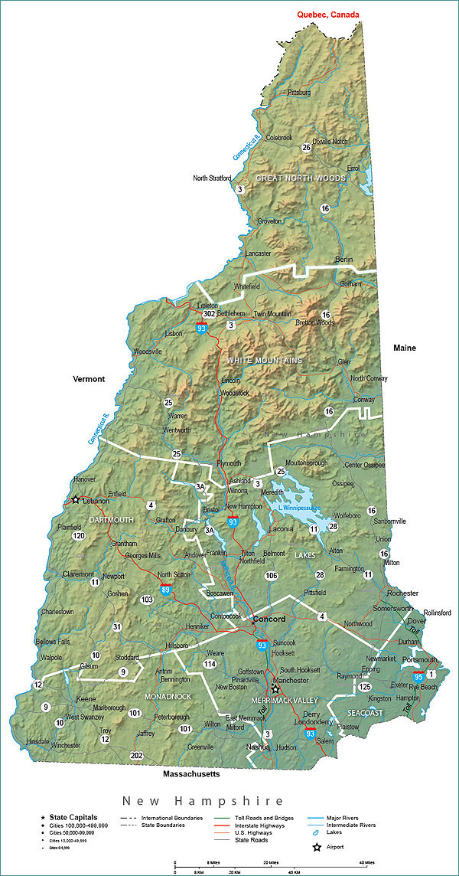
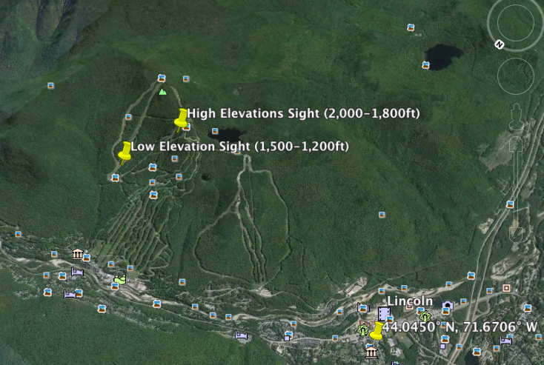


Monitoring the Health of Sugar Maples (Acer saccharum) on Loon Mountain
Harrison Jutras
Major: Environmental Science and Sustainability, COLSA
hry9@wildcats.unh.edu
Abstract: This study looked at the health of sugar maples (Acer saccharum) on Loon Mountain in Lincoln New Hampshire to see if a 2010 PAN event caused a stress to this species. During the summer of 2010, raging wildfires in Quebec sent clouds of smoke, filled with hydrocarbons and NOx south into the New Hampshire region during a high ozone event. This perfect combination created a toxic atmospheric band known as PAN (Peroxyacetyl Nitrate) . Sugar maples Symptoms of PAN stress (canopy thinning, early defoliation and browning, and unusual growth) were seen to have a strong affect at high elevation sites (around 1,800 feet). This study looked at two sites on Loon Mountain. One at 1,500 feet and the second at 2,000 feet. I expected to see symptoms of unusual growth inside the 2010 twig segments at the high study site and little to no damage in the control site (1,500 feet). The length of the first four internodes in each growth segment and the length of the total growth segments were calculated for all maples observed at both sites. The amount of buds on each internode were calculated to see if there were less buds produced in 2010.
The study showed no significant difference between the sugar maples at the low site compared to the high site, but some of the findings suggested a 2010 PAN event did have an affect on sugar maples growth patterns at the high site. Although there were no significant differences between the number of buds on each internode and the length of each internode between the two sites, the average length of the twig segments were both at a low in the 2010 twig segments.
Introduction
A 2010 PAN event was seen to affect the health of sugar maple trees on Bald Mountain in Campton, NH. The study found that maples growing at high elevations (around 1,800ft) were more affected than trees at lower elevations. Symptoms of PAN include a thinning canopy layer, drying and yellowing of tender spring leaves, and early defoliation (Guderian, 1984). The Bald Mountain study concluded that PAN has the ability to stress maples in very short amounts of time (Carlson, 2013).
Loon Mountain (located in Lincoln NH) shares a similar location and configuration to Bald Mountain, making it a good site to make a comparative study. Maples were observed at 1,500 feet (control site) and 1,800 feet (experimental site) to see if there were any differences in the growth pattern and cellular structure between the low site maples and the high site maples. Leaf structure was not observed due to the timing of the study (fall and winter).
Results
Cell Structure
Figure 1.
P: 175x
Figure 2.
P: 900x
Figure 6.
Table 1. looks at the average length of nine twig samples from three individual sugar maples at both sites. Both lines share a similar trend, having the longest twig segment in 2013 and the shortest in 2010. The high site had a more gradual positive trend after the year 2010, where as the low site showed a more pronounced positive slope after the year 2010.
Figure 1. displays the cell structure in the 2010 segment at the high site. Starch grains were found inside the cell structures, indicating stored energy and good health.
Figure 2. displays a close up on the starch grains inside a 2013 cross section at the high site. The cell structures contained large amounts of starch grains that were irregular in shape and size, suggesting a metabolic malfunction of some sort
Figure 3.
P: 1,250x
Figure 4.
P: 900x
Hypothesis or Questions
I expect to see more symptoms of PAN induced damage in maples at the high elevations site than the low elevation site.
If PAN does affect maples more severely at higher elevations, than I expect to see more cellular damage and unusual growth patterns in the maple’s 2010 growth segments at the high site.
Figure 7.
Figure 8.
Figure 3. displays the terminal buds cell structure inside the 2010 segment at the low site. Starch grains were irregular in shape and size, hinting to possible water stress, or unusual metabolic function that put more energy into producing leaves than producing starch grains
Figure 4. displays the twig cell structure in the 2013 section of the twig at the low elevation. The cell structures were loaded with healthy starch grains. There were significantly more starch grains in the 2013 section compared to the 2010 section at the same site.
  Objective and Methods
I look at the length of the twigs yearly growth segments and at the length of the first four internodes for each year to see if individuals at the high site produced smaller segments in the 2010 segment.
Bud density for each segment was examined to see if there were fewer buds produced in 2010 at the high elevation site compared to the low site.
Cellular characteristics were observed under the scanning electron microscope and used to make comparisons between the two sites.
Using a GPS, I hiked up to 1,500 feet (control: low site).
Three sugar maples were located and three twigs were cut per individual using a six foot pole pruner (producing nine samples)
For each twig, a 12 inch ruler was used to measure the distance between each years growth segment and the first four internodes in each segment.
Buds were counted by hand for each years segment for all samples.
The same process was conducted for the higher elevations site (2,000 feet).
Half cross sections were taken out of the 2013 and 2010’s growth segments from both the low and high elevations sites and observed under the SEM.
The results were averages and put into graphs to see if there were any significant differences.
Figure 5.
P: 20.0x
Table 2. displays the total amount of buds found on each internode in all five growth segments for the high site. The graph shows a positive trend between the number of buds observed and time. 2013 displayed the most buds overall (13) and 2009 had the fewest buds (4).
Table 3. displays the total buds found on each internode in all five growth segments for the high site. Similar to the high site, there was a positive trend between the number of buds observed and time. The 2013 segment had the most buds intact (17) while 2009 had the least (4).
Figure 5. displays a half cross section of a twig sample at the high site. The top half of the cross section represents the 2010 growth segment. A false growth rings were present in the 2010 section, indicating unusual growth caused by a stress factor.
Figure 9.
Figure 10.
Experimental Design
Loon Mountain in Lincoln, NH
(44° 2′ 10″ N, 71° 37′ 18″ W)
Two study sights 1,500 ft and 2,000 ft (control and experimental)
A random sampling approach used to pick individual sugar maples
Length of yearly segments and internodes were measured off a ruler and recorded in mm (tip to tip)
Study began the first week of October and ended the last week of November.
1
2
Table 4. shows the average length of the first four internodes for each growth segment for the high site. There were no unusual growth patterns seen in the 2010 segment of the twig. Instead all 5 years had similar growth. The 2009 segments had a slightly larger average than the other four years.
Table 5. shows the average length of the first four internodes for each growth segment at the high site. All five growth segments shared a similar average and no signs of unusual growth were observed in the 2010 growth section of the twig. The graph above is not skewed and shares a similar trend for all five years.
Week 1: Formatted study design
Week 3: Samples taken
Week 5: Summed findings
Week 6: SEM prep and observation
Week 7: Graphed results
Week 8: Interpreted results
Conclusion
Findings suggest a 2010 PAN event had an affect on the growth and cell structure of sugar maples at both the high and low elevation site, although It was difficult to confirm if the unusual growth and starch grain structures were directly correlated with a PAN event, due to a lack of study trials and time requirements. Figure 5. displayed a false growth ring inside its 2010 growth segment, indicating the presence of some sort of stress. Figure 6. showed a decrease in the twigs 2010 growth segment in both the high and low sites. In the control site (low site), there was a pronounced difference between the length of the 2010 growth segments compared to the other 4 years. This finding did not support my hypothesis, that the maples in the experimental site would show more unusual growth patterns than the control site’s, but it did suggest a PAN event may have effected the control site as well. Figure 3. was a 2010 low site sample, but contained irregularly shaped starch grains. The control site might have been too similar to the experimental site for this study, affecting my hypothesis.
There was no significant difference between the length of the internodes and the amount of buds observed on each internode between the two study sites (seen in figures 7-10). There was a increase in the number of buds as the years increase but it was difficult to see any significant difference between the 2010 segment and the 2009 and 2011 segments because all three years had relatively few buds per internode . More replicates needed to be conducted to achieve a more accurate finding for this study, but the false growth ring in figure 5. might suggest a 2010 PAN event stunted the growth of that individual sugar maple .
A follow up study might look at more samples and take the aspect of the slope into consideration (maybe compare northern facing slopes to southern slopes). Overall, my findings did not support my hypothesis that the sugar maples in the high elevation showed more growth and cellular damage in their 2010 growth segments than the low site.
References
Guderian, R., Tingey, D.T., & Rabe, R. (1984). Effects of photochemical oxidants on plants. Retrieved from http://www.osti.gov/scitech/servlets/purl/6827858
Carlson, Martha. “Maples on Bald Mt. Using Forest Monitoring Tools to Understand a Defoliation Event.” University of New Hampshire. Nr 782.01 Monitoring Forest Health. October, 2013.

