Slide 1
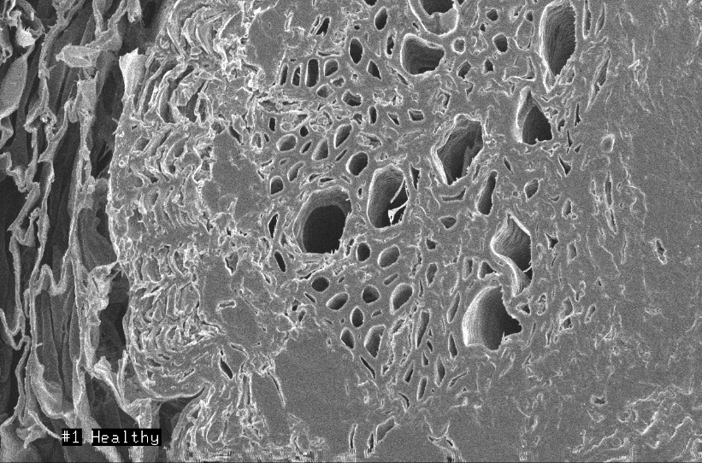
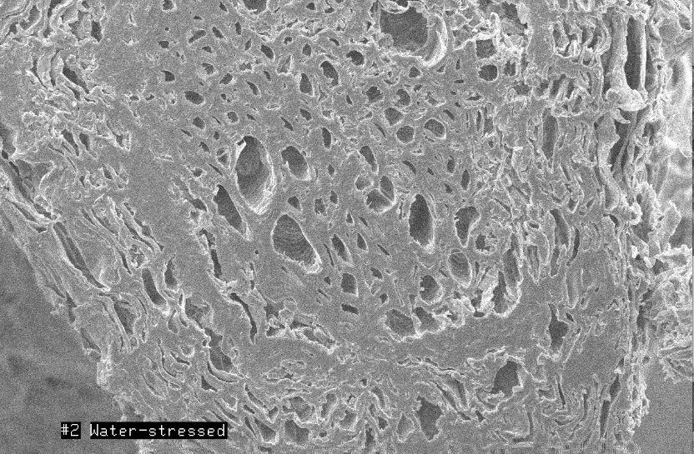
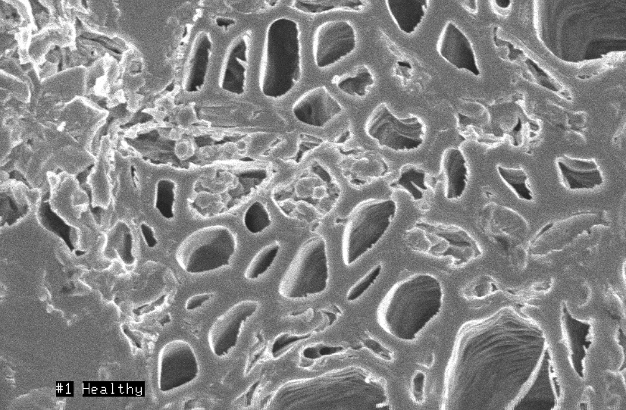
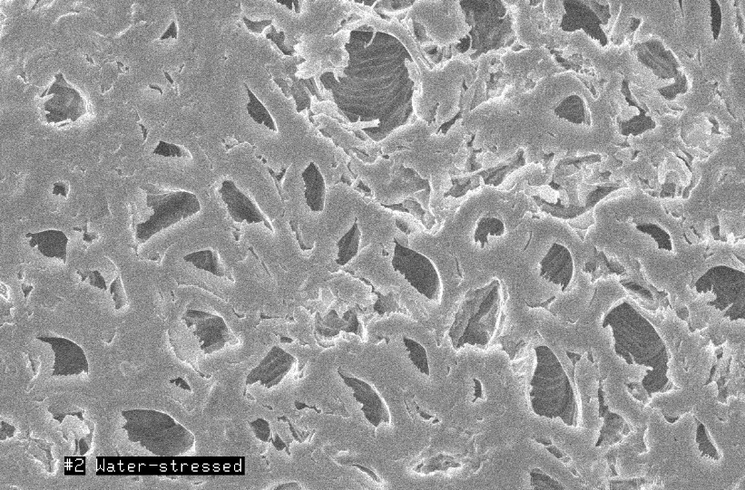
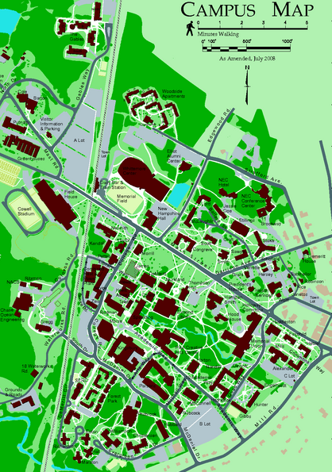
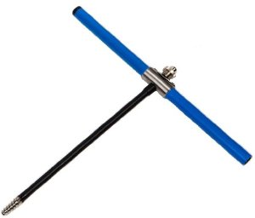
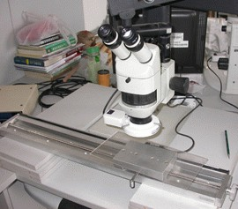
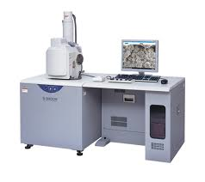
Effects of Road Construction on Nearby Trees
Conor Madison
Natural Resources, Environmental Science
Dr. Rock and Dr. Carlson
University of New Hampshire, Durham, NH
conormadison9@gmail.com
Abstract
Results
Discussion
Road construction has a clear impact on the surrounding environment that decrease the net urban tree loss. However, what is not known is to what extent construction has on nearby trees, and how exactly the damage occurs (Hauer et al. 1994). This experiment looks into the extent of damage on trees, specifically Basswoods, due to road construction. Four Basswoods were studied, two Basswoods (1,2) directly next to recent road construction, and two Basswoods (3,4) set back from the road construction. By use of a VIRIS scan it was found that Basswoods 1 and 2 were extremely water stressed when compared to Basswoods 3 and 4. Also their annual tree ring growths were measured and Basswood 1 and 2 had less growth, as well as less starch within their fine root structures (SEM scans). This is a result of the heavy construction vehicles constantly driving over the root systems of Basswoods 1 and 2, while Basswoods 3 and 4 were far enough set back to not result in too much damage.
Figure 1 shows the spectral curves of each tree’s leaves, however it is Table 1 which shows the significance of the graph. By having such high TM5/4 ratios, it proves that Basswoods 1 and 2 are much more water stressed and damaged than the other Basswoods (Rock et al. 1986). Also in Table 1 is the REIP values which indicate that all trees are absorbing light, even though Basswoods 1 and 2 have significantly less leaf development and maturity, as seen in their NIR3/1 ratios. Figure 2 shows the annual ring width of the trees, which is a well known indicator of the tree’s stress periods (LeBlanc and Foster 1992). In 2010, all trees underwent stress due to the expansion of James Hall which all the trees are near. However in 2013, only Basswoods 1 and 2 declined in annual growth, which was due to the recent College Road construction. By looking very closely at each tree’s fine roots, it became clear how the caused water stress effected the root system. In Figure 3 of Basswood 4 shows clear starch grains, while Figure 4 of Basswood 1 shows no starch grains at all (SEM scans). Having no starch for the upcoming winter and spring, shows clear signs of a damaged tree. This has been seen in other research as well, such as in Schoeneweiss 1982, which found that soil compaction, and drainage pattern changes often causes tree decline and death. Using all of these methods, it is apparent that the trees by the most recent construction are extremely water stressed and have fine root damage, compared to the healthier Basswoods which have limited fine root damage and are not as water stressed. This water stress is caused from the construction vibrations and physical compaction destroying Basswood 1 and 2’s fine root system. Destruction of this system effects trees water uptake, and results in extreme water stress. This root damage has been seen in other research as well such as in Riley 1984, which showed road construction increasing soil compaction up to 200 times relative to undisturbed soil, which results in water stress for the roots. Basswood 3 and 4 grew new roots out of the compaction zone formed in 2010 and are on their way to being healthy once again, while Basswood 1 and 2 are on the brink of death due to their extreme water stress in more recent years.
Figure 1: VIRUS scan of basswood leaves showing their spectral curves.
Introduction
 | Basswood 1 | Basswood 2 | Basswood 3 | Basswood 4
REIP | 716.2 | 723.9 | 730.1 | 727
NDVI | 0.719 | 0.737 | 0.865 | 0.871
TM5/4 | 1.444 | 1.374 | 0.65 | 0.684
NIR3/1 | 1.433 | 1.387 | 0.939 | 0.966
Among the most widespread forms of modification of natural landscape during the past century has been construction and maintenance of road (Diamondback 1990). Construction, which is a big part of University of New Hampshire as we expand buildings and fix roads on a yearly basis, is a major impact the university has on its environment. To see the construction’s effect in Durham, NH, this tudy has selected four basswoods to study; two on College Road next to James Hall (Basswood #1,2) and two behind James Hall in front of Hewitt Hall (Basswood #3,4). While these trees are close to each other, Basswood 1 and 2 show significant signs of being unhealthy while the Basswood 3 and 4 show signs of being healthy. By running multiple analysis techniques on both sets of trees (tree core measurements, VIRUS scans, SEM pictures), the reason for the trees being unhealthy will be easier to see. My hypothesis is that the recent road construction (Summer 2013) on College Road has negatively affected Basswood 1 and 2, and Basswood 3 and 4 were at a safe distance so they were not affected at all. The road construction required heavy vehicles to be constantly driven over Basswood 1 and 2’s root system, which I hypothesize to have caused fine root damage which is the cause of the extreme water stress Basswood 1 and 2 are undergoing.
Table 1: Indices and Ratios calculated from Figure 1
Figure 2: Annual Tree Ring Growth Measurements (mm)
Fine Root Cross Sections – November 1, 2013
Conclusions
Methods
VIRIS scans (Figure 1) showed Basswoods 1 and 2 to be more water stressed than Basswoods 3 and 4.
Table 1 also showed that Basswoods 1 and 2 leaves were less developed than trees 3 and 4.
The annual ring growths (Figure 2) shows the stress in 2010 for all trees and also shows the stress in 2012-2013 for Basswoods 1 and 2.
Taking an SEM scan of each fine root cross section resulted in the finding of starch grains in Basswoods 3 and 4 and the absence of the grains in Basswoods 1 and 2.
My hypothesis was proven correct in that construction does cause tree damage, to near death in this experiment, by inducing water stress caused by damaging the fine root system.
This damage could be caused by soil compaction and the vibrations through the soil.
An increment borer (Figure 1) was used October 12, 2013 at breast height to core each of the four trees (red dots on Campus Map).
These cores were then measured using the Velmex Measuring System (Figure 2).
On September 17, 2013 leaves were collected and scanned using the VIRIS on October 1, 2013.
Fine roots were collected on November 1, 2013 three feet from the trunk of the tree, put in liquid nitrogen and cut on November 14, 2013. These pieces put into the Scanning Electron Microscope (Figure 3) and view on November 15, 2013.
Figure 1: Increment Borer
Figure 3: Fine root cross section of Basswood #4 showing starch grains at 550x magnification (top) and 1,800x magnification (bottom) from a SEM
Figure 4: Fine root cross section of Basswood #1 showing no starch grains at 550x magnification (top) and 1,800x magnification (bottom) from a SEM
- B.N. Rock, J.E. Vogelmann, D.L. Williams, A.F. Vogelmann, T. Hoshizaki. Remote detection of forest damage. BioScience, 36 (1986), pp. 439–44.
- Diamondback. 1990. Ecological effects of roads (or, the road to destruction). Pages 1-5 in J. Davis, editor. Killing Roads: A Citizen’s Primer on the Effects and Removal of Roads. Earth First! Biodiversity Special Publication, Tuscon, AZ.
- LeBlanc, D. C. and J. R. Foster. 1992. Predicting effects of global warming and mortality of upland oak species in the midwestern United States: A physiologically based dendroecological approach. Canadian Journal of Forest Research 22:1739–1752.
- Hauer et al., 1994. R.J. Hauer, R.W. Miller, D.M. Ouimet. Street tree decline and construction damage. Journal of Arboriculture, 20 (1994), pp. 94–97
- Riley, S.J. 1984. Effect of clearing and roading operations on the permeability of forest soils, Karuah catchment, New South Wales, Australia. Forest Ecology and Management 9:283-293.
- Schoeneweiss, D.F. 1982. Prevention and treatment of construction damage to shade trees. J. Arboric. 8:169-175
Pictures from -
Increment borer –www.pacforestsupply.com
Velmex Measurement System – www.trl.ibcas.ac.cn
Scanning Electron Microscope - www.nanocenter.umd.edu
Thank you for the generous help and support Dr. Rock, Dr. Carlson and Nancy Cherim for leading me through this research.
Figure 1: The main result from the spectral curves is how much lower the curve starts in Basswoods 1 and 2, compared to Basswoods 3 and 4.
Table 1: Table showing significant ratios and indices calculated from Figure 1, further explained in discussion.
Figure 2: The first arrow shows the 2010 construction effecting all trees and the second arrow shows the decline growth in Basswoods 1 and 2 in 2013 and the increased growth in Basswoods 3 and 4.
Figure 3 and 4: Figure 3 shows the fine root of the healthier tree (BW#4) which has starch in their cells (the circles inside the cells). Figure 4 is the fine root of the water stressed tree (BW#1) and shows empty cells, without starch grains.
Acknowledgements
Figure 2: Velmex Measurement System
Figure 3: Scanning Electron Microscope

