Slide 1





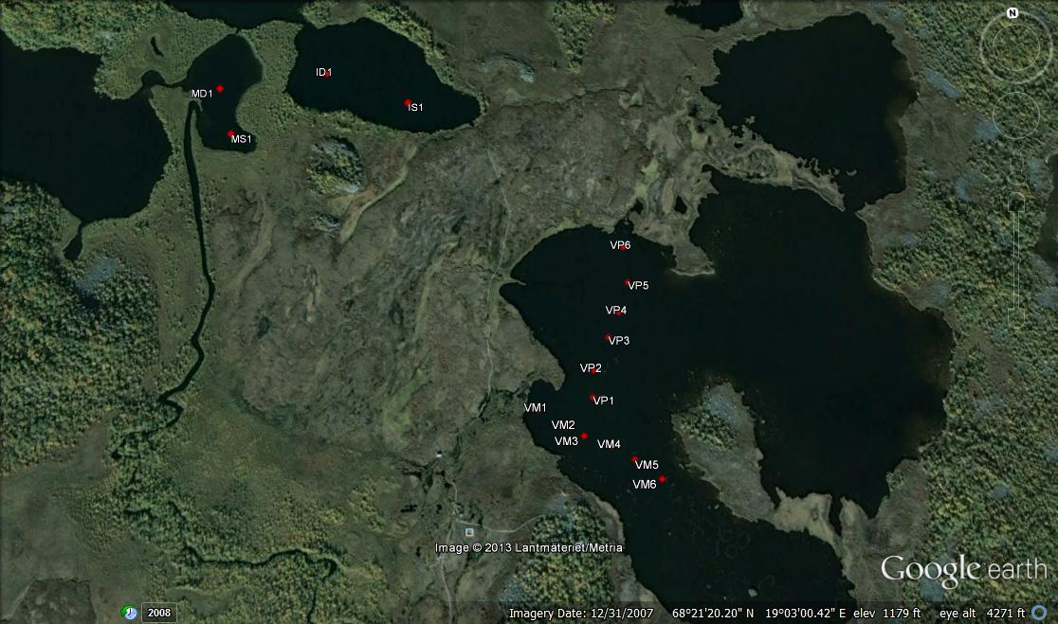
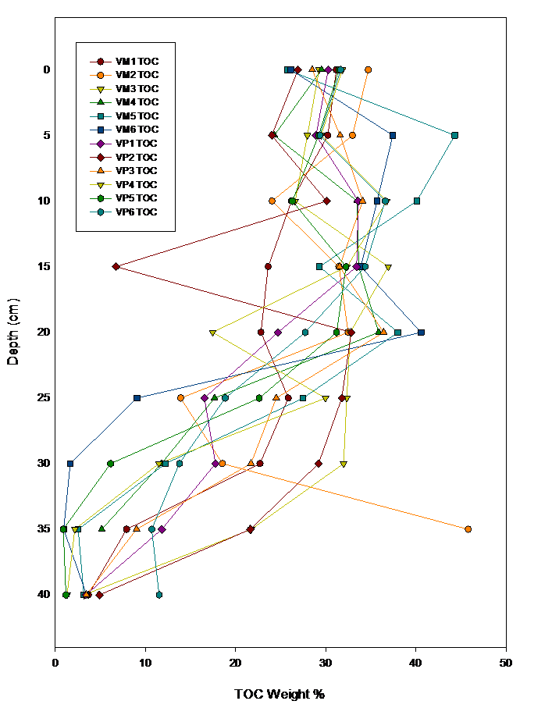
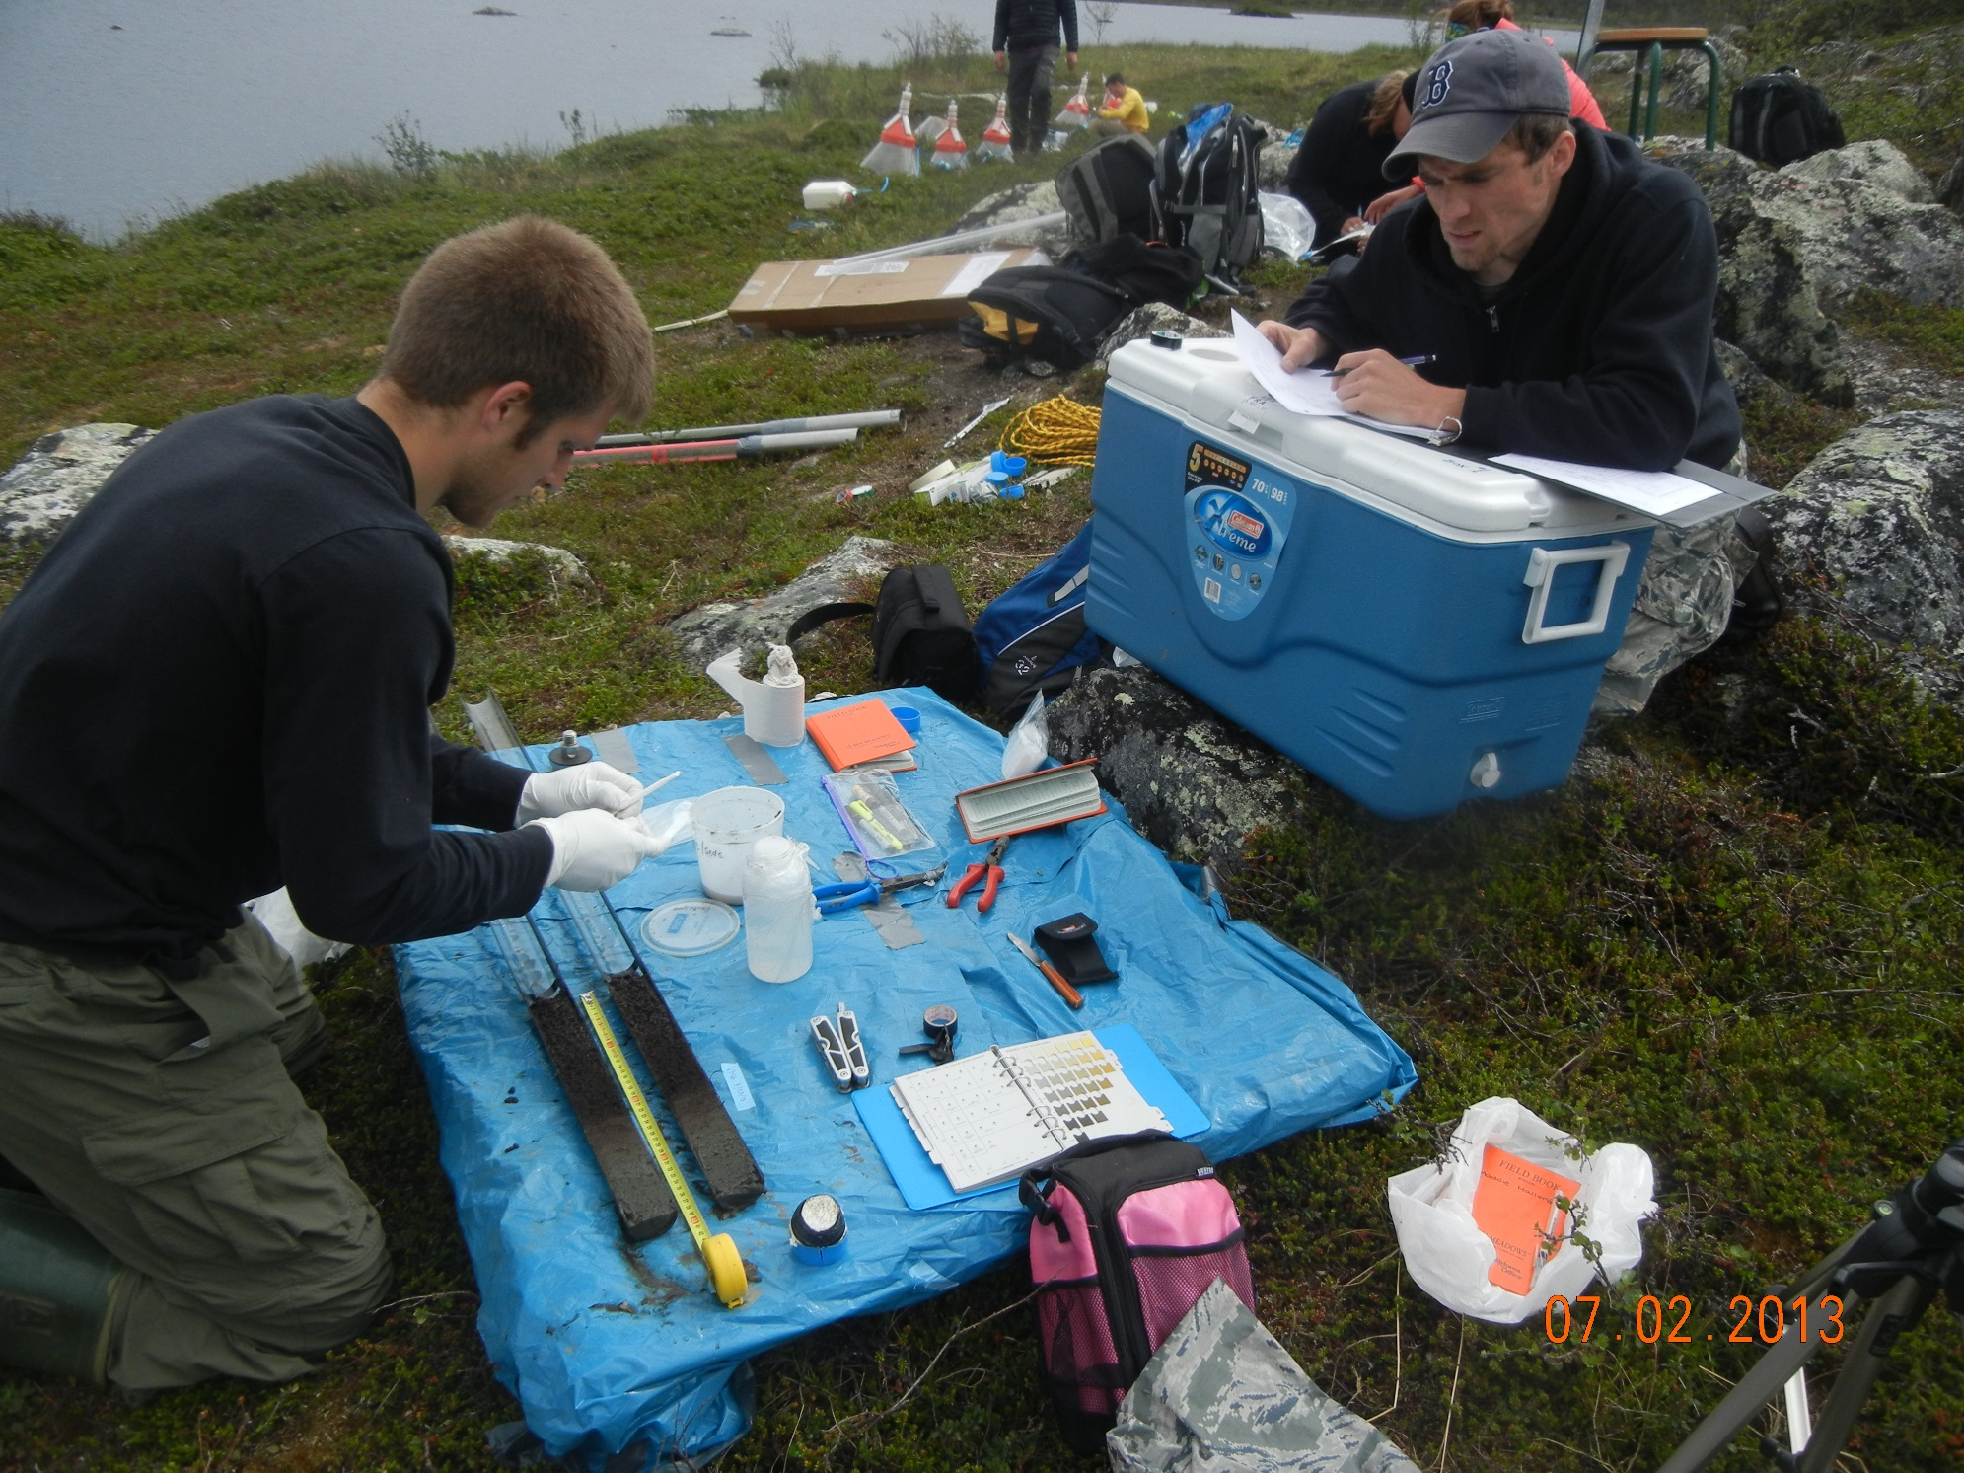
Methane and Carbon Dioxide Production Rates in Lake Sediments from Sub-Arctic Sweden
Joel DeStasio¹, Madison Halloran², Lance Erickson³, Ruth K Varner⁴, Joel E Johnson⁵, Jacob Setera⁵, Maria F Meana Prado⁵, Martin Wik⁶, Patrick M Crill⁶
1. Departments of Natural Resources and the Environment and Earth Sciences, University of New Hampshire, Durham, NH, United States. 2. Department of Environmental Studies, Carleton College, Northfield, MN, United States. 3. Department of Geology, Gustavus Adolphus College, St. Peter, MN, United States. 4. Institute for the Study of Earth, Oceans, and Space, University of New Hampshire, Durham, NH, United States.5. Department of Earth Sciences, University of New Hampshire, Durham, NH, United States. 6. Department of Geological Studies, Stockholm University, Stockholm, Sweden.
Introduction
Ecosystems at high latitudes are undergoing rapid change due to amplified atmospheric warming. Lakes in these regions are sources of both methane (CH₄) and carbon dioxide (CO₂) to the atmosphere and will likely be impacted by elevated temperatures.
CH₄ and CO₂ production potential of sediments were studied using cores from three lakes in the Stordalen Mire complex in sub-Arctic, Sweden: Inre Harrsjön, Mellan Harrsjön, and Villasjön.
Sediment cores were incubated to determine CO₂ and CH₄ production rates and were analyzed for CH₄ concentrations, dissolved inorganic carbon (DIC) concentrations, total organic carbon (TOC) concentrations, as well as carbon, nitrogen and sulfur content.
Results
Hypotheses
Sediments from areas within Villasjön known to have the highest rates of CH₄ ebullition (western end of VM transect) will yield the highest CH₄ concentrations and production rates.
CH₄ and CO₂ concentrations and production rates will be highest in organic rich sediments containing the highest TOC .
Figure 2: CO₂ flux rates for samples taken at eastern & western most points of transect VM. Samples taken from Villasjön.
Figure 3: CO₂ flux rates for samples taken at eastern & western most points of transect VM. Samples taken from Villasjön.
Figure 4: CO₂ vs. TOC weight % from samples taken from cores VI1 and VI2. Samples taken from Villasjön.
TOC Content vs. Sediment Depth in Villasjön
Research site:
Inre Harrsjön
Figure 1 (Right): Stordalen Mire complex. The 2 uppermost lakes are Inre Harrsjön and Mellan Harrsjön. Villasjön is the largest of the three lakes, located at the bottom right. The marked points indicate where each sample core set was taken.
Photo courtesy of Google Maps, 2013
Mellan Harrsjön
Villasjön
Figure 5: CO₂ flux rates for samples taken at eastern & western most points of transect VM. Samples taken from Villasjön.
Figure 6: CO₂ flux rates for samples taken at eastern & western most points of transect VM. Samples taken from Villasjön.
Figure 7: Total organic carbon (TOC) content for VM & VP transect core samples. Samples taken from Villasjön.
Methods
Cores were taken along 2 perpendicular transects within Villasjön: VM & VP. 2 sediment cores were taken at each sample site in Villasjön. Cores were sampled for CH₄ concentrations, TOC, S, N & C. Additional sediment cores were also taken from each end of the VM1 transect (VI1 and VI2) for CO2 and CH4 production rate analysis.
Villasjön (VM Transect):
Inre Harrsjön & Mellan Harrsjön (Sites MD1, MS1, ID1 & IS1):
2 sets of samples were taken from each lake; Inre Harrsjön (IS1 &ID1) & Mellan Harrsjön (MS1 & MD1). Each sample set consisted of 4 individual sediment cores:
- The first core was sub-sampled for CH₄ incubation . Duplicate 2 cm³ sub-samples from this core were taken at surface, middle and maximum sediment depths.
- The second core was sub-sampled for bulk CH₄ concentration in increments of 5cm along the length of the core. Samples were stored in sealed 30mL vials.
Figure 8: CH₄ concentrations vs. sediment depth along VP transect. Samples taken from Villasjön.
Figure 9: CH₄ concentrations vs. sediment depth along VM transect. Samples taken from Villasjön.
Figure 10: CH₄ concentrations per sediment depth from cores ID1, IS1, MD1 &MS1. Samples taken from Inre Harrsjön & Mellan Harrsjön.
Conclusions and Future Work
Villasjön cores indicate that CH₄ production rates were highest at the same sediment depths as peak dissolved CH₄ concentrations, with maximum values between depths of approximately 10cm and 30cm (Figures 5,6,8 & 9).
CH₄ production was highest in areas of Villasjön known to have the highest rates of CH₄ ebullition.
CO₂ production was highest in surface sediments ranging from about 4cm to 11cm in depth, with rates displaying a steady decrease below 11cm (Figures 2 & 3).
CO₂ production correlated with total organic carbon (TOC) concentrations with respect to sediment depth. (Figures 2-4 & 7).
Future isotopic analysis of sediment & headspace samples will help determine if the ages between sampled CH₄ and sediment match or differ. Older CH₄ would indicate production may be occurring at depths below what we have sampled.
The third core was sub-sampled for bulk total
organic carbon (TOC), carbon, sulfur and nitrogen concentrations in increments of cm along the length of the core.
- The fourth core was sub-sampled every 5cm using Rhizons to extract pore water samples for dissolved inorganic carbon (DIC) content.
Acknowledgements
Special thanks to Mr. Dana Hamel, Dr. and Mrs. Arthur G. Rand, Georgeann Murphy, Peter Akerman, ANS and the Northern Ecosystems Research for Undergraduates program (NSF REU site EAR#1063037) for making this project possible. Additional thanks to my research mentors, Dr. Ruth Varner and Dr. Joel Johnson
Photo: Ruth Varner

