Slide 1

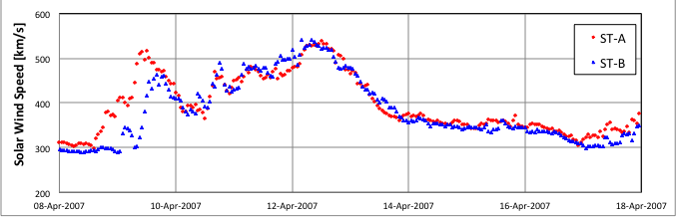
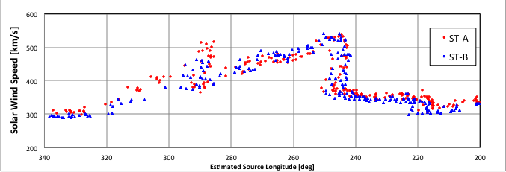
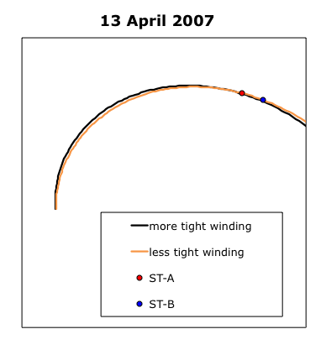
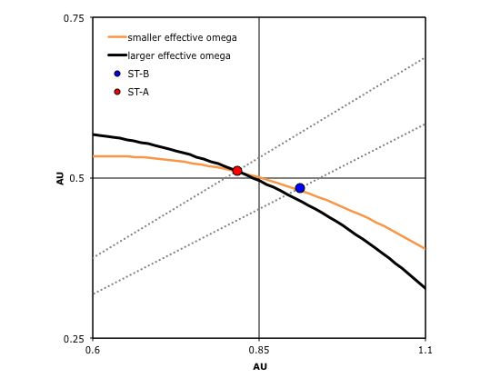
In Situ Observations of Corotating Rarefaction Regions with STEREO
SH13A – 2048
K.D.C. Simunac*, A.B. Galvin, and N.A. Schwadron
University of New Hampshire, Durham, NH
*K.Simunac@unh.edu
Abstract
It has been observed that the in situ magnetic fields of corotating rarefaction regions (CRRs) are underwound (i.e. closer to radial) compared to the nominal Parker spiral angle. One suggested explanation for the underwinding is footpoint motion of the solar wind source region. Schwadron (2002) presents a model that can be used to calculate the angular speed of the footpoint motion using in situ observations of magnetic field and solar wind speed. This model is applied to 12 CRRs observed by both STEREO observatories from March through May 2007, when temporal and spatial separation between the spacecraft is minimal. We calculate the effective angular speed of the source region (solar rotation plus footpoint motion) at both STEREO-A and STEREO-B using the Schwadron (2002) model. An alternative geometric technique (possible with multiple in situ observations of the same CRR) is also used to calculate the effective angular speed of the source region. We find the three effective angular speeds calculated for each CRR generally do not agree with one another..
Example
From 12 - 13 April 2007 the observed solar wind speed at ST-A and ST-B followed a similar decline from about 540 km/s to about 350 km/s, so δV = 190 km/s and the median V is 445 km/s. This material maps to a source region about 7.96 degrees wide, or a longitudinal spread δ𝜙 = 0.14 radians. During this same time interval the median value of B_{T}/B_{R} is -0.76 (giving α = -37.2°; underwound compared to the nominal Parker spiral angle of -43.1°). Plugging in for spacecraft coordinates and assuming Ω_{Sun} = 14.38 degrees/day = 2.905 x 10⁻⁶ rad/s (Newton and Nunn, 1951), we can solve for ω. (Because we are near the ecliptic plane sin θ ≈ 1.)
A similar calculation for ST-B where the median value of B_{T}/B_{R} is -0.59 yields Ω_{eff} = 2.48x10⁻⁶ rad/s.
Next we solve for Ω_{eff} using the Carrington coordinates of the two STEREO spacecraft when they encounter the CRR.
This suggests the large-scale structure of the CRR is overwound, which is at variance with the observed underwound magnetic field. Overwinding is supported by the fact that the CRR arrives several hours later than expected at ST-B. As shown in the figures below, a less tightly wound spiral can arrive at ST-A and ST-B almost simultaneously, while the more tightly wound spiral arrives first at ST-A and later at ST-B, which agrees with observation.
The left hand panel is drawn to scale and shows the in-ecliptic locations of the STEREO spacecraft on 13 April 2007. The orange and black Parker spirals represent a 455 km/s stream with Ω_{eff} = 2.74x10⁻⁶ rad/s and Ω_{eff} = 3.56x10⁻⁶ rad/s respectively. The right hand panel shows a close up of the region where the Parker spirals encounter the spacecraft. The dotted grey lines indicate the radial paths from the Sun to the spacecraft, along which the solar wind flows. The winding of the Parker spiral has been exaggerated in the right hand panel (but not the left) to emphasize how the winding angle influences the time of arrival at the two spacecraft with the orange curve arriving almost simultaneously at ST-A and ST-B, but the black curve arrives first at ST-A and later at ST-B.
Summary and Discussion
It is important to note that the choice of averaging used on the in situ magnetic field data can result in substantial changes to the value of ω, sometimes even changing in its sign. In this study we used the median value observed in each CRR because a small value of B_{R} can result in one ratio of B_{T}/B_{R} that dominates the mean.
Another point of caution is that while the CRRs examined here were selected for study because of the minimal separation between the two STEREO spacecraft (< 8 degrees longitude, corresponding to several hours of time), the solar wind speed profiles were not always identical from one spacecraft to the next. Possible explanations include source region evolution, connection to different sources, and evolution that occurred somewhere en route to 1 AU.
Effective angular speeds have been calculated for thirteen CRRs observed by both STEREO spacecraft in the first half of 2007. Using the two measurement point (geometric) technique, 11 of 13 CRRs had Ω_{eff} > Ω_{Sun}, indicating an overwound geometry. Using the in situ B-field measurements and the Schwadron model at ST-A, all 13 cases had Ω_{eff} ≤ Ω_{Sun}, consistent with an underwound magnetic field. At ST-B, 11 cases had Ω_{eff} < Ω_{Sun}, and 2 cases had Ω_{eff} > Ω_{Sun}. The calculated values for effective omega were not consistent from one spacecraft to another, nor between the Schwadron model and the two-point geometric technique. However, averaging over all 13 CRRs the Schwadron model yields an average Ω_{eff} of 0.8Ω_{Sun} at both ST-A and ST-B. This is consistent with the best fit result of Smith (2013) who was looking at CRRs observed between 1.5 and 4 AU with Pioneer 10 and 11.
Solar Wind Speed versus Time
Introduction
Under the frozen-in assumption, the geometry of large-scale solar wind structures and their frozen-in interplanetary magnetic fields were theorized by Parker (1963) to take the shape of an Archimedean spiral (created by the Sun’s rotation), with the tightness of the winding depending on the solar wind speed. At a radial distance R from the Sun, at colatitude θ, the angle between the Parker spiral and a radial vector is given by:
[1]
Where α is the azimuthal “garden hose” angle, Ω_{Sun} is the Sun’s angular rotation speed, and V is the solar wind speed. The slower the solar wind speed, the tighter the winding angle.
Observations have shown (c.f. Forsyth et al. 1996) the Parker model does give the most probable value of the magnetic field’s azimuthal orientation (tan ϕ_{B} = B_{T}/B_{R}). However, significant deviations from the idealized Parker spiral are seen at corotating interaction regions (CIRs) where the solar wind speed increases, and at the corresponding transitions from fast to slow wind, corotating rarefaction regions (CRRs). One explanation for the observed variance of the in situ magnetic field at CRRs is motion of the solar wind source region footpoints (Murphy, Smith, and Schwadron 2002). This would result in an effective angular speed (Ω_{eff}) of the source region that is not equal to Ω_{Sun}.
Schwadron (2002) presented a footpoint motion model that can be used to calculate the expected deviation from the Parker spiral.
[2]
The difference between Ω_{Sun} and Ω_{eff} is given by ω. δV/δ𝜙 is the solar wind velocity shear. δV is the change in solar wind speed from the fast stream to the slow, and δ𝜙 is the longitudinal extent of the source region over which the transition occurs, which can be estimated using ballistic mapping (Murphy, Smith, and Schwadron 2002; Smith 2013). The relationship above can be inverted to solve for ω using in situ measurements of B and V from a spacecraft at a known position (R, θ). Then Ω_{eff} = Ω_{Sun} + ω.
With the unique orbit of the STEREO mission, the same CRR can be observed at both spacecraft (ST-A and ST-B). The curvature of the CRR (and the effective angular speed of its source region), can be obtained using the coordinates of the two spacecraft when they respectively encounter the CRR.
[3]
R_{A} and R_{B} are the respective orbital radii of ST-A and ST-B, ϕ_{A} and ϕ_{B} are the spacecraft longitudes in the Carrington coordinate system, and V is the observed solar wind speed.
In this study we have calculated the effective angular speed of the solar wind source region using both the Schwadron model and the two-point measurement technique for thirteen CRRs observed early in the STEREO mission (March – early May 2007) when both temporal and spatial separations between the two spacecraft were small (so there is minimal opportunity for changes at the source region). The results of the two techniques were then compared for consistency.
Solar Wind Speed versus Mapped Source Longitude
References
Forsyth, R.J. et al., The underlying Parker spiral structure in the Ulysses magnetic field observations, 1990 – 1994, J. Geophys. Res., 101, 395, 1996.
Murphy, N., Smith, E.J., and Schwadron, N.A., Strongly underwound magnetic fields in co-rotating rarefaction regions: Observations and Implications, Geophys. Res. Lett., 29, 23-1, 2002.
Newton, H.W., and Nunn, M.L., The sun’s rotation derived from sunspots 1934 – 1944 and additional results, Mon. Not. Roy. Astron. Soc., 111, 413, 1951.
Parker, E.N., Interplanetary Dynamical Processes. New York: Wiley-Interscience, 1963.
Schwadron, N.A., An explanation for strongly underwound magnetic field in co-rotating rarefaction regions and its relationship to footpoint motion on the sun, Geophys. Res. Lett., 29, 8-1, 2002.
Smith, E.J., Large deviations of the magnetic field from the Parker spiral in CRRs: Validity of the Schwadron model, J. Geophys. Res., 118, 58, 2013.
Acknowledgements
This work was supported under NASA contract NAS5-00132 and NASA Grant NNX13AP52G.

