Slide 1

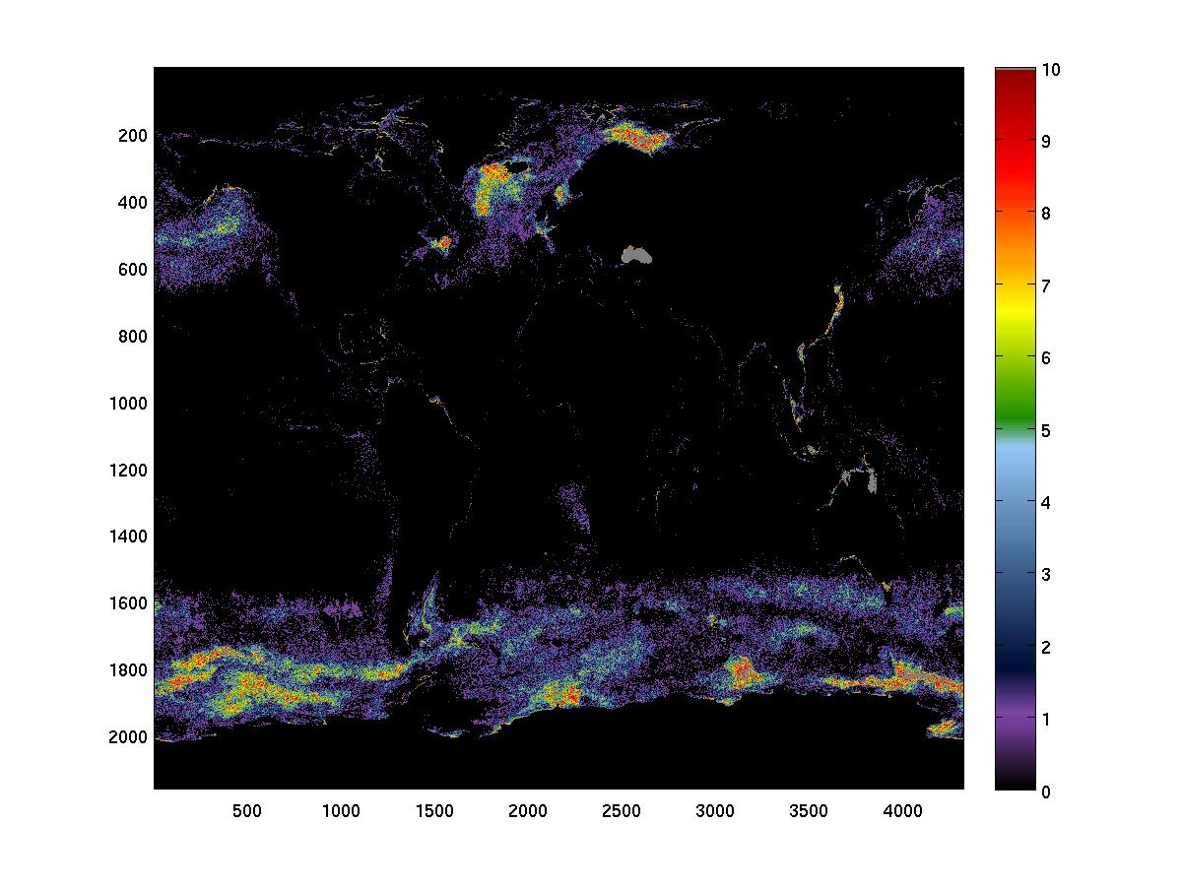
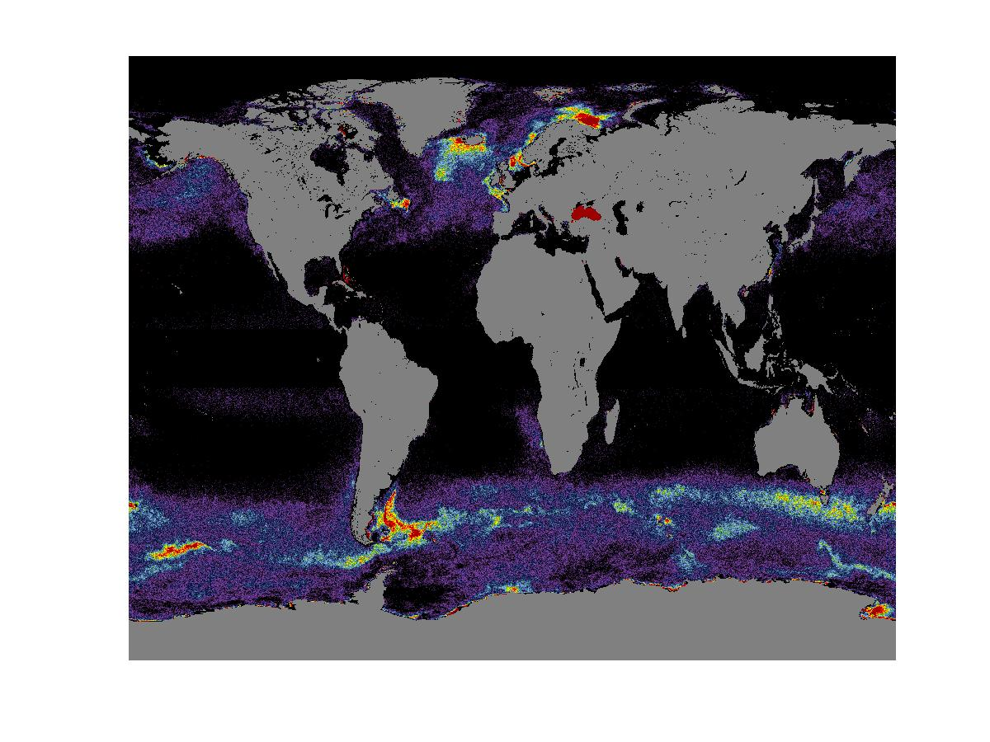
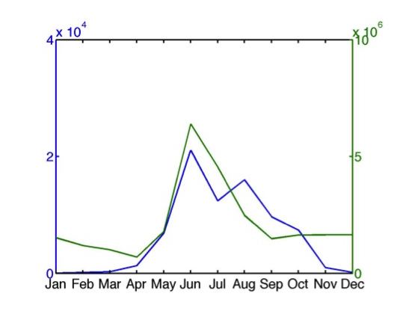
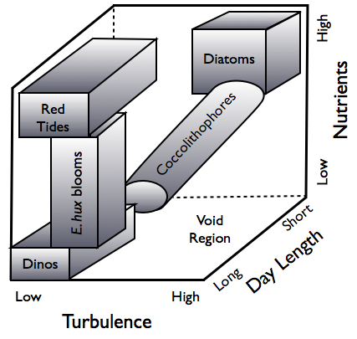
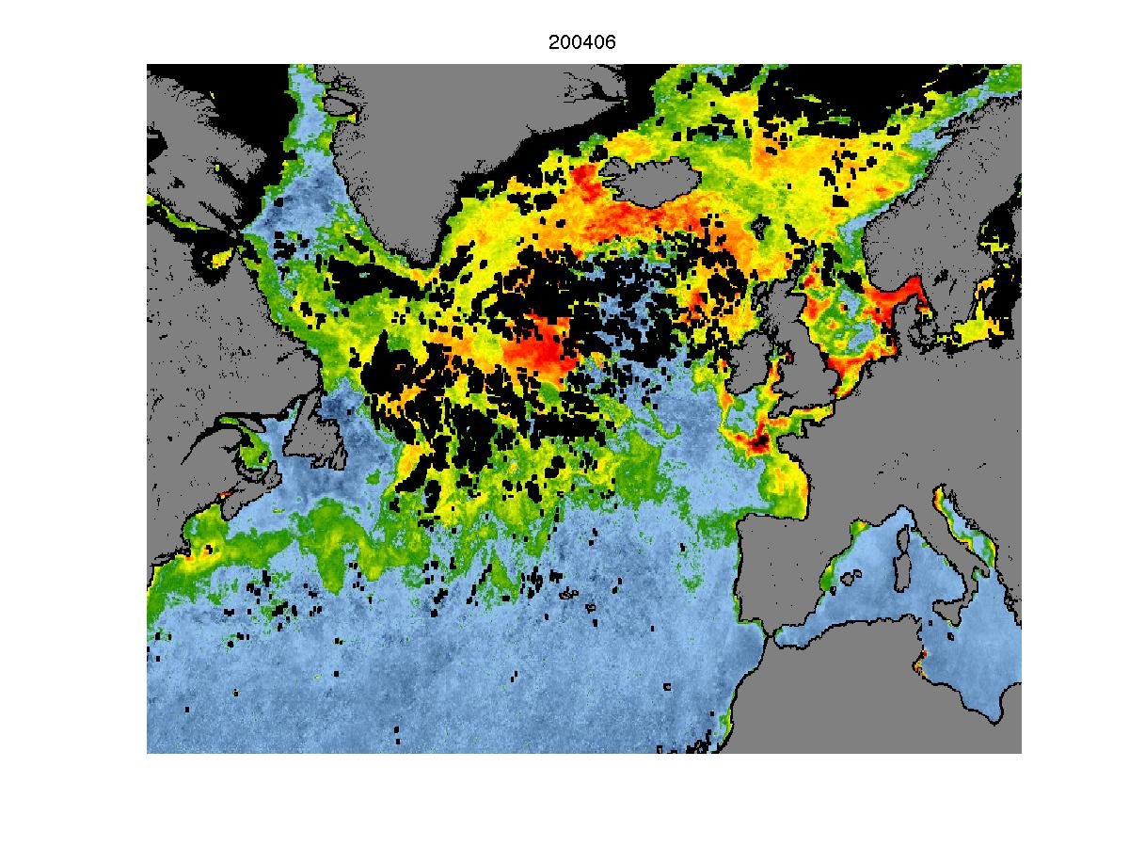
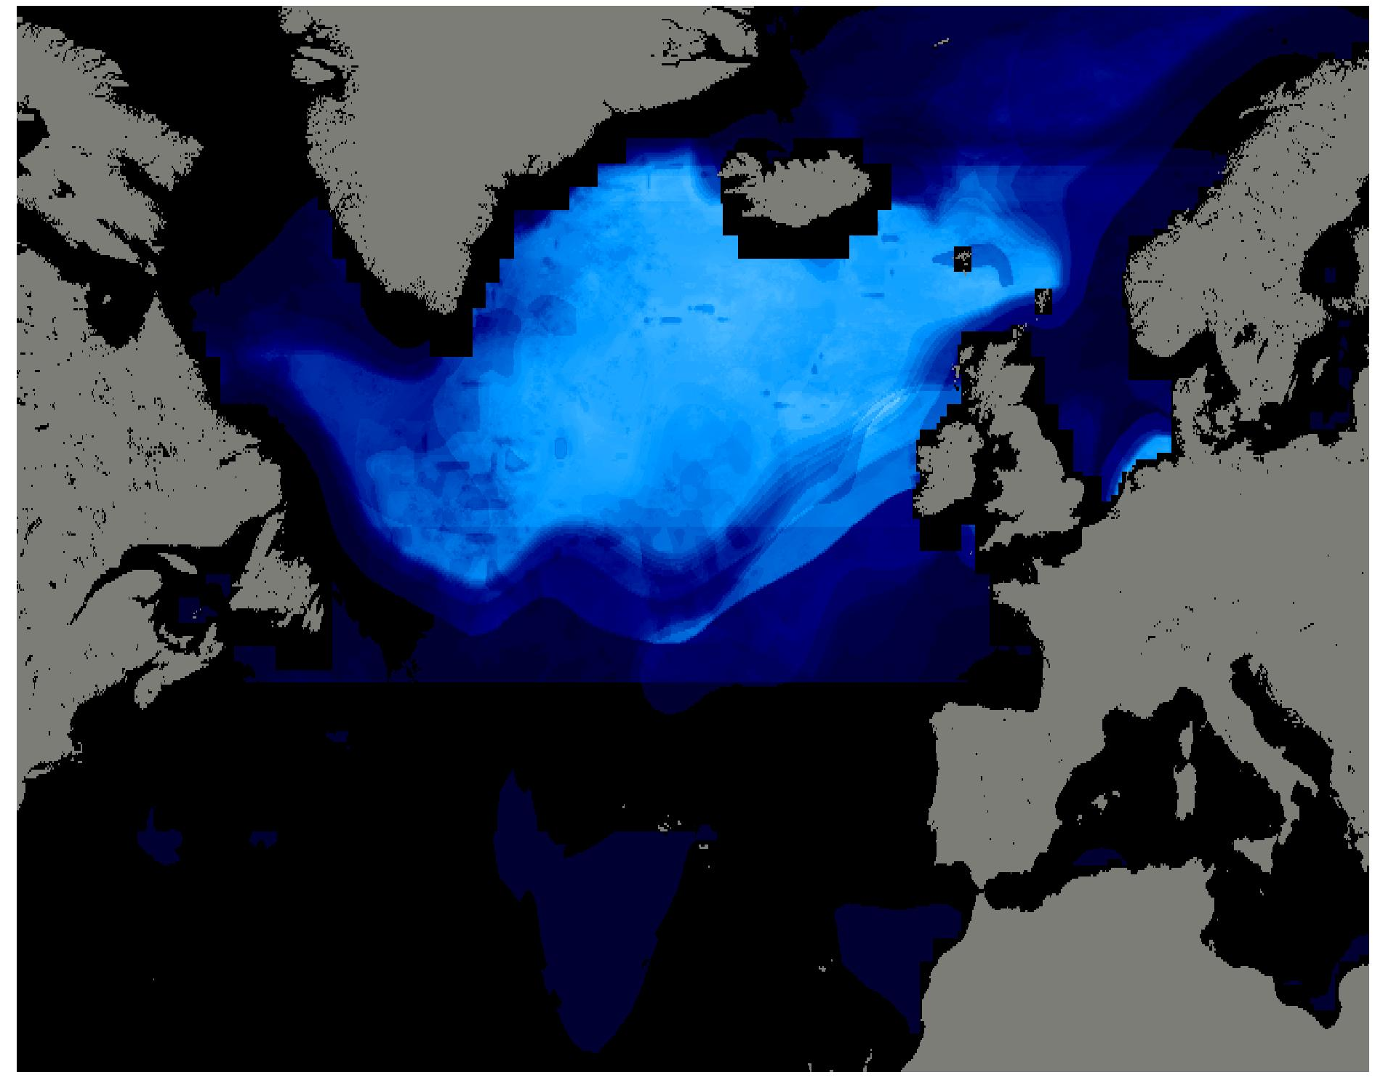
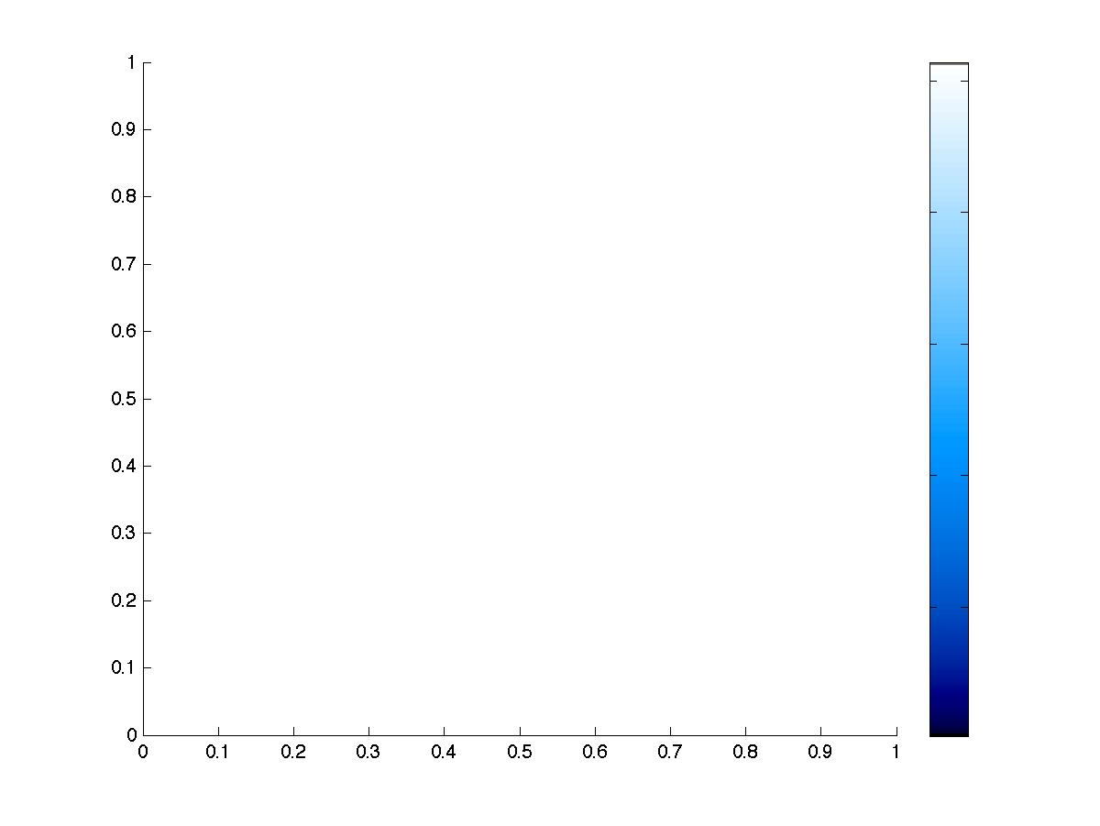
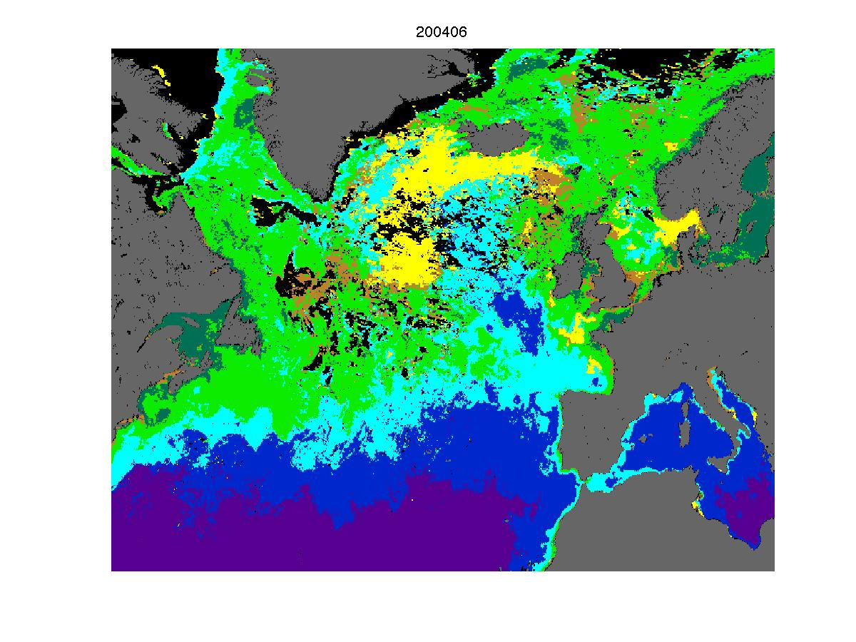
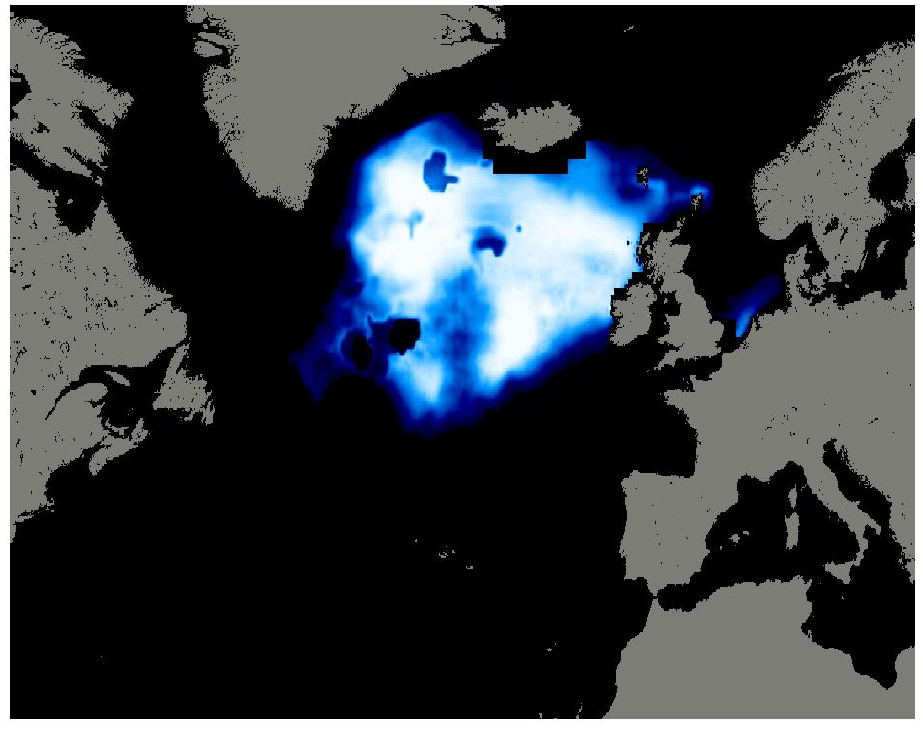
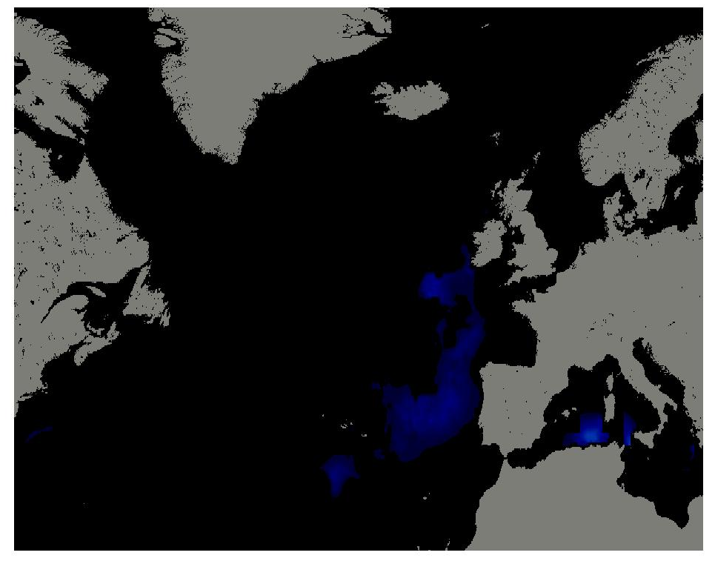
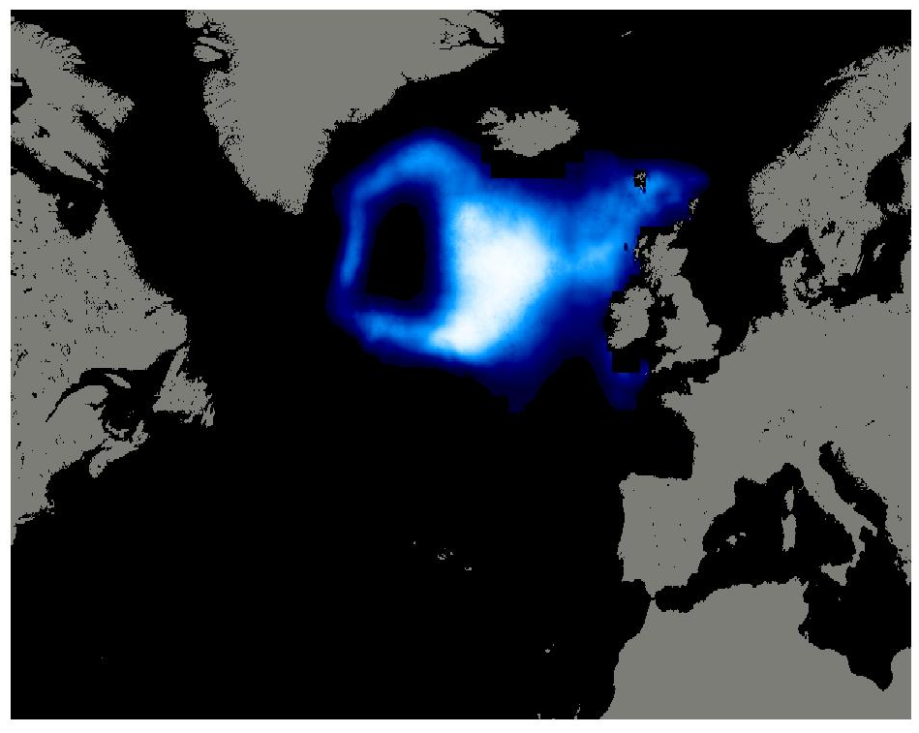
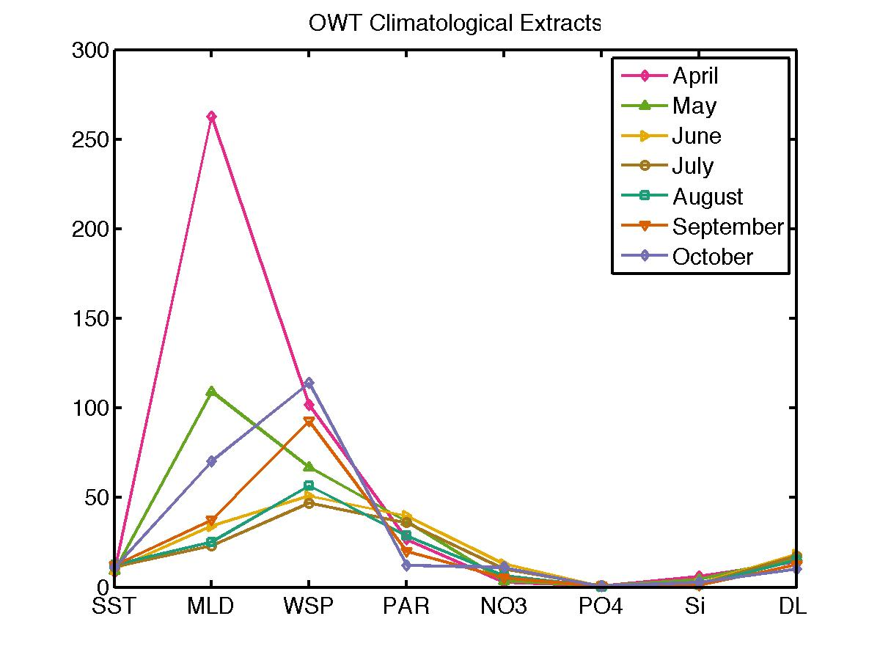
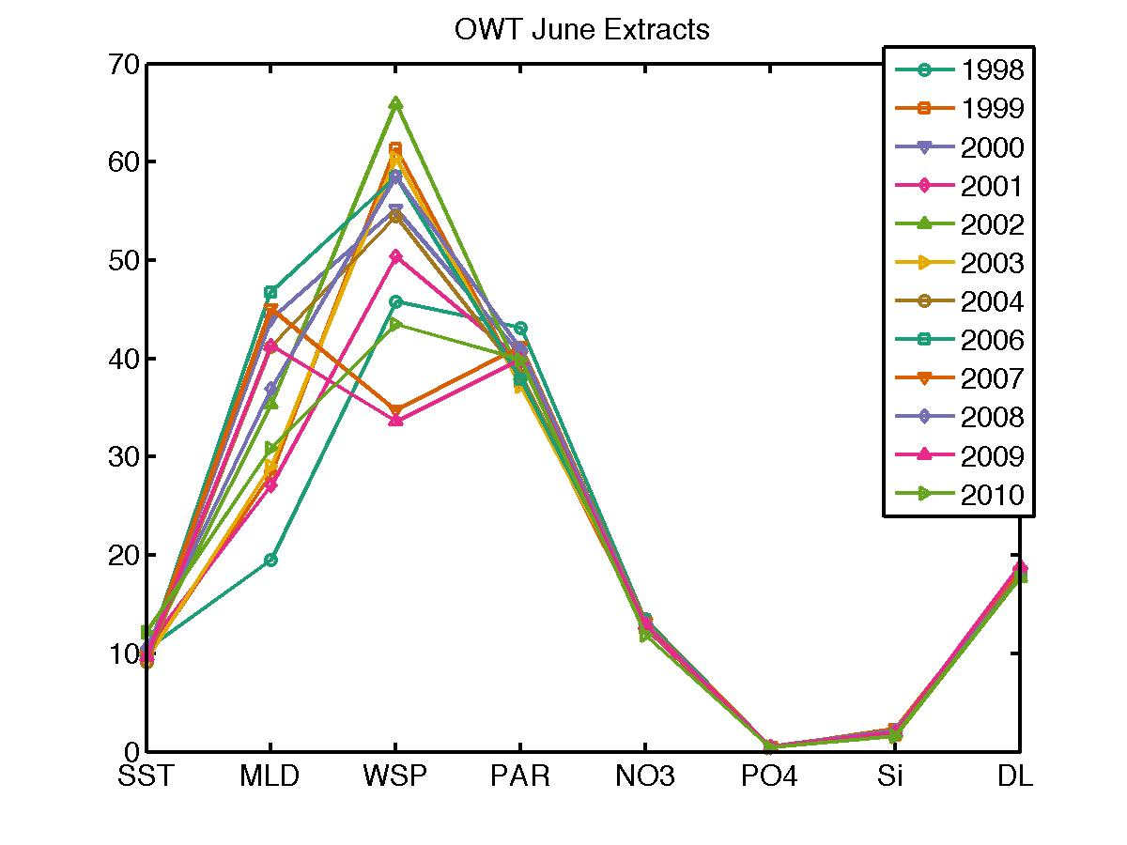
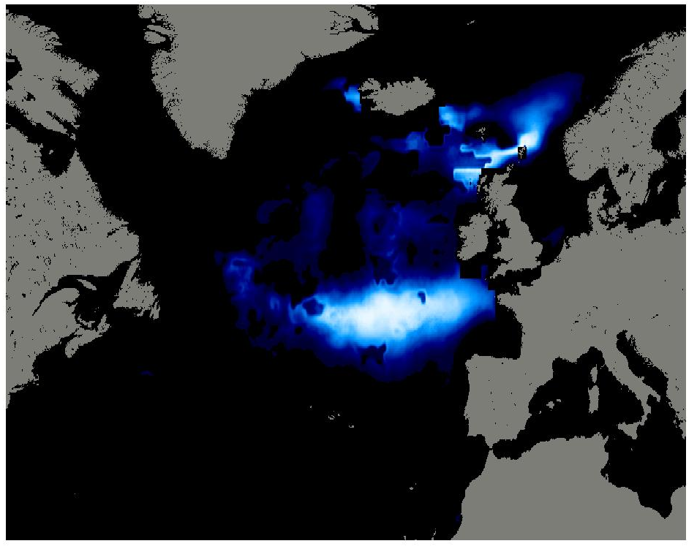
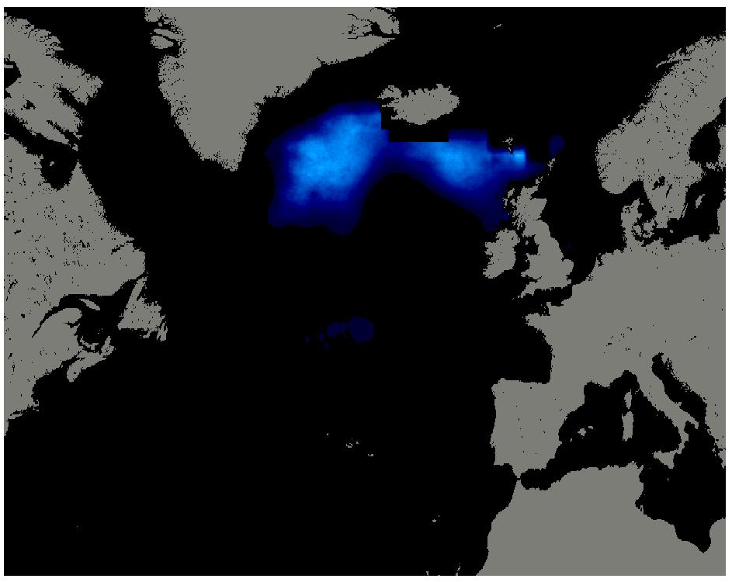
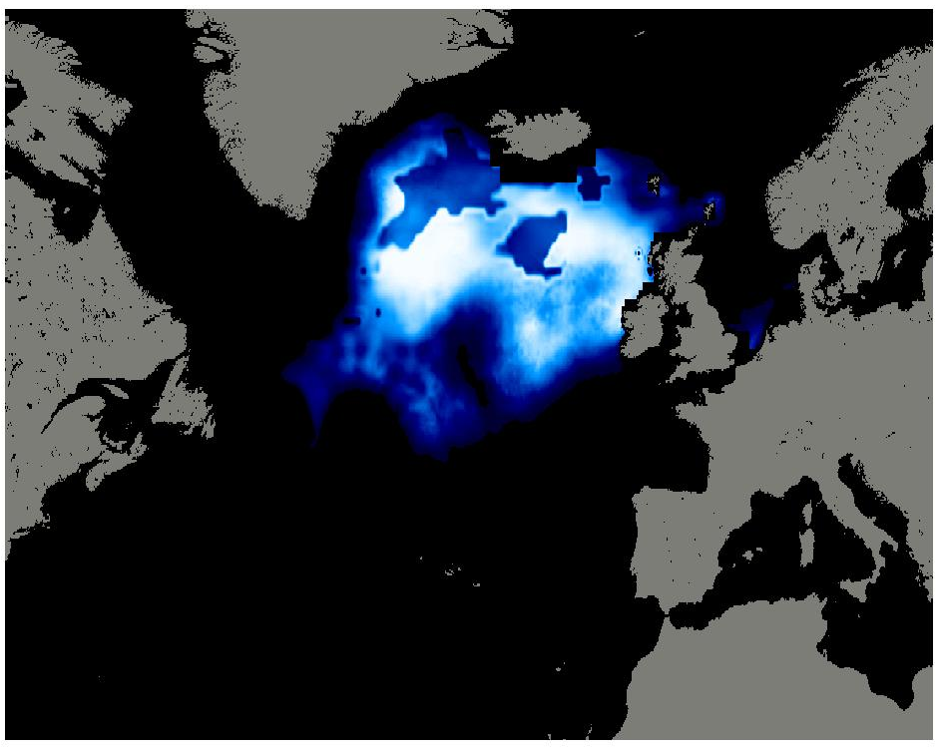
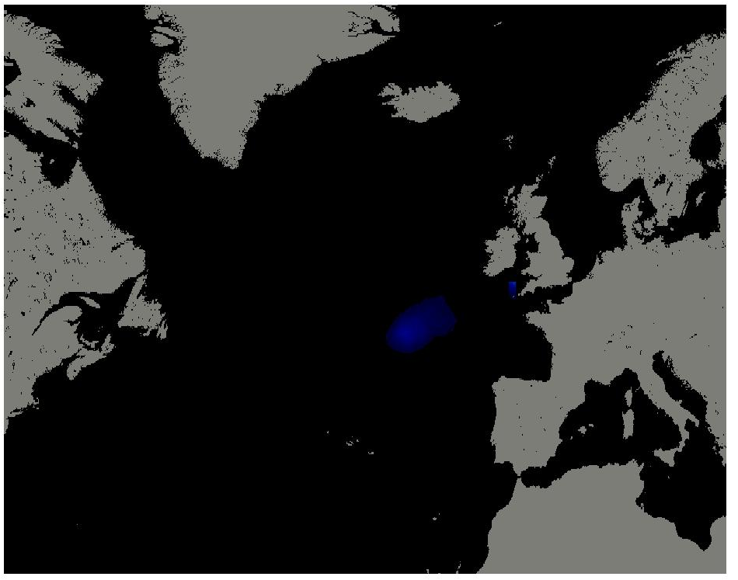
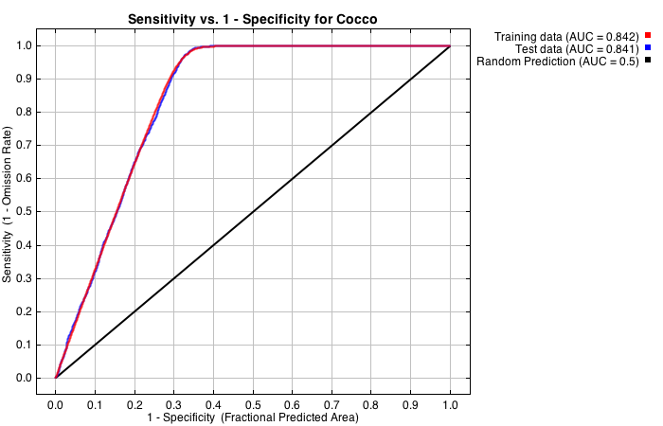
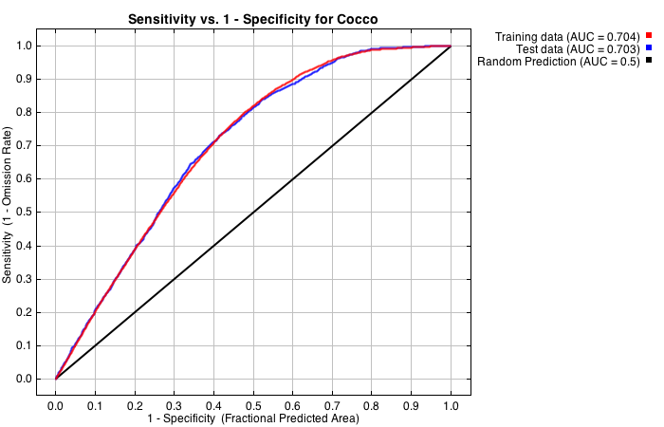
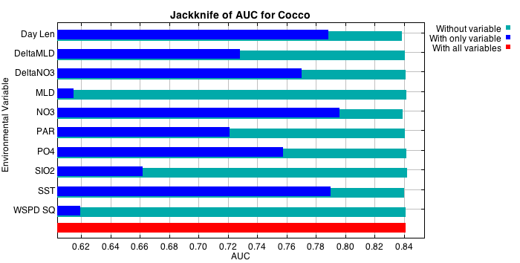
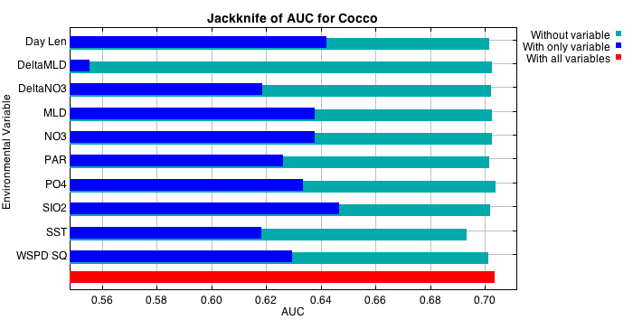
PROJECTING THE ENVIRONMENTAL NICHE FOR SUMMERTIME COCCOLITHOPHORE BLOOMS
IN THE NORTH ATLANTIC
Timothy S. Moore
University of New Hampshire, Durham NH 03824
timothy.moore@unh.edu
ABSTRACT
Coccolithophore blooms are one of the few phytoplankton species-specific ocean phenomena that are distinguishable from ocean color satellite observations. These blooms, dominated by the species Emiliania huxleyi (E. hux.) in specific geographic regions. Niches have been identified (Figure 1), and niche concepts have been applied to predict bloom occurrence (Iglesias-Rodgriguez et al., 2002). In this work, the niche approach is re-visited with two statistical niche models developed from satellite data, and used to generate bloom prediction maps for a region to the south of Iceland in the North Atlantic Ocean – an area of frequent E. hux. blooms in the summertime.
RESULTS:
MaxEnt and the Gaussian model show similar geographic distributions for the presence of blooms using the same input variables (Figure 5).
Predicted E. hux bloom distributions from environmental variables show similar patterns to elevated PIC levels and coccolithophore bloom mask from ocean color.
The seasonal progression evolves over space and time: niche space increases in size and latitude from spring to summer, and then decreasing from late summer to fall (Figure 6).
%
30
27
24
June 2004
21
18
cell counts
km²
15
Probability
12
9
1
6
June 2004
3
0
PIC
MaxEnt
Figure 2. Left: Coccolithophore bloom frequency in the North Atlantic from SeaWiFS imagery as percentage (box shows boundaries for study region for bloom analysis); Right: Climatology of coccolithophore counts (blue) from CPR data, and monthly averaged area of satellite bloom pixels from SeaWiFS (green) in the study region.
DATA
Continuous Plankton Recorder (CPR) data and satellite ocean color images of coccolithophore blooms from SeaWiFS global data were used as templates to extract co-matched environmental variables at the monthly time scale (Table 1). The dynamic variables used were SST, PAR, MLD, wind, and day length. Static nutrient climatologies were also used. These data were used to define the niche space favorable to bloom development in a region south of Iceland (Figure 2). As the interest is in the environment favorable to blooms, only months with growing populations were used for the niche characterization (April through June). Satellite observations were verified with data collected from the CPR for coccolithophore counts, and similar trends/characterisitics were observed. The remaining analyses were based on the SeaWiFS coccolithophore extractions.
Figure 1. The niche space for coccolithophores adapted to a 3-D extension of the Margalef Mandala (Balch, 2004).
OWT
Gaussian
0
Figure 5. Comparisons of observations and models for June 2004. Top Left: PIC concentration; Bottom Left: Optical water type classification (yellow=coccolithophore bloom); Top Right: MaxEnt distribution prediction; Bottom Right: Gaussian niche model prediction.
Table 1. Environmental data sets used for niche characterization.
April
July
Probability
Variable | Source | Scale
PAR | GSFC | 9km, monthly
MLD | OSU | 9km, monthly
Wind Speed | IFREMER | 25km, monthly
NO3,PO4,SiO2 | NODC | 1 degree, monthly climatology
SST | GSFC | 9km, monthly
Day Length | Calculated | 9km, monthly
1
Figure 3. Left: climatological means of variables associated with coccolithophore blooms. Blooms increased from April to June in the North Atlantic. Right: variation of mean variables for June (peak month).
May
August
0
NICHE MODELS
Two niche statistical niche models were developed to predict the niche space for coccolithophore blooms - one using MaxEnt (Phillips et al., 2006) and the second is based on a Gaussian probability model. Each model was tuned with a subset of the environmental data (10 variables in all – see Figure 4) extracted from the gridded ocean data associated with coccolithophore blooms. MaxEnt is a niche model based on maximum entropy, and is a popular statistical tool for predicting species distributions. The gaussian model is based on the multivariate distributions and a chi-square probability function. Each model used the same input data set, and were evaluated for the prediction of niche space on gridded data.
June
September
Figure 6. Gaussian niche model prediction for monthly data in 2003. High probability indicates the likelihood of bloom development based on favorable environmental factors. Bloom area increases from April to June (peak), then declines post-June. There is a general northward progression from April to June.
CONCLUSIONS:
Statistical niche models can be applied to phytoplankton species presence when bottom-up forcing is the determining factor in governing their distribution.
These models represent a projection of the fundamental and realized niche (pseudo niche) space for coccolithophore bloom events, not species distributions.
For E. hux., the fundamental niche occupies a much wider range of environmental variability (ubiquitous) compared to bloom conditions that peak in June in the North Atlantic.
MaxEnt and a Gaussian model both describe similar geographic niche distributions for the same set of environmental input variables.
These models offer a means to project ecological response of E. hux. blooms from extrapolating climate change models into the future.
Comparison of E. hux. bloom controls for other oceanic regions are needed to further assess the presence of any common factors in promoting blooms.
Figure 4. ROC and univariate sensitivity analysis (length of blue bars indicate a greater influence). Top Left: ROC using background data for all months (AUC=0.84). Top Right: ROC using background data for April to June months (AUC=0.70); Bottom Left: univariate model sensitivity using data for all months; Bottom Right: univariate model sensitivity using data for April to June months.
MaxEnt Results
Figure 4 shows the Receiver operating characteristic Curve (ROC), and sensitivity of the model for each environmental variable run on its own across presence and background data (Jackknife Test). The Area under ROC (AUC) summarizes the predictability with a single number: 1 is perfect; the AUC is shown to be 0.84 for all months, and 0.704 for bloom developing months: a random model will have AUC = 0.5. The Jackknife Test shows that SST, NO3, and Day Length are important for estimating distributions alone across all environments (higher blue bars) at the seasonal scale. During blooms periods, all variables are relatively important except the change in mixed layer depth (DeltaMLD).
References:
Balch, W. (2004). Coccolithophores: from molecular processes to global impact, chapter Reevaluation of the physiological ecology of coccolithophores. Springer-Verlag.
Iglesias-Rodriguez, M. D., Brown, C. W., Doney, S. C., Kleypas, J., Kolber, D., Kolber, Z.,(2002). Representing key phytoplankton functional groups in ocean carbon cycle models: Coccolithophorids. Global Biogeochemical Cycles, 16, doi:10.1029/2001GB001454.
Phillips, S. et al. 2006. Maximum entropy modeling of species geographic distributions. – Ecol. Model. 190: 231–259.
This project was funded by NASA grant NNX13AB64G.

