Slide 1

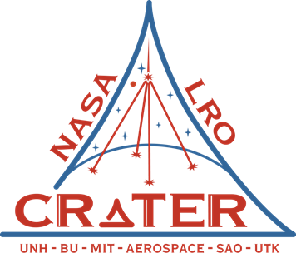
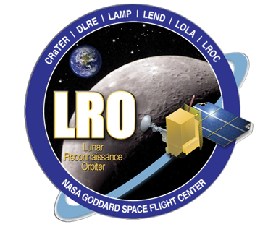
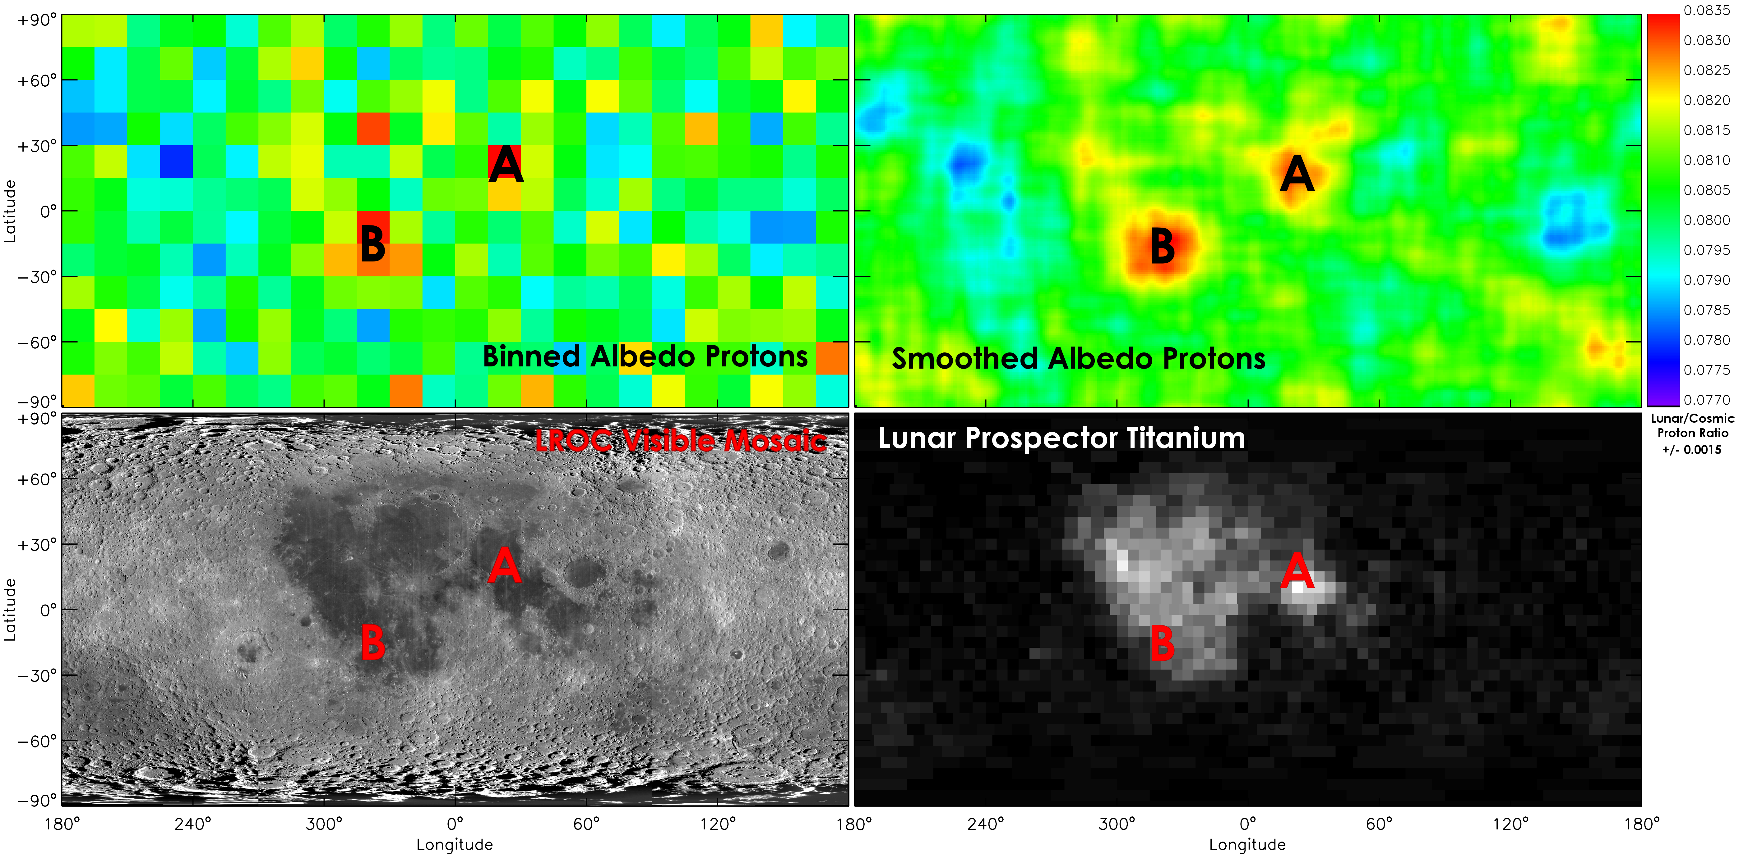
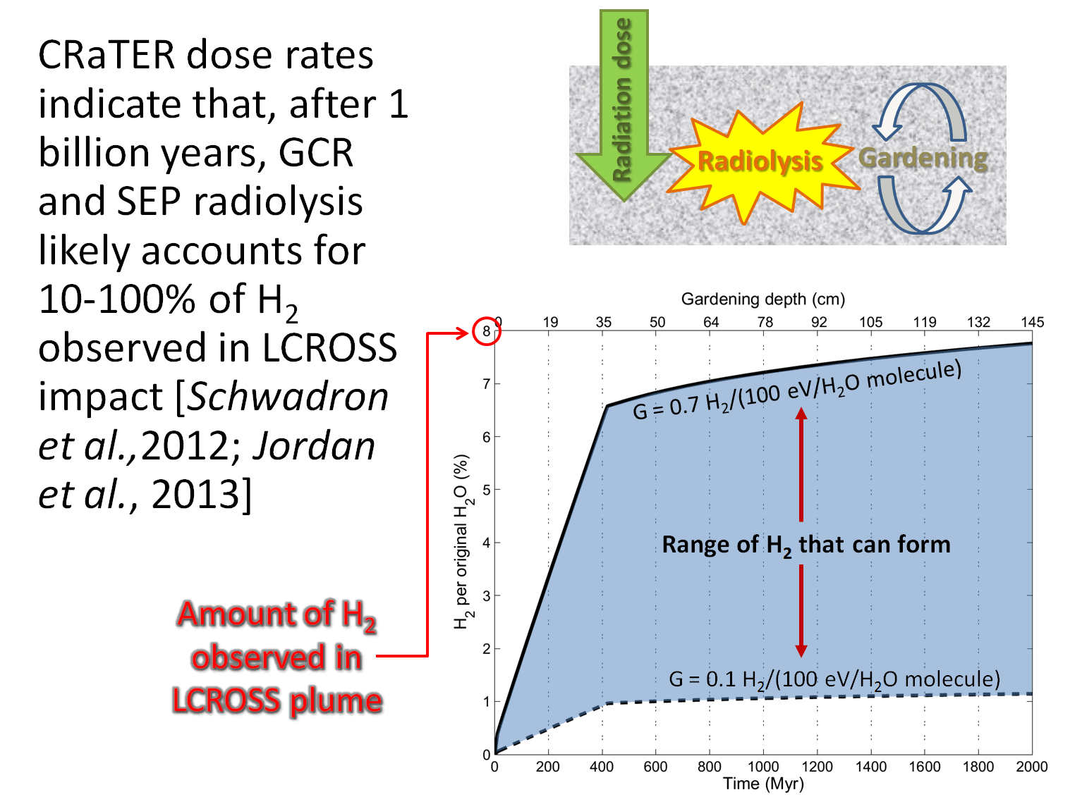
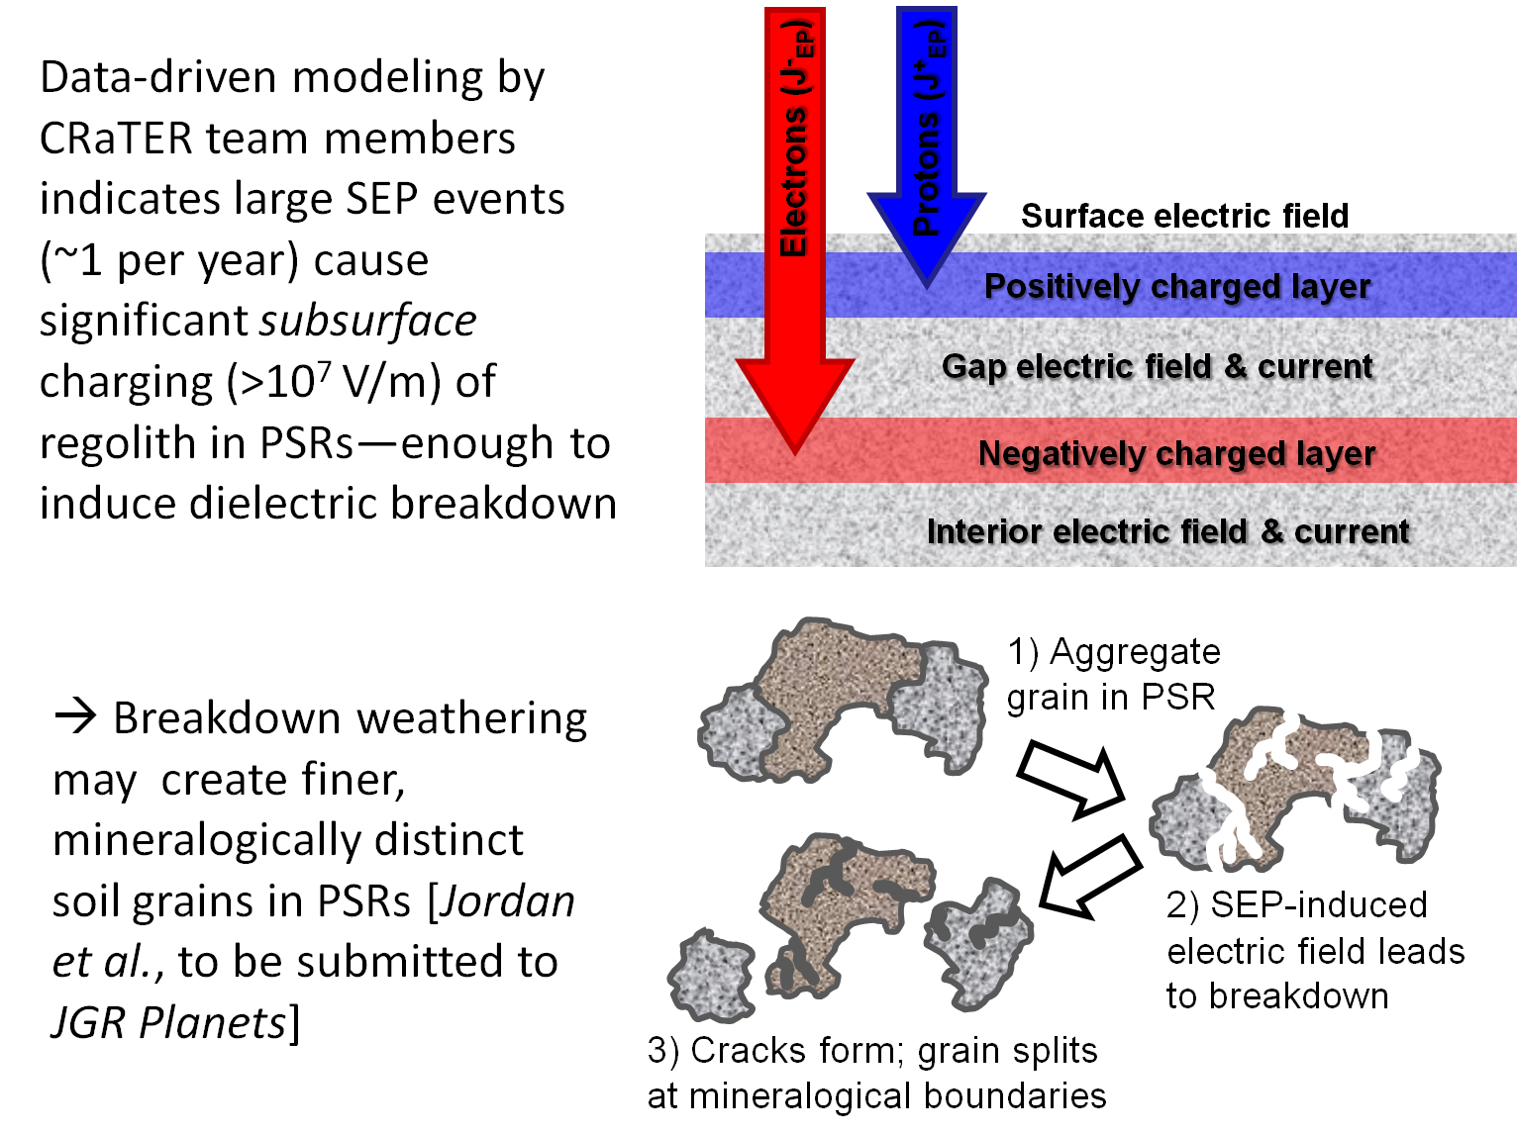
Localized Features in the Cosmic Ray Albedo Proton Map of the Moon
Jody K. Wilson¹ (jody.wilson@unh.edu), N. Schwadron¹, H. E. Spence¹, M. J. Golightly¹, A. W. Case^{2,7}, J. B. Blake³, J. Kasper^{2,7}, M. D. Looper³, J. E. Mazur³, L. W. Townsend⁴, C. Zeitlin⁵, T. J. Stubbs⁶
(1) Space Science Center, University of New Hampshire, Durham, NH; (2) High Energy Astrophysics Division, Harvard CFA, Cambridge, MA; (3) The Aerospace Corporation, Los Angeles, CA
(4) Dept. of Nuclear Engineering, Univ. of Tennessee, Knoxville, TN; (5) Southwest Research Inst., Boulder, CO; (6) NASA Goddard Space Flight Center, Greenbelt, MD; (7) NASA Lunar Science Inst.
Summary
We use “albedo” or “splash” protons with energies between ~60 and 150 MeV to construct a galactic cosmic ray (GCR) albedo proton map of the Moon. The yield of albedo protons is:
Yield = (Lunar proton rate) / (GCR proton rate)
We detect a statistically significant higher proton yield from the lunar maria compared to the lunar highlands, particularly at two localized spots which may be associated with specific elemental concentrations. We do not yet see any obvious small-scale features in the polar regions.
Albedo proton yield map compared with LROC visible map and LP titanium abundance map
Proton-bright spots “A” and “B”
Spots yield 4% ±2% more protons than lunar avg.
Both spots located on margins of maria
“A” centered close to Taurus-Littrow, between maria Serenitatis and Tranquillitatis
“A” near strongest titanium concentration
“B” between Maria Humorum & Procellarum
“B” has no matching feature in elemental maps
What affects the proton yield?
1. Elements which are more abundant in the maria (Fe, Ti, K) may yield more protons by spallation (evaporation or intra-nuclear cascades) than do other elements.
OR
2. Maria-enriching elements may have slightly higher cross-sections for GCR collisions (~1 GeV) compared to albedo proton collisions (~100 MeV), resulting in a shallower spallation source distribution from which albedo protons are more likely to escape to space.
OR
3. Unique chemical properties at certain mare margins (due to pyroclastic flows, perhaps?) may result in more efficient trapping of solar wind protons, leading to higher albedo proton yields from simple knock-on collisions of GCR protons with implanted H.
Additional results (Jordan et al.): H₂ formation & subsurface charging/breakdown in PSRs

