Slide 1


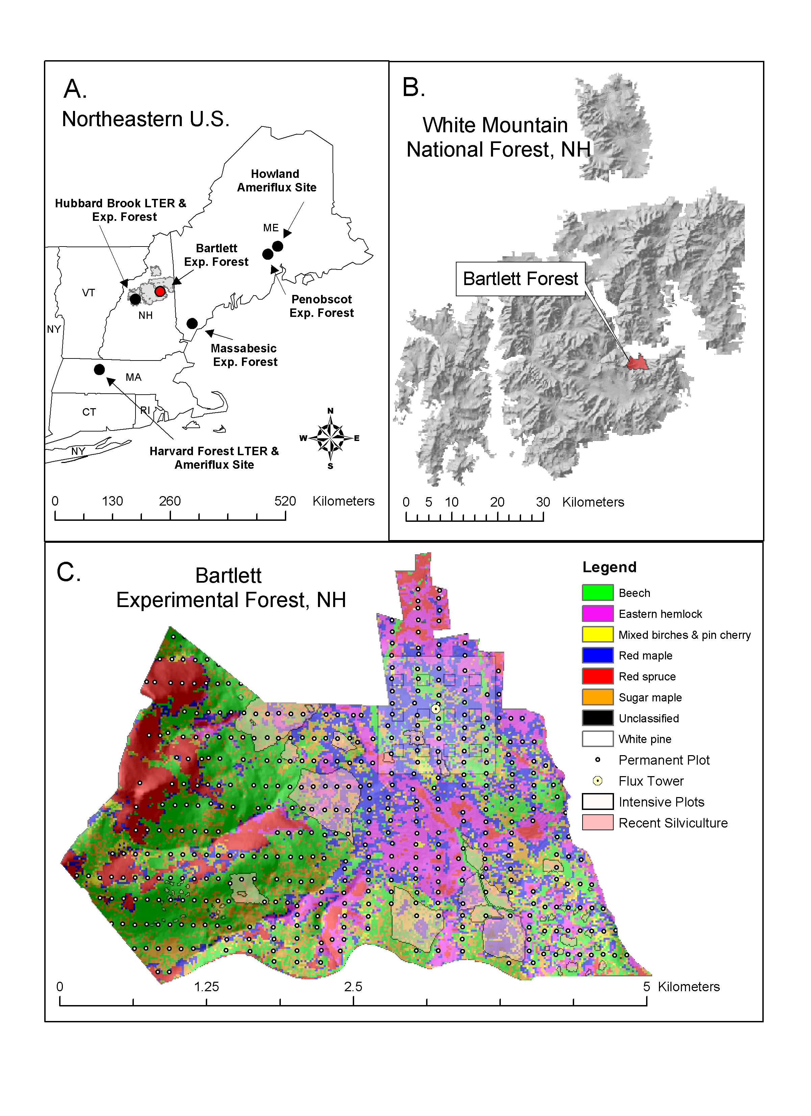
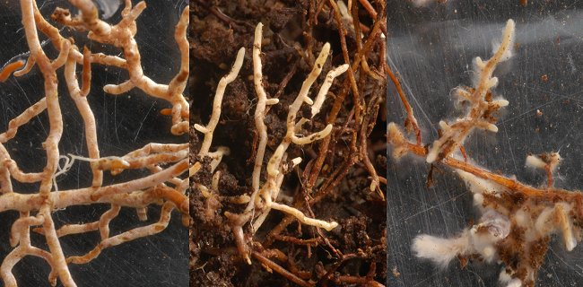
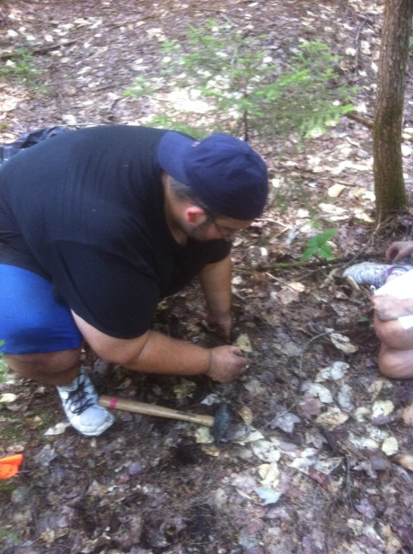
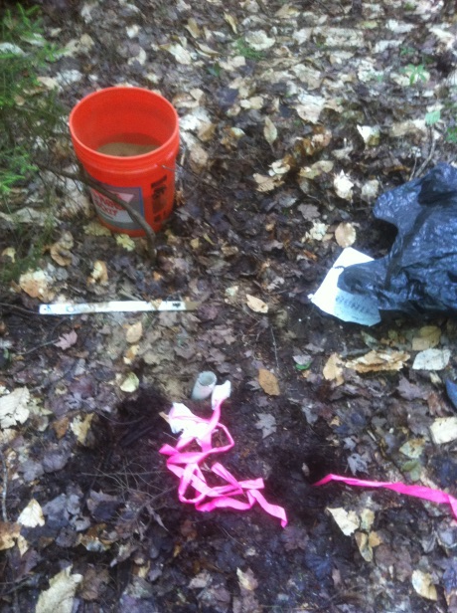

Quantifying carbon allocation to mycorrhizal fungi by temperate forest tree species across a nitrogen availability gradient
Shersingh Tumber-Davila¹, Andrew Ouimette¹
University of New Hampshire, Durham, NH
sjg79@wildcats.unh.edu
ABSTRACT
3) Ergosterol Ingrowth Analysis
Carbon dioxide (CO₂) is a greenhouse gas that traps radiation in the Earth’s atmosphere. Increasing levels of CO₂ can lead to warming and alter other climate processes. Terrestrial ecosystems contain 3 times more carbon than the atmosphere, and each year forests release more than 10 times the amount of CO₂ to the atmosphere through soil respiration than fossil fuel emissions. Although these large natural soil respiration fluxes tend to be balanced by fixation of atmospheric CO₂ through photosynthesis, the carbon balance of forests under future climate is still unknown. In order for scientists to better model the role of forests under future climate change, an improved understanding of the amount of carbon allocated and stored in different compartments of forest ecosystems is needed.
This project aims to provide a more thorough understanding of whole-plant carbon allocation in temperate forests. While trees may allocate up to 50% of their photosynthetically fixed carbon belowground, carbon allocation belowground has been historically overlooked. In particular, very few studies have quantified the amount of carbon allocated to mycorrhizal fungi – the symbiotic fungi found on tree roots that provide the plant with water and nutrients in return for sugars (carbon). We will employ three distinct methods (including new isotopic techniques) to quantify carbon allocation to mycorrhizal fungi across forest stands with a range of species composition and nitrogen cylcing rates. Preliminary results show that in nutrient poor conifer forests, mycorrhizal fungi may receive as much as 30% of the total plant carbon. This is one of the first studies to quantify carbon allocation to mycorrhizal fungi in northeastern temperate forests.
Table 1: Ergosterol Ingrowth Methods
Table 2: Predictions of C allocation to ECM fungi at Bartlett Experimental Forest (Δf = 4)
Description | Closed Core | Open Core | Sandbag
Material | PVC | Lined by 3 aluminum rods (open) | 25-50 micron nylon mesh
Substrate | Native Soil | Native Soil | Quartz Sand
Ingrowth of : | Saprotrophic fungi | Mycorrhizal and Saprotrophic fungi | Mycorrhizal fungi
Site | Depth of Roots | δ¹⁵N AM Hardwood | δ¹⁵N ECM Hardwood | δ¹⁵N ECM Conifer | Tr | Total N uptake (g N/m²/yr) | C to fungi g C/m2/yr
32P | 0-15 cm | -0.6 |  | -2.3 | 0.56 | 6 | 79
14Z | 0-15 cm | -0.4 | -0.7 |  | 0.93 | 8 | 17
Preliminary Ingrowth and NPP data
  Ergosterol is a fungal sterol used as a fungal biomarker
    Open core ergosterol-closed core ergosterol= mycorrhizal ergosterol
    Use conversion factor of 3μg of ergosterol per mg of fungal biomass
    Sandbags give an underestimate of mycorrhizal abundance
Site Location
B.
2) Isotope Technique
Using δ¹⁵N we can estimate the proportion of assimilated N that ends up in plant (Tr) vs. fungal (1-Tr) tissues
  If we can estimate total plant N uptake (g N/m²/yr), then using C:N of fungi we can estimate C allocation to ECM fungi
(1-Tr) = (δ15NSoil - δ15Nplant)/Δf (1)
C_{fungal}= (1/T_{r}-1) x N_{p} x C/N x (1/e) (2)
where, (1-Tr) is the fraction of Nitrogen remaining in ECM biomass, (δ15NSoil) is the δ15N measured in the soil, (δ15Nplant) is the δ15N measured in tree roots, and (Δf) is a fractionation constant, typically with values between 4-10‰, (C_{fungal}) refers to the carbon allocated to ECM fungi, (N_{p}) is the total amount of nitrogen uptake by the plant, (C/N) refers to the ratio of carbon to nitrogen of fungi (typically between 10-20), and (e) is the microbial efficiency (typically around 0.50 or 50%). The red figures represent uncertainties in the equations used, the only values typically measured are (δ15NSoil) and (δ15Nplant). In this study we will try to find more accurate values for (Δf) and (C/N) through a sandbag study in which we will capture fungal hyphae and run isotopes on them. (e) and (N_{p}) will be found through the literature and through Nitrogen data from Bartlett.
Low N
High N
Low N
High N
Ingrowth Cores
Fraction of NPP
Figure 1: Fine root and fungal ingrowth rates were measured at 5 plots within Bartlett Experimental Forest, NH differing in species composition and nitrogen (N) availability. Low N conifer stands have relatively low root ingrowth rates and high fungal ingrowth rates, while N-rich broadleaf deciduous stands have higher fine root but lower fungal ingrowth rates. Presumably this represents a stronger reliance on symbiotic ectomycorrhizal (ECM) fungi in nutrient poor conifer-dominated stands.
Figure 2: Above- and below-ground NPP at 5 plots within Bartlett Experimental Forest, NH differing in species composition and nitrogen (N) availability. Low N conifer stands allocate a higher proportion of total net primary production (NPP) belowground to roots and especially ectomycorrhizal fungi. In contrast, nutrient-rich, broadleaf deciduous stands allocate a larger proportion of NPP to wood and foliar tissues and a majority of belowground NPP is found in fine roots (not ectomycorrhizal fungi).
Experimental Design
Six stands ranging in tree species composition and nitrogen availability within Bartlett Experimental Forest, NH (NEON site). Within each stand ergosterol analyses were performed on:
  12 paired (open and closed) cores filled with native soil (organic and mineral horizons). Ingrowth period - July 15 to Sept 15
  24 sandbags distributed across 6 soil profiles Ingrowth period - July 15 to Sept 15
  6 bulk soil cores (organic and mineral horizons)
  Root and soil profiles (6 depths in first 30 cm) at different depths at six stands were also collected for 15N stable isotope analysis
Conclusions
Ingrowth core techniques suggest stronger reliance on ECM fungi at N poor sites, however quantification of C allocation is difficult
Isotopic data support ingrowth core data and have the potential to provide quantitative estimates of C allocation to ECM fungi especially when focusing on roots and available N from well constrained soil horizons
A combination of methods can allow us to solve for the uncertainties of individual methods
Publication of this data can allow for climate change models to include mycorrhizal fungi as a significant source of terrestrial carbon
Preliminary Isotope Data
Methods Quantifying ECM Production
1) Carbon Budget Approach
A
B
  Use knowledge of respiration and Total Belowground Carbon Allocation (TBCA) to measure carbon going to fungi
    TBCA-root carbon=fungal carbon
Figure 3: Soil and root δ¹⁵N patterns with depth at A) a nitrogen poor, conifer dominated plot and B) a nitrogen rich, hardwood dominated plot at BEF. At a given soil depth roots of all species have lower δ¹⁵N than soil. Roots of ECM conifer species have lower δ¹⁵N than roots of arbuscular mycorrhizal (AM) broadleaf species at the N poor site, suggesting substantial reliance on ECM fungi by conifers. This is not seen at the N rich site in ECM hardwood roots. Foliage depicted as open triangles. Using the δ¹⁵N of roots and plant available N from soil horizons can better estimate C allocation to ECM fungi using equation 1.
Acknowledgements
Research funded by a McNair Scholars Program Fellowship and an USDA Northerneastern States Research Cooperative grant . My sincere thanks to Dr. Erik Hobbie, Ben Smith, Mary Santos, Megan Grass, Connor Madison, Jaturong Kumla and everyone in the Terrestrial Ecosystems Analysis Lab and the UNH Stable Isotope Lab with all your help and assistance

