Slide 1




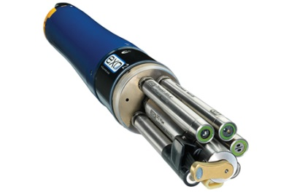
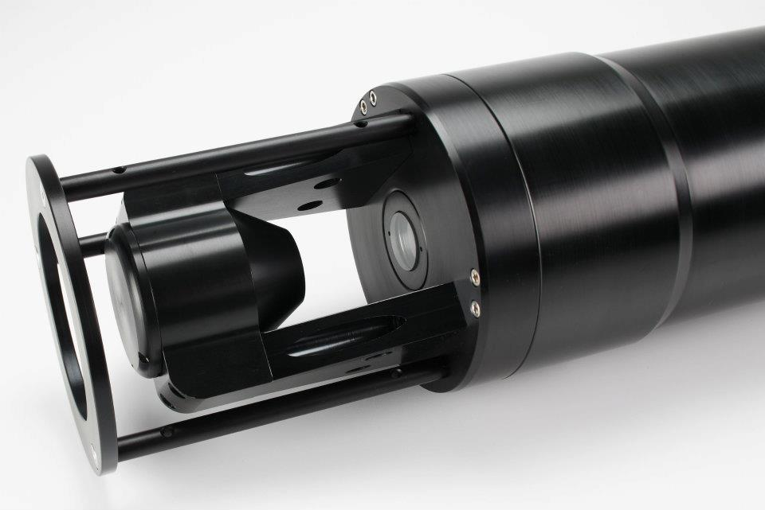
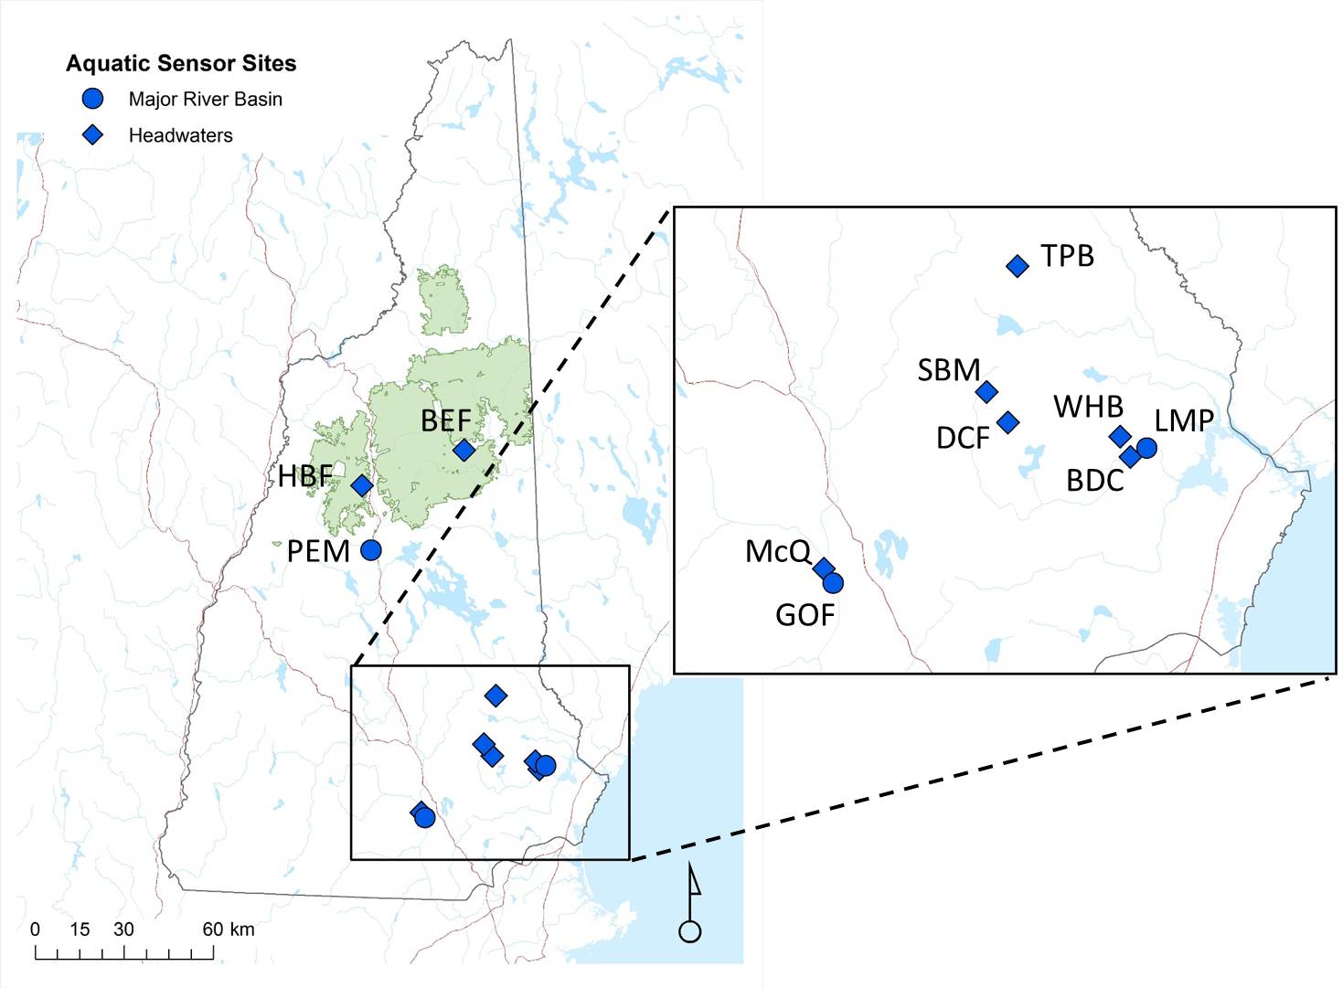
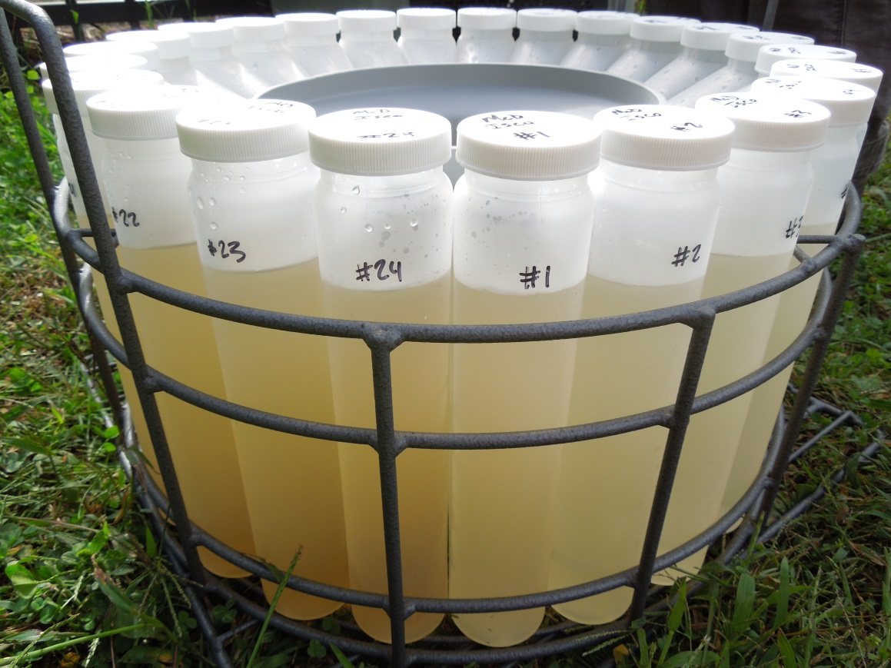
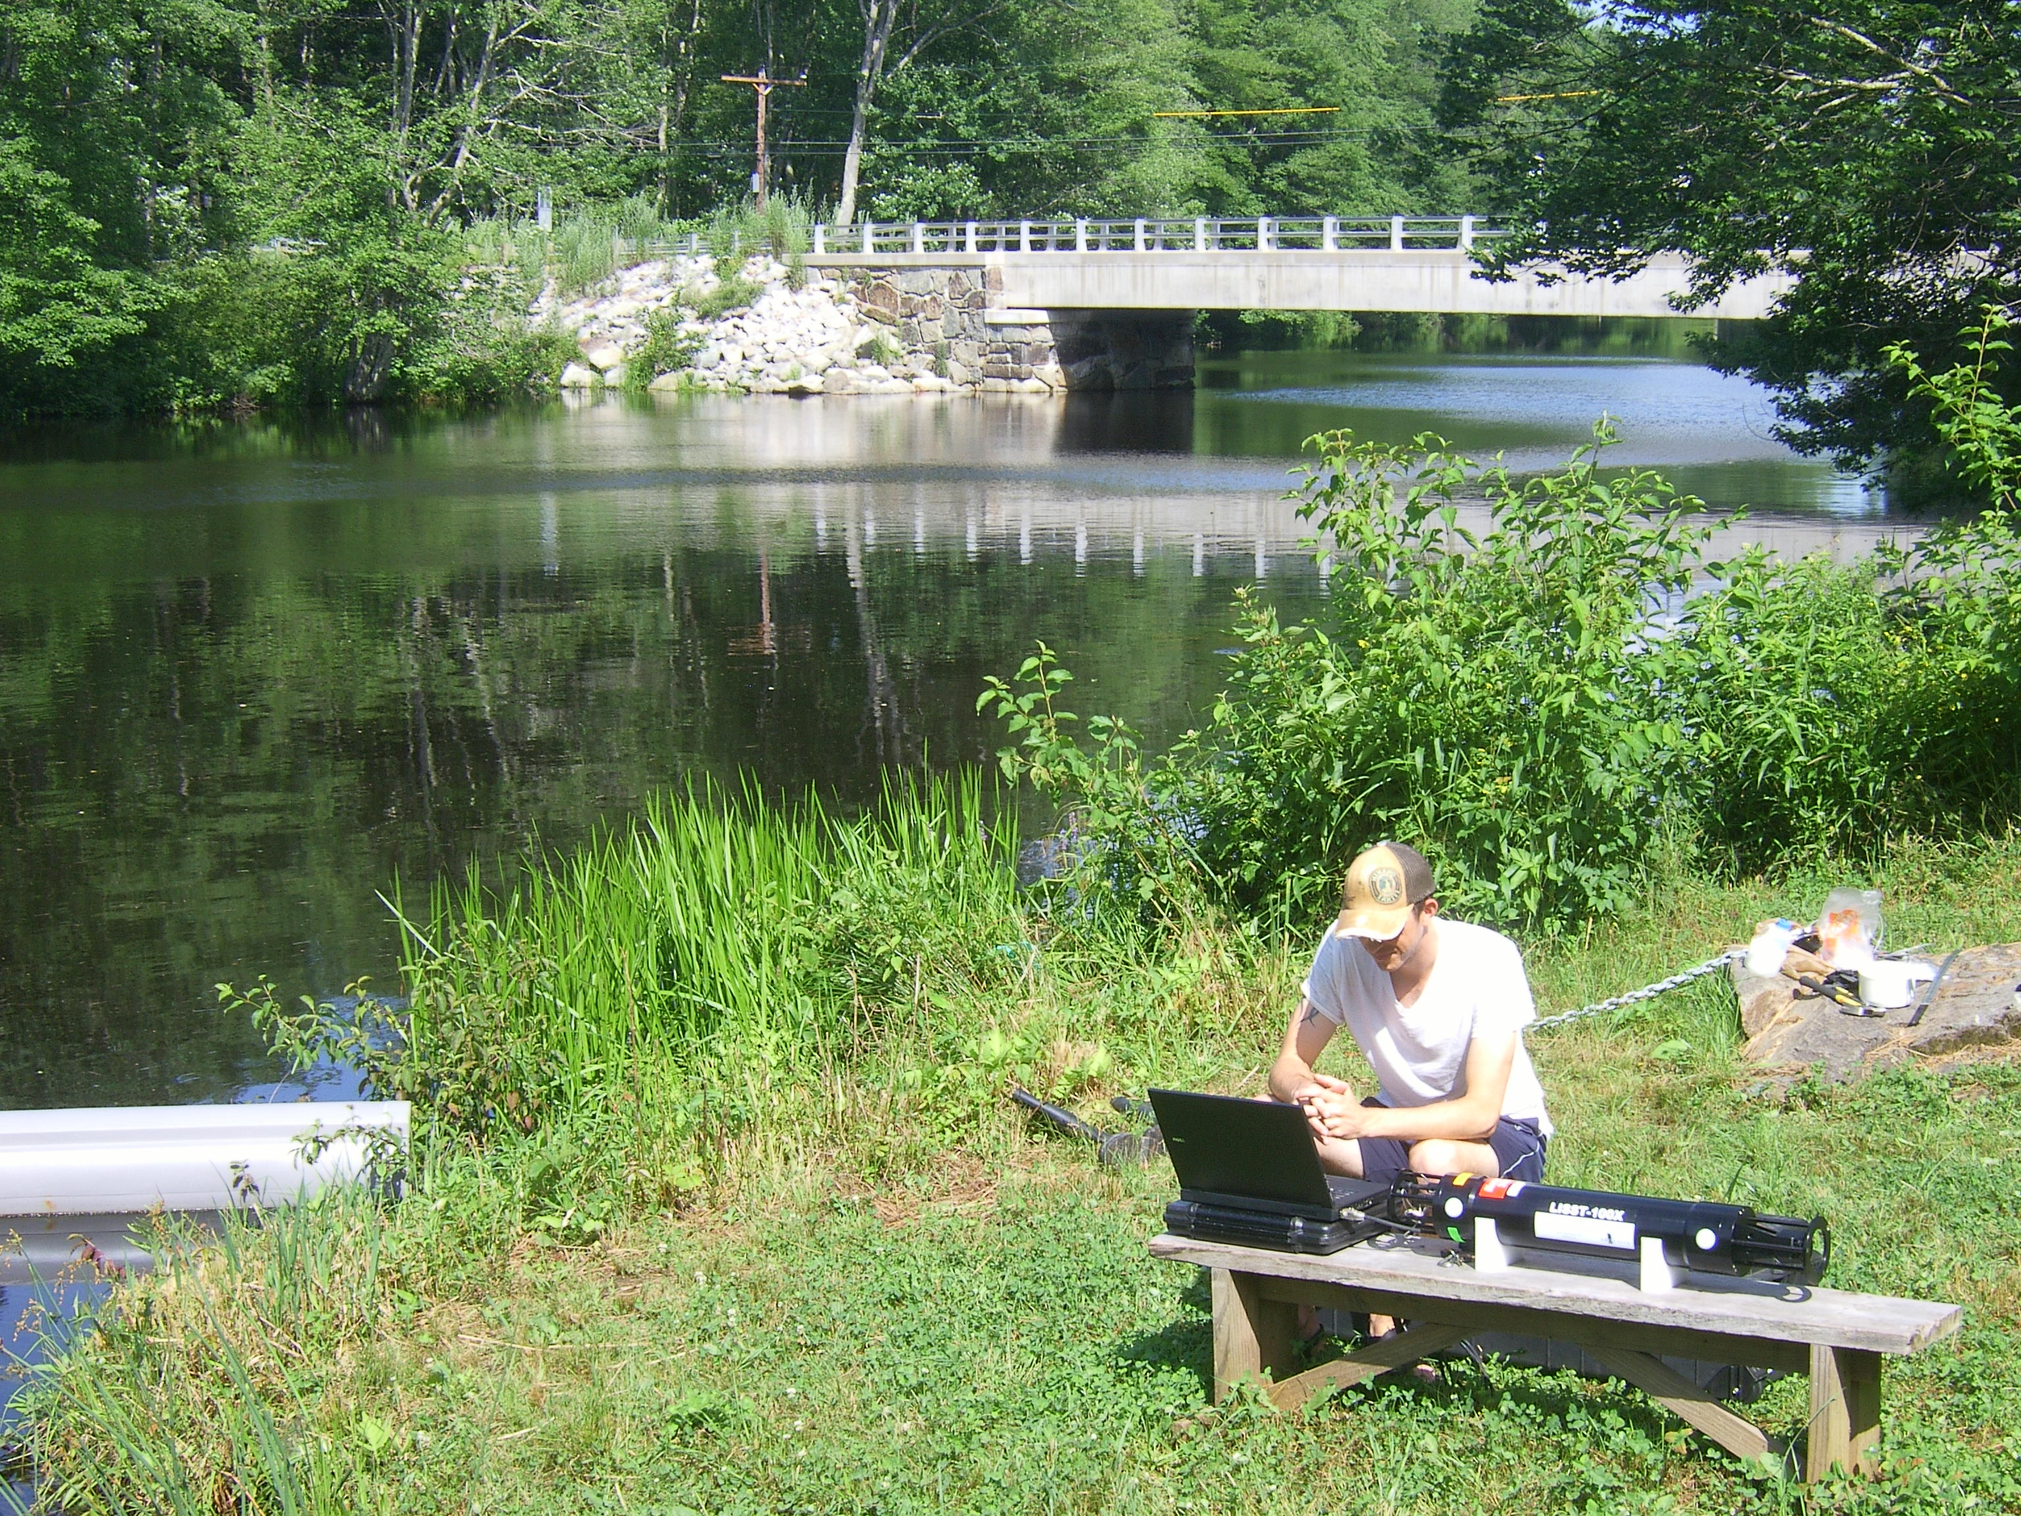
Water quality sensors provide insight into the suspended solids
dynamics during high flow events in the Lamprey River, NH
Nicholas K. Shonka and William H. McDowell
Department of Natural Resources and the Environment, University of New Hampshire, Durham, NH nkw9@unh.edu, www.wrrc.unh.edu
Acknowledgements and Thanks to: Michelle Daley, Gopal Mulukutla, Jody Potter, Lisle Snyder, and Wil Wollheim
Rationale & Research Questions:
Preliminary Results:
Excess Total Suspended Solids (TSS) in rivers are often the first observable indicators of poor water quality (US EPA, 2006).¹
The Lamprey River Watershed is facing increased land development, population gain , and has more frequent extreme precipitation events, all of which can increase TSS pollution and have negative impacts on water quality in the Lamprey River. ²
Traditional weekly or monthly sampling may not capture pulses of suspended solids and associated nutrients during short duration high flow events following storms.
Can high frequency in-situ water quality sensors be used to improve the understanding of the suspended solids variation within the Lamprey River in response to high flow storm events?
Can turbidity sensors be used as a surrogate to estimate Total Suspended Solids concentrations (TSS in mg/L)at the Wiswall Dam site (LMP) on the Lamprey River?
Water Quality Sensors:
YSI EXO2 multi-parameter sonde:
Dissolved Oxygen(DO), Conductivity, Temperature, pH, Turbidity (FNU) and Fluorescent Dissolved Organic Matter (FDOM)
Figure 1: Hydrograph of 12Sept13 storm event at LMP site with TSS, Turbidity, and LISST VPC response
Study Site:
Lamprey River @ Wiswall Dam = LMP
USGS gauging station #01073500 provides continuous discharge data
Line power available for sensors and automated water sampler
Laser In-Situ Scattering Transmissometer (LISST):
Particle Size Distribution (PSD), Volumetric Particulate Concentration (VPC µL/L)
y = 1.60x - 1.22
R² = 0.76
p = <.0001
Figure 2: Developed relationship of TSS vs Turbidity at LMP site over variable flow conditions
Conclusions and Future Work:
High frequency turbidity (Formazin Nephelometric Units, FNU) sensor data can be used as a surrogate for TSS at site specific locations with established statistical relationships.
Traditional low frequency TSS sampling can miss rapidly changing suspended solids conditions during storm events.
Future work: 1)Are these flashy high flow storm events changing particulate nutrients (N, P, & C) concentrations that are missed by traditional weekly or monthly sampling techniques? 2)What is the dominate suspended solid particle size before, during and after a high flow period?
ISCO Automated Water Sampler: Synchronized with sensors; used for TSS & particulate nutrient samples
References:
1. US Environmental Protection Agency. 2006. Wadeable Streams Assessment: a collaborative survey of the nation’s streams. EPA 841-B-06-002. Office of Research and Development and Office of Water, US Environmental Protection Agency, Washington, D.C.
*
2. Wake C.P., Burakowski E.A., Kelsey E., Hayhoe K., Stoner A., Watson C., Douglas E. 2011. Climate Change in the Piscataqua/Great Bay Region: Past, Present, and Future. Carbon Solutions New England Report for the Great Bay (New Hampshire) Stewards.
  *LMP site is collaboratively supported by NH EPSCoR, NH Sea Grant and the United States Geological Survey

