Slide 1

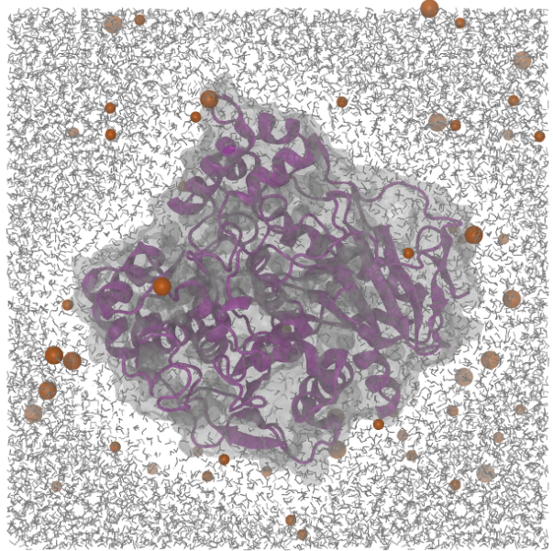
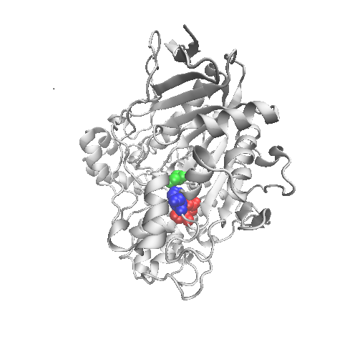
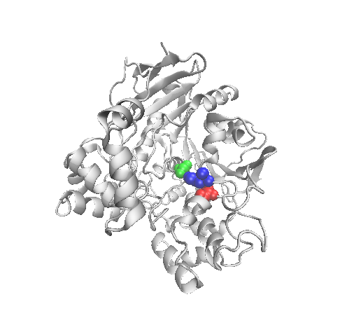
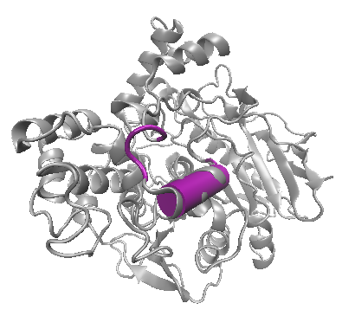
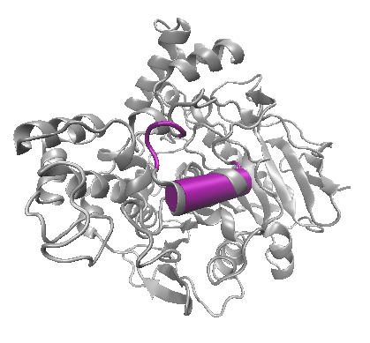
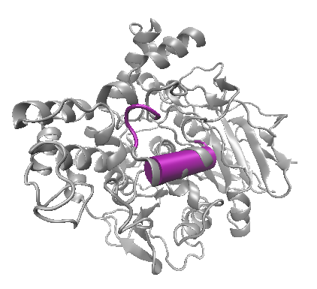
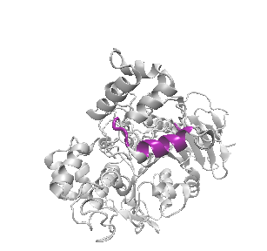
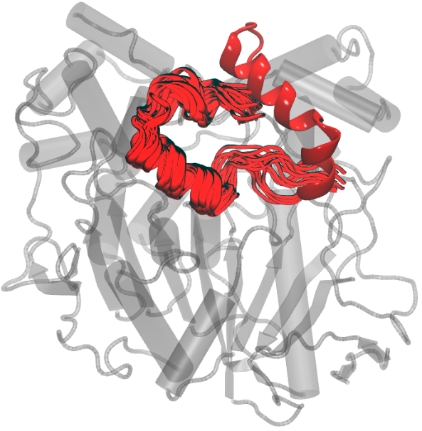
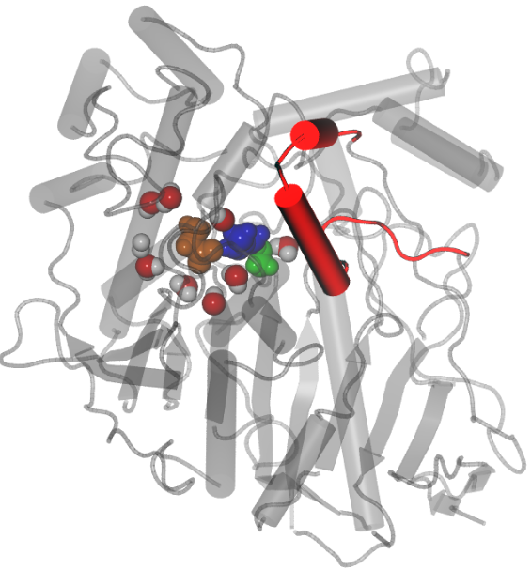
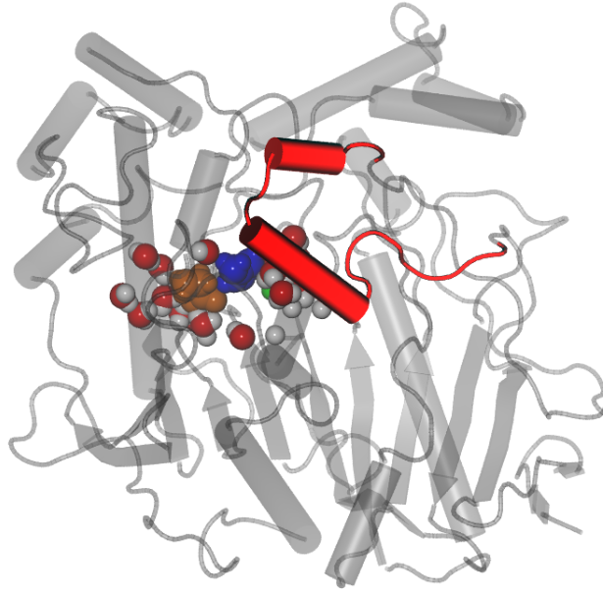
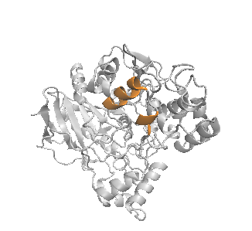
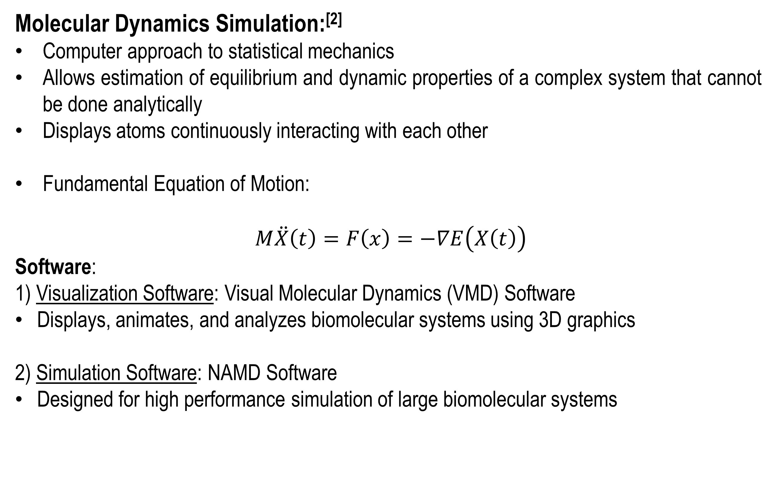
Multiscale Simulation of Enzyme Conformational Dynamics
Rhiannon Jacobs and Harish Vashisth
Department of Chemical Engineering, University of New Hampshire, Durham, NH 03824
Abstract
System Details
Background: Molecular Dynamics
Lipases are extracellular hydrolytic enzymes that comprise the most important group of biocatalysts in various technological applications. Several crystal structures of lipase enzymes have been solved, which reveal a “canonical” α/β hydrolase fold with catalytic triad formed by residues Ser, Asp or Glu, and His. The access to this active site is prevented by a few α-helices that are jointly designated as a “lid” domain. The plasticity of this lid domain is apparent in several open and closed state structures of different lipase enzymes. However, the functional significance of the lid domain and underlying conformational change remains under debate. Various mechanisms of lipase activation, such as interfacial activation, temperature-switch activation, or aqueous activation, have been suggested earlier. In this work, we investigate the conformational flexibility of lipases using molecular dynamics simulations.
Molecular Dynamics Simulation:^{[2]}
Computer approach to statistical mechanics
Allows estimation of equilibrium and dynamic properties of a complex system that cannot be done analytically
Displays atoms continuously interacting with each other
Fundamental Equation of Motion:
$M\ddot{X}\left(t\right)=F\left(x\right)=−∇E\left(X\left(t\right)\right)$
Software:
1) Visualization Software: Visual Molecular Dynamics (VMD) Software
Displays, animates, and analyzes biomolecular systems using 3D graphics
2) Simulation Software: NAMD Software
Designed for high performance simulation of large biomolecular systems
Size
Atoms: 62324
Waters: 18117
Protein: 534
Background: Lipase Enzymes
Enzyme: a protein molecule that acts as a biological catalyst
Lipase Facts: catalyzes the hydrolysis of triacylglycerols (glycerol and fatty acids); catalytic properties for the degradation of lipids; sources include plants, animals, microorganisms, recently bacteria & fungi
Structural Details
Ser-His-Asp/Glu Catalytic Triad^{[1]}
Molecular Dynamics Simulation of a Lipase Enzyme
Catalytic Triad
Conclusion
Ser
His
Ser
His
MD Simulation of the lipase reveals that:
lid domain is highly flexible,
(b) solvent/water molecules can penetrate the active site of the enzyme.
Glu
Glu
Candida rugosa lipase: closed state (1TRH)
Candida rugosa lipase: open state (1CRL)
Inactive & Active Conformations: Inactive conformation: active site shielded by part of polypeptide chain— “lid” domain
Single domain protein with α/β hydrolase fold
Location of “lid” : fixed by Cys 60-97 disulfide bridge and Glu 95 – Arg 37 salt bridge
t = 35.2 ns
Future Work
t = 0 ns
t = ~70 ns
Long time-scale and enhanced sampling molecular dynamics simulation on different lipases to understand the conformational changes between the open and closed states and compute the thermodynamic barriers.
MD
open crystal
Beginning
End
Loop “lid” Domain
lid
lid
Acknowledgements & References
Candida rugosa lipase: open state (1CRL)
Candida rugosa lipase: closed state (1TRH)
Faculty Advisor: Harish Vashisth, PhD
[1] Grochulski P, Li Y, Schrag JD, Cygler M. Two conformational states of Candida rugosa lipase. Protein Sci. 1994;3:82-91.
[2] Schlick, Tamar. Molecular Modeling and Simulation: An Interdisciplinary Guide. New York: Springer, 2010.
Transition between the two states through movement of lid domain: structural reconfiguration of enzyme
Loop possesses an amphipathic character: side facing protein hydrophobic & side facing solvent hydrophilic
Flexibility of the “lid” domain as revealed by MD simulation
Water Diffusion to Enzyme Active Site
Water molecules displayed within 5A of catalytic triad.

