Slide 1
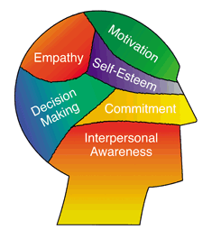

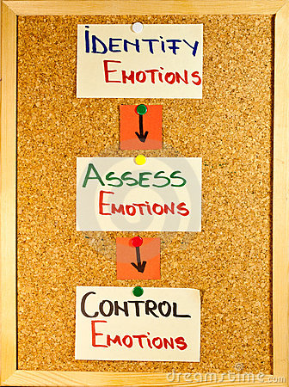
Self Awareness-
Recognizing your own emotions and how they affect your thoughts and behavior.
Social Awareness- Understanding the emotions, needs and concerns of other people, and identifying the power structure in groups.
Self Management-
Learning to control your behavior and manage your emotions effectively.
Relationship Management- Knowing how to communicate clearly, motivate and influence others, and manage conflict in teams.
Emotional Intelligence in Hospitality Management
Tips for Managing EI:
Rapidly reduce stress in the moment
Use emotional awareness to avoid relationship stress
Learn to understand nonverbal communication
Use humor to manage
challenges
EI is especially important in hospitality because of the huge variety of nationalities represented in its employees.
Source: http://www.helpguide.org

