Slide 1
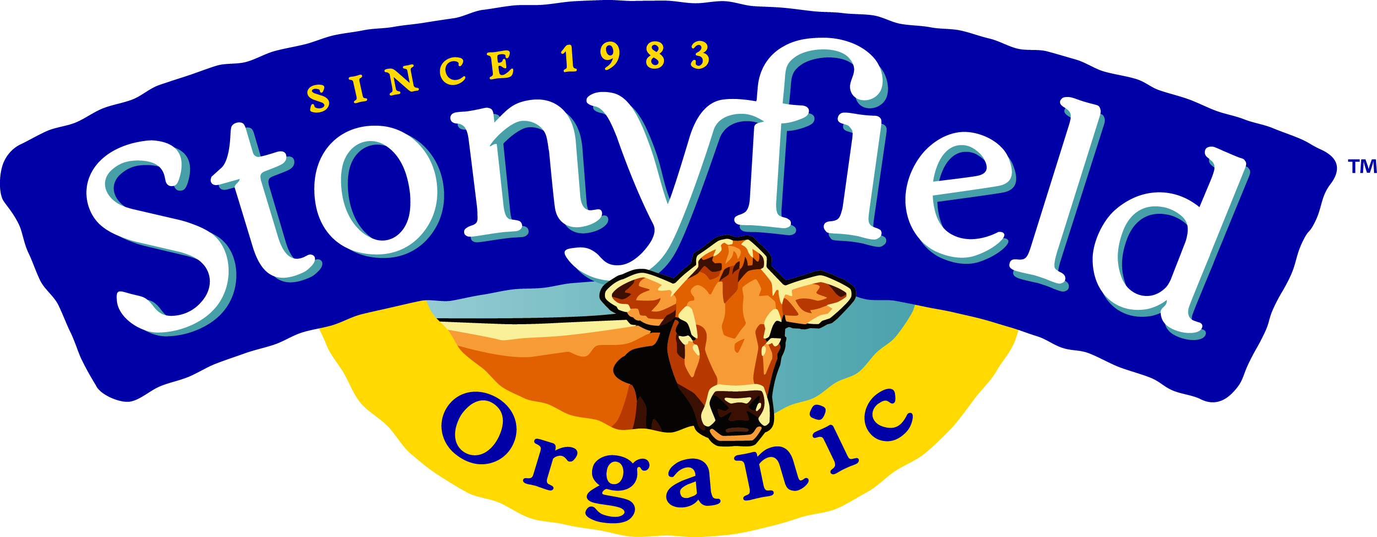
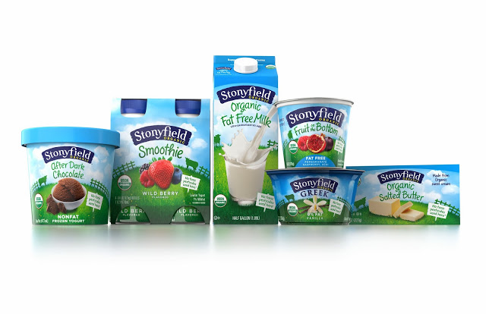
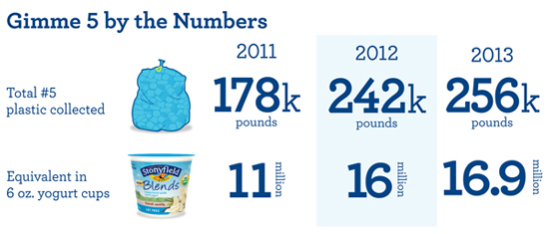
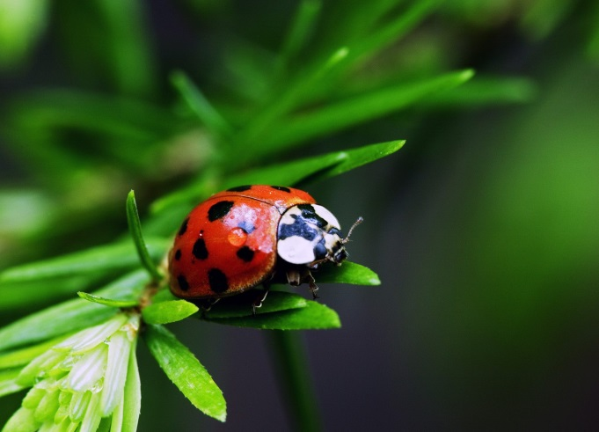
Stonyfield Farm
Kyle Scarano, Max Post, Stephanie Gibbons
Organic and Homegrown
Stonyfield farm is an all-organic yogurt company
The Farm avoids the use of toxic persistent pesticides and herbicides, growth hormones, and antibiotics
Stonyfield has also taken the pledge as an organic farm to forbid all use of genetically modified organisms (GMO’s)
Natural Defense
The providers for Stonyfields’s milk, veggies, and fruit also do not use chemical pesticides
To achieve natural alternatives, the farms regularly introduce ladybugs into their crops who hunt harmful critters
Frequent crop rotation is another environmentally friendly method in avoiding pests
Yogurt and Antibiotics
Through the process of temperature controlled fermentation, yogurt is produced from milk
This requires several types of bacteria who ferment the lactose in milk
Stonyfield abolishes the use of potentially harmful antibiotics within this method
Earth Efforts
Stonyfield’s “earth efforts” reach from their organic ingredients to the plant made containers that package the yogurt
The company has reduced their solid waste by 50% and GHG emissions at the factory by 20%
The company strives to make more moves in keeping our environment clean by getting their waste down to 0% in the upcoming years
Hitting Home
At UNH, Stonyfield is an integral part of the dining experience as well as a business partner
Stonyfield donated $450,000 to the UNH Organic Dairy Farm in efforts to provide funding for organic farming research
UNH and Stonyfield are members of Organic Valley, the oldest and largest organic farmer’s network and leading brand in dairy
In 2007, UNH started shipping milk supply to be used in companies such as Organic Valley and Stonyfield Farm
Locally Cultured
Founded 1983 in Wilton, NH
Exclusive organic yogurt provider for UNH
#1 selling organic yogurt brand in America
Tasting Success
85% of shares owned by Groupe Danone, an international powerhouse for food-based products
Has successfully entered international market with Les 2 Vaches brand
Owns other popular U.S. yogurt brands such as: YoBaby, YoToddler, YoKids and Oikos
Community Driven
Despite international involvment, it remains headquartered locally in Londonderry, NH
Through its Profits for the Planet program, Stonyfield gives 10% of profits to environmental causes
Obtains milk from Organic Valley—a cooperative of organic dairy farmers out of La Crosse, Wisconsin

