Slide 1
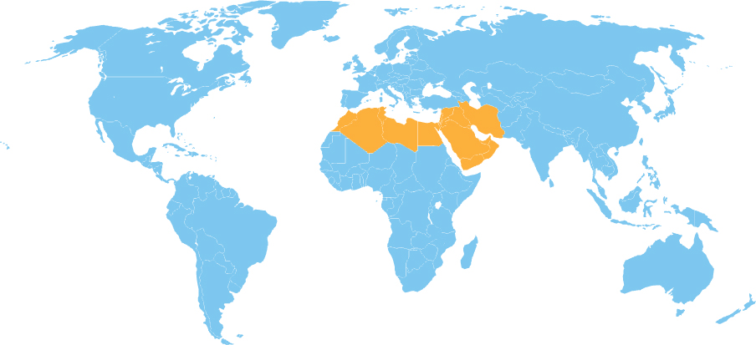
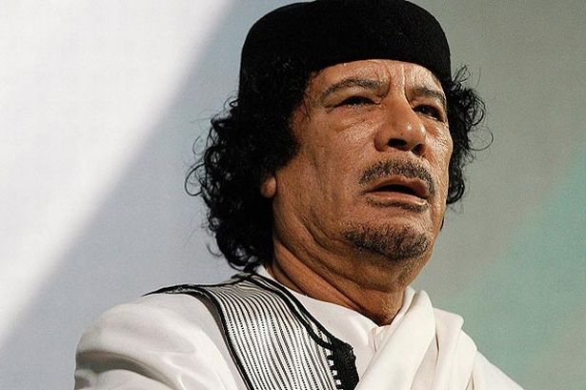
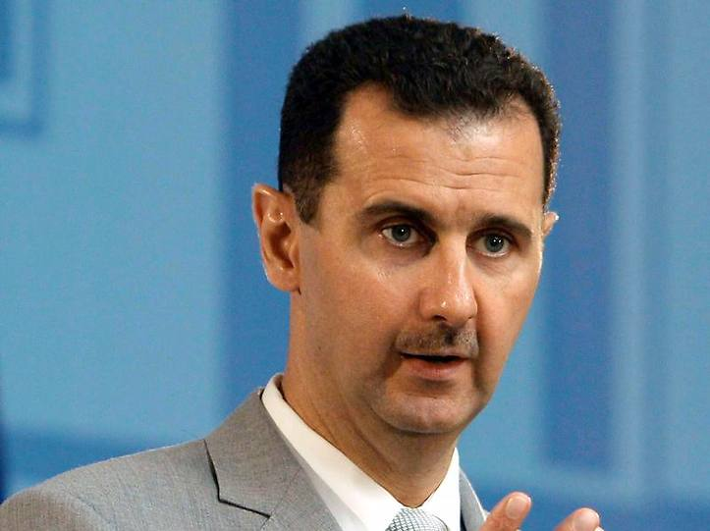

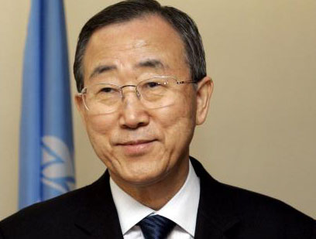
Responsibility to Protect in the Middle East and North Africa
R2P Timeline
1994
Rwandan Genocide
1995
Srebrenica Massacre
2000
Kofi Annan writes
“We the Peoples”
ICISS established in Canada
2001
ICISS Releases “The Responsibility
to Protect”
AU adopts Right to Intervene
2005
World Summit Outcome
Document
2007
Kenya
2009
Secretary General Ban Ki Moon
establishes 3 Pillars
First UN Informal Interactive
Dialogue re: R2P
2011
Cote d’Ivoire
Libya
Norm Diffusion Theory
* The Norm Life Cycle –
1.) Norm Emergence
Who are the Norm Entrepreneurs?
2.) Norm Cascade
What is the Tipping Point?
3.) Norm Internalization
(Finnemore and Sikkink)
* Localization (Acharya)
* Subsidiarity (Acharya) & The Feedback Loop (Prantl and Nakano)
Each individual state has the responsibility to protect its populations from genocide, war crimes, ethnic cleansing and crimes against humanity. This responsibility entails the prevention of such crimes, including their incitement, through appropriate and necessary means.
The international community should, as appropriate, encourage and help states to exercise this responsibility.
The international community, through the United Nations, also has the responsibility to use appropriate diplomatic, humanitarian and other peaceful means, in accordance with Chapters VI and VIII of the Charter, to help protect populations from genocide, war crimes, ethnic cleansing and crimes against humanity. Should peaceful means be inadequate…we are prepared to take collective action, in a timely and decisive manner, through the Security Council, in accordance with the Charter, including Chapter VII, on a case-by-case basis and in cooperation with relevant regional organizations as appropriate.
States
Limited participation at Informal Interactive Dialogues
Responses range from full support (Turkey) to strong resistance (Iran)
* Saudi Arabia has been entirely silent on the matter
* Egypt endorses RWP, subsidiary norm championed by Brazil
* Range is consistent with levels of democracy in these countries
Regional Organizations
LAS demonstrated unprecedented initiative in response to Libya, and has been very active in Syria, suspending both governments’ memberships and committing personnel to UN missions.
GCC, OIC, and LAS have not been highly critical of atrocities carried out by influential member states.
States’ and regional organizations’ selective approaches to R2P have been driven by national interests and regional stability concerns.
Future of R2P in MENA
* Few Signs of Internalization
* Few Signs of Localization
* Could Pan-Arabism lend itself to institutionalization of R2P?
  Not prior to democratization,
  according to norms scholarship

