Slide 1
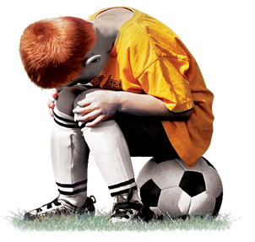
Is It Wise To Specialize?
Effects of specialization:
Stress fractures
Increase in pressure has cognitive side effects
Leads to higher adult inactivity
Specialization is defined as year-round training in a single sport with the exclusion of other sports
Specialization accounts for 50% of overuse injuries
On the six-point scale, the average sports-specialization score of uninjured athletes was 2.75, while the average score of injured athletes was 3.49.
Trains more than 75 percent of the time in one sport.
Trains to improve skill or misses time with friends
Has quit other sports to focus on one sport.
Considers one sport more important than other sports.
Regularly travels out of state.
Trains more than eight months a year, or competes more than six months.
Stress levels of student athletes has increased by over 1000% in the past 8

