Slide 1

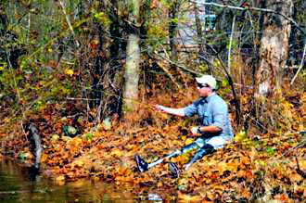
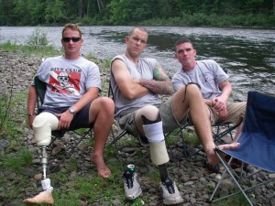

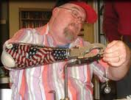
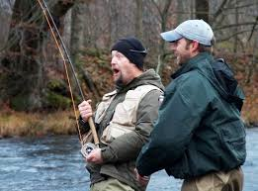
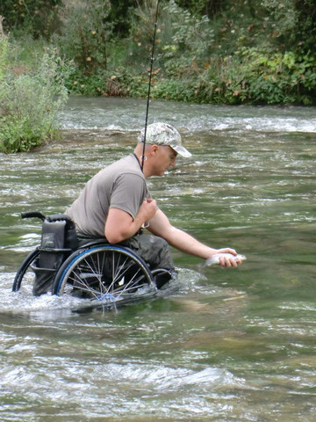
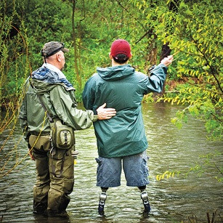
Perceived Benefits of a Fly-fishing Program for Veterans with Post-Traumatic Stress
Dustin Alger
The University of New Hampshire: Dept. of Recreation Management and Policy
PROJECT HEALING WATERS
FINDINGS
WHAT IS POST-TRAUMATIC STRESS?
Project Healing Waters is a non-profit organization dedicated to the emotional and physical rehabilitation of disabled active duty military personnel and Veterans through fly-fishing and fly tying education and outings.
Benefits of Using Nature as a Platform for Therapy
Veterans recount calming, tranquil setting dispels feelings of anger, anxiety and depression
Veterans stated feeling more connected to the world and at peace when in a natural setting such as a river environment
PTS is the inability to regulate and control extremes in emotional response after exposure to a traumatizing experience or event such as physical harm to oneself
PURPOSE OF THE STUDY
Explore the therapeutic benefits of a fly-fishing program for Veterans who have PTS
Identify aspects of the Project Healing Waters program that may be responsible for mental health related outcomes for Veterans
Establish protocols and/or guidelines for administration of Complimentary and Alternative Medicines for Veterans with PTS
Importance of Camaraderie for Psychosocial Benefits
Veterans desire and long for camaraderie and ability to socialize with fellow Veterans, and doing so allows them to feel “normal” and able to relate with others over their struggles and common interests and experiences
WHAT ARE SOME SYMPTOM OF PTS?
Hypervigilance - Hypersensitivity
Uncontrollable outbursts of emotional response
Inability to properly store and recall memories
Re-experiencing of the event
Avoidance - Hyper-arousal - Intrusive thoughts
Social isolation - Guilt - Depression
Loss of motivation or interest in previously enjoyable activities
Able to Learn a Skill and Therapy That Veterans Can Use on Their Own and With Buddies
Veterans expressed desire for avenues to therapy they can control and share with buddies
Veterans enjoy mastering a new skill which renews and enhance self-confidence, locus of control, self-determination and motivation
RESEARCH QUESTIONS
What are the perceived benefits of a fly-fishing program for Veterans who experience PTS?
What aspects of a fly-fishing program may be responsible for mental health related outcomes for Veterans with PTS?
Ability of fly-fishing and related activities to help with multiple symptoms of PTS
Veterans stated how much fly-fishing is able to calm their symptoms and relieve the stresses and triggers associated with their PTS almost immediately, sometimes by even recounting a fishing story in their mind.
ACKNOWLEDGEMENTS
METHOD
Patricia Craig, PhD.
The University of New Hampshire
Department of Recreation Management and Policy
Tamar P. Martin-Franklin, PhD., CRC
Project Healing Waters
Mid-Atlantic Regional Coordinator
Evaluative needs assessment methodology involving the administration of a focus group interview tool and field notes taken by the researcher

