Slide 1
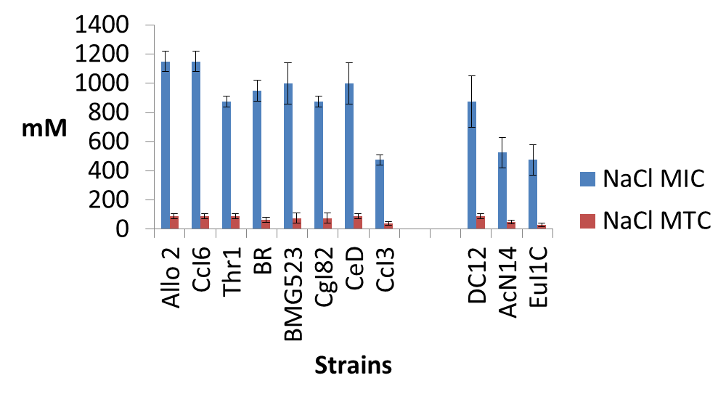
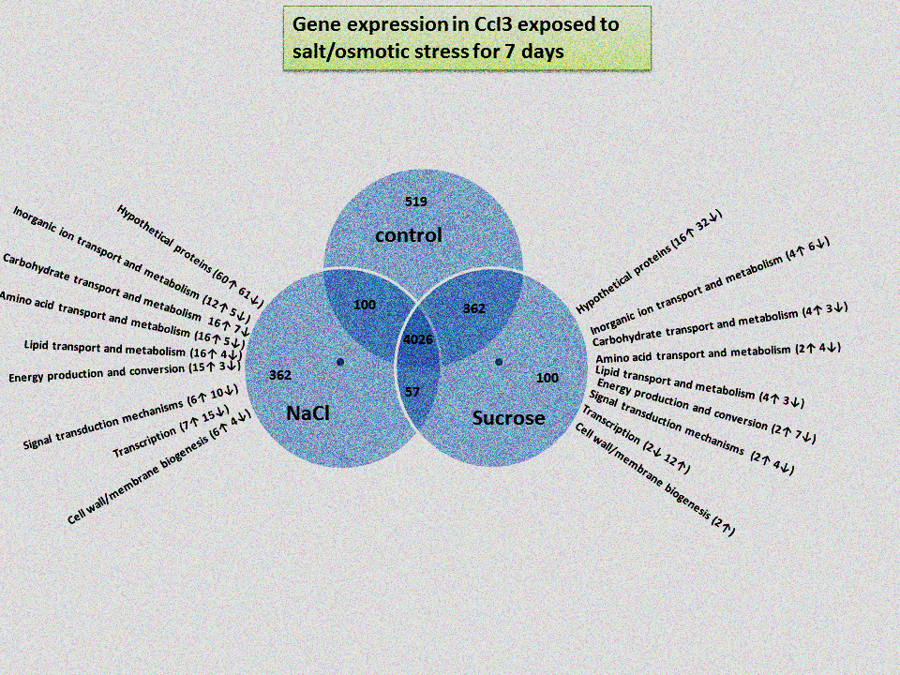
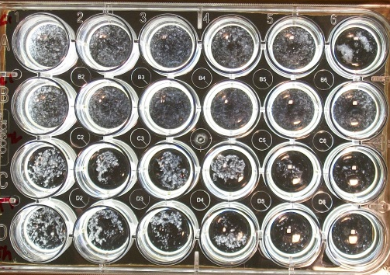
Identification and Molecular Characterization of Salt Stress Tolerance in Frankia Isolates from Casuarina Plants
Rediet OSHONE¹, Mariama NGOM^{2,3,5}, Nathalie DIAGNE^{3,5}, Diegane DIOUF^{3,5}, Valérie HOCHER^{4,5}, Mame Oureye SY^{2,5}, Laurent LAPLAZE^{4,5}, Antony CHAMPION^{3,4,5}, and Louis S. TISA¹
1. University of New Hampshire, USA 2. Laboratoire Campus de Biotechnologie Végétale, Faculté des Sciences & Techniques, Université Cheikh Anta Diop (UCAD), Dakar, Sénégal 3. Laboratoire Commun de Microbiologie IRD/ISRA/UCAD, Dakar, Sénégal 4. Equipe Rhizogenèse, UMR DIADE, IRD, Montpellier, France 5. Laboratoire mixte international Adaptation des Plantes et microorganismes associés aux Stress Environnementaux (LAPSE), Dakar, Sénégal
Introduction
Results
Results
Salinization of soils and groundwater is a serious problem causing drastic reduction in agricultural production. Actinorhizal plants form a symbiotic association with the actinobacteria, Frankia, and are able to tolerate a variety of abiotic stresses including salt stress. Among the actinorhizal plants, some trees of the genus Casuarina have been shown to grow well under these conditions. The bacterial partner, Frankia, of the actinorhizal symbiosis plays a role in the ability of these plants to survive under harsh conditions. The aim of this study was to identify salt-tolerant Frankia strains and to determine the genes responsible for the molecular mechanisms of salt stress tolerance.
RNA seq results correlated well with qPCR results (R² = 0.72)
RNA sequencing of Allo2, CcI6 , and CeD is ongoing
Ridgway KP, Marland LA, Harrison AF, Wright J, Young JPW
and Fitter AH 2004 Molecular diversity of Frankia in root
nodules of Alnus incana grown with inoculum from polluted urban soils. FEMS Microbiol. Ecol. 50 255–263
Conclusion
These preliminary results are uncovering the mechanisms of salt stress tolerance in Frankia
Fig 2 salt and osmotic stress tolerance of Frankia strains as measured by the minimum inhibitory concentration (MIC) and maximum tolerance concentration (MTC). Allo2, CCI6, and CeD were identified as tolerant strains while CcI3 was the most sensitive strain
References
Benson DR and Silvester WB 1993 Biology of Frankia strains,
actinomycete symbionts of actinorhizal plants. Microbiol. Mol.Biol. Rev. 57 293–319
Giri B, Kapoor R and Mukerji KG 2003 Influence of arbuscular mycorrhizal fungi and salinity on growth, biomass, and mineral nutrition of Acacia auriculiformis. Biol. Fertility Soils 38 170–175
Oshone R, Mansour SR, Tisa LS. 2013. Effect of salt stress on the physiology of Frankia sp. strain CcI6. J. Biosci. 38:699–702
Rengasamy P 2006 World salinization with emphasis on Australia. J. Exp. Bot. 57 1017–1023
Materials and Methods
A 24-well growth assay (Fig 1) was used to determine salt tolerance levels for Frankia
strains. RNA sequencing was carried out to identify genes and pathways differentially regulated under salt and osmotic
Fig 3. Differential gene expression in CcI3 exposed to salt and osmotic stress for 7 days . Differentially expressed genes (p<0.05) are grouped into functional categories.
Acknowledgement
Fig 1. A 24 well plate growth assay
stress. Quantitative PCR was performed on a sub set of the genes to confirm results of the RNA seq analysis. Amino acid analysis was used to determine changes in the amino acid profile under salt stress .
This research is supported in part by Hatch NH585, JGI 2012 CSP585, and by the College of Life Sciences and Agriculture at the University of New Hampshire, Durham. Travel support was obtained from the MCBS department, Graduate School, and the Zsigray Memorial Fund.
Fig 4 Amino Acid profile of Frankia strains exposed to salt and osmotic stress for 7 days

