Slide 1

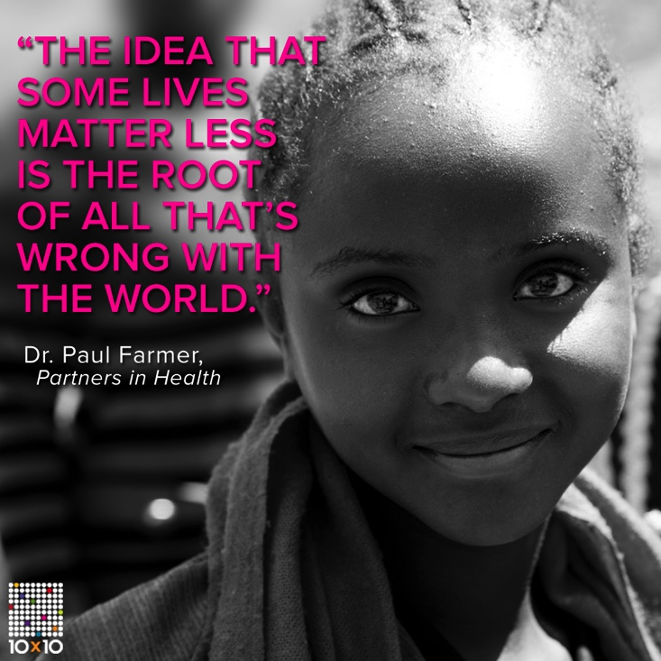
Girl Rising
Film Screening
Goals
Raise $200 for Ten Times Ten
Raise awareness about girls education in the developing world
Get 150 people+ at event
Emeric Szep University of New Hampshire
Community Leadership
What Is Girl Rising
A grassroots global action campaign for girls education
The film tells the story of nine girls around the world. It delivers a simple truth that educating girls can transform societies
Collaboration With Other Organizations
Women’s Studies
AIUNH (Amnesty International)
Alpha Phi Omega-CIEE
Ten Times Ten
Organization that made film
NGO And Corporate Sponsors
Anewday Cambodia
GirlUp
Care
Partners in Health
Plan
Room to Read
World Vision
Day of Event
Wednesday April 23rd 7:00pm
MUB Theatre 2

