Slide 1
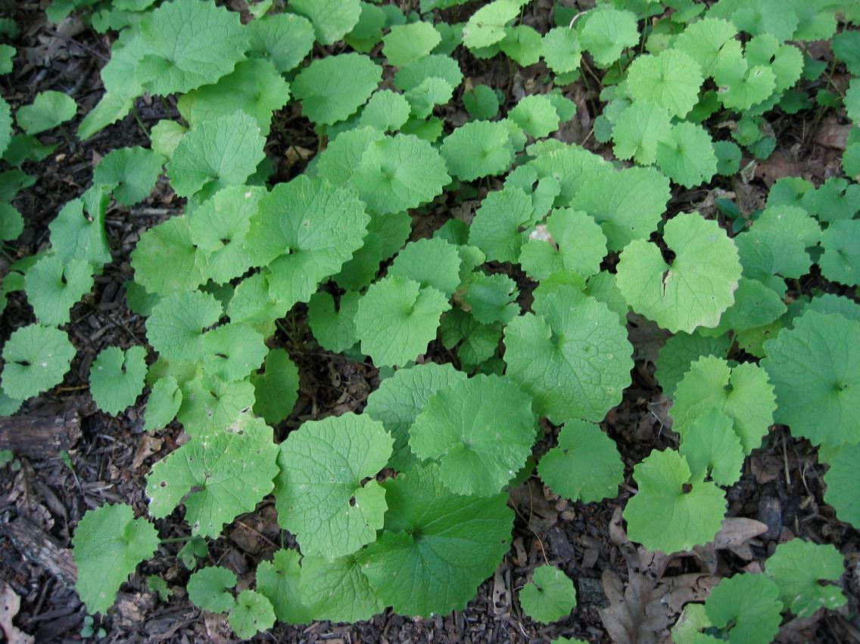


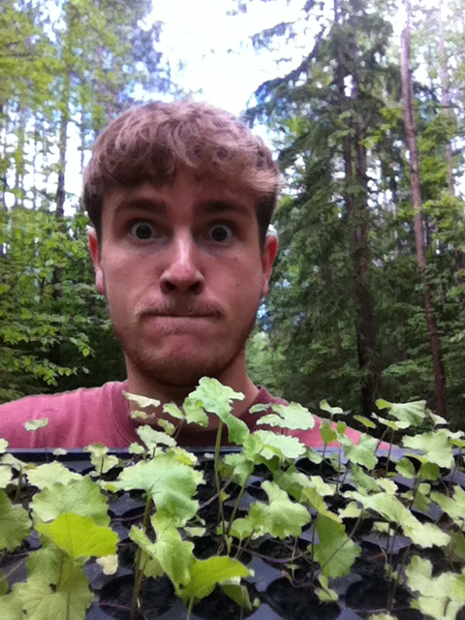
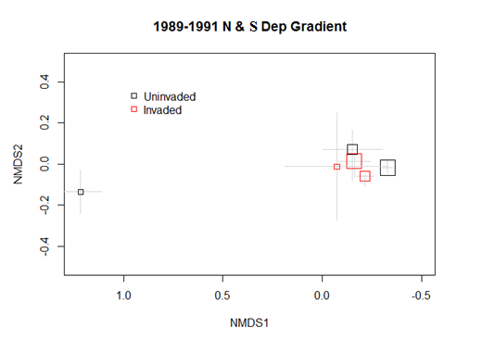
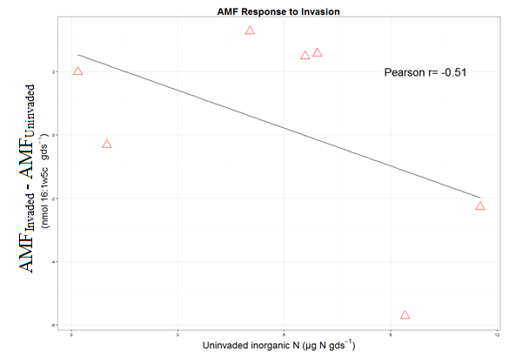
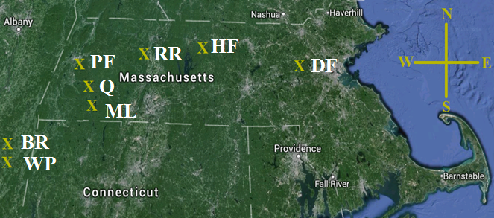
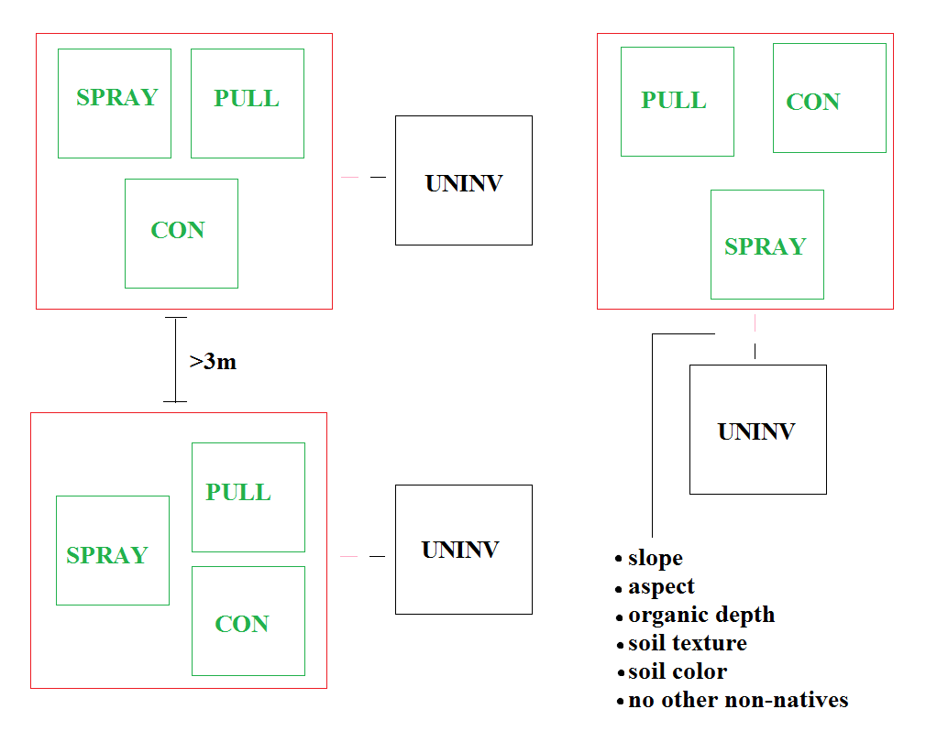
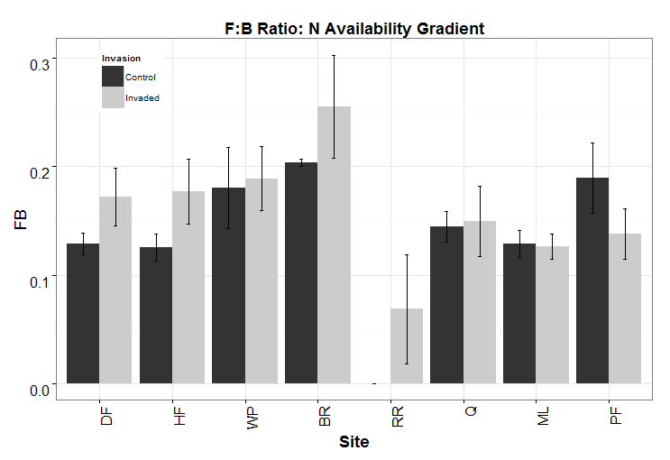
Microbial Responses to Alliaria petiolata (garlic mustard) Invasion in Northeastern Mixed Forests
Mark Anthony^{1*}, Serita D. Frey¹, Kristina Stinson²
Department of Natural Resources and the Environment, University of New Hampshire, MA;
2. Department Of Environmental Conservation, University of Massachusetts, Amherst, MA
*Presenting author (mat5955@wildcats.unh.edu)
Background
Alliaria petiolata is a non-native forb invasive throughout most of North America¹. A. petiolata is allelopathic, producing compounds that can suppress native plant species and soil microorganisms¹.
These allelochemicals are attributed with the suppression of mycorrhizal fungal function (e.g. colonization of host-plants²) and community structure (e.g. diversity, community composition³).
There are known edaphic properties that can influence the biomass of A. petiolata, such as the fertility of a forest’s soils⁴, which is controlled by climate and decomposing microbes (saprobes)^{5.}
It is pertinent to understand if invasion influences saprotrophic fungi and bacteria.
It is unclear if climatic variables influence the susceptibility or resiliency of forest microbial communities invaded by A. petiolata.
Site Selection
Sites established in mixed hardwood forests along a regional climatic gradient.
Analytical Methods
1) Extract soil biomarkers and analyze phospholipid
fatty acids (PLFAs) profiles using gas chromatography.
2) Quantify concentrations of bioavailable N and net rates of bioavailable N production.
Statistics:
Visualize patterns in microbial responses using NMDS and joint plots. Test the effects of invasion and climatic variation using permANOVA. Assess the response of univariate variables using Kruskal Wallis Rank Sum tests. All statistics performed using R 3.0.2.
Site F = 3.37, P = 0.001
Invasion F = 3.15, P =0.046
Invasion:Site F = 0.68, P = 0.81
Red→ Invaded
Black → Uninvaded
Microbial community composition is not the same in invaded and uninvaded forest patches.
Invasion is associated with differences in microbial- nutrient relationships.
Decreasing Nitrogen and Sulfur Deposition
Forest understories invaded by a minimum of 20 A. petiolata per m² were selected.
Plots were established as part of a long term eradication study.
Rates of nutrient deposition may influence how soil microbes respond to invasion.
Arbuscular mycorrhizal fungal responses to invasion are correlated with concentrations of inorganic N.
Conclusions
Invasion is associated with changes in microbial community composition.
In addition to AMF, decomposing soil fungi and bacteria also respond to invasion.
AMF are suppressed in forests with high inorganic N concentrations, while F:B ratios responds positively in forests with higher inorganic N concentrations.
Invasion may exert the greatest influence on soil microbes from forests receiving lower N and S deposition, in addition to sites accumulating the greatest quantity of snow.
Invasion may shift microbial nutrition from that of amino acids to nitrate.
Invasion was related with significantly higher pH (organic horizon displayed) and soil nitrate (mineral horizon) concentrations.
References
¹ Roders et al. (2008). BioScience 58: 5.
² Stinson et al. (2006) PLoS Biology 4:5.
³ Lankau (2010) New Phytologist 189.
⁴ Meekins & McCarthy (2000) Journal of Ecology 88.
⁵ Schimel & Schaeffer (2012) Frontiers in Microbiology 3:348.
The ratio of fungi to bacteria displayed along a descending inorganic N availability gradient.

