Slide 1


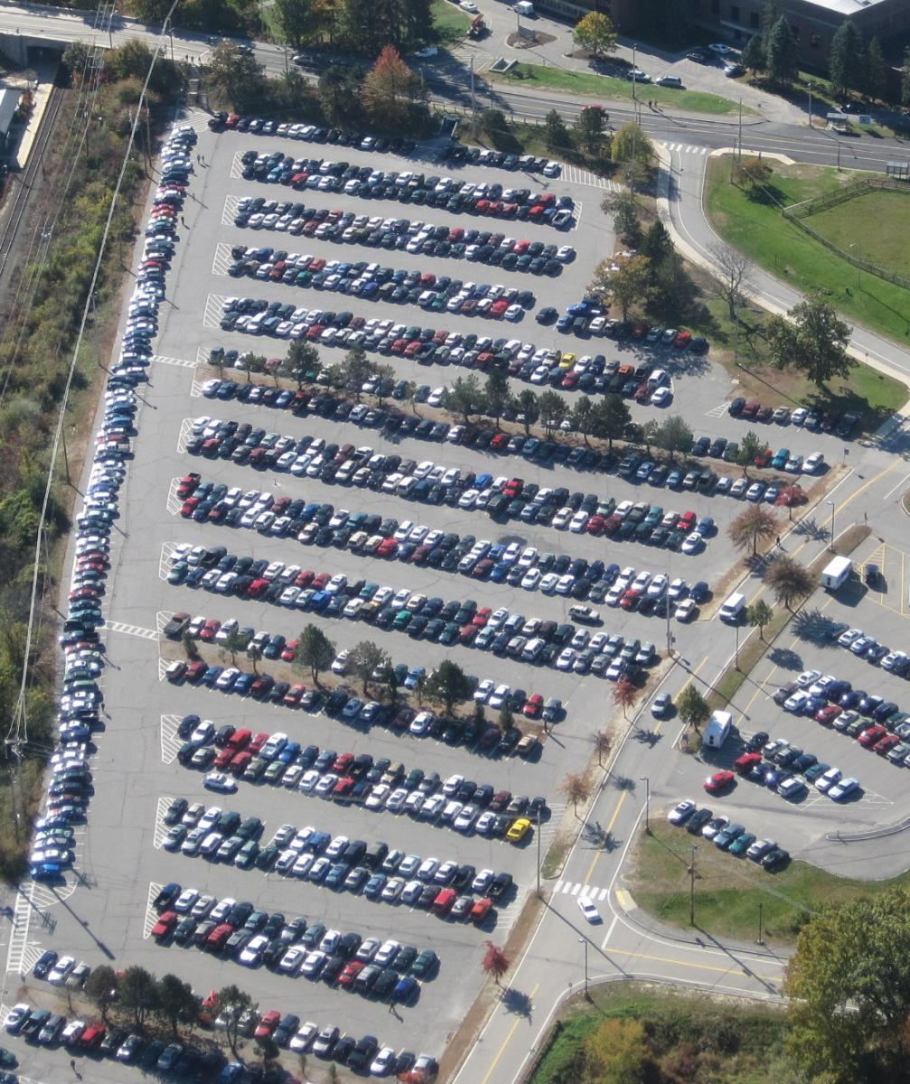
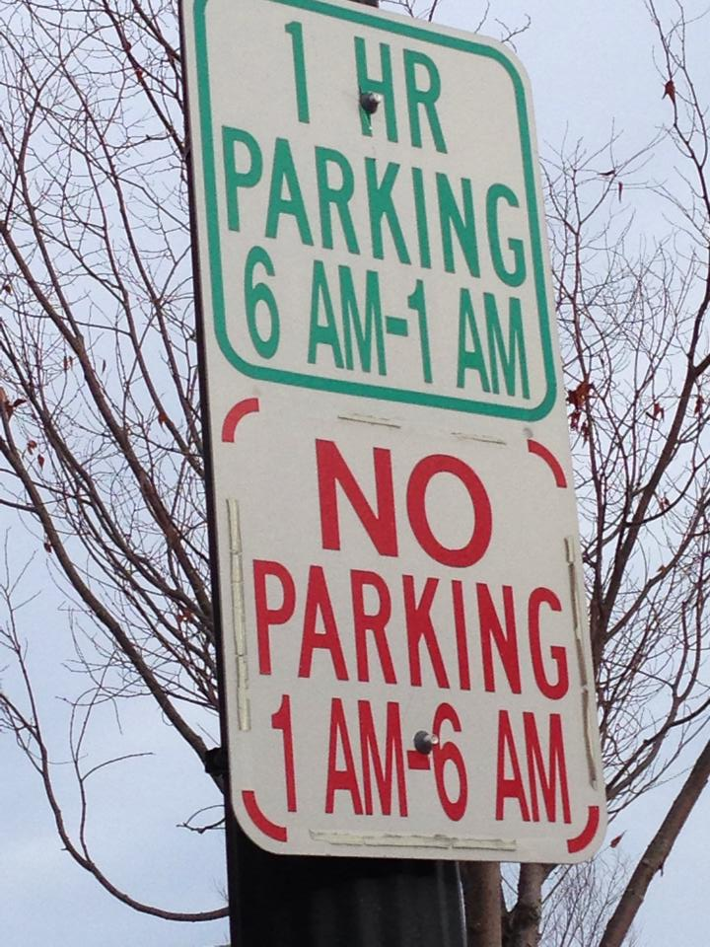
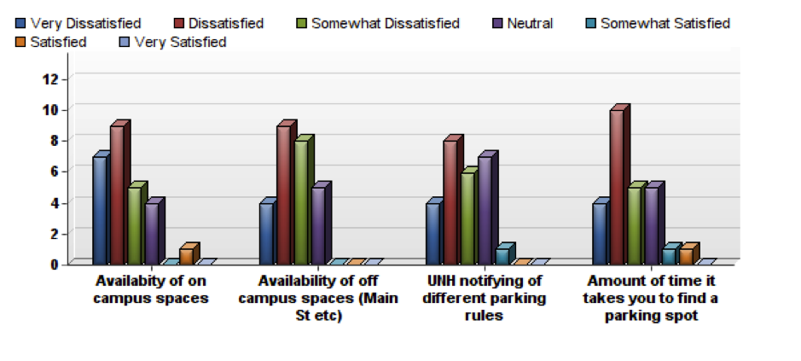

EZ Park Business Plan
Identifying and notifying users of parking availability around universities and cities to increase efficiency and convenience.
Market Pains
Trouble finding parking
Large ticketing ticketing fines
Parking rules and regulations
Time constraints
Business Concept
Innovative Laser Technology
Smart technology-application
Accessibility and Convenience
Advertisements for profit
Product and Service
iOs and Android based application
Assists individuals with locating parking spots to make it more convenient and efficient
Wireless motion sensing lasers
Real-time parking availability
Market Summary
Serving UNH and Durham
community
Commuter students and faculty
Those looking for convenience
Market Research
How satisfied consumers are in regards to parking
Created By:
Kristen Bellomo, Jackie Deasy,
Quinn DesiderioMel Karpel,
Marisa Quintanar, and Josh Sokol

