Slide 1

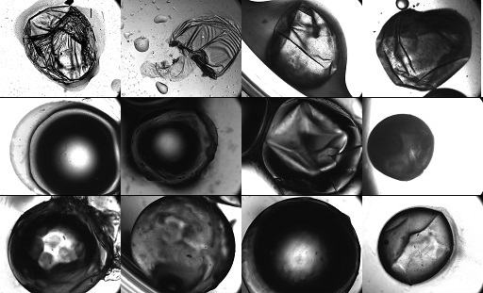
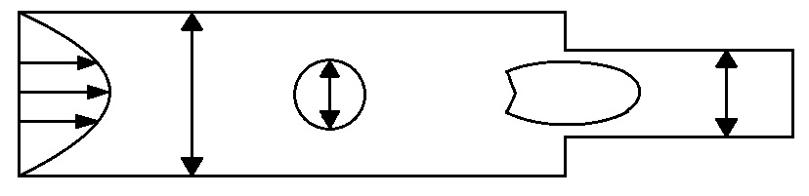



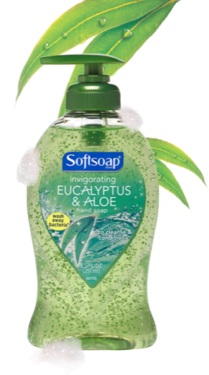
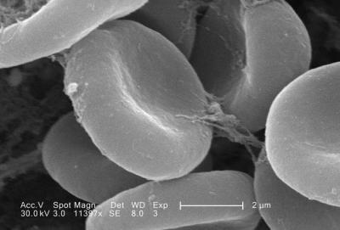
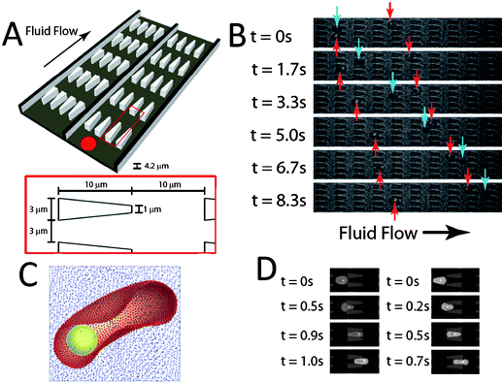
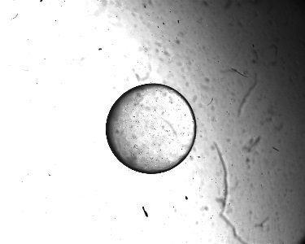
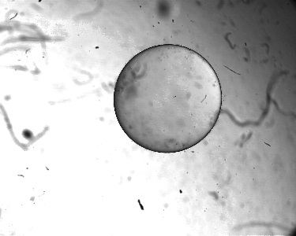
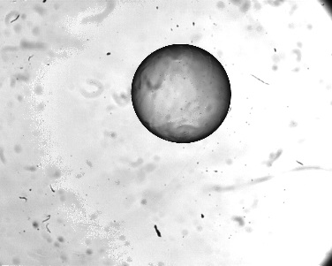
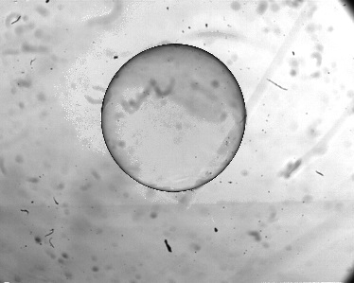
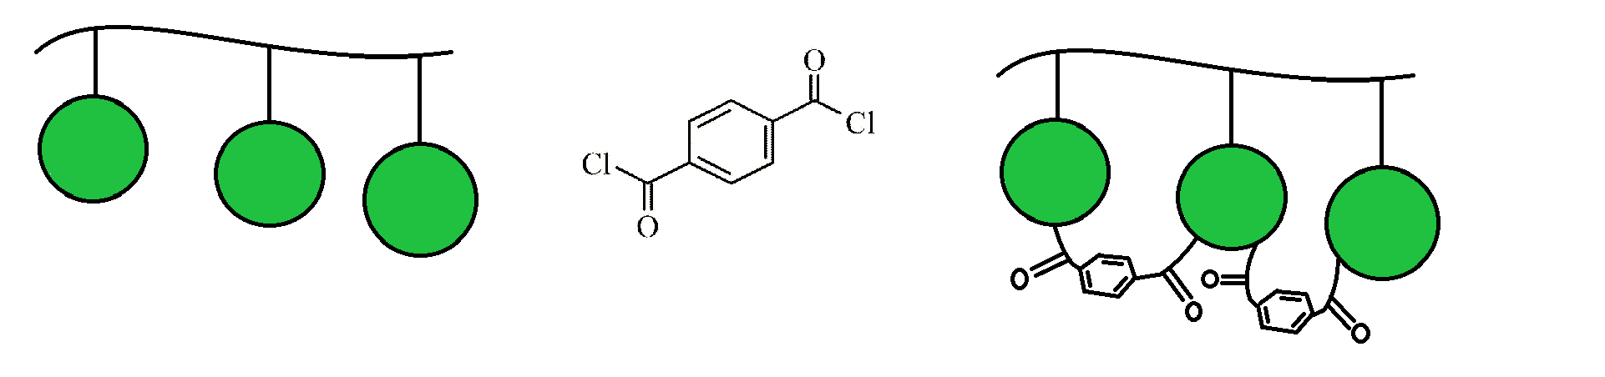
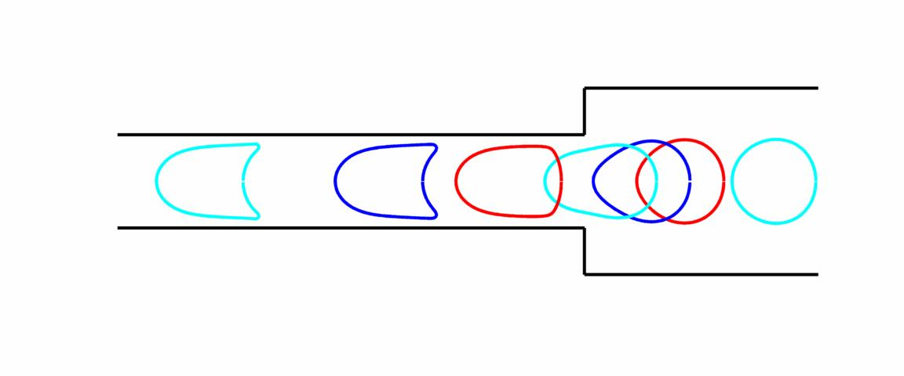
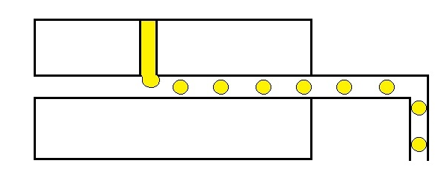

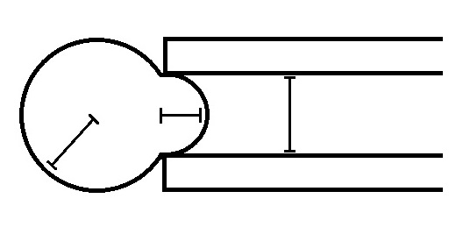
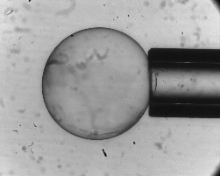
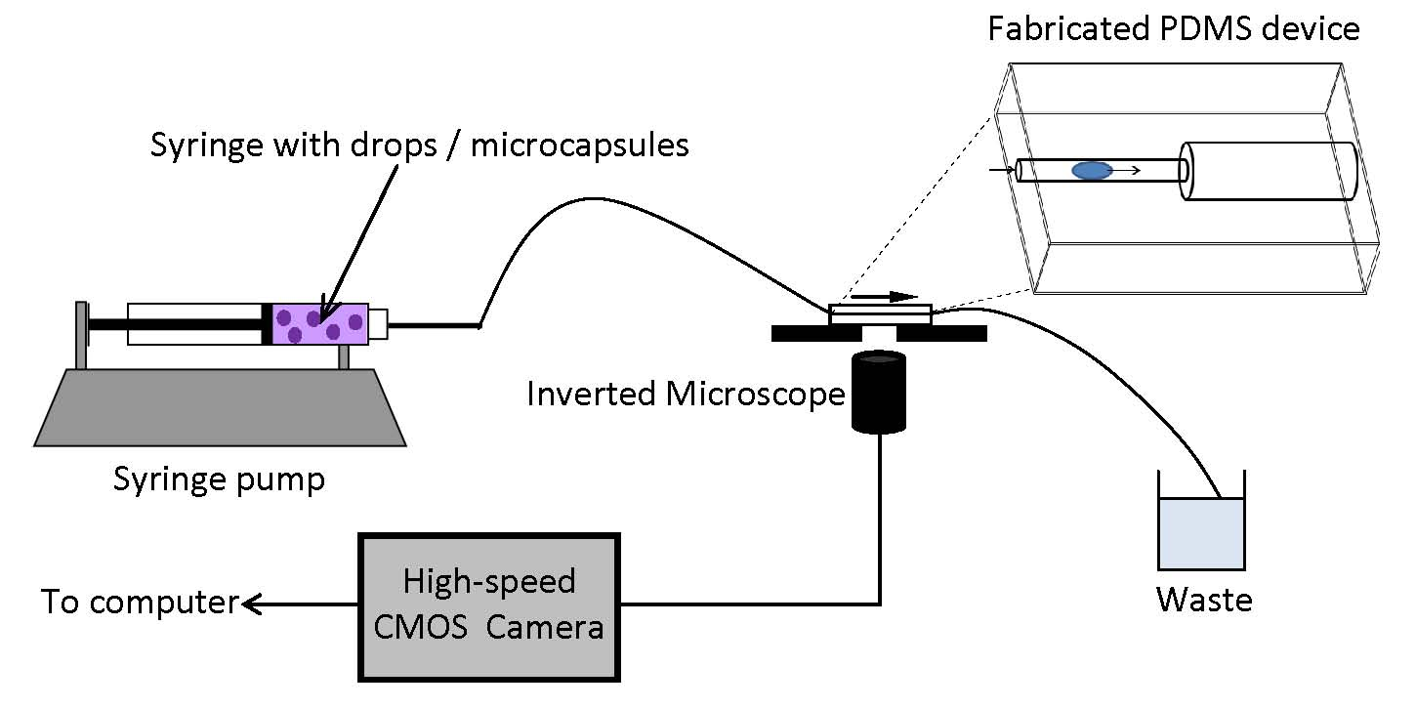
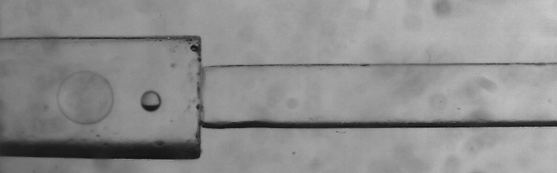
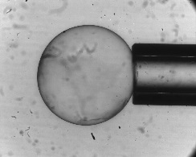
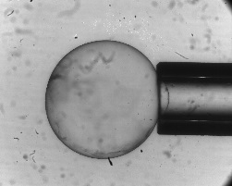
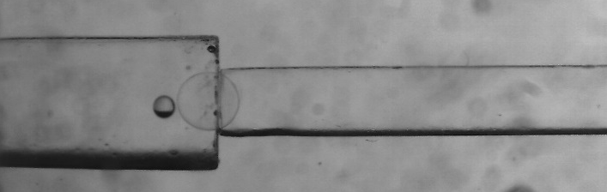
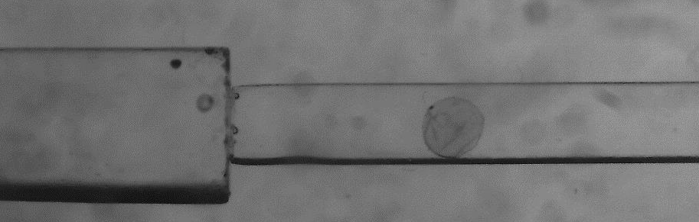
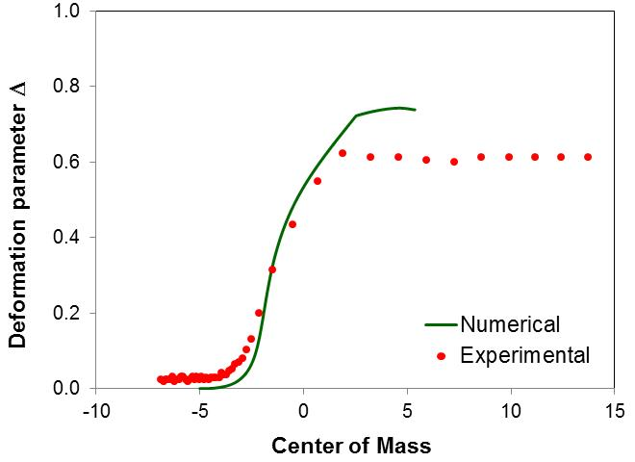
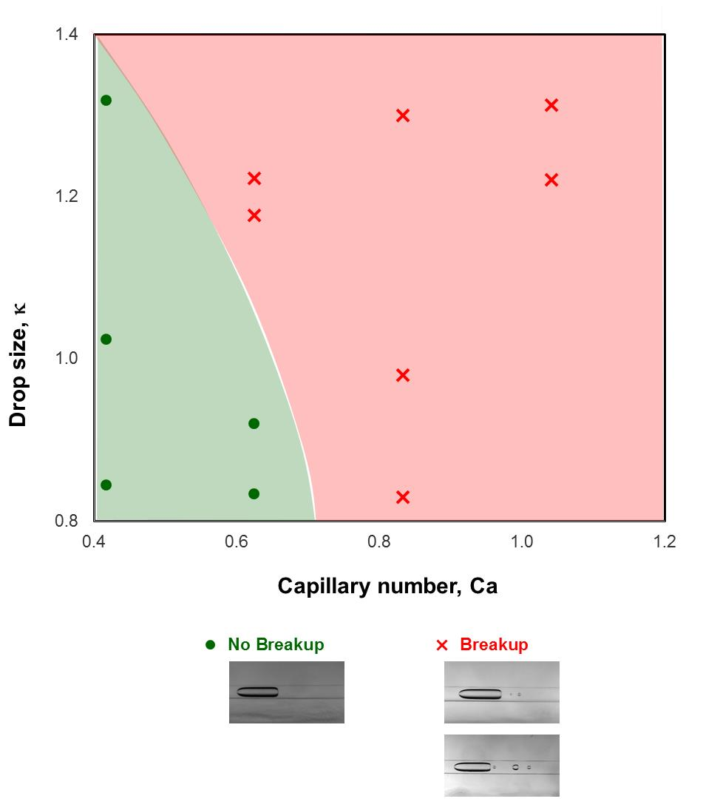
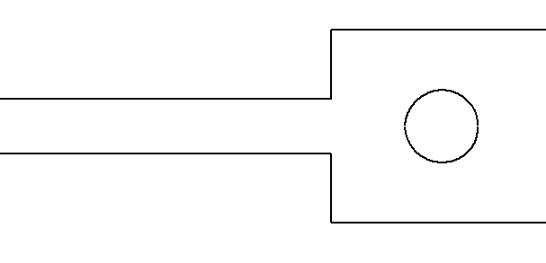
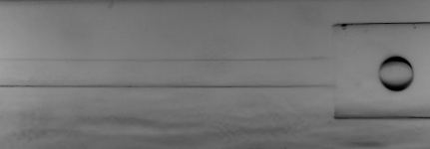
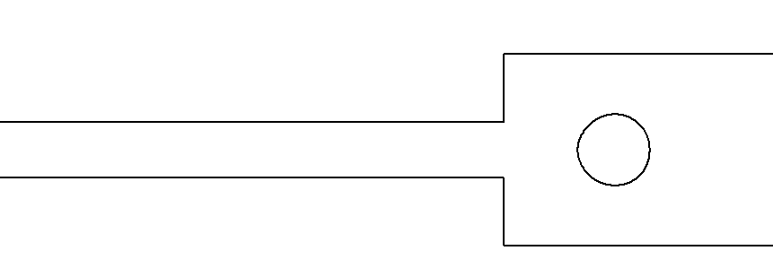
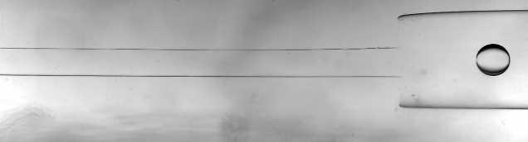
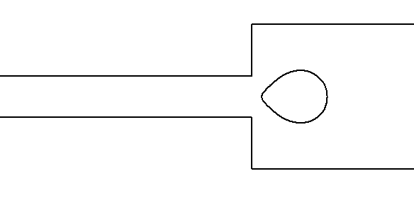
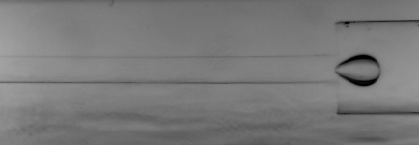
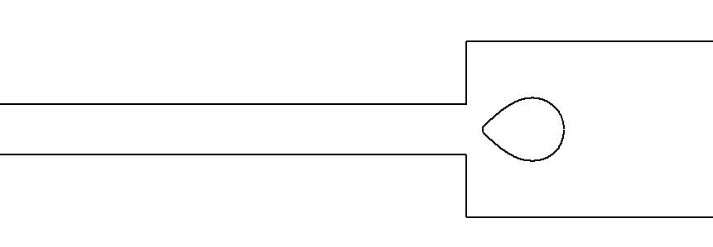
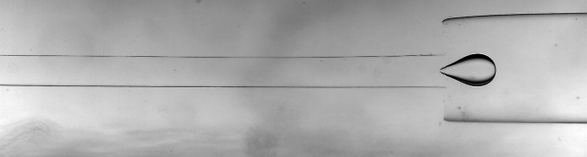
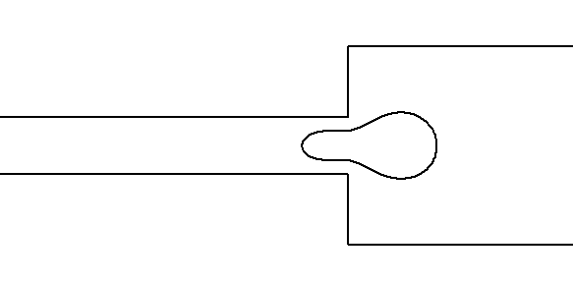
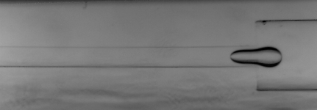
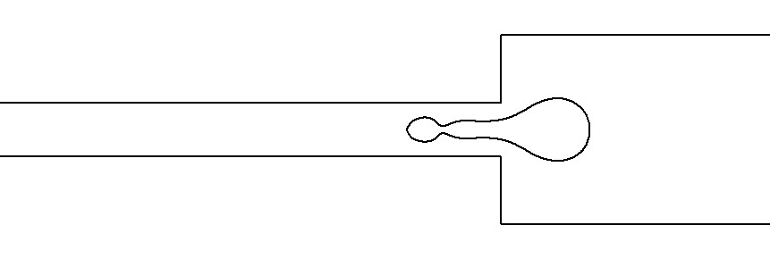
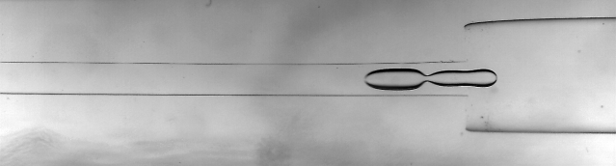
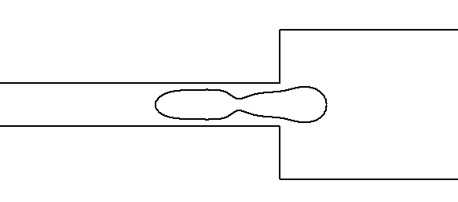
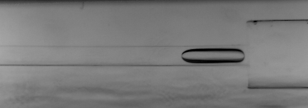
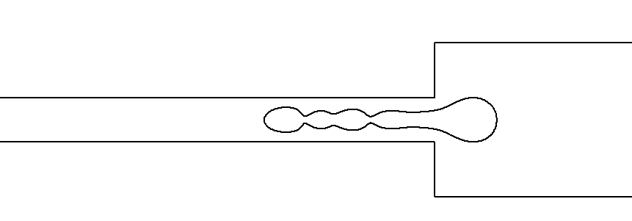
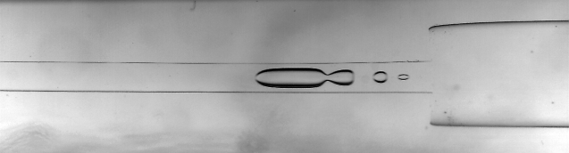
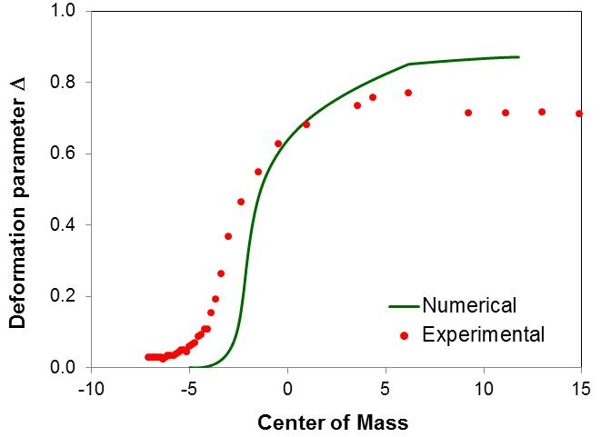
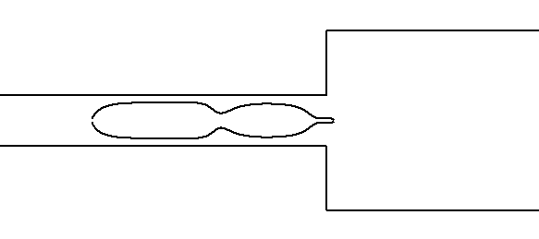
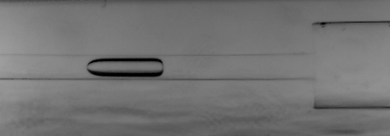
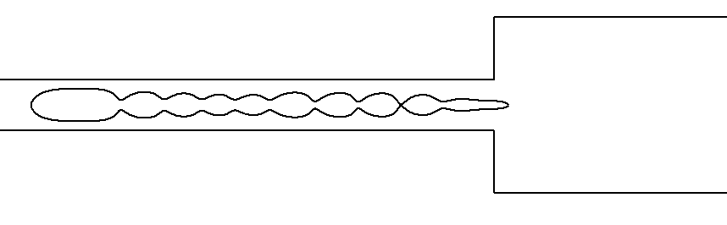
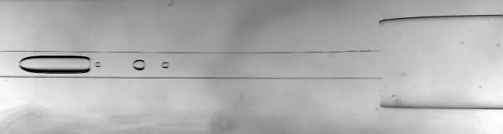
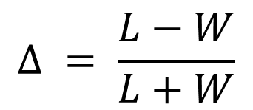
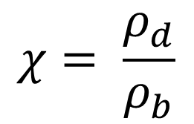
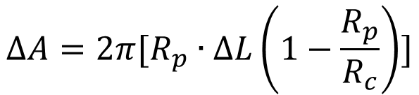


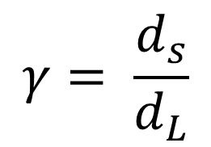


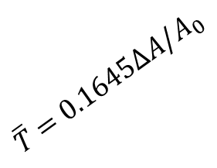




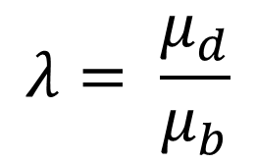


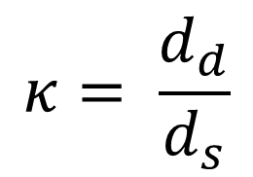



Fabrication and Characterization of Human Serum Albumin (HSA) Microcapsules
Christopher Blais and Nivedita Gupta
Department of Chemical Engineering
Motivation
Optimization of HSA Capsule Fabrication
Relevant Parameters
Study capsules in constraining geometries
10 min 20 min 30 min 60 min
Parameters Studied
C_{HSA} - HSA concentration (percent by weight)
    10% , 20%, 30%
τ_{rxn} - Reaction time
    10 min, 20 min, 30 min
Q
Food
Cosmetics
Pharmaceuticals
Carbonless Paper
Textiles
Living cells
${μ_{d} ρ}_{d}$
$$d_{s}$$
10%
20%
30%
$d_{L}$
${μ_{b} ρ}_{b}$
z = 0
Longer reaction times and higher HSA concentrations yielded more robust capsules
$$χ= \frac{ρ_{d}}{ρ_{b}}$$
$$Ea=\frac{4μ_{b}Q}{πd_{s}^{2}G_{s}}$$
$$κ= \frac{d_{d}}{d_{s}}$$
$$Δ = \frac{L−W}{L+W}$$
Characterization of HSA Capsule
$$γ= \frac{d_{s}}{d_{L}}$$
Flow induced deformation of diseased cells can be used to diagnose diseases
    Dilatation Studies
d_{d}
$$W$$
3% NaCl
10% NaCl
$$λ= \frac{μ_{d}}{μ_{b}}$$
$$Re=\frac{4ρ_{b}Q}{πd_{s}μ_{b}}$$
$$L$$
Fabrication of HSA Capsule
Future Work: Capsule Deformation Studies
Smaller volume change of capsules observed at lower saline solution concentrations
Numerical Simulation of a Capsule
20% wt. HSA in DI water
NH2
    Aspiration Studies
9.86 kPa
10 cSt Silicone oil
$$L$$
$\overline{T}$ $=0.1645∆A/A_{0}$
Experimental setup
3mL/min, 25% HSA Capsule in 5.5 w/v salt solution
HSA Drop formation in T-Junction
$$R_{c}$$
$$R_{p}$$
6.4 kPa
13.9 kPa
t = 0s
Drain Bulk and wash with IPA and DI Water
$∆P=2\overline{T}$ $(\frac{1}{R_{c}}−\frac{1}{R_{p}})$
t = 0.96s
Crosslinking Reaction in Terephthaloyl Chloride forms membrane
Store capsules in Isotonic Saline Solution
$$∆A=2π[R_{p}∙∆L\left(1−\frac{R_{p}}{R_{c}}\right)]$$
t = 2.60s
HSA capsule strength affected by reaction time and solution concentration
$\overline{T}$ $=K∙∆A/A_{0}$
Capsules are too rigid to pass through current geometry without lysing. Larger channel geometry and lower required
25% HSA capsules show a compressibility modulus (K) of 164.5 mN/m
Drop Deformation Studies: Experimental versus Numerical
Summary
γ = 0.28, χ = 1, λ = 0.02, Re/Ca= 0.53
γ = 0.28, χ = 1 , λ = 0.02, Re/Ca = 0.53
HSA microcapsules successfully fabricated
Robust capsules for 25% HSA solution with 30 minute reaction time
Dilatation and aspiration experiments set up to characterize capsules
Ca = 0.42, κ = 1.32
Ca = 0.83, κ = 1.30
Further Research
Conduct deformation studies to determine critical Elasticity number at which capsule breaks
Analyze how it changes with constraining geometry
Acknowledgements
Numerical simulations predict breakup at lower Ca
Interfacial tension may be underestimated
UNH Hamel Center for Undergraduate Research
Robert Carroll (PhD 2014 UNH)
Brian Zukas (PhD 2016 UNH)

