Slide 1


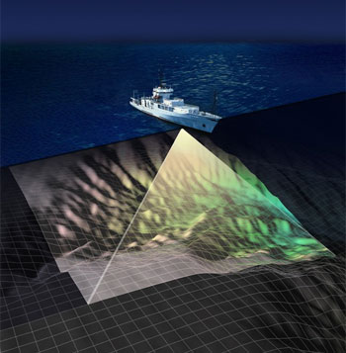
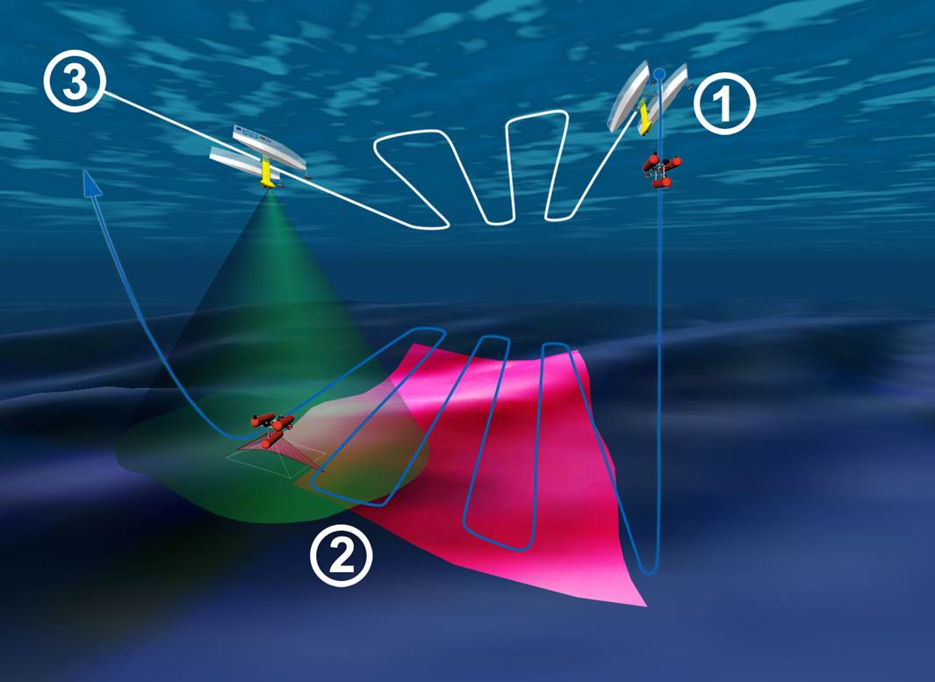
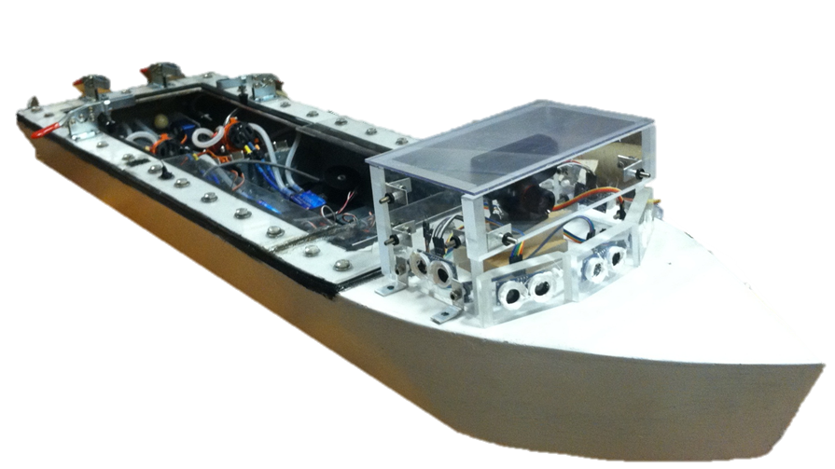
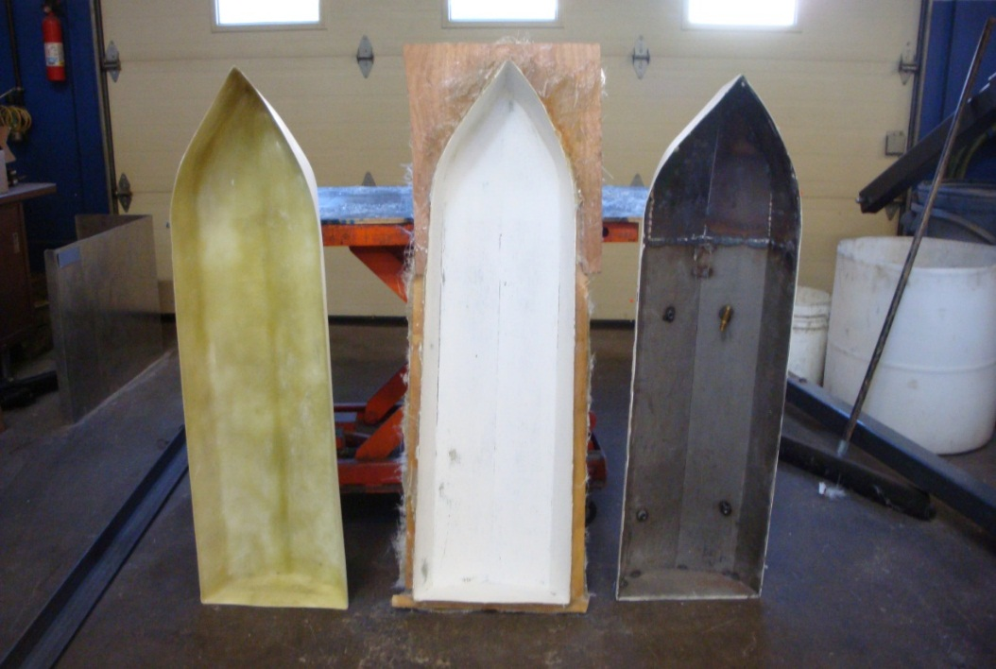
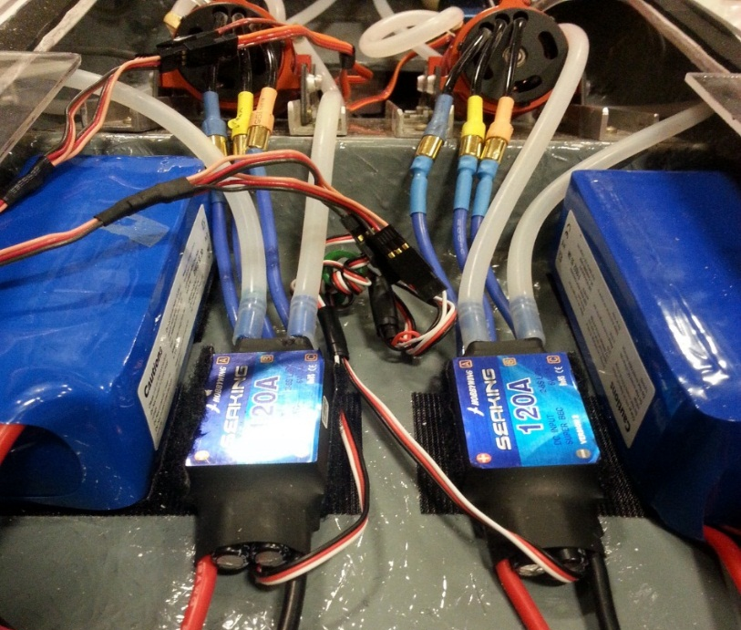
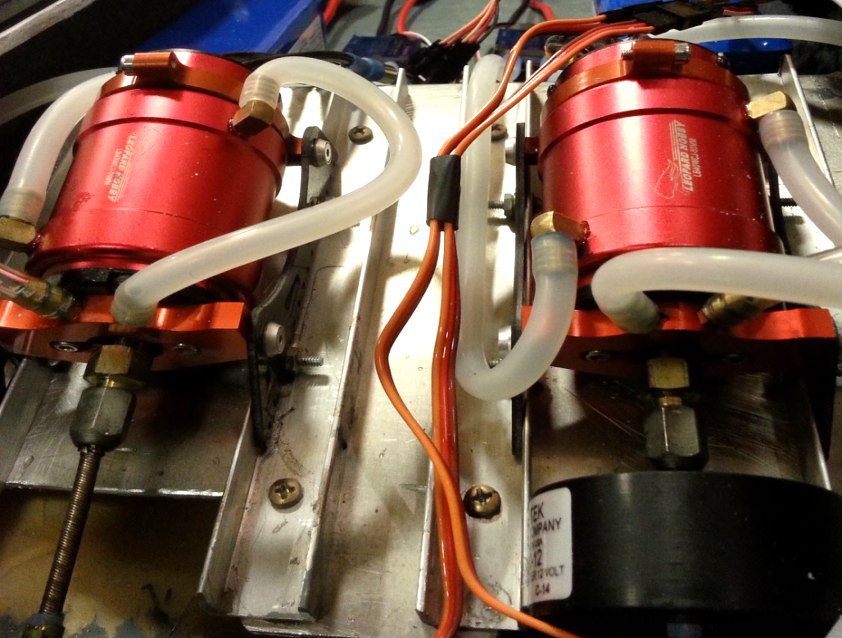
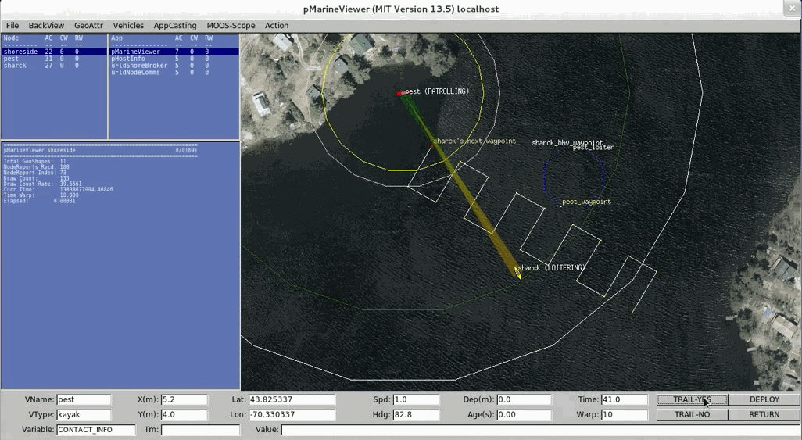
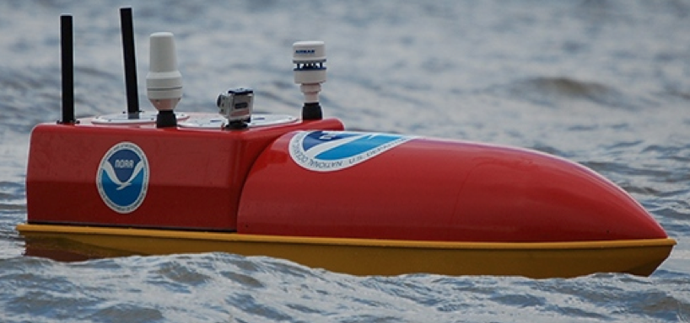
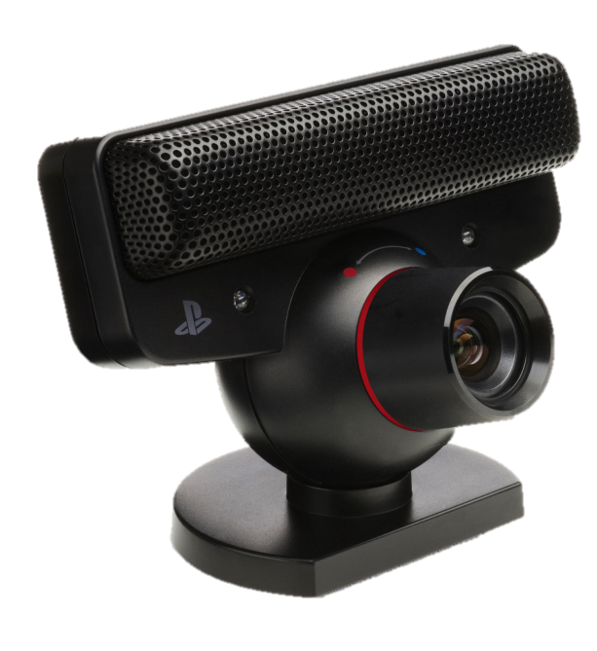
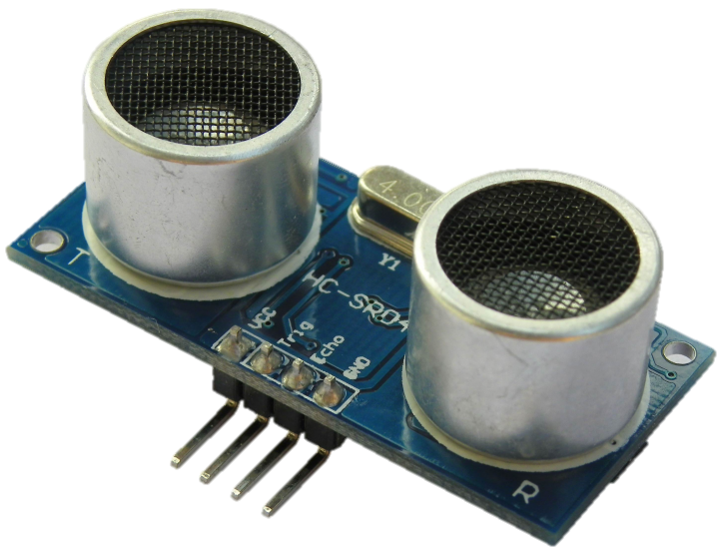
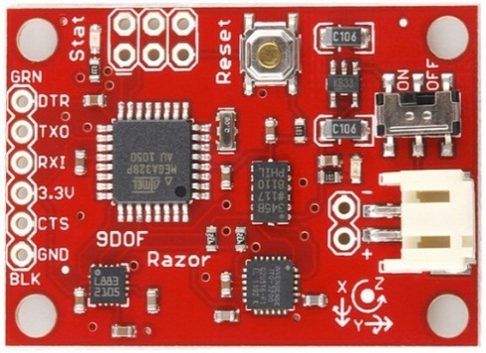
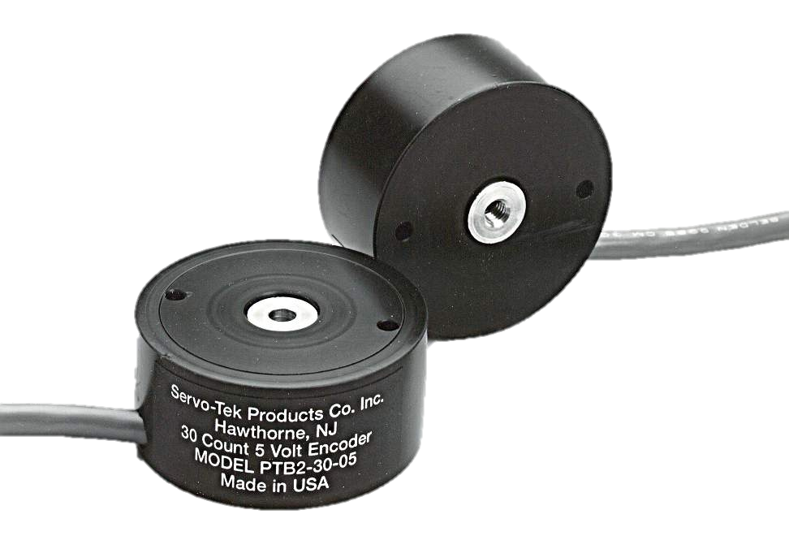
Autonomous Surface Vehicle
Andrew D’Amore, Kristin Therrien, Tom Conway, Billy Lerner—Mechanical Engineering
Mike Bogochow, Jeffery Masucci, Cody Noel—Computer Science
Graduate Advisors: Damian Manda, Firat Eren
Advisor: Professor May-Win Thein
NAVSEA POC: Dr. Martin Renken, Keyport NAVSEA
Background—ASV
Objective
Hull Construction
Autonomous surface vehicles (ASV) are extremely useful for both military and civilian purposes. ASVs can be used for a wide variety of tasks in which human operation is either inefficient and/or too dangerous, including:
  Ocean Mapping
  Surveillance
  Search and Rescue
The purpose of the project is to obtain proof of concept of autonomy. Our group has been tasked with developing the logic necessary that is flexible enough to be installed on a range of surface vehicles. The logic must be implemented such that it is able to perform three main tasks:
  Obstacle Avoidance
  Track & Trail
  Travel from a waypoint to a specified end point
The prototype will have the ability to know where it is at all times and arrive at its specified destination while avoiding obstacles.
The ASV was chosen to be built instead of purchased due to specific size requirements and the need for accessibility. The hull of the ASV has been crafted from fiberglass for durability and strength. This provides a light-weight body to allow easy maneuverability.
The dual-motor, dual rudder assembly was chosen to provide sufficient power and precise control for the ASV.
  A latch was constructed for the top of the hull out of plexiglass and clamps. To prevent the possibility of water leaking into the boat, a foam sealant was used to seal the latch top. This assembly can easily be removed to access and update the interior electronics.
Figure 1: Example of an ASV ocean floor mapping. This same method can also be used for search and rescue.
Figure 2: Example of an ASV completing track and trail with an underwater ROV (Remotely Operated Vehicle) that is mapping the ocean floor.
Figure 5: (Left) Three-step process of modeling and construction of the hull for the prototype. (Middle) Two DC Brushless motor setup with corresponding Encoder. (Right) Two 120A ESC (Electronic Speed Controller) with their corresponding 22.2V Hyperion Batteries.
Background—MOOS-IvP
Feedback System
MOOS-IvP is equipped with tools to aid in development as well as mission deployment. One is the pMarineViewer, which gives a graphical representation of the current state of a particular mission, displays a variety data that is being used within MOOS-IvP, and allows control over the mission through programmable buttons. Figure 3 shows this in motion.
By its nature, autonomy requires a precise feedback system to function efficiently. The feedback system constantly relays environmental and internal information back to the onboard computer (with autonomy installed) such that the autonomy can make accurate decisions.
Collaboration with NOAA
Visual Feedback System—Playstation®Eye
Used to detect object of known diameter to determine distance and orientation from said object
Essential for Track & Trail capability
Figure 3: The built-in MOOS-IvP graphical mission viewer (pMarineViewer) running a simulation of a track and trail mission.
Figure 6: Emily,
Courtesy of NOAA
MOOS-IvP Communication
Sonic Feedback System—Ultrasonic Proximity Sensor
3m range pinging capabilities
Used to detect obstacles in 30° field of view
BeagleBone
Black
The payload autonomy interface is a MOOSApp which subscribes to MOOSDB variables that are published by the IvP Helm.
It then forwards this data to the Arduino over the USB serial connection, with its schematic shown in Figure 4.
At the same time, the interface reads in sensor data sent from the Arduino and forwards this data to the MOOSDB to be read by the IvP Helm. Data that is sent to the Arduino, includes desired heading and speed.
Data can then be sent back from the Arduino in the form of position, actual heading and speed, and detected obstacle data.
This research focuses on development of a modular autonomy platform and application to hydrographic surveying. The basic behaviors and controlling electronics developed by the undergraduate ASV team will be applied to a National Oceanic and Atmospheric Administration (NOAA) autonomous platform known as EMILY and all necessary functionality replicated. Additional behaviors will then be developed relating to seafloor mapping, including avoidance of newly detected shoals and automatic development of survey lines to achieve full coverage. A sonar system will be mounted to EMILY for testing these behaviors.
MOOSDB
IvPHelm
Payload
Autonomy
Interface
Other
MOOSApps
Heading Feedback System—9 Degrees of Freedom Razor IMU
Triple-axis digital-output gyroscope
13-bit resolution, ±16g, triple-axis accelerometer
Triple-axis, digital magnetometer
Serial
Arduino
Special Thanks
Ultrasonic
Sensors
IMU
The group would like to acknowledge Sheldon Parent, Paul Lavoie, Scott Cambell, Mike Conway, and James Abare for allowing us to use their facilities and helping us with various construction tasks. Additional thanks to the UNH NASA MMS QuadSatC team for developing the visual recognition program. We’d also like to thank Tracey Harvey and Jenn Bedsole for their valuable input on our project.
RPM Feedback System—PT series ServoTek Hollow Encoder
Used to control the speed of the ASV
30 Pulse, 15V
Figure 4: Diagram displaying the map of the communication between the onboard computer and the feedback system of sensors.

