Slide 1

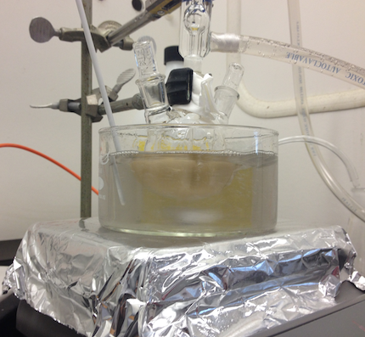
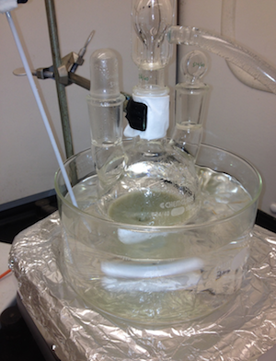
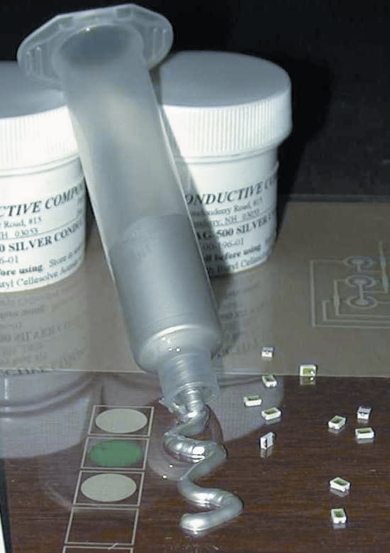
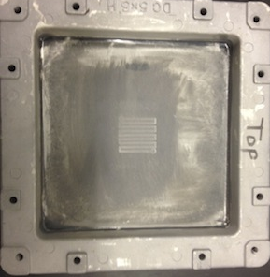
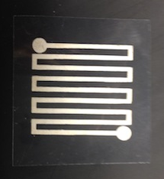
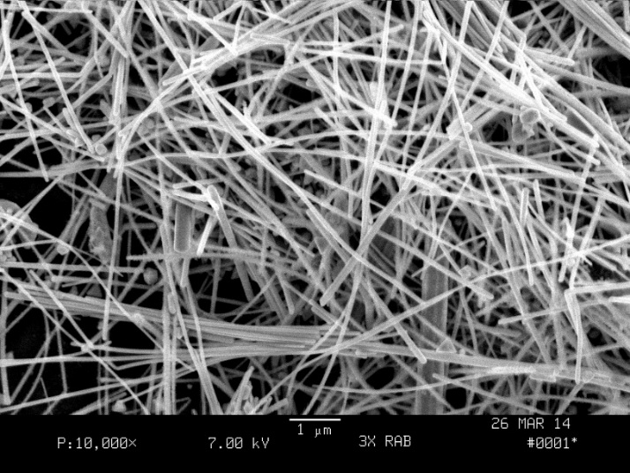
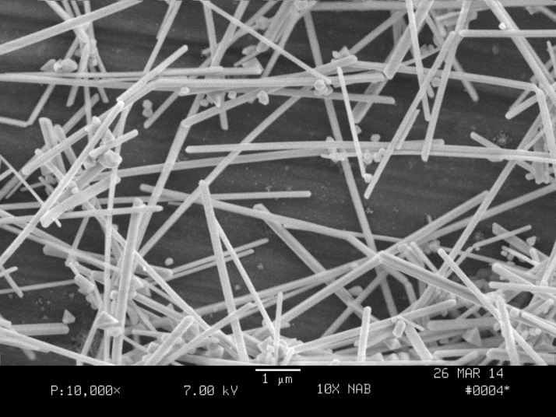
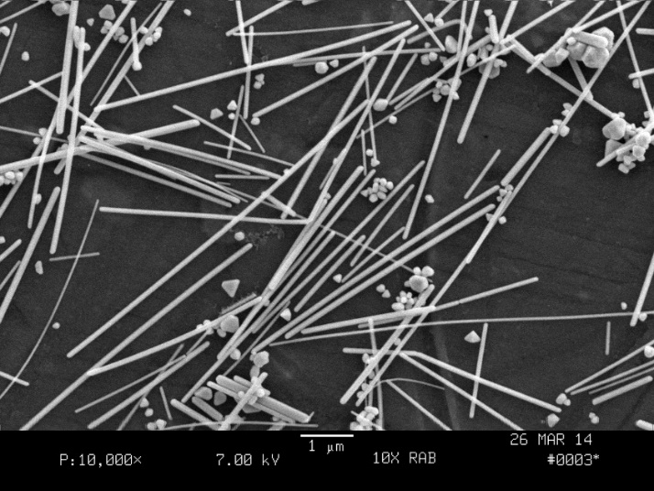

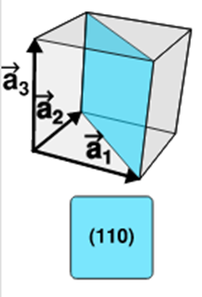
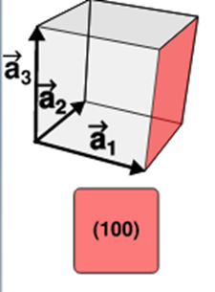
Synthesis of Silver Nanowires for Conductive Ink
Ryan Huard, Derek Hellested
Department of Chemical Engineering
University of New Hampshire, Durham, NH
Background
Reactor Design
Screen Printing
Conductive ink is used in various technologies, such as solar panel current collectors. The purpose is to create ink with a low resistance, allowing for the a higher collection of solar radiation to increase efficiency.
Typical inks contain solvent, binder, silver powder, and rheological agents. The binder is useful in dispersing silver powder into the solution to form smooth, homogeneous ink.¹
Research groups at the University of New Hampshire Chemical Engineering Department and Conductive Compounds LLC in Hudson, NH are working together on this project with support from the NSF under
Grant #CMMI-1200544
Nanowire synthesis under inert atmosphere with rapid magnetic stirring
Successive scale up design
Challenges of scale up include good mixing and clean injection
3 times (right) and 10 times (left) than original bench scale
Commercial application of conductive ink with AgNW
Print test circuits using commercial ink and compare results to synthesized ink
Print onto silicon ships and test resistance
Current Results
Nanowire Synthesis
Particle Characterization
Synthesized silver nanowires
Scaled up reactor 10 times the original quantity
Synthesized silver nanowires with dimensions 25nm in diameter with a 230nm length
111 orientation of nanowire determined by x-ray diffraction
Two stages: Nucleation and Crystal Growth
Start synthesis by forming silver nuclei
Reach the critical nucleus size
- Particles continue to grow from the critical nuclei
Growth is limited by diffusion
Ethylene glycol (EG) is used as a precursor reducing agent and solvent
Silver Nitrate (AgNO₃) is used as the source for silver.
Copper (II) Chloride (CuCl₂) is added to scavenge oxygen
Polyvinylpyrrolidone (PVP) adsorbs faces of silver to inhibit growth in 2 directions (perpendicular to face, 100)³, resulting in 1D growth
- Smaller reactor scales have higher yield of cylindrical particles
- More spherical particles present without needle injection of argon
Gas atmosphere in reactor influences particle shape¹
SEM Imaging of particles from various experiments
Future Research
Study rheological properties of conductive inks
Determine if wire orientation of nanowires in ink can be controlled
- Investigate production of 100 nanowire orientation
- Investigate synthesis of longer nanowires
3x in Ar with Needle 10x in Ar with Needle 10x in Ar
Reaction Mechanisms
The reaction below shows the formation of silver nanowires
Ag_{(aq)} + R → Ag_{(s)} + O
The R represents a reduced form of EG. The O represents the oxidized EG agent. The Ag_{(aq)} is provided by AgNO₃.
Cu(II), added as CuCl₂ is reduced by EG to Cu(I). Cu(I) is then oxidized by oxygen back to the Cu(II) state. The reaction with oxygen removes dissolved O₂ from the solution. O₂ is a poison for the crystal growth.
References
1) Kylee, K. E.; Skrabalak, S. E.; Xia, Younan. Rapid synthesis of silver nanowires through a CuCl- or CuCl₂₋mediated polyol process. Journal of Materials Chemistry. 2008, 18, 437-441.
2) Lee, J. H.; Lee, P.; Lee, D.; Lee, S. S.; Ko, Seung Hwan. Large-Scale Synthesis and Charazterization of Very Long Silver Nanowires via Successive Multistep Growth. Crystal Growth Des. 2012, 12, 5598-5605.
3) Zhu, J. J.; Kan, J. G.; Han, M.; Wang, G. H. High-Yield Synthesis of Uniform Ag Nanowires with High Aspect Ratios by Introducing the Long-Chain PVP in an Improved Polyol Process. Journal of Nanowires. 2011, 982547.
4) Neil W. Ashcroft and N. David Mermin, Solid State Physics (Harcourt: New York, 1976).
Objectives
Synthesis of silver nanowires (AgNW)
- Reactor scale up to ten times the bench scale
Collect rheological data under screen printing conditions
Ink formulation to minimize electrical resistance and optimize printing performance
Acknowledgement: We would like to thank Dr. Dale Barkey and Shohreh Hemmati for supporting this project with funding provided by the NSF.

