Slide 1



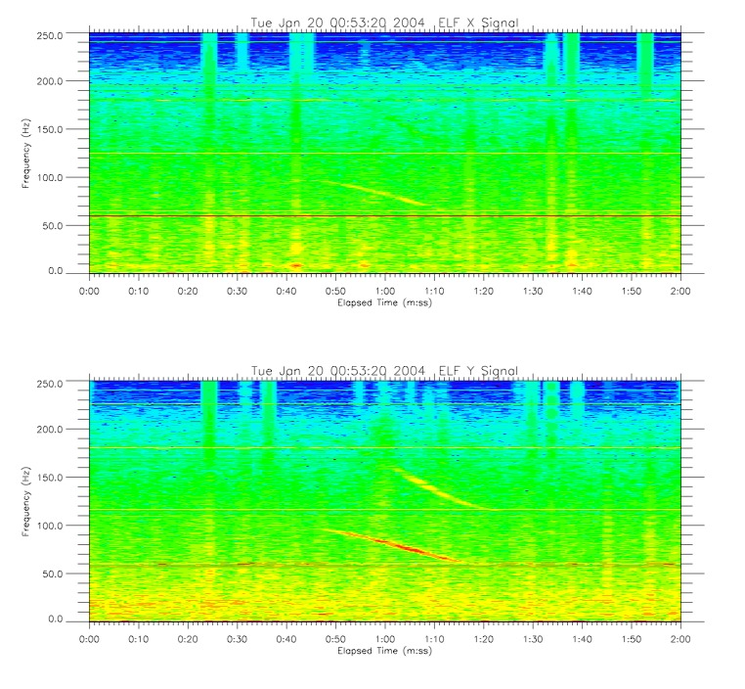
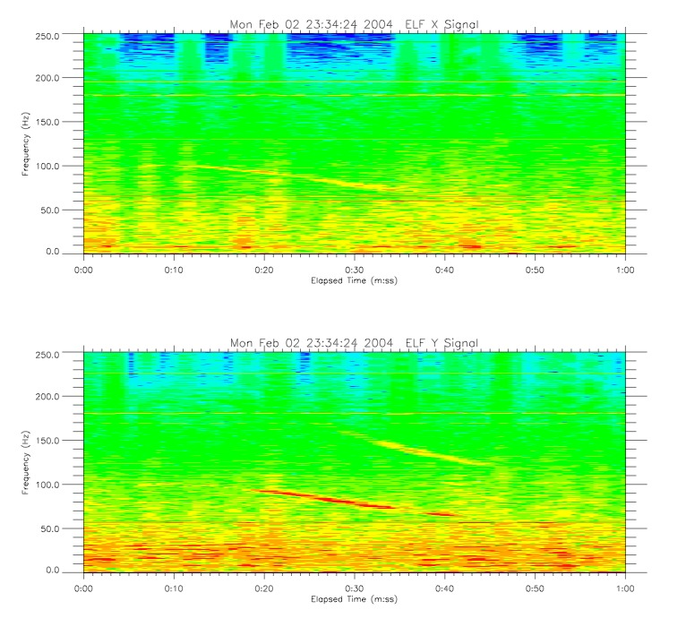
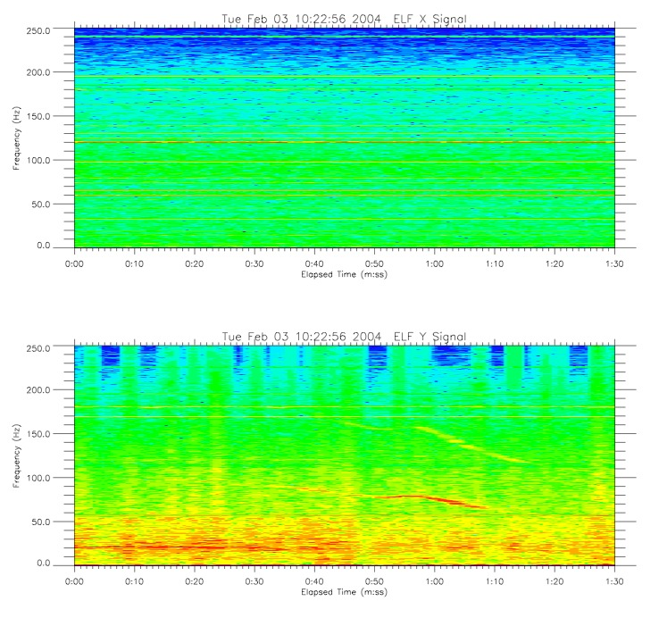
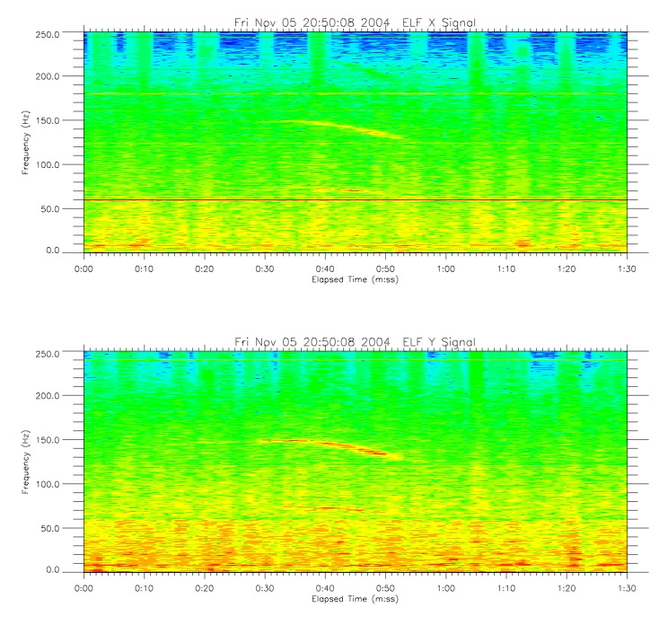
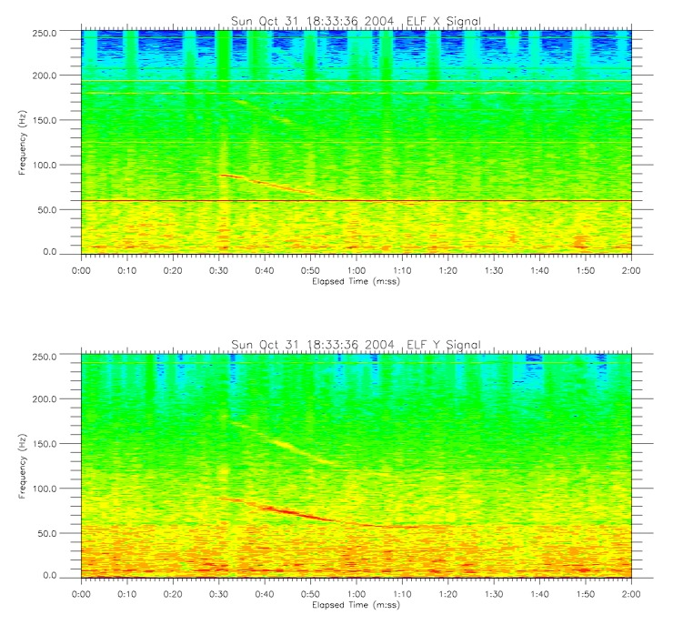
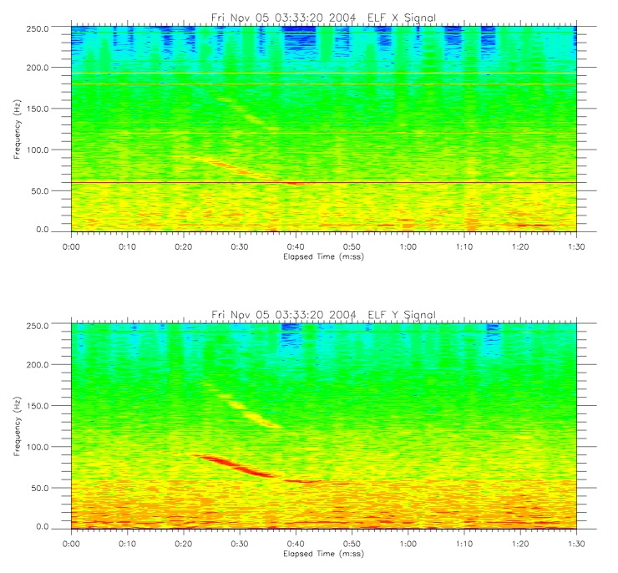
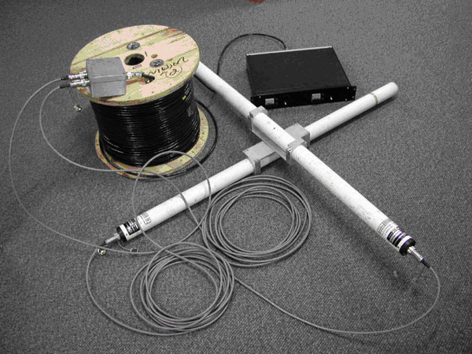
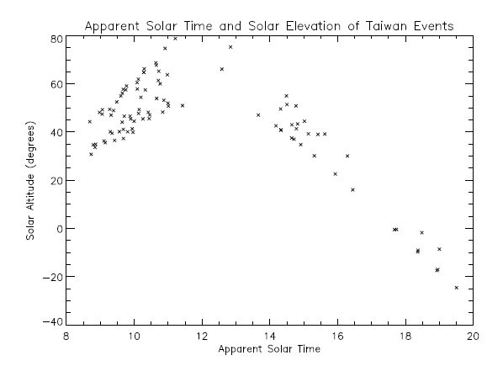
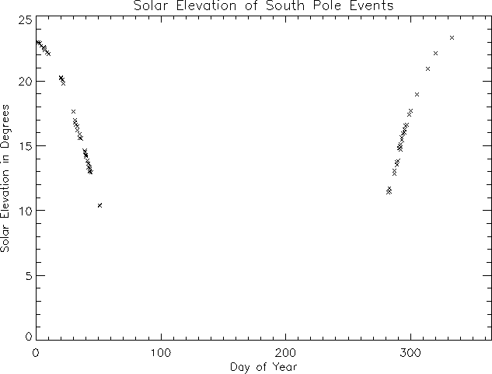
Extremely-Low-Frequency Whistler-Like Waves Observed at South Pole Station
John Heavisides Dr. Marc Lessard, Faculty Adviser
Department of Physics, University of New Hampshire, Durham, NH
Extremely-Low-Frequency (ELF) waves are narrow-bandwidth events that occur between 60-200 Hz. First detected in 1974 in Alaska, these waves start at a high frequency which then decreases over a period of ~30 seconds. Their structure is reminiscent of lightning-generated radio whistlers, but last much longer. ELF events are electromagnetic in nature and have had no demonstrated temporal connection to lightning strikes, suggesting a very different (and yet unknown) origin. Recent investigations have centered around a UNH-MIRL magnetometer at Amundsen-Scott South Pole Station, and data collected by a magnetometer from the National Cheng Kung University in Taiwan in 2004, before the device was destroyed in a lightning strike. For the first time, data was collected in two locations at once.
Falling Tone
  These waves are observed to begin with a certain frequency which then gradually decreases. How much and how fast they decrease varies between individual events and locations – events in Taiwan are generally longer and decrease slower than those at the South Pole.
Narrow Bandwidth
  The signals are intense, and only spread over several Hertz.
Global Distribution
  Events have been recorded at high, mid, and low latitudes. High latitude measurements come from both hemispheres.
Introduction
Sample Events
Key Features
January 20 (00:53 UT)
February 2 (23:34 UT)
January 20 (00:53 UT)
Nearly constant slope, harmonic present.
Note the point at which spectral power briefly increases in one event and decreases in the other.
The slope decreases, flattens, then decreases again.
Drastically lower frequency
  ELF events are found between 150-60 Hz, as opposed to the kHz range of radio whistlers.
Not correlated to lightning strikes
  VLF whistlers have been shown to be caused by lightning strikes, but no such correlation exists for ELF waves.
Much longer timescales
  The typical ELF event lasts about 30 seconds, an order of magnitude longer than VLF events.
Correlation to solar elevation angle
  ELF events of this nature seem to occur when the ionosphere is lit and therefor more electrically conductive, which might play a role in their creation.
The Ion Cyclotron?
  When a charged particle encounters a magnetic field, it begins spinning with a frequency proportional to the particle’s charge and speed, as well as the strength of the magnetic field. A possible explanation is that an ion moving through the Earth’s magnetic field could be causing these oscillations. As the wave propagates from the source, higher frequencies may disperse more rapidly than lower ones, reaching the ground first.
Sunlit Ionosphere?
  Events that are shown to occur during times when the ionosphere has been exposed to sunlight. The increased conductivity might play an unknown role in the creation of these waves.
What Makes ELF Waves Different from Whistlers?
Potential Sources
November 5 (20:50 UT)
October 31 (18:33 UT)
November 5 (03:33 UT)
Slope decreases with decreasing frequency. X-axis shows three harmonics.
A broad event with pronounced harmonic.
An event with more prominent high-frequency part.
ELF events have been correlated to solar elevation
  With access to year-long observational data, ELF waves at South Pole Station appear to abruptly stop when the sun drops below 10 degrees above the horizon.
Events are localized
  Simultaneous measurements from a research team in Taiwan show that events detected in one location are not detected at the other.
Automatic data processing
  MIRL undergraduates John Heavisides and Matt Smith have been working on automatic processing of ELF data files.
Events as a Function of Solar Elevation Angle
Thank you to Kaiti Wang for providing us with Taiwan data for 2004.
Funding for this research provided by NSF grants to the University of New Hampshire ANT-0839938 and ANT-0838910.
Heacock, R. R. (1974), Whistler-Like Pulsation Events in the Frequency Range 20 to 200 Hz, , 1, 77–79, doi:10.1029/GL001i002p00077
Kim, H., M. R. Lessard, J. LaBelle, and J. R. Johnson (2006), Narrow-band extremely low frequency (ELF) wave phenomena observed at South Pole Station, , 33, L06109, doi:10.1029/2005GL023638
Sentman, D. D., and D. A. Ehring (1994), Midlatitude detection of ELF whistlers, , 99, 2183–2190, doi:10.1029/93JA02103
Wang, K., Y.-C. Wang, H.-T. Su, R.-R. Hsu, and T.-Y. Lin (2011), Wave mode of the low-latitudinal ELF-whistlers, Journal of Geophysical Research (Space Physics), 116, A09323, doi:10.1029/2011JA016832
Wang, Y.-C., K. Wang, H.-T. Su, and R.-R. Hsu (2005), Low-latitude ELF-whistlers observed in Taiwan, , 32, L08102, doi:10.1029/2005GL022412
The Instrument: ELF magnetometer
Recent Developments
Acknowledgements
For the first time, we can now show when these events happen from a year’s worth of data. In Taiwan events only occur well after sunrise, but persist into the evening. The south pole, with its year-long day, sees an abrupt cutoff once the sun is very low in the sky. This seems to indicate that solar heating plays a role in ELF wave generation.
References
Figure 1:
The ELF magnetometer measures changes in the magnetic field in two axes.

