Slide 1


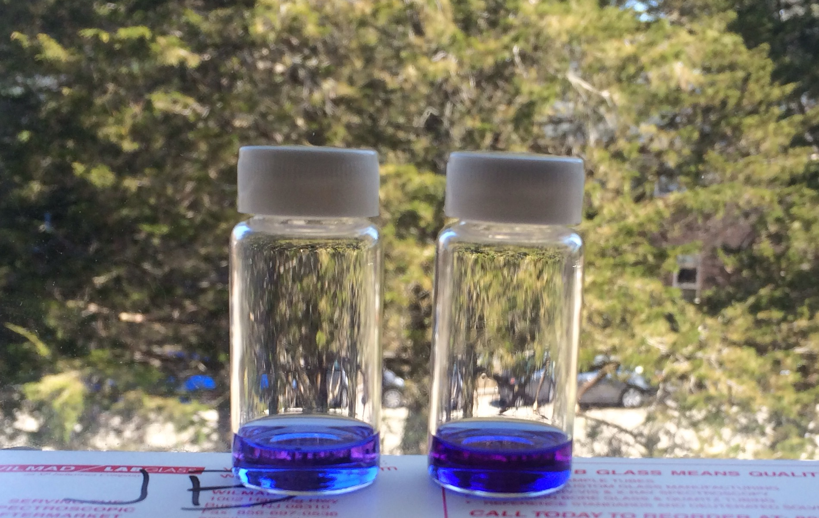
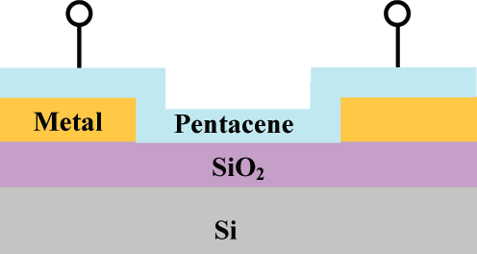
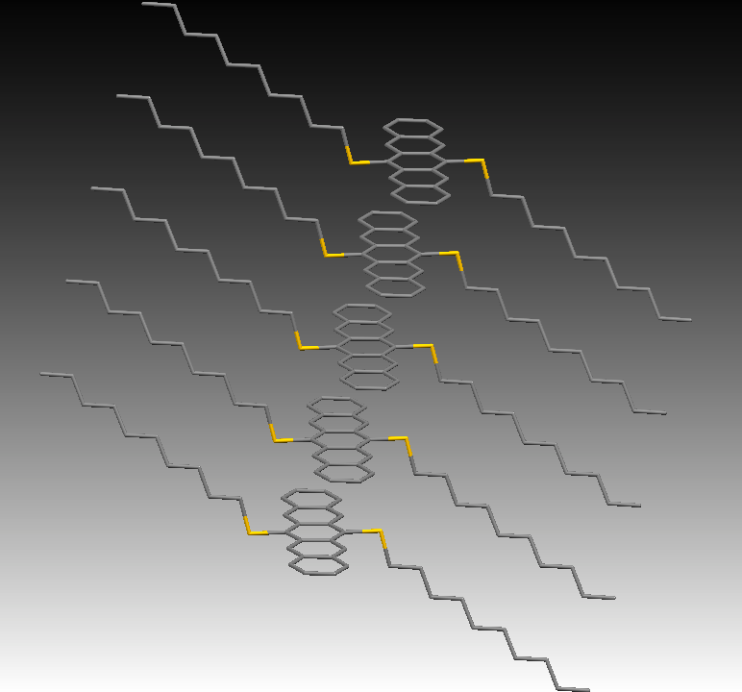
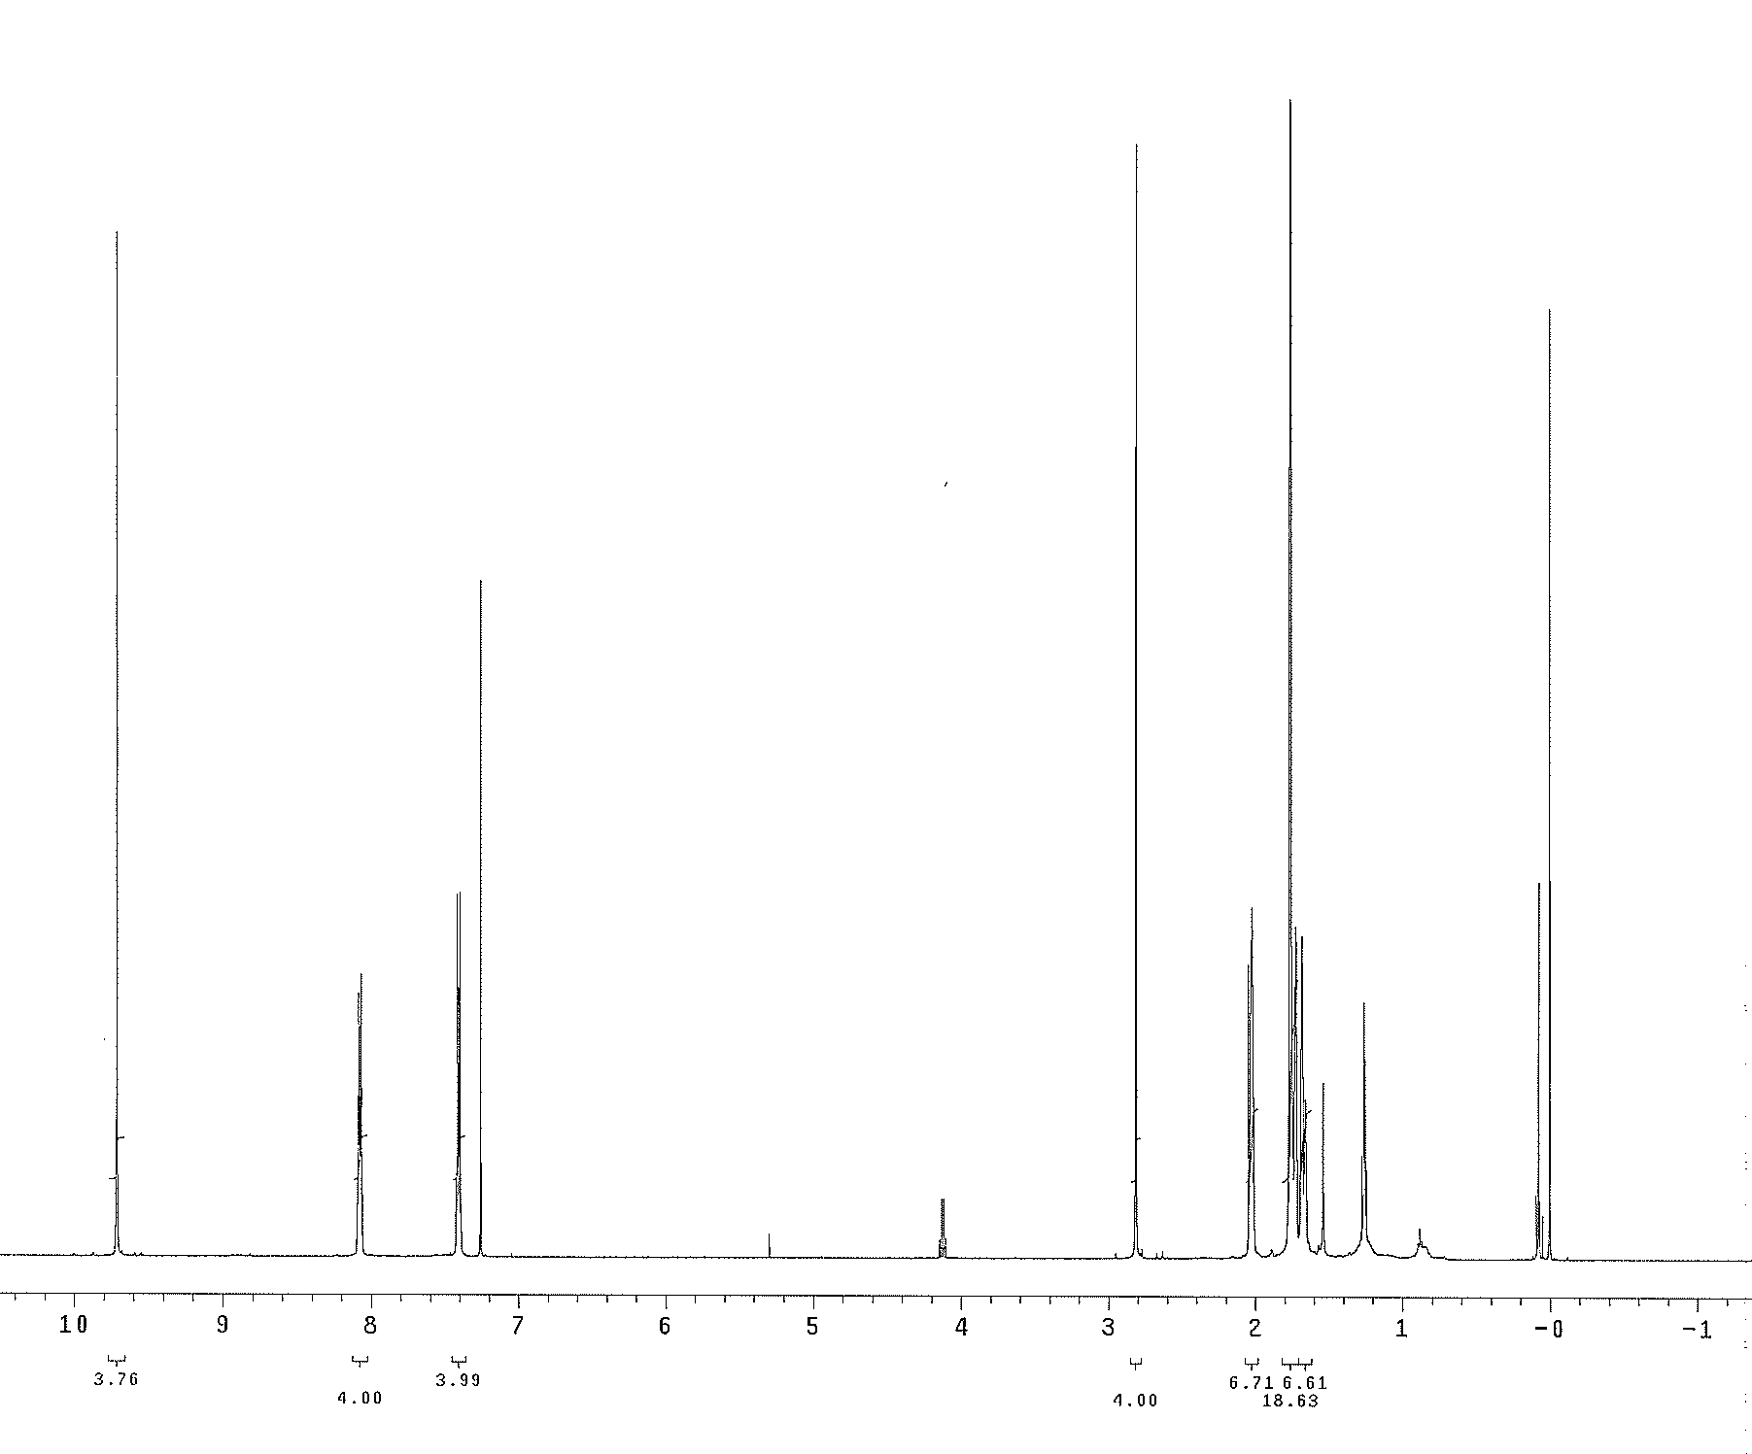
Building a Better Pentacene with Excellent Photooxidative Properties and Thin Film Morphology
Brittany Chambers, Jonathan Briggs, Weimin Lin, Glen P. Miller*
Department of Chemistry, University of New Hampshire, Durham NH
Abstract
An adamantane substituted pentacene was designed, synthesized and characterized using NMR and UV-vis spectroscopies, and X-ray crystallography. This new organic semiconductor should order in the solid state in such a way as to provide for high charge carrier mobility, as required by certain applications including organic transistors. Initial findings imply the compound to be stable.
Objective
Synthesize and characterize 6,13-bis(organothio) substituted pentacenes with bulky adamantyl groups attached
Conclusions
The target pentacene compound was successfully synthesized
Preliminary testing shows the pentacene is long lived, similar to the other thio substituted pentacenes synthesized in the Miller Group
Methods
Chemical syntheses were achieved using standard methods and glassware
All compounds were purified using preparative thin layer chromatography and column chromatography
Compounds were characterized by UV-vis and ¹H and ¹³C NMR spectroscopies as well as X-ray crystallography
Transistor architecture with pentacene as organic semiconductor¹
Results and Discussion
Synthesis:
Introduction
Pentacene:
Pentacene is an organic semiconductor used in thin-film electronic devices such as transistors
Unfortunately, unsubstituted pentacene has poor solubility and is unstable in light and air
Substituted Pentacenes:
Drastically improve solubility and shelf life
Many still face photooxidation and degradation
Parallel displacement in solid state is preferred for charges to be carried in the X-Y plane
Thio Substituted Pentacenes:
Thio substituted pentacenes are among the most photooxidatively resistant
Miller Group synthesized and characterized a series of thio substituted pentacenes that demonstrated superior stability¹
Not all thio substituted pentacenes exhibit the desired parallel displaced packing
Adamantanethio Pentacene:
Bulky substituents have not been explored and may lead to stacking in a parallel displaced fashion.
Decylthio pentacene next to adamantanethio pentacene, showing the characteristic blue/purple color of pentacenes
Future Work
Complete characterization of the adamantane substituted pentacene
Grow a high quality crystal to confirm stacking pattern in solid state
Use other bulky substituents on pentacene
This process has been started with adamantane ethanol.
Acknowledgements
A gracious thank you to the UNH Center for High-Rate Nanomanufacturing for funding research through the REU program and the University of New Hampshire’s Department of Chemistry.
References
1. Kaur, I.; Jia, W.; Kopreski, R.; Selvarasah, S.; Dokmeci, M.; Pramanik, C.; McGruer, N.; Miller, G., Substituent Effects in Pentacenes: Gaining Control over HOMO-LUMO Gaps and Photooxidative Resistances. J. Am. Chem. Soc. 2008, 130, 16274-16286.
2. Pramanik, C.; Miller, G., An Improved Synthesis of Pentacene: Rapid Access to a Benchmark Organic Semiconductor. Molecules 2012, 17, 4625-4633.
3. Kitagawa, T.; Idomoto, Y.; Matsubara, H.; Hobara, D.; Kakiuchi, T.; Okazaki, T.; Komatsu, K., Rigid Molecular Tripod with an Adamantane Framework and Thiol
Legs. Synthesis and Observation of an Ordered Monolayer on Au(111). J. Org. Chem. 2006, 7, 1362-1369.
Characterization:
UV-vis of newly synthesized adamantanethio pentacene
UV-vis of commercial pentacene
¹H NMR of adamantanethio pentacene
Notes:
thio?
Captions- descriptive of concise
Abstract
***pictures from light test
UV DECAY? CRYSTAL?
YEILDS

