Slide 1


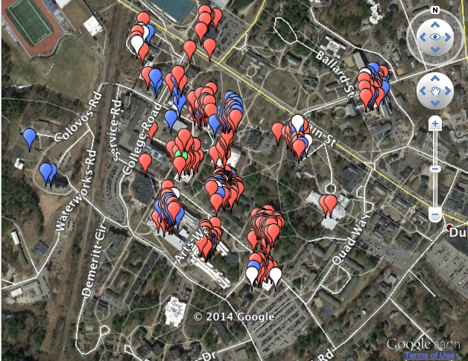
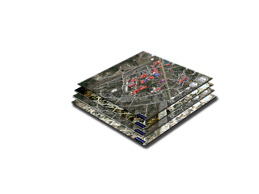
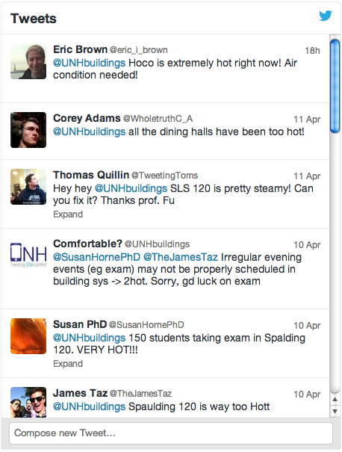
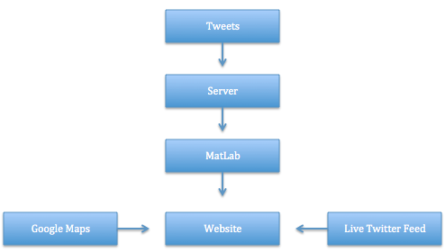
Department of Civil Engineering
Dr. Tat S. Fu
Faculty Advisor
Tweeting (Dis)comfort Website
Department of Computer Science
Trung Cao and Julie Rose
Information Technology Students
Background
Increase the overall comfort level of classrooms around the UNH campus
Provide the UNH Energy Office with information from students, faculty, and staff relevant to classroom temperature
Utilize data, which was gathered and analyzed by previous project, as input for new interactive website
Map of UNH Campus
Future Plans
Devise a method to automatically send data to maintenance department
Continue collecting data from students and faculty
Create a mobile application so users can see the website on their mobile device
Twitter Feed
Goals
To provide visual data of comfort level in different buildings around campus
Show most recent tweets and plot them on a map of campus
Provide the Energy Office with information relative to the performance of heating systems around the UNH campus
Distinguish between hot and cold complaints using colors
Allow users to select different time range of tweets to show on the map
Create a more comfortable classroom environment
System Architecture Diagram

