Slide 1
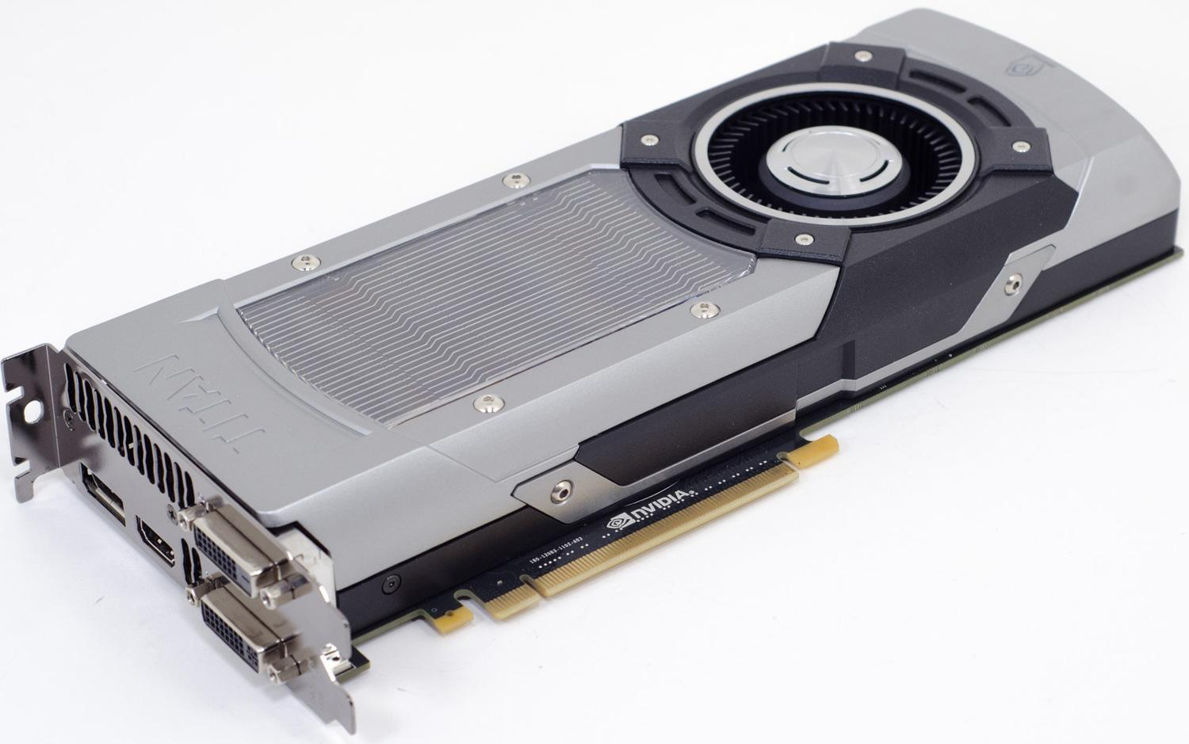
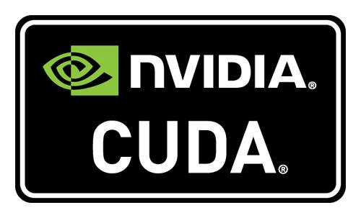
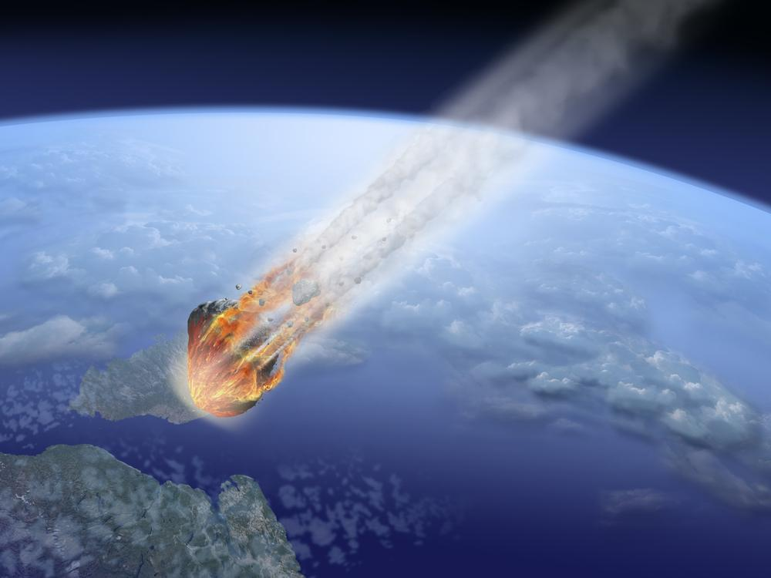
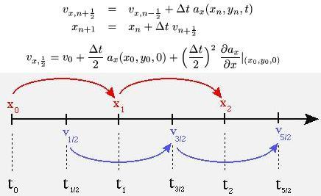

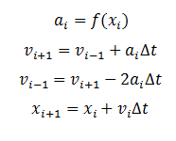
Asteroid Modeling and Prediction
Laurenz Gallopyn, Michael Rabideau, Jonathan Thomas
Project Sponsor: Professor May-Win Thein
Introduction
Astronomical Body Simulation
Technical Methods
Asteroid impact with Earth is an ever present danger for the inhabitants of our planet. The desire to be able to avoid such catastrophe is very clear. For that reason, asteroids are closely studied, and data is collected that will help predict their paths of travel. But how can this data be used to accurately predict if an asteroid is a threat to us in something so large and complex as our solar system? Moreover, if it is discovered that an asteroid will impact the planet in the future, could it be effectively deflected away from Earth in time? These are the problems that the Asteroid Modeling and Prediction team attempted to solve. It was the goal of the team to model the planets and asteroids within the solar system in a way that is accurate and fast to compute.
N-Body Simulation
Parallel Programing
Gravity connects all astronomical bodies, including asteroids
The gravitational force between two bodies can be found using a simple equation
The equation can be applied to many pairs of bodies in one simulation to find a net force for each one
These forces can be found at each time interval to model the motion of a system
Equation:
F = GM₁M₂
Two Bodies
Orbital mechanics calculations require calculating the gravitational force of every body against every other body
These calculations are independent and can be done simultaneously
Modern graphics processing hardware perform large amounts of math simultaneously
NVIDIA’s CUDA framework allows us to run our orbital calculations on NVIDIA graphics hardware
M₁
r
M₂
F = G M₁M₂
r²
Time Slice 1
Three Bodies
Results
F = G M₁M₂
M₁
F = G M₁M₃
r₁²
r₁
r₂
r₂²
M₂
r₃
M₃
F = G M₃M₂
Many mathematical models were evaluated for use with the project. The equations and methods that were determined to be possible to implement within the scope of the project are detailed on this poster. The software system that was built can model the solar system with asteroids moving through it. This can be used to predict their destination of an asteroid and its origin. However, there are several aspects of asteroid modeling that the team was not able to implement. Modelling collisions with asteroids was determined to be to much work for the given time frame. Finite Element Analysis was considered for modelling the asteroid collisions. This can be a possible task for future asteroid modeling teams.
r₃²
Time Slice 2
F = G M₁M₂
M₁
F = G M₁M₃
r₁²
r₁
r₂
r₂²
M₂
r₃
M₃
F = G M₃M₂
r₃²
r²
Leap-Frog Integration
Solar Pressure
Symplectic - conserves energy of dynamic systems
Numerical approximation
Time Reversible
Equation:
Leap-Frog Integrator improved
Radiation from the sun exerts force on the astronomical bodies that it hits
Effect of solar pressure on a planet or asteroid is much smaller than gravitational forces
Equation:
Acknowledgements: Professor T. Mimi
Professor R. Daniel Bergeron
Graduate Research Student Dan Castelli
Notes:
Further work: higher order leapfrog inegrator, FEM and collisions,

