Slide 1
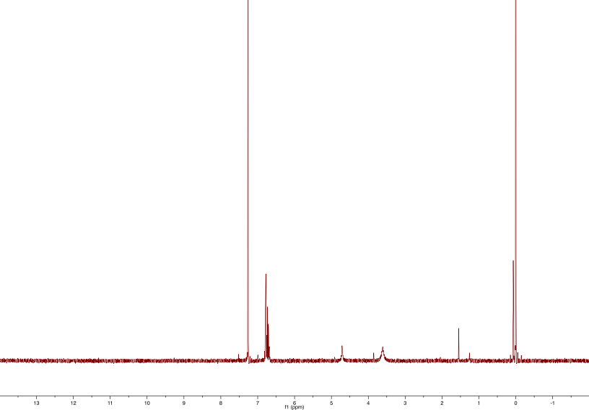
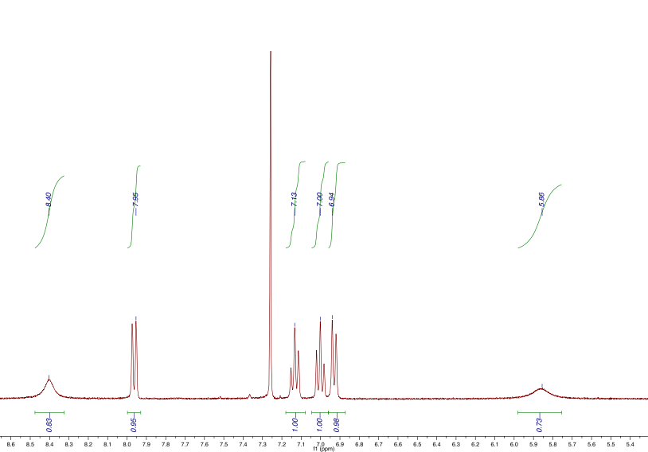
Modeling N–H･･･O Hydrogen Bonding in Biological Tyrosinate-bound Iron Centers
Eric Guinto and Dr. Samuel Pazicni
Department of Chemistry, University of New Hampshire, Durham, NH
INTRODUCTION
Iron center proteins are featured in all living organisms and act as oxygen transport systems in molecules. Tyrosine residues represent 3-4 mol % of the residues in the protein environment. These residues are often engaged in intermolecular hydrogen bonding with the protein backbone which make analysis of these residues extremely complicated. However, some tyrosine residues are directly bound to iron centers and will be the focus of this study. The ligands designed in complex 5 display similar electronic and structural features to tyrosine residues in biological systems. Derivatives of complex 5 were synthesized to adjust the electronic structure for comparison. The three ligand sets 2 in scheme 1 (where X = CH3, CCl3, CF3) will be used to compare the effect of intramolecular hydrogen bonding from N-H ･･･ O on the Fe-O bond distances. The oxygen is a hydrogen bond acceptor and will participate with the neighboring hydrogen bonded to the nitrogen in complex 5.
Scheme 2.
OBJECTIVE
To quantitatively compare the three derivatives of complex 5 to determine the Fe-O bond lengths, effect of hydrogen bonding on these bonds, and further understand the nature of tyrosine bound iron centers.
DISCUSSION
In progress towards complex 5, 2-aminphenol 2 and three acetylated derivatives of 2 were synthesized using a microwave and an acetylation reaction. The reaction of 2-nitrophenol to 2-aminophenol 1 in scheme 1 proceeded with difficulty. Synthesis using an iron catalyst proved to be insufficient for reduction and likely resulted in complexation of the 2-nitrophenol. Due to this road block, a microwave reaction was carried out using Pd/C as the catalyst with two equivalents of 1,4 cyclohexadiene table 1 resulting in a 0% yield. By adjusting the equivalents of the proton source (1,4 cyclohexadiene) from 2 to 8, the molecule 1 was synthesized with a 35% yield (table 1). The ¹HNMR and IR spectra are located in figure 1 and 2 respectively. Continuing the synthesis, 2-aminophenol 1 was acetylated by a specific functionalized anhydride to give 2. These reactions were carried out at room temperature in dichloromethane and allowed to react overnight producing relatively high yields. Specifically, reaction of 2-aminophenol 1 with acetic anhydride resulted in a 99% yield (table 2). The reaction of 1 with trifluoracetic anhydride produced the acetylated product with a 85% yield (table 2). The ¹HNMR spectrum for this product is shown in figure 3. Tetraphenylphosphonium Tetrachloroferrate (III) 4 in scheme 2 was synthesized with a 99% yield (table 2). Characterization of this complex could not be completed and indication of successful synthesis was noted by the instant color change to yellow during the addition of tetraphenylphosphonium chloride scheme 2. Further synthesis is still required for the completion of the target complex 5.
Scheme 1.
Figure 1. ¹HNMR spectrum of (1) 2-aminophenol.
Chloroform
TMS
Ar-H
E
F
Methanol
Proton Source | Equivalents | 2-Aminophenol
1,4 Cyclohexadiene | 2 | 0 % yield
1,4 Cyclohexadiene | 8 | 35% yield
Figure 2. IR spectrum of (1) 2-aminophenol.
Table 1. Synthesis of 1 (2-Aminophenol).
Figure 3. ¹HNMR spectrum of (2) 2-hydroxyphenyl trifluoroacetamide.
Future Work:
Chloroform
• Finish preparing target complex.
• Cyclic Voltammetry to observe redox potentials of complexes.
• X-ray diffraction of target complex.
 | Product | Percent Yield
(1) | 2-Aminophenol | 35%
(2) | 2-(hydroxyphenyl) acetamide (X= CH3) | 99%
(3) | 2-(hydroxyphenyl) trifluoroacetamide (X=CF3) | 85%
(4) | 2-(hydroxyphenyl) trichloroacetamide (CCl3) | 75%
(5) | Tetraphenylphosphonium Tetrachloroferrate (III) | 99%
ACKNOWLEDGMENTS
I would like to thank Kyle Rodriguez, Stephanie Jones, Christian Tooley, and Dr. Samuel Pazicni for
their contributions to this study.
E
C
D
B
REFERENCES
A
F
Frantom, P. A.; Seravalli, J.; Ragsdale, S. W.; Fitzpatrick, P. F., Reduction and Oxidation of the Active Site Iron in Tyrosine Hydroxylase: Kinetics and Specificity.
Biochemistry 2006, 45 (13), 4338-4338.
Pyrz, J. W.; Roe, A. L.; Stern, L. J.; Que, L., Model studies of iron-tyrosinate proteins. Journal of the American Chemical Society 1985, 107 (3), 614-620.
Que, L., Jr., Metalloproteins with Phenolate Coordination. Coordination Chemistry Reviews. 1982, 50, 73-108.
Table 2. Synthesis of various derivatives of 2

