Slide 1
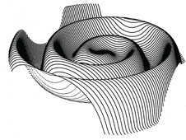
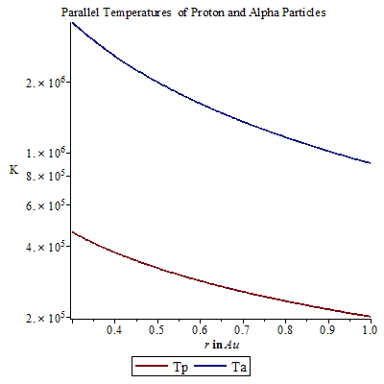
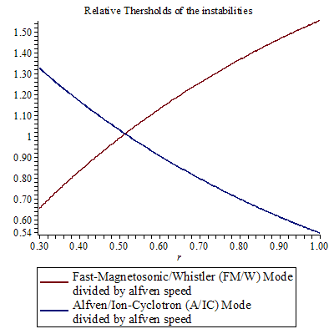
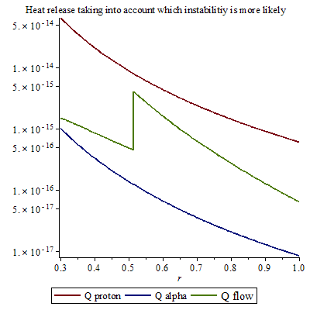
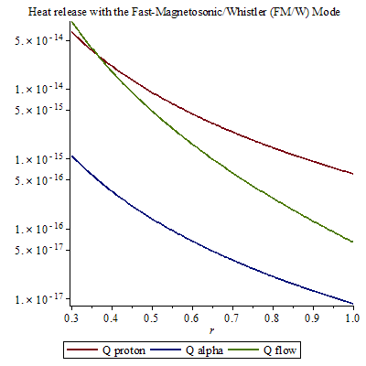
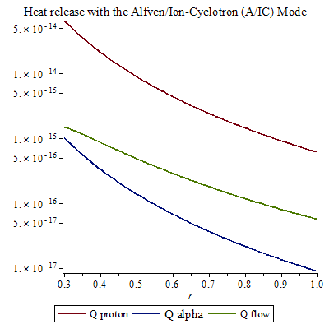
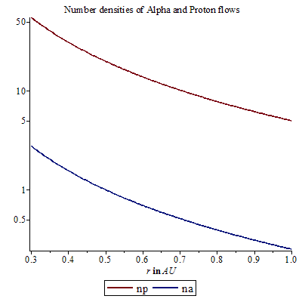
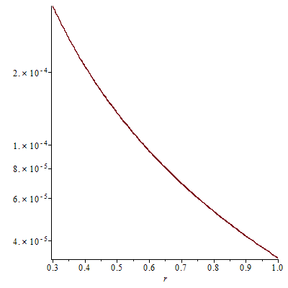
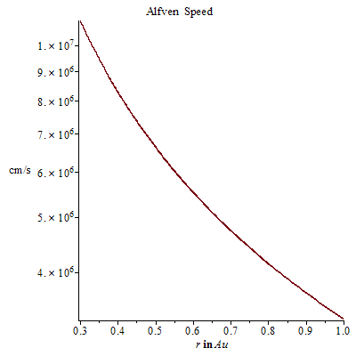
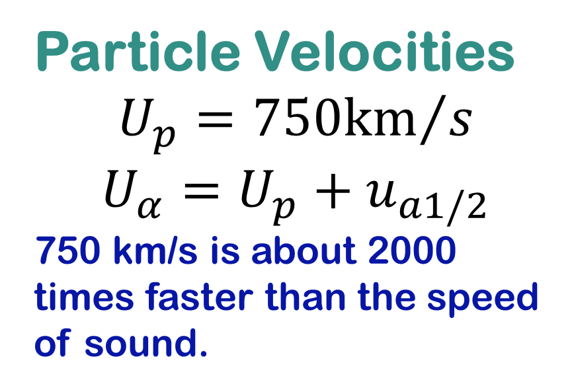
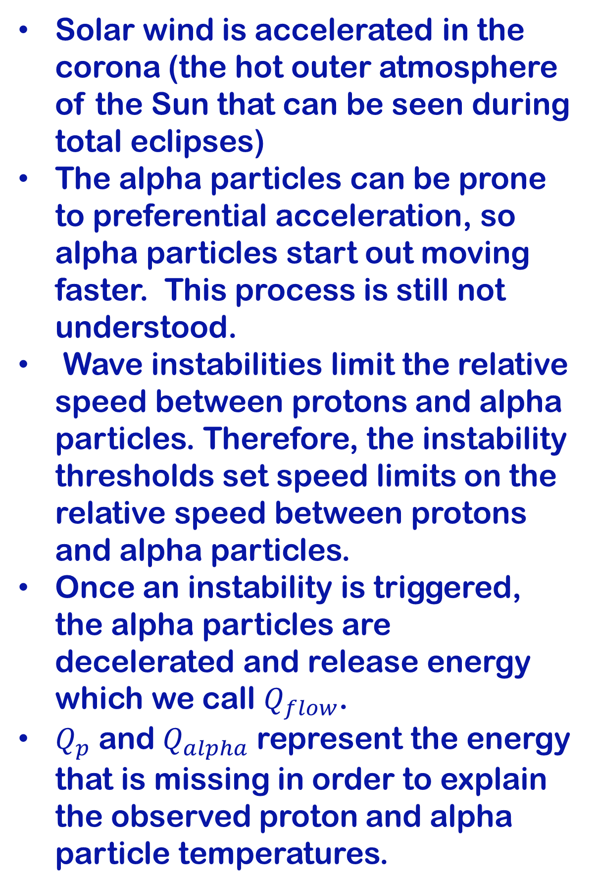
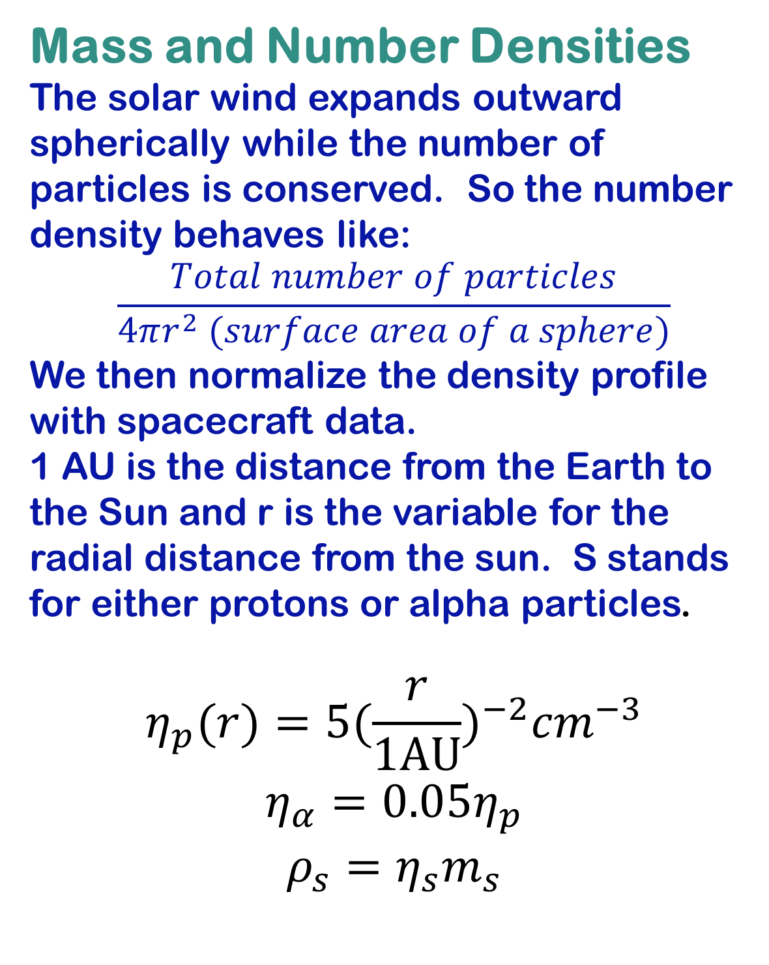
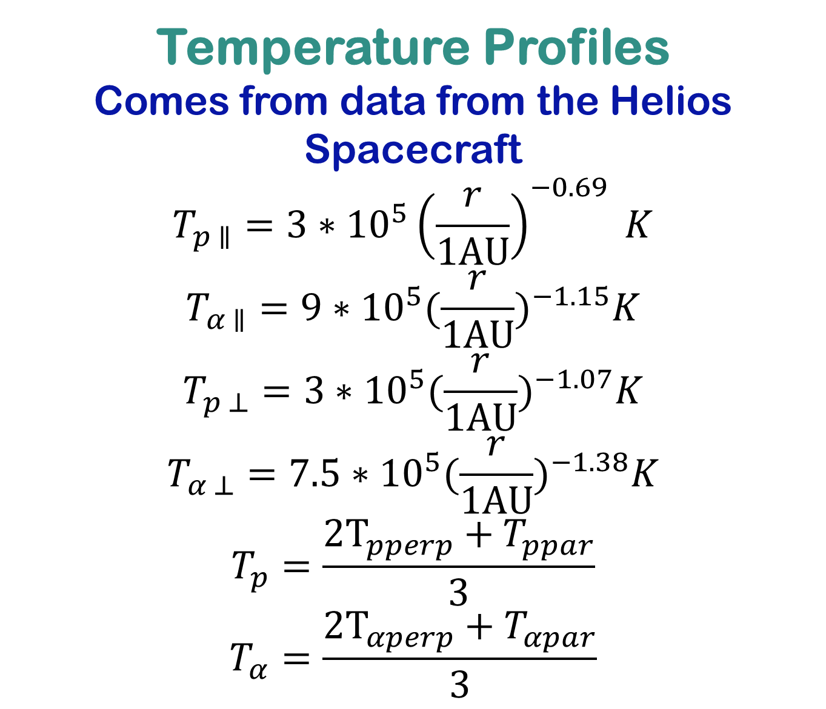
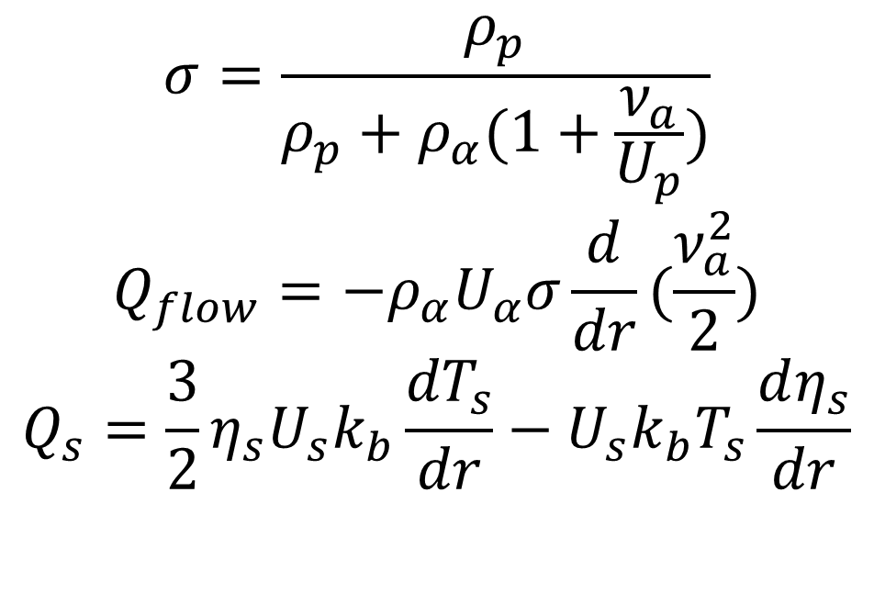
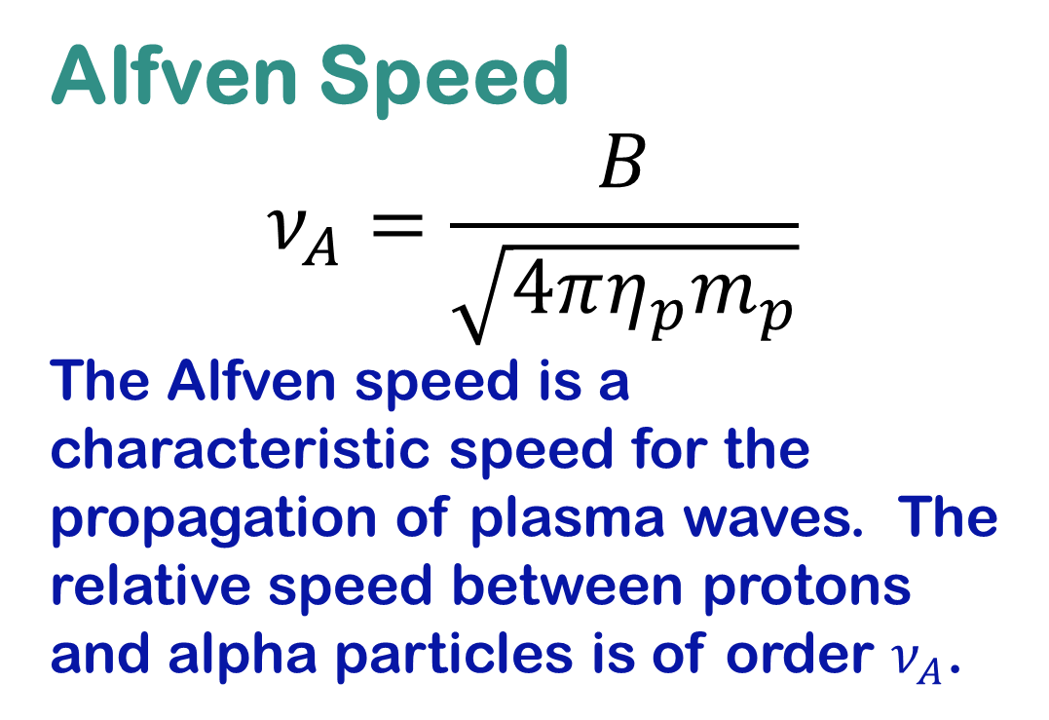
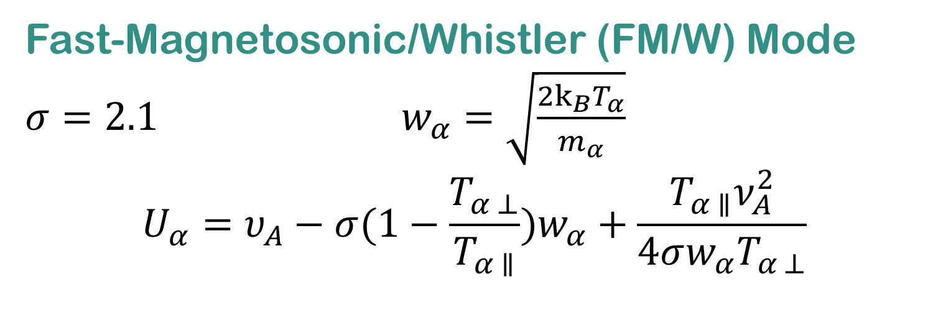
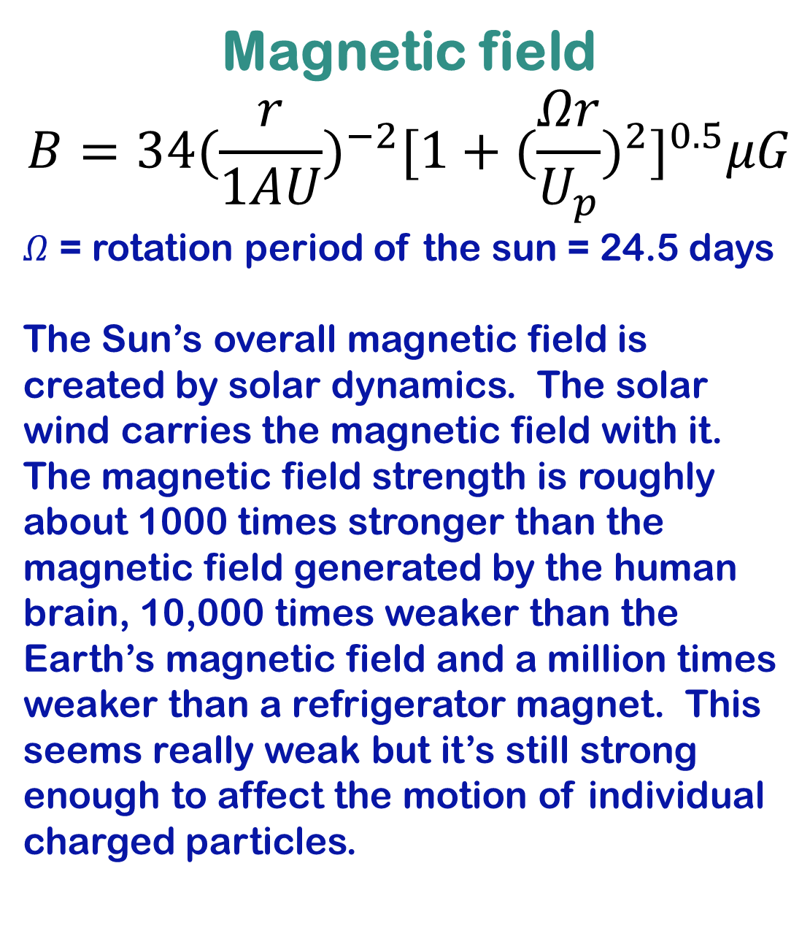
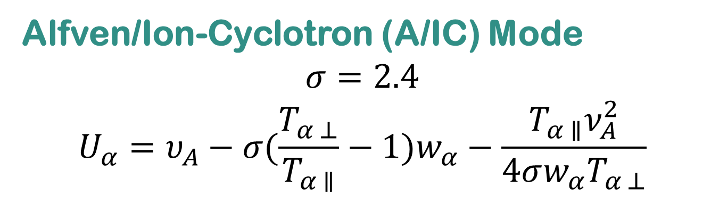
On the Role of Alpha-Particle Driven Beam Instabilities for the Thermodynamics of the Solar Wind
Denise Richard
Faculty Advisors: Ben Chandran and Daniel Verscharen
Temperature Profiles
Comes from data from the Helios Spacecraft
$$T_{p ∥}=3∗{10}^{5}{\left(\frac{r}{1AU}\right)}^{−0.69} K$$
$$T_{α ∥}=9∗{10}^{5}{(\frac{r}{1AU})}^{−1.15}K$$
$$T_{p ⊥}=3∗{10}^{5}{(\frac{r}{1AU})}^{−1.07}K$$
$$T_{α ⊥}=7.5∗{10}^{5}{(\frac{r}{1AU})}^{−1.38}K$$
$$T_{p}=\frac{{2T}_{pperp}+T_{ppar}}{3}$$
$$T_{α}=\frac{{2T}_{αperp}+T_{αpar}}{3}$$
Instabilities
Introduction
Overview
Waves in the solar wind can be generated by instabilities. For these instabilities to happen certain requirements must be met. The instability with the lowest threshold will be the one to happen.
The solar wind consists of individual charged particles moving outward from the Sun. 95% of the positively charged particles are single protons. The remaining 5% is mostly helium ions which consist of 2 protons and 2 neutrons. Therefore the hellion ions (or alpha particles) make up 20% of the mass density and have a very important effect on solar wind dynamics.
Solar wind is accelerated in the corona (the hot outer atmosphere of the Sun that can be seen during total eclipses)
The alpha particles can be prone to preferential acceleration, so alpha particles start out moving faster. This process is still not understood.
Wave instabilities limit the relative speed between protons and alpha particles. Therefore, the instability thresholds set speed limits on the relative speed between protons and alpha particles.
Once an instability is triggered, the alpha particles are decelerated and release energy which we call $Q_{flow}$.
$Q_{p}$ and $Q_{alpha}$ represent the energy that is missing in order to explain the observed proton and alpha particle temperatures.
Fast-Magnetosonic/Whistler (FM/W) Mode
$σ=2.1$ $w_{α}=\sqrt{\frac{{2k}_{B}T_{α}}{m_{α}}}$
$$U_{α}=υ_{A}−σ(1−\frac{T_{α ⊥}}{T_{α ∥}})w_{α}+\frac{T_{α ∥}ν_{A}^{2}}{4σw_{α}T_{α ⊥}}$$
Several processes contribute to the solar wind acceleration and can create different average flow speeds. In the fast solar wind, deviations from thermodynamic equilibrium survive.
Data from the Helios spacecraft taken at the heliocentric distances between 0.3 to 1 AU (1 AU = distance from the Earth to the Sun) show that the proton speed is about constant while the alpha particles often show a relative drift with respect to the protons that decreases with distance from the sun. Instabilities such as the Whistler-mode and the Alfven-mode drift instabilities lower the difference in speeds of the different ions once a certain threshold has been crossed. The instabilities create plasma waves that can potentially heat solar wind ions.
Alfven/Ion-Cyclotron (A/IC) Mode
$$σ=2.4$$
$$U_{α}=υ_{A}−σ(\frac{T_{α ⊥}}{T_{α ∥}}−1)w_{α}−\frac{T_{α ∥}ν_{A}^{2}}{4σw_{α}T_{α ⊥}}$$
Modeling the Solar Wind
Heat Release
Mass and Number Densities
The solar wind expands outward spherically while the number of particles is conserved. So the number density behaves like:
$$\frac{Total number of particles}{4πr^{2} (surface area of a sphere)}$$
We then normalize the density profile with spacecraft data.
1 AU is the distance from the Earth to the Sun and r is the variable for the radial distance from the sun. S stands for either protons or alpha particles.
$$η_{p}(r)=5{(\frac{r}{1AU})}^{−2}{cm}^{−3}$$
$$η_{α}=0.05η_{p}$$
$$ρ_{s}=η_{s}m_{s}$$
Magnetic field
$$B=34{(\frac{r}{1AU})}^{−2}{[1+{(\frac{Ωr}{U_{p}})}^{2}]}^{0.5}μG$$
$Ω$ = rotation period of the sun = 24.5 days
The Sun’s overall magnetic field is created by solar dynamics. The solar wind carries the magnetic field with it. The magnetic field strength is roughly about 1000 times stronger than the magnetic field generated by the human brain, 10,000 times weaker than the Earth’s magnetic field and a million times weaker than a refrigerator magnet. This seems really weak but it’s still strong enough to affect the motion of individual charged particles.
Particle Velocities
$$U_{p}={750km}/s$$
$$U_{α}=U_{p}+u_{a1/2}$$
750 km/s is about 2000 times faster than the speed of sound.
$$σ=\frac{ρ_{p}}{ρ_{p}+ρ_{α}(1+\frac{ν_{a}}{U_{p}})}$$
$$Q_{flow}=−ρ_{α}U_{α}σ\frac{d}{dr}(\frac{ν_{a}^{2}}{2})$$
$$Q_{s}=\frac{3}{2}η_{s}U_{s}k_{b}\frac{{dT}_{s}}{dr}−U_{s}k_{b}T_{s}\frac{dη_{s}}{dr}$$
The instability with the least threshold speed will be the one to happen so I pieced together the 2 plots using the crossover point. The crossover point is very sensitive to the temperature profiles. Variations in the temperature profile will lead to a different location of this point.
Alfven Speed
$$ν_{A}=\frac{B}{\sqrt{4πη_{p}m_{p}}}$$
The Alfven speed is a characteristic speed for the propagation of plasma waves. The relative speed between protons and alpha particles is of order $ν_{A}$.
Conclusions
The energy released by these instabilities is enough to account for the observed alpha temperature profiles but not for the observed proton profiles. The processes heating the protons are still unknown. The two instabilities have lower thresholds in different regions, so both have important roles in alpha particle deceleration. There are other possible instabilities; however, their role in the solar wind is believed to be less important, and the analytical thresholds have not been determined yet.
References
Marsch, E., Muhlhauser, K., Schwenn, R., & Rosenbauer, H. (). Solar Wind Protons: Three Dimensional Velocity Distributions and Derived Plasma Parameters Measured Between 0.3 and 1 AU. Journal of Astrophysical Research, 87, 52-72.
Marsch, E., Muhlhauser, K., Schwenn, R., & Rosenbauer, H. (). Solar Wind Helium Ions: Observations of the Helios Solar Probes between 0.3 and 1 AU. Journal of Astrophysical Research, 87, 35-51.
Verscharen, D., Bourouaine, S., & Chandran, B. (). Instabilities driven by the drift and temperature anisotropy of alpha particles in the solar wind. The Astrophysical journal, 773.

