Slide 1
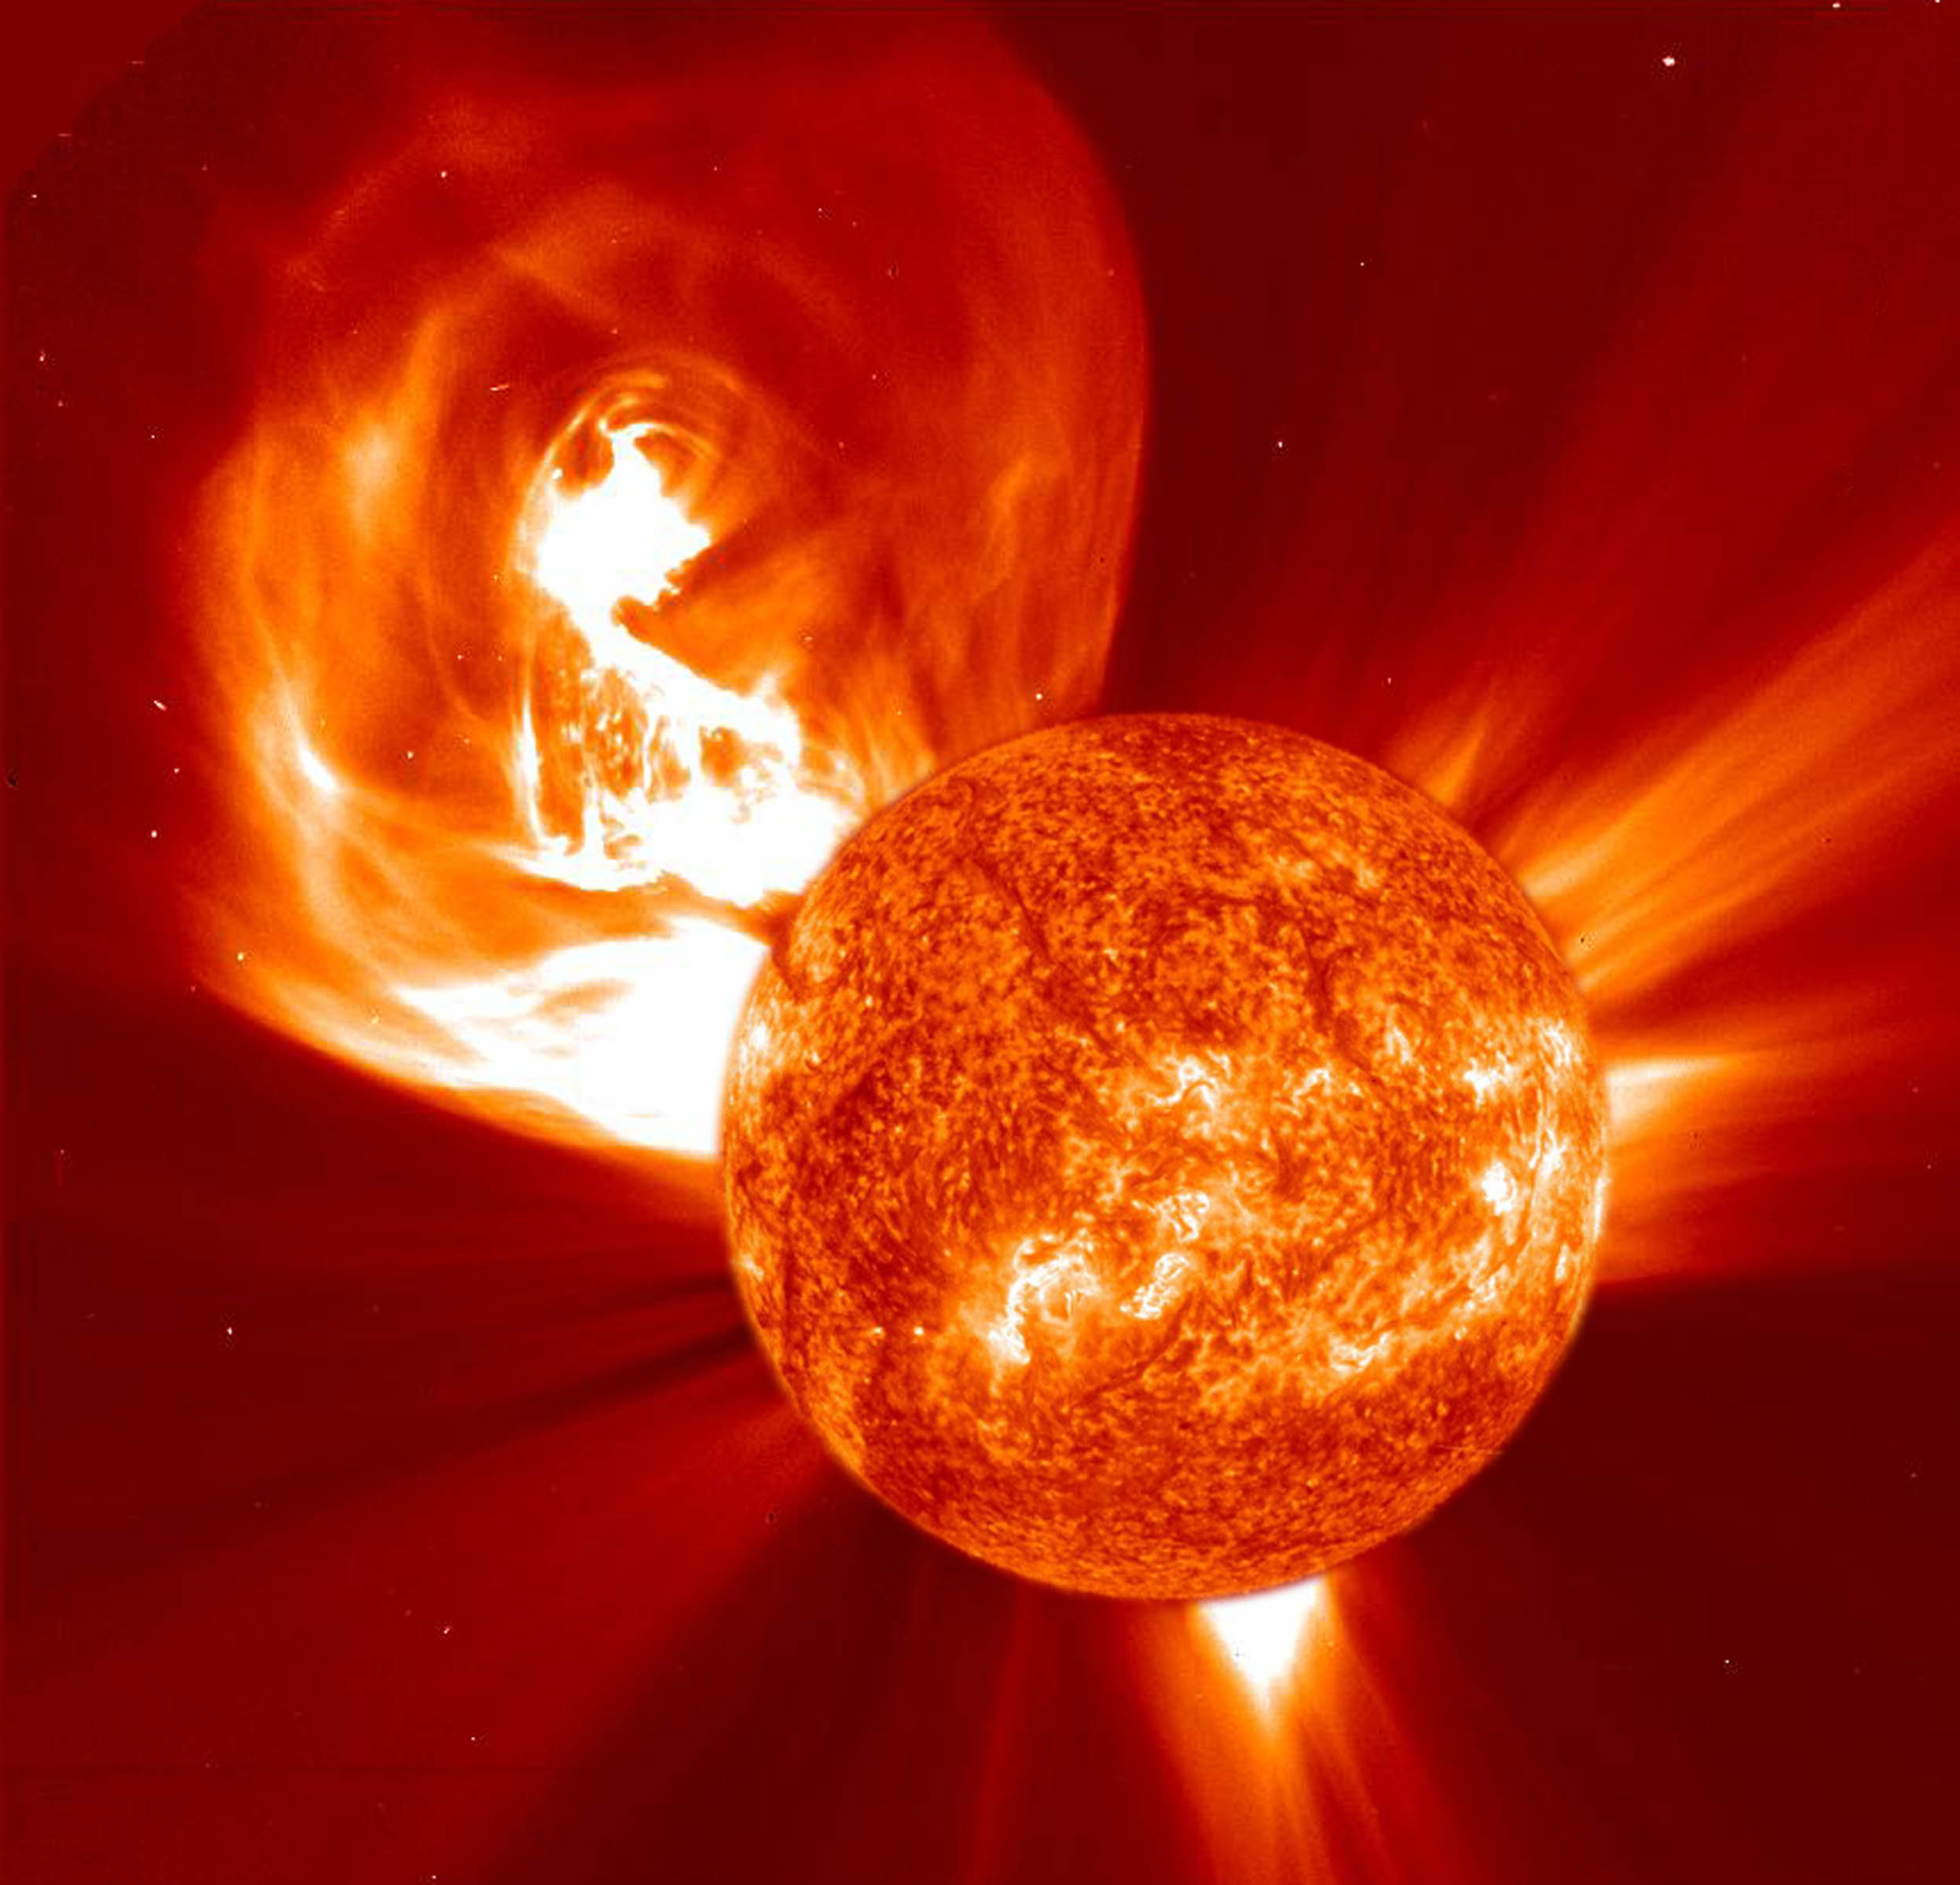
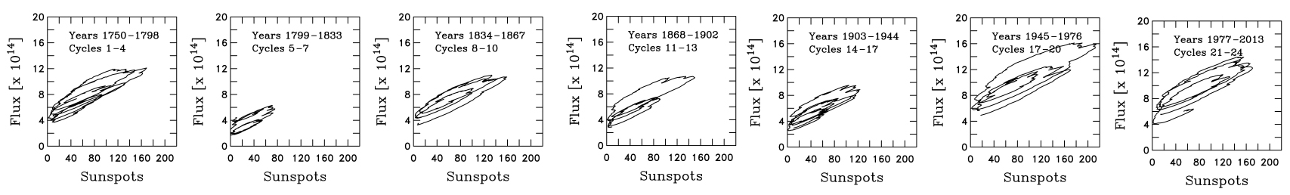
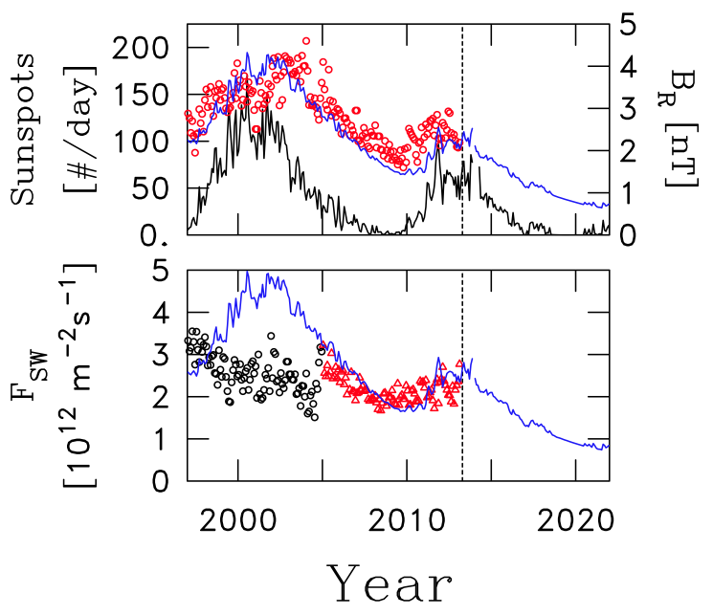
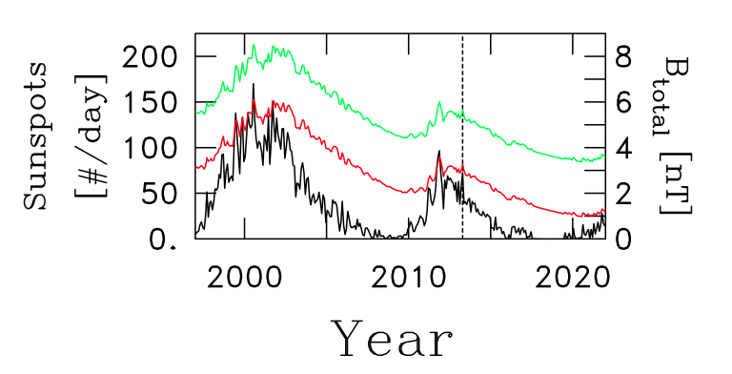
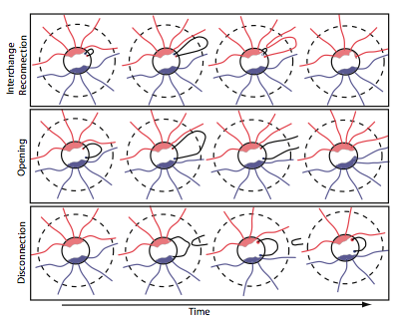

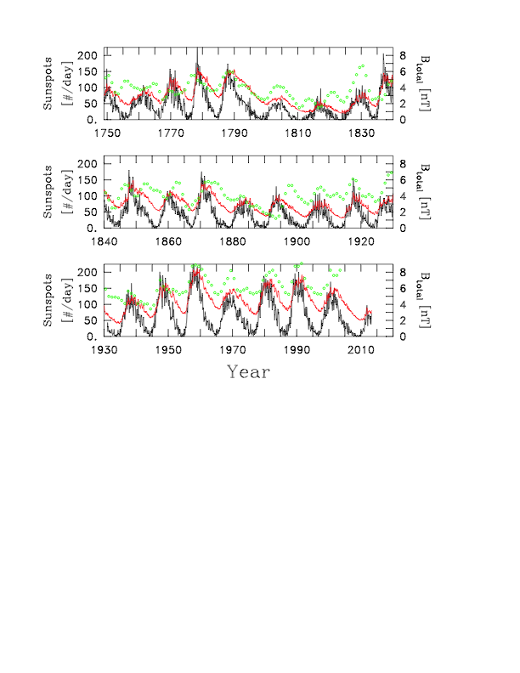
An Analysis of Heliospheric Magnetic Field Flux Based on Sunspot Number from 1750 to Today and Prediction for the Coming Solar Minimum
Introduction
The Heliospheric Magnetic Field (HMF) intensity has been shown by observation to rise and fall with the solar cycle. In situ observations have only been available from 1963 onward. This work takes the model of Schwadron et al. (2010) and uses it to model the HMF using sunspots as a proxy for flux injection. This allows us to project the HMF intensity as far back as 1749.
As a comparison, the level of the cosmogenic isotope ¹⁰Be has been shown to vary with the HMF. McCracken et al. (2013) used the ¹⁰Be in ice core samples to make a model for the HMF. We compared the sunspots with the ice cores to determine validity of the sunspot predictions.
Equations
Data Analysis
Figure 2 shows the sunspot number, B_{p} as computed from sunspot data and the B as computed from ¹⁰Be data. The most important feature of this figure is the hysteresis visible. The HMF rises quickly with the sunspot number, but falls off at a lower rate. This is further visible in Figure 4, where a 7 month running boxcar average has been applied and the data smoothed over a smaller set of years.
Equations used in Schwadron et al. (2010) to compute flux based on monthly averages of sunspot numbers.
¹⁰Be Data
At times of lower solar activity, more radionuclides are produced and subsequently more are trapped in the polar ice. Ice cores layers can be used to determine the level of solar activity with a resolution as high as one year. It has been shown with sunspot data and recorded HMF intensities that sunspot minima and the corresponding changes to the HMF increase ¹⁰Be levels, from which the historic HMF can be modeled.
Comparing Flux and Total Field Intensity
Looking at Figure 1, it is evident that there is a systematic difference between the results obtained from sunspots and from ¹⁰Be. The reason for this is that the Schwadron et al. (2010) model predicts the Parker component of the field , |B_{p}|, and the McCracken et al. (2013) predicts the average total field intensity, |B|. Therefore, since |B_{p}| neglects the azimuthal components of the field, is it expected and shown to be consistently less than |B|.
Predictions for Coming Solar Cycle
After reconciliation with the ¹⁰Be data and in situ measurements in more recent years, we make a prediction for the HMF in the coming solar cycle. We note that 2013 marks the peak of Cycle 24 and the sunspot numbers bear remarkable similarity to the Dalton Minimum. Therefore, we have used the data for 1805 onward as a prediction for the next seven years of solar activity.
If this analysis proves accurate, then the hysteresis effect means the the HMF intensity will fall from a much lower level and will reach a lower final value than the last protracted solar minimum. The Parker field will reach as low as 0.5 nT, and |B| as low as 1.5 nT, due to the smaller difference in the two during solar minimum.
As well, the solar energetic particle fluxes will likely be reduced, reducing transient event frequency. Fluxes of galactic cosmic rays will lead to elevated persistent doses and elevated risks associated with long-duration exploration missions.
Figure 4. Hysteresis plots for given years and cycles plotting smoothed sunspot numbers vs. smoothed computed HMF flux as derived from the above theory.
Because the flux rises quickly with sunspots, which we use as a proxy for CME activity, and falls more slowly as sunspot activity decreases, there is a noted hysteresis effect.
Figure 5. Top: monthly average sunspot number (black curve), predicted value of ⟨|BR|⟩ and the measured value of ⟨|BR|⟩. Bottom: predicted value of FSW (blue curve) as obtained by the theory of Schwadron and McComas [2008] and related papers. The measured values of FSW before 2005 are shown in black circles while the measured values from 2005 onward is given by red triangles.
Figure 1. Analysis of recent solar cycle. From year 2013 onward the sunspot number is from the historical record 1805 onward. Resulting |B_{p}| is 1 nT lower than in the last protracted solar minimum.
Figure 2. (black) Plot of monthly average sunspot number from 1749 to the present. (red) Corresponding predicted Parker component of the HMF intensity at 1 AU. (green) Yearly average value of |B| derived from ¹⁰Be data.
Figure 3. Diagram from Schwadron et al. 2010 showing the interchange reconnection, opening, and disconnection processes of the heliospheric magnetic field lines.
Literature
Goelzer, M. L., C. W. Smith, and N. A. Schwadron (2013), An analysis of heliospheric magnetic field flux based on sunspot number from 1749 to today and prediction for the coming solar minimum, J. Geophys. Res. Space Physics, 118, 7525–7531, doi:10.1002/2013JA019404.
Schwadron, N. A., D. E. Connick, and C. W. Smith (2010), Magnetic flux balance in the heliosphere, Astrophys. J., 722, L132–L136.
McCracken, K., J. Beer, F. Steinhilber, and J. Abreu (2013), The heliosphere in time, Space Sci. Rev., 176, 59-71, doi10.1007/s11214-011-9851-3.
Contact
Molly L. Goelzer
mlw292@wildcats.unh.edu
Department of
Chemical Engineering
Acknowledgements
Special thanks to advisors and coauthors Drs. Charles Smith and Nathan Schwadron, and coauthor Dr. Ken McCracken.

