Slide 1
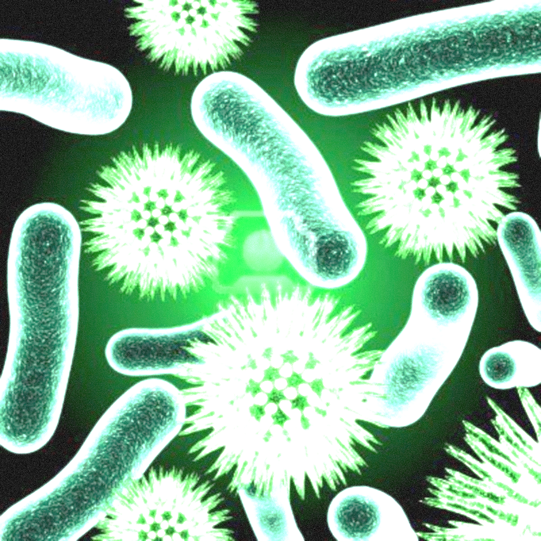

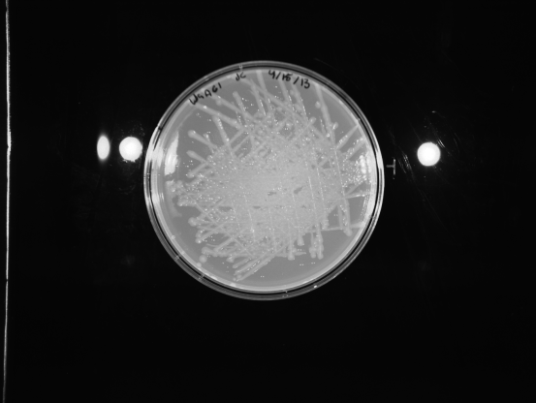
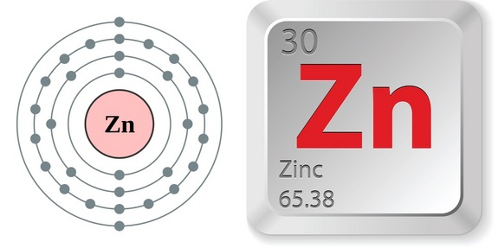
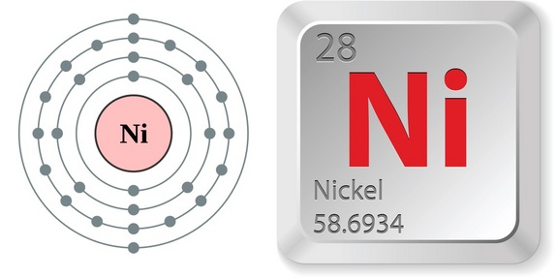
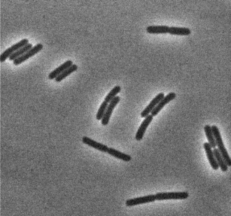
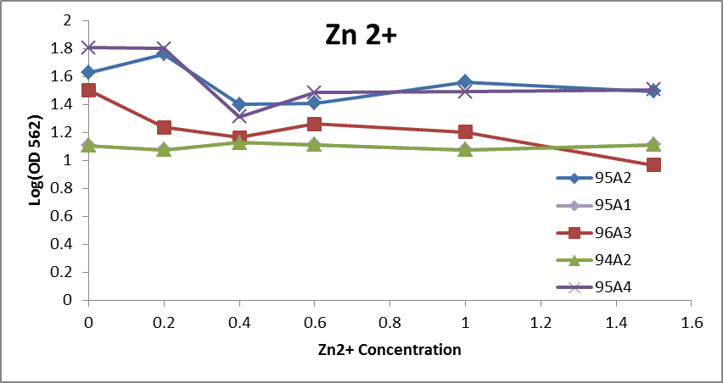
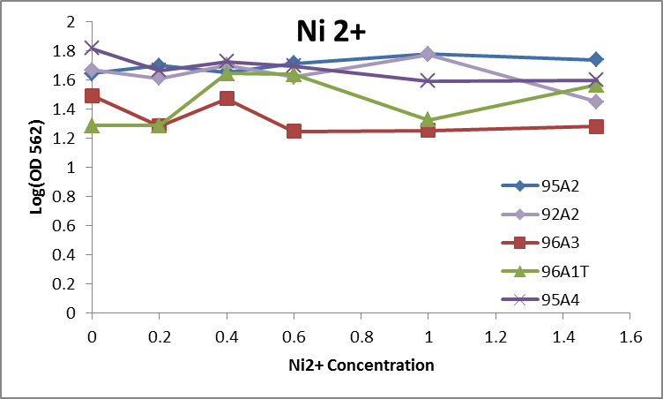
Resistance of Geobacillus Strains to Heavy Metals Justin Cullity
Adviser: Dr. Kang Wu
Chemical Engineering
University of New Hampshire
Durham, NH
Introduction
Geobacillus are a genus of rod-shaped gram-positive thermophilic bacteria, many of which have been shown to have unique features for industrial applications or bioremediation. Some of them have been shown to have unique features to survive and utilize materials often toxic to living organisms, such as heavy metal. To engineer and optimize them for specific needs for remediation, we need to understand the cellular, mechanism associated with these features, more specifically, the geneses or pathways carrying out these functions. The aim of this project is to screen the collection of 82 Geobacillus strains for their resistance to heavy metals and characterize the ones with the highest resistance to identify the novel genes or pathways. These strains will be further genetically engineered toward remediating heavy metals in waste water.
Cell Preparation
Plate
A given strain of Geobacillus was streaked out on a Tryptose Blood Agar Base (TBAB) plate, and incubated at 60ᵒC over night.
Liquid Culture
One colony of each given strain was then transferred to an overnight liquid culture (TGP). The overnight culture would last for 12 - 14 hours.
Results
Based upon the data obtained there are certain strains that have shown the capability to be used for bioremediation.
Useful for Bioremediation
  Zinc
    94A2
  Nickel
    95A1
    95A2
Not Useful for Bioremediation
  Zinc
    95A2
    95A4
  Nickel
    92A2
Multiple trials must be run of each strain in order to minimize the noise associated with biological processes. This noise is greatly exhibited in strain 96A1T of the Ni2+ resistance testing.
Resistance to Heavy Metal
TGP was mixed with various concentrations of heavy metal solutions. Based on prior research the concentration of heavy metal in TGP was determined. The overnight TGP culture was transferred into the TGP + Heavy Metal culture. A 1:4 dilution factor was used. All strains were cultured and analyzed in a 96 deep well plate for 7 hour. A micro plate reader, at an OD of 562nm, was used to analyze data.
Future Work
Perform heavy metal testing on all heavy metals, including:
  • Hg2+ • Fe2+
  • Cd2+ • Cu2+
  • Cr2+ • Co2+
Continued testing of the ability of Geobacillus to utilize simple sugars such as glucose, xylose, arabinose, and cellobiose.
Utilize PCR to amplify the gene expression of the gene responsible for the resistance to heavy metals.
Geobacillus thermoglucosidasius 95A1
Use in Bioremediation
Bioremediation
The use of microorganisms or other forms of life to consume and/or break down environmental pollutants such as heavy metals, hydrocarbons, arsenic, etc., in order to clean up a polluted site.
Industrial Use
This would be useful in:
Waste Water Treatment Plants
In place, ground water decontamination
  Agricultural Industry
    Saves money on excavating
References
http://www.academicjournals.org/ajb/pdf/Pdf2005/Spe%20Rev/Aiyer.pdf
http://lib.convdocs.org/pars_docs/refs/132/131624/131624_html_m3e204d5d.png
http://blogs.discovermagazine.com/discoblog/files/2008/04/bacteria.jpg
http://www.newhealthguide.org/images/19999893/image001.jpg

