Slide 1
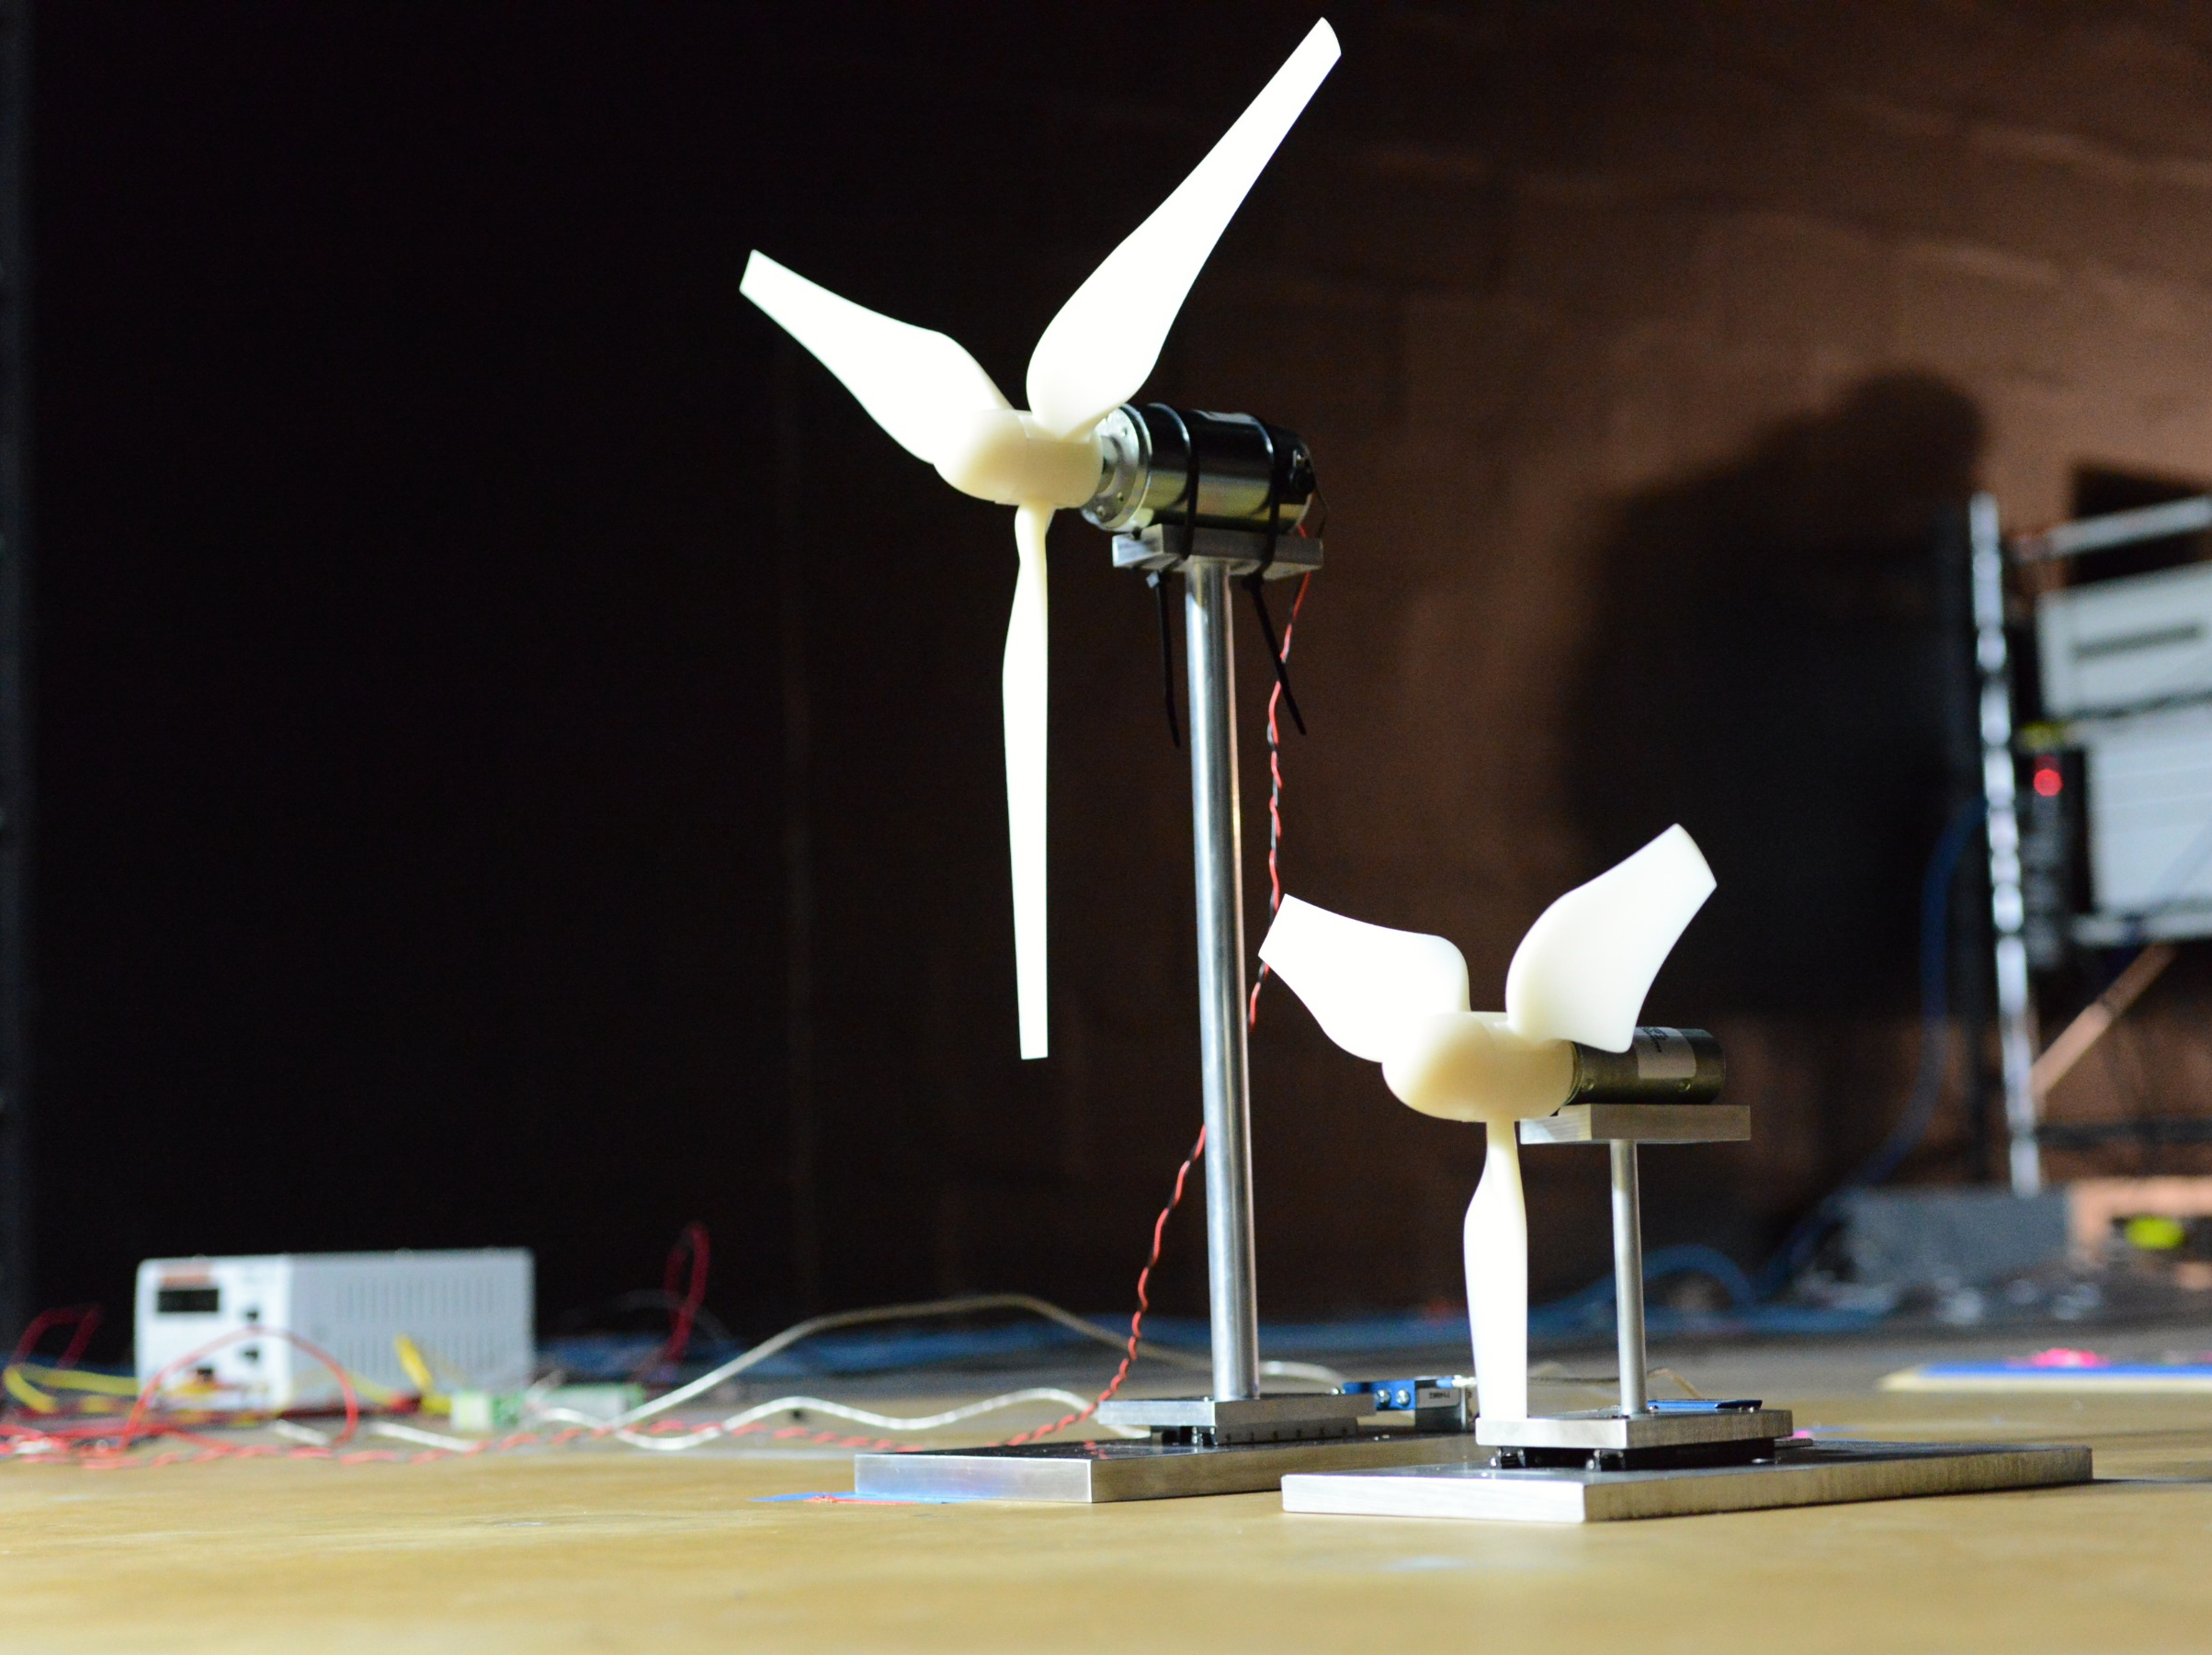
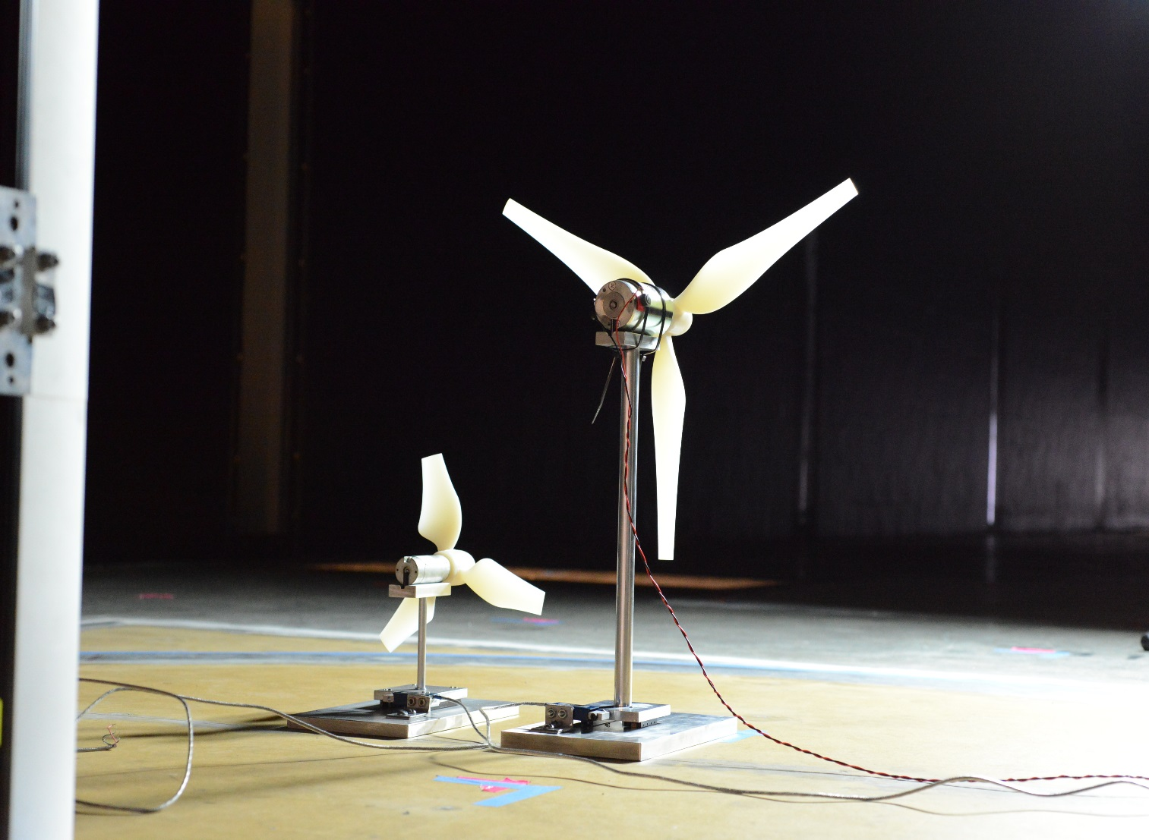
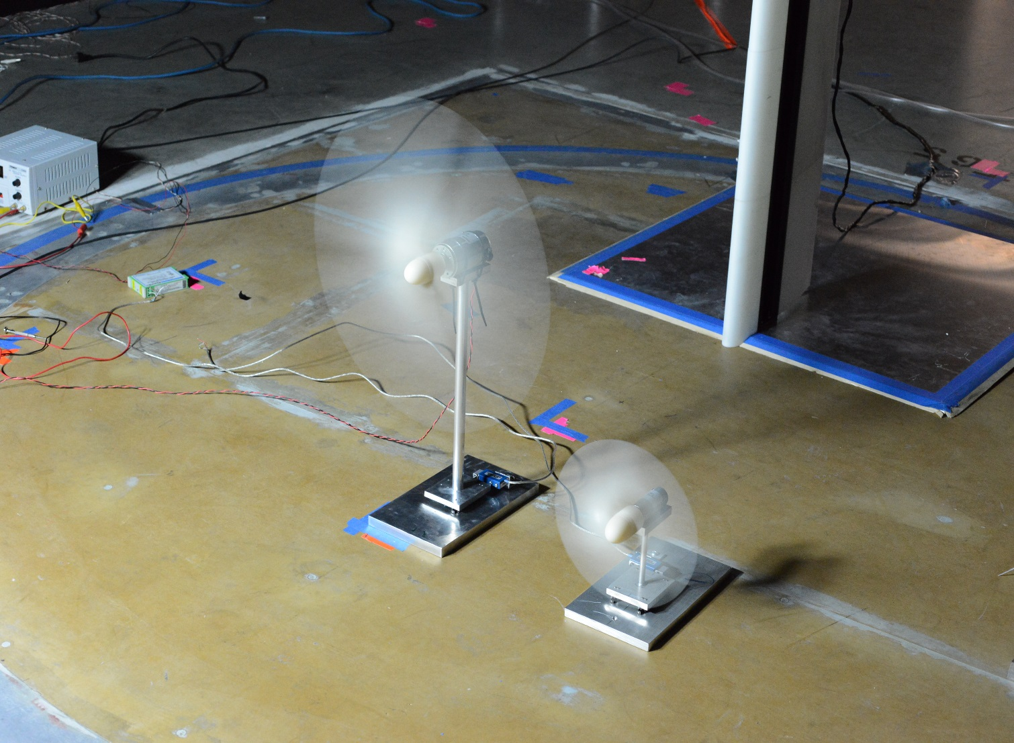
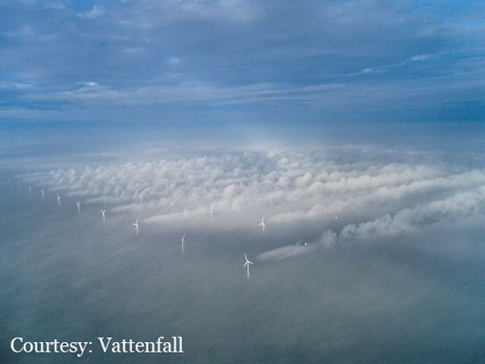
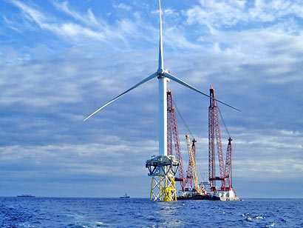
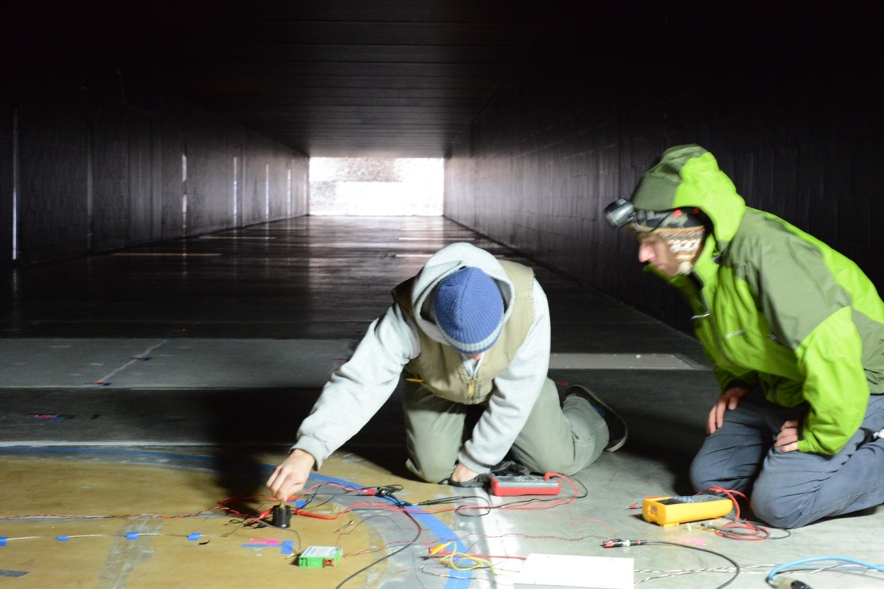
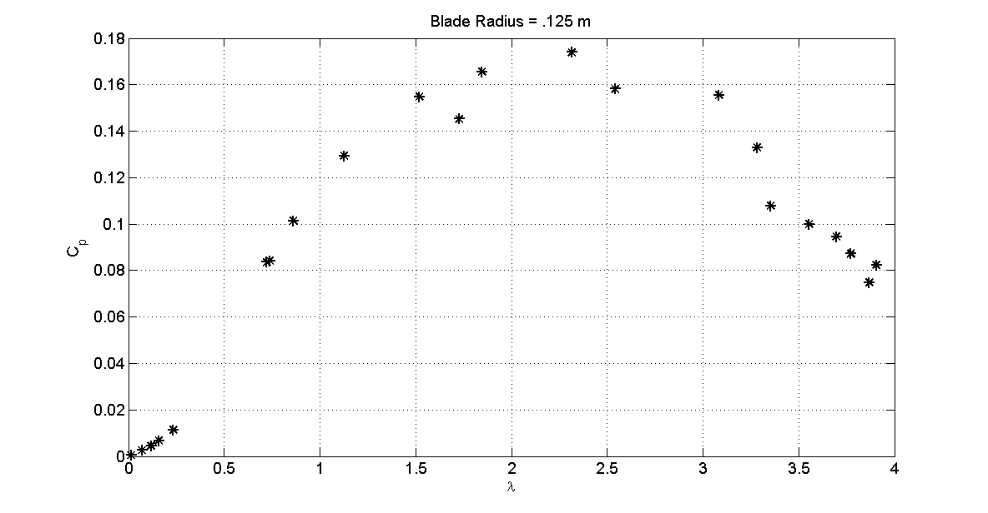
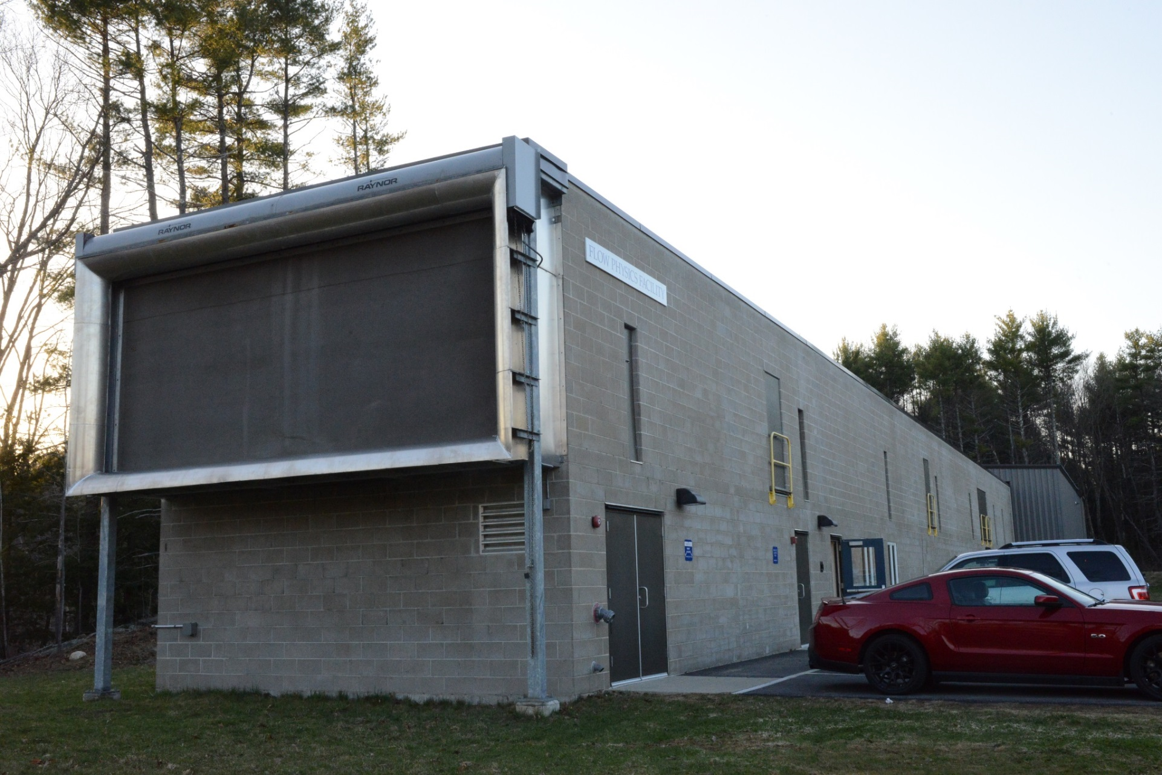
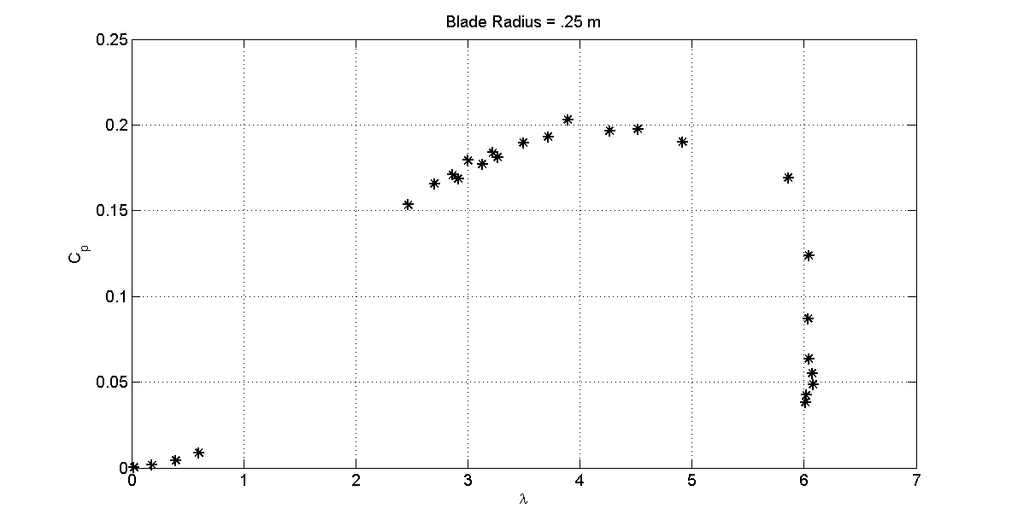
Effects of Scale on Model Offshore Wind Turbines
An Examination of How Well Scaled Model
Wind Turbines Can Represent Full Sized Counterparts
Group Members:
Zachary Charewicz
Dimitry Harris
Zachary Countie
This project is funded by New Hampshire Sea Grant College program through NOAA grant # NA10OAR4170082 and the UNH Marine Program
Advisor: Martin Wosnik Student Advisor: John J Turner V
Motivation
Approach
Future Research
It is common practice to use model wind turbines to study wind turbine array dynamics. As with most scale models there are differences in performance associated with the change in size of the turbines. The goal of this project is to determine what the effects of scale are on model wind turbines, meaning how does a wind turbines performance change as the turbine becomes smaller. A more complete understanding of the effects of scale can lead to more accurate prediction of how full scale turbines will behave, and possibly prevent situations such as the one pictured below.
To determine effects of scale, two wind turbines of different scales (1/500 and 1/250) are designed using blade element momentum (BEM) theory. The following comparisons are then made.
Power Coefficient (C_{P})
Drag Coefficient (C_{d})
Tip Speed Ratio (λ)
Now that effects of scale are understood, this knowledge can be combined with research previously performed studies on the interaction of turbine wakes. The new study objective could be to design an experiment that examines the effects of scale on turbine wake interactions. This project as well as last years project have paved the way for future wind turbine projects in that they have solidified the process for turbine design and testing.
Fig 4: Rear view of turbines in test section
Fig 5: Turbines side by side rotating comparison in test section
Fig 8: Adjusting rotor resistance while testing
Fig 1: Turbine wake propagation at Horns Rev in Norway. Only leading turbines experience full flow.
Fig 2: German RePower turbine rated at 5 MW, similar to the NREL reference turbine used to scale.
Experimental Results and Conclusions
(Turbulent Boundary Layer)
Flow Physics Facility
m
Small Turbine
Peak C_{p} ≈ 0.18 @ TSR ≈ 2.5
Hub Height = 0.1875 m
Large Turbine
Peak C_{p} ≈ 0.21 @ TSR ≈ 4
Hub Height = 0.375 m
Scale Model Conclusions
C_{p} max of small turbine ≈ C_{p} max of large turbine, which was a design goal.
Both turbines peaked at lower TSR than design TSR.
Losses associated with testing in turbulent boundary layer.
Model designed for higher TSR allows for a broader operating range
Different positions within turbulent boundary layer due to different hub heights
Experimentation validated design process
Allows for testing in a high Reynolds number turbulent boundary layer
Largest wind tunnel of its kind in the world
Test section: 6.0m x 2.7m x 72m
Maximum velocity 14 m/s
Fig 6: Experimental power coefficient vs tip speed ratio for 0.125m turbine rotor radius. Designed for peak C_{p} at TSR = 3.
m
Fig 3: UNH Flow Physics Facility boundary layer wind tunnel
Fig 7: Experimental power coefficient vs tip speed ratio for 0.25m turbine rotor radius. Designed for peak C_{p} at TSR = 5.
Notes:
Artsy picture of both wind turbines in the background.

