Slide 1



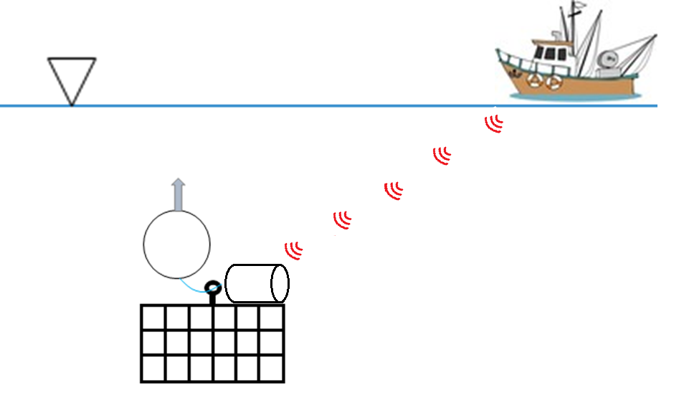
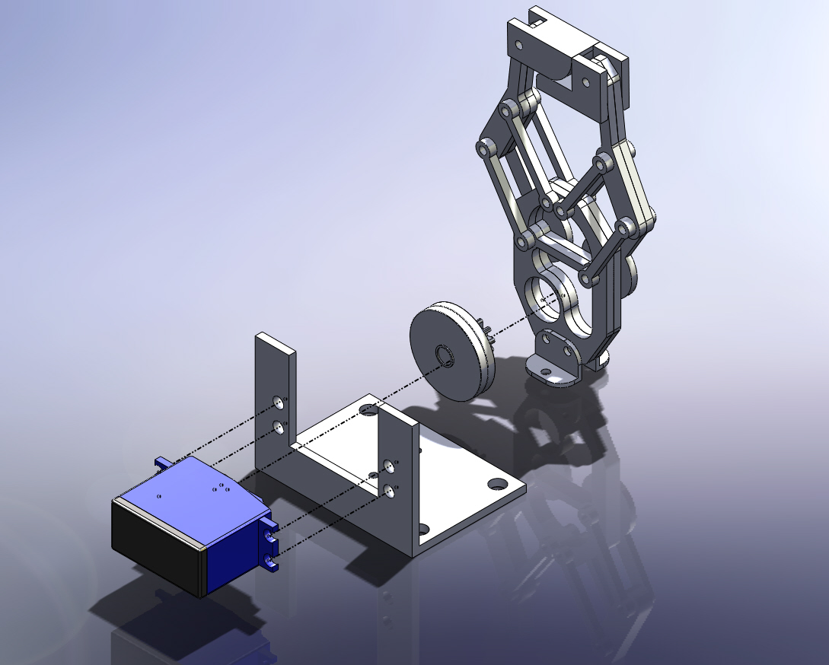
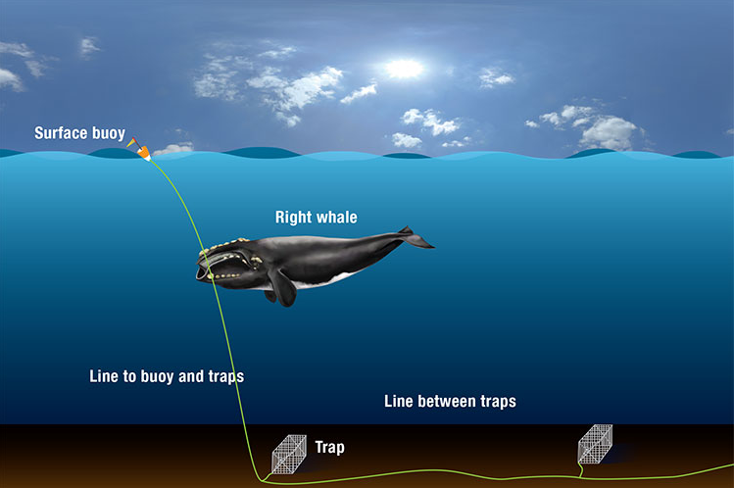
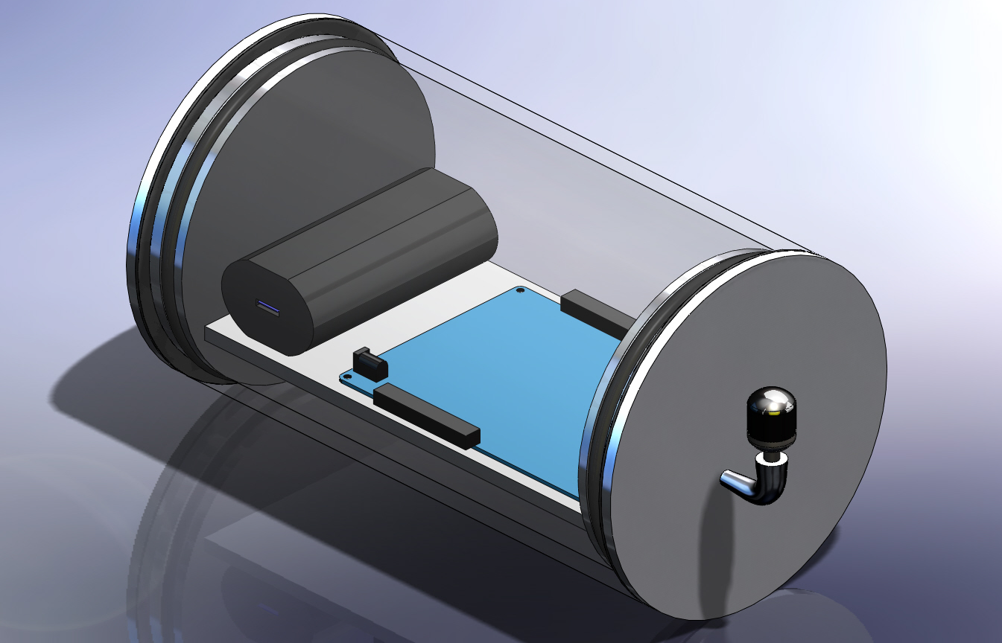
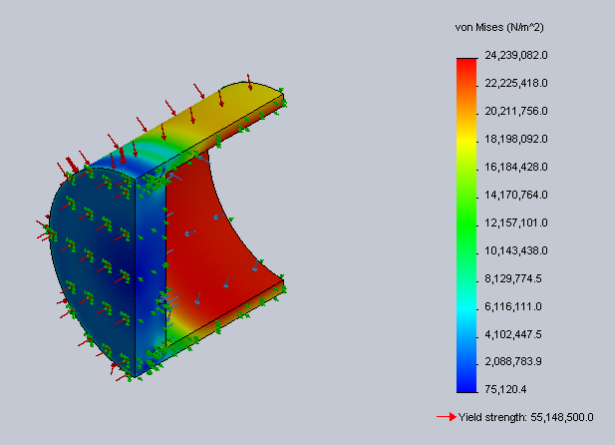
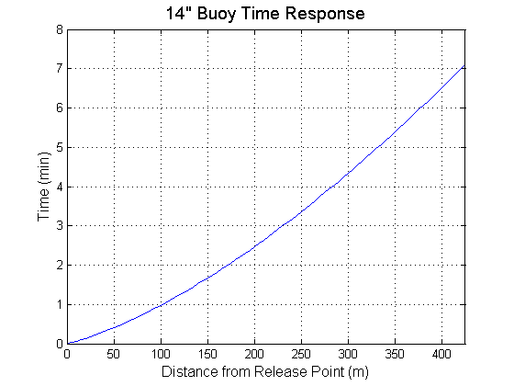
SUBMERGED ACOUSTIC RETRIEVAL
Jeff Davies, Brian Regan, Kris Hopkins
University of New Hampshire, Department of Mechanical Engineering
Introduction
Signal Processing
Mechanical Release
Our submerged acoustic retrieval concept is being used to provide an eco-friendly alternative to current lobster fishing practices. The inspiration for our project comes from entanglement issues caused by floating vertical lines associated with current fishing methods. These lines have caused countless deaths among marine animals along with increasing economic setbacks stemming from equipment failure and replacement costs. Our design concept aims to eliminate vertical lines through a submersible buoy release system. The new trap configuration accommodates an acoustic signal receiver that allows fishing vessels to communicate with a mechanical release system at the bottom of the ocean. Once the appropriate signal is received by the submerged trap, the release mechanism will activate to send the auxiliary buoy floating towards the surface. Once the buoy has surfaced, the auxiliary rope will be hoisted in to start the trap retrieval process. The new concept will seamlessly integrate into current fishing practices with minimal cost impact.
Lobster fishing vessels will send out unique coded signals corresponding to their trawl sets
This prevents theft and miscommunication with trawl lines not belonging to the transmitted signal
The fishing vessel will house an onboard hydrophone that transmits the coded acoustic signal
Purchased a mechanical claw to hold submerged line and buoy to the trap
Upgraded all hardware to minimalize movement between components
Modifications were made to the claw to withstand buoyant force from buoy
  Attached two steel outriggers to claw hook
  One element is fixed to safely hold buoy when closed
  Other element moves on a pivot to swing out and release buoy upon opening
Mechanical Release
Operation Schematic
Battery Pack
Using GearPower ultra capacity mobile power station
5V1A power output rating
USB port used to power submerged microcontroller
Hydrophone
Two hydrophones purchased from Aquarian Audio are used
One transmits the signal while the other receives the signal at the ocean floor
Current lobster trap configuration
Cypress PSOC 3 Microcontroller
Servo Motor
Depth Step Analysis of Surfacing Buoy
Developer board is used to condition the transmitted signal and process the received signal from the hydrophones
Once the correct signal has been received the servo motor is triggered and the mechanical release is opened
Using Traxxas 2056 high-torque waterproof servo motor
Connects directly to the claw used for the mechanical release
Upon receiving command from the PSOC the servo actuates and opens the claw
The new system will require the submerged buoy to release from the ocean floor and float to the surface
Typical lobster fishing depths reach up to 425m
Buoy must surface fast enough to have a minimal impact on fishing productivity
Several different buoys and buoy configurations were considered for the surfacing mechanism
Depth step analysis was performed in MATLAB to determine the theoretical surfacing time
Theoretical times were confirmed through testing in the Chase Engineering tank
14” buoy had the fastest surfacing time and smallest deviation from theoretical surfacing time
Pressure Vessel
Pressure Vessel
Optimization study was done in SolidWorks on wall thickness
  Pressure tested at 425m (445 psi)
  Optimal Outer Diameter: 6.2 in.
  Shell Thickness: 0.7 in.
Watertight with inner gasket and O-ring at each end
 | Surfacing Time (s)
Configuration | Theoretical | Experimental | % Error
14 in. | 2.25 | 2.39 | 5.86
11 in. | 2.65 | 3.28 | 19.21
11 in. (series) | 4.31 | 3.18 | 35.53
11 in. (parallel) | 2.74 | 2.32 | 18.10
9 in. | 3.82 | 5.11 | 25.24
Acknowledgements
Professor Kenneth Baldwin, Project Advisor
Robert Dick, Cyprus Representative
Project funded by N.H. Sea Grant

