Slide 1


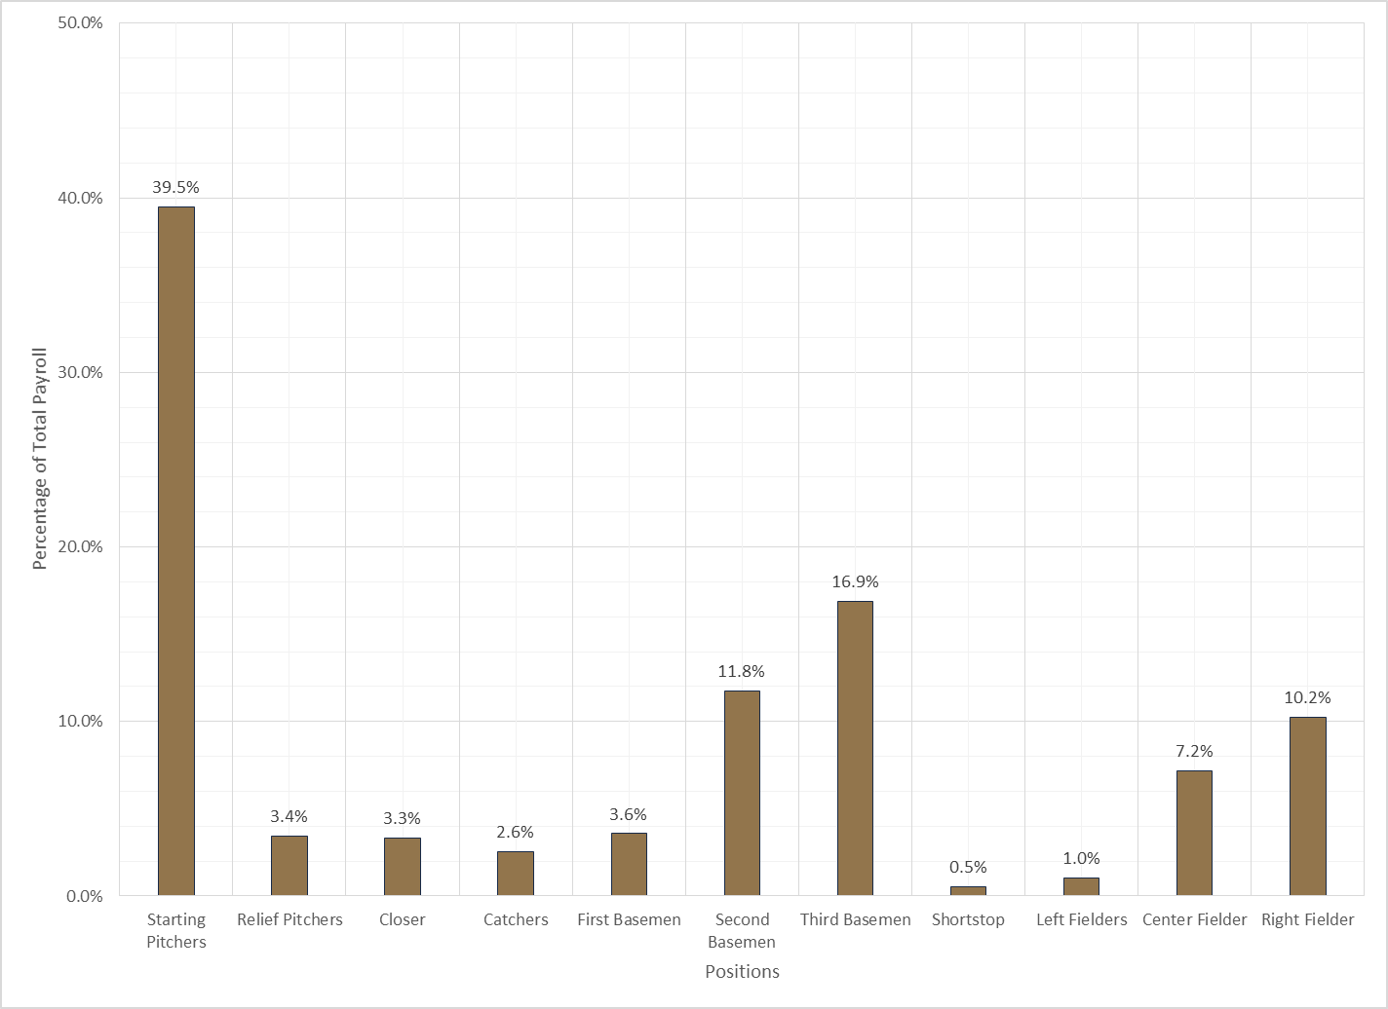
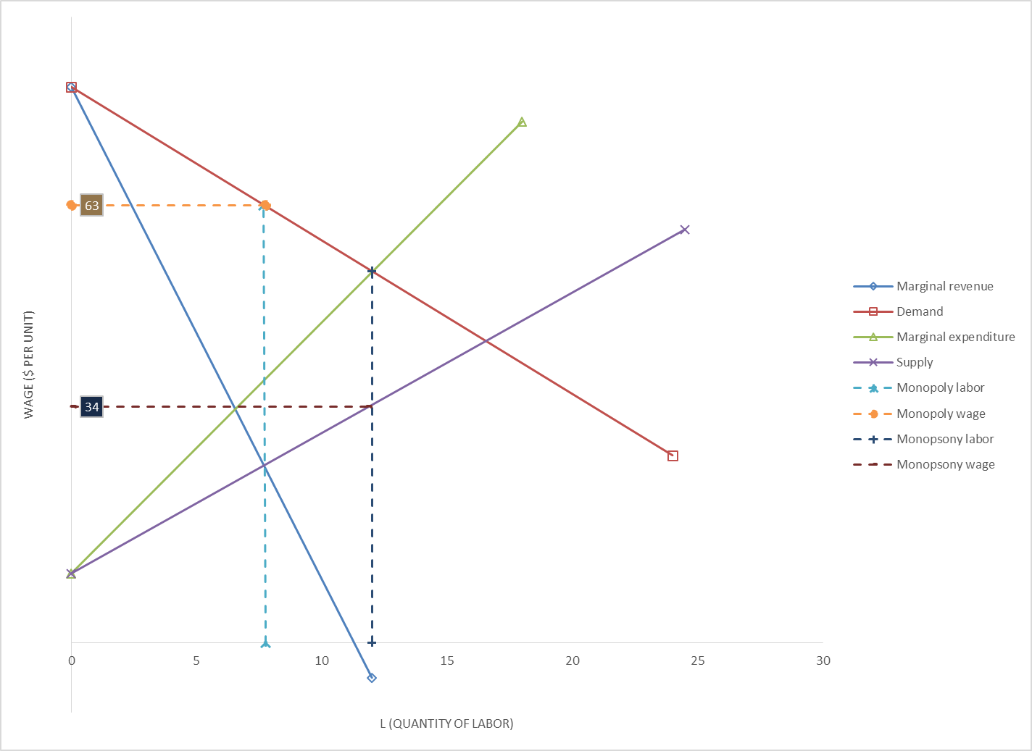
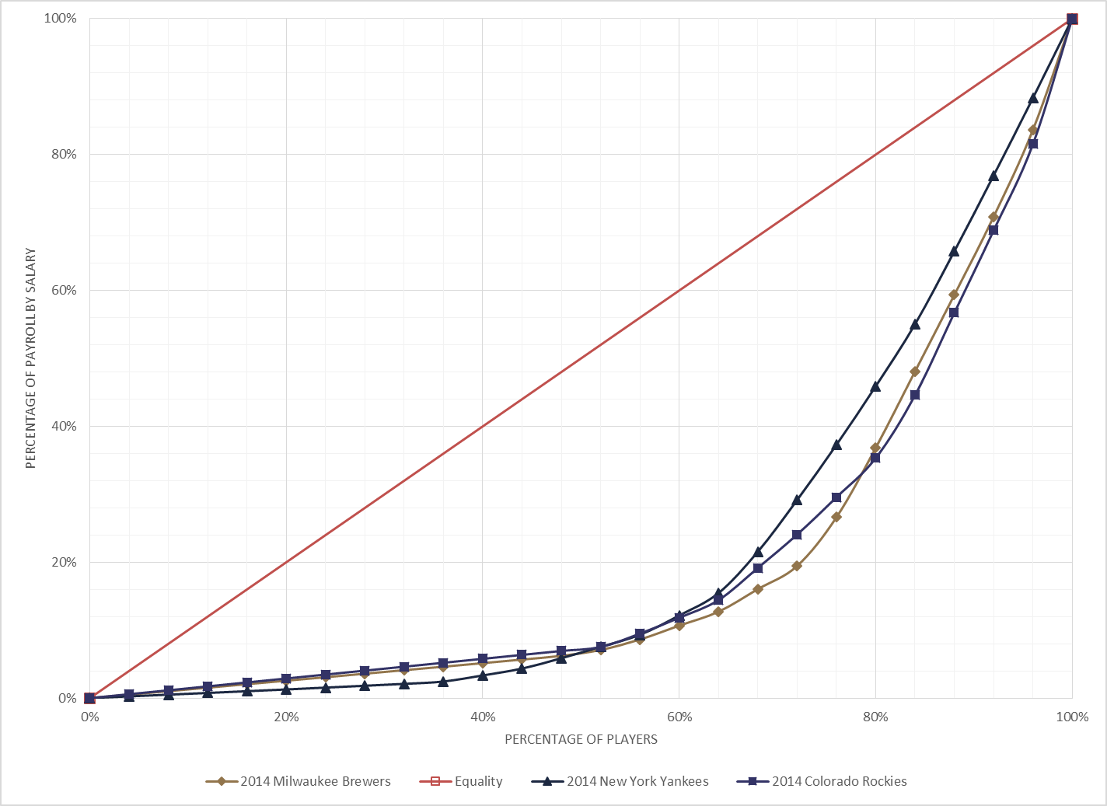
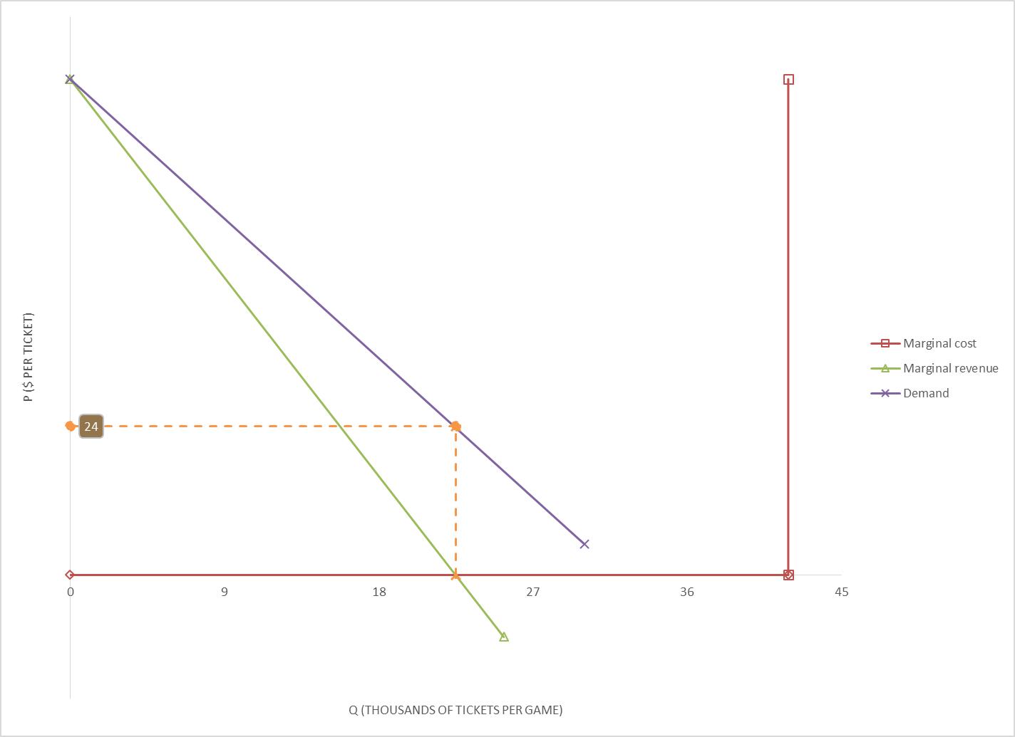

2014 Milwaukee Brewers Franchise/Roster Evaluation
By: Philip Sophinos, Professor: James Wible
Introduction
The Milwaukee Brewers are a professional baseball team that play in the National League of a larger league called Major League Baseball (MLB). They play their home games at Miller Park in Milwaukee, Wisconsin. They are also part of a division called the NL (National League) Central, which comprises four other teams: the Chicago Cubs, the Cincinnati Reds, the Pittsburgh Pirates and the St. Louis Cardinals.
Purpose
The main purpose of this project is to look at, economically and theoretically, how the Milwaukee Brewers as an organization and roster are structured. The overall team has a payroll that is distributed amongst the players. However, there can only be 25 of them on the active roster during the season and each one isn’t necessarily paid the same salary. Questions like ‘do certain positions on the field account for a larger portion of the payroll?’ and ‘relative to other teams, how evenly distributed are the Milwaukee Brewers’ salaries?’ will be answered.
Active Roster
MP/$: Marginal product per dollar of labor; the additional production of a player relative to their current salary
Production is measured by the player’s 2013 WAR
WAR: Wins Above Replacement; it is a sabermetric statistic that shows how many wins a player contributed to his team’s overall number relative to what a replacement level player would contribute towards it
Payroll Distribution by Position
Bilateral monopoly
Three of the team’s five starting pitchers in the rotation are earning eight-figure salaries, which explains why that position accounts for the highest percentage
Carlos Gómez, their only true center fielder, accounts for a larger percentage of the team’s payroll than the catchers, first basemen and shortstop do combined!
This situation occurs when there is a single consumer and a single seller in a market
The franchise/owner (monopsonist) wants to maximize profits when the marginal expenditure curve intersects the demand curve
The monopsony wage can be found by following the supply curve down to the value of 34
This number represents the bottom 60% of the Milwaukee Brewers receiving the resultant percentage amount of payroll by salary
Conversely, the monopolist (any player and their agent) would like to maximize profits when the marginal revenue curve intersects the supply curve
The monopoly wage can be found by following the dashed line up from that intersection to the number 63
This value represents the top 20% of Milwaukee Brewers receiving the corresponding percentage amount of payroll by salary
The actual wage falls somewhere between these two values
The monopsonist’s’ and monopolist’s’ bargaining power is a major influence
Lorenz curve comparisons
Attendance and Prices
This curve measures the distribution of income among the 25-man rosters of the Milwaukee Brewers along with the Colorado Rockies and New York Yankees
Theoretically, the first 10% of a team’s roster is supposed to account for 10% of the payroll and the first 20% is supposed to account for the first 20% of the payroll, et cetera
However, all three Lorenz curves sag below the equality line to indicate an unequal distribution of wealth
From the graph, the top 32% of the New York Yankees’ roster is significant because their Lorenz curve lies inside that of the Milwaukee Brewers’
This indicates that the Brewers have a much more unequal salary distribution than the Yankees
The quantity of eight-figure salaries on the Brewers compared to the Rockies is illustrated by the higher percentage of payroll by salary within the top 20% of both teams’ rosters
The Milwaukee Brewers’ marginal revenue and demand curve are downward-sloping to signify the degree of market power they exercise (i.e. when baseball fans in Milwaukee believe there are no perfect substitutes to a Brewers game)
On game days at their home ballpark, Miller Park, the team’s marginal cost curve is zero and lies horizontal until the stadium is at full capacity (41,900)
Because of this large capacity, the marginal cost curve becomes vertical after reaching the end of the demand curve, which shows that the stadium is almost never at full capacity
In order to maximize profits, the Milwaukee Brewers should set their ticket prices at $24, which would enable around 22,000 fans to buy a ticket
Data
Salary figures were mostly obtained from www.baseball-reference.com, but also from www.spotrac.com
Active roster and depth chart information were received from the team’s’ official website
For the “Attendance and Prices” section, the Forbes website was used to retrieve ballpark information
Contact Information
Email: paq35@wildcats.unh.edu

