Slide 1

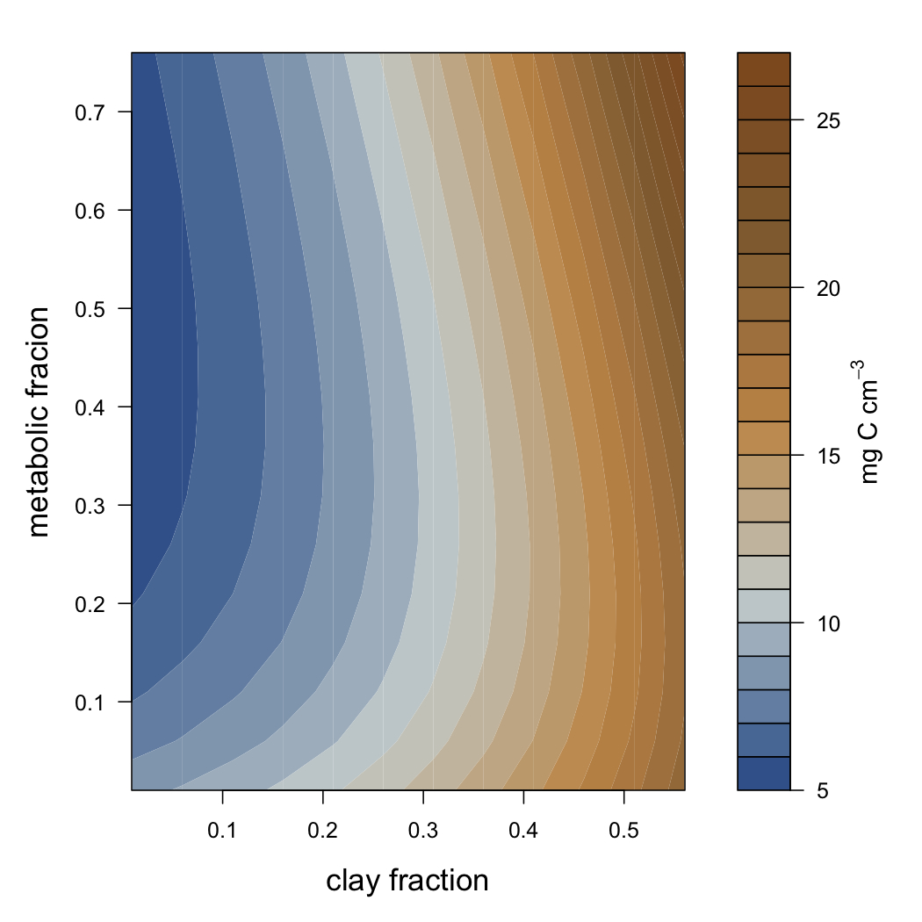



Integrating plant-microbe interactions to understand soil C stabilization with the MIcrobial-MIneral Carbon Stabilization model (MIMICS)
Stuart Grandy^{1*}, Will Wieder², Cynthia Kallenbach¹
¹University of New Hampshire, Department of Natural Resources and Environment; ²National Center for Atmospheric Research (NCAR) and University of Colorado
*Contact: stuart.grandy@unh.edu
Background
Despite wide recognition that microbial physiology and soil mineral interactions facilitate the formation of stable SOM, this theoretical insight has not been adequately represented in process based models. Preliminary results suggest that, compared with models based on more traditional concepts (e.g., models that implicitly represent microbial activity like CENTURY or RothC), global models that explicitly represent microbial activity generate markedly divergent projections about the fate of soil C in a changing world.
In order to more rigorously evaluate relationships between microbial physiology, soil environmental conditions and SOM formation we developed the MIMICS (MIcrobial-Mineral Carbon Stabilization) model, which is building on initial efforts by Wieder and others (2013) to represent microbial processes in global soil C predictions made by the Community Land Model. MIMICS incorporates the relationships between microbial physiology, substrate chemical quality, and physical stabilization of SOM.
Major model components in traditional soil biogeochemical models based on theories of chemical recalcitrance and the MIMICS microbial model.
Component | Traditional model | MIMICS model
Litter quality | Determines partitioning to pools with different turnover times. SOM pools decline w/ increasing f_{met} | Determines partitioning to LIT pools and the relative abundance of MIC communities. Variable SOM pool response to f_{met}.
Litter quantity | Determines SOM pool size. | Determines MIC pool size.
Soil texture | Modulates turnover constants & partitioning of SOM between pools. No explicit representation of physical protection. | Explicitly represents physical protection of SOM. Provides a mechanism for microbial byproducts to build stable SOM.
Reaction kinetics | Environmentally sensitive. Determines turnover of C pools. | Temperature sensitive. Along with MIC pool size determines turnover. Structures competitive dynamics between MIC_{r} & MIC_{K}.
MGE | Determines fraction of C lost between pool transfers, no effect on rates of C mineralization. | Determines fraction of C lost in transfers to MIC pools & MIC pool size. Thus, MGE affects rates of C mineralization and competitive dynamics between MIC_{r} & MIC_{K}.
t | Implicitly simulated as part of reaction kinetics. | Explicitly simulated. Determines microbial control over SOM formation in mineral soils
Model parameter descriptions, values, and units used in MIMICS.
.
Model validation and comparison
Concepts from soil biogeochemical theory were used to develop and apply a new microbial-based soil C model, comparing this model to both a conventional SOM model and a recent microbial model developed for CLM (Community Land Model).
1) Conventional model – Daycent. Emphasizes litter recalcitrance and litter quantity in SOM accumulation.
2) Microbial CLM. The microbial model adaptation of CLM (Community Land Model) builds SOM through links between high litter quality and microbial biomass and turnover but deemphasizes physical protection.
3) MIMICS explicitly incorporates microbial physiological parameters, including contrasting microbial communities possessing different kinetics, growth rates, turnover rates and chemistries, as well as protection of some microbial products against microbial decay due to physical protection.
Parameter | Description | Value | Units
f_{met} | Partitioning of litter inputs to LIT_{m} | 0.85 - 0.013(lignin/N) | –
f_{i} | Fraction of litter inputs directly transferred to SOM | 0.02, 0.3×e^{(-4×fmet)} § | –
V_{slope} | Regression coefficient | 0.063 # | ln(mg C_{s} (mg MIC)⁻¹ h⁻¹)°C⁻¹
V_{int} | Regression intercept | 5.47 # | ln(mg C_{s} (mg MIC)⁻¹ h⁻¹)
a_{V} | Tuning coefficient | 8 ×10^{-6 #} | –
V_{mod-r} | Modifies V_{max} for each substrate pool entering MIC_{r} | 10, 2, 6, 2 * | –
V_{mod-K} | Modifies V_{max} for each substrate pool entering MIC_{K} | 2, 2, 2, 2 ¶ | –
K_{slope} | Regression coefficient | 0.017 §§ | ln(mg C cm⁻³)°C⁻¹
K_{int} | Regression intercept | 3.19 # | ln(mg C cm⁻³)
a_{K} | Tuning coefficient | 10 # | –
K_{mod-r} | Modifies K_{m} for each substrate pool entering MIC_{r} | 0.125, 0.5, P_{scalar}, C_{scalar} * | –
K_{mod-K} | Modifies K_{m} for each substrate pool entering MIC_{K} | 0.5, 0.25, P_{scalar}, C_{scalar} ¶ | –
P_{scalar} | Physical protection scalar used in K_{mod} | 1 / (2.5×e^{(-3×fclay)}) | –
C_{scalar} | Chemical protection scalar using in K_{mod} | 1 / (1.4 + 0.2(f_{clay})) | –
MGE | Microbial growth efficiency for substrate pools | 0.6, 0.6, 0.3, 0.3 ## | mg mg⁻¹
t | Microbial biomass turnover rate | 6×10⁻⁴×e^{(0.9×fmet)}, 3×10⁻⁴ ** |  | h⁻¹
f_{c} | Fraction of t partitioned to SOM_{c} | 0.2×e^{(-2×fmet)}, 0.4×e^{(-3×fmet)} ** |  | –
Soil C response to litter quality across soil types in MIMICS
MIMICS predicts litter decomposition
A
B
Soil C response by soil type to an increase in litter quality in MIMICS
C
Soil C response to an increase in litter inputs in a conventional and microbial model and MIMICS
LIT_{m}, LIT_{s}: metabolic and structural litter. MIC_{r}, MIC_{k}: r vs k selected microbial communities. SOM_{p}, SOM_{a}, SOM_{c}: physically protected, active, and chemically protected soil C pools
§For metabolic litter inputs entering SOM_{p} & structural litter inputs entering SOM_{c}, respectively
#From observations in German et al. (2012), as used in Wieder et al. (2013).
*For LIT_{m}, LIT_{s}, SOM_{p}, and SOM_{c} fluxes entering MIC_{r}, respectively.
¶For LIT_{m}, LIT_{s}, SOM_{p}, and SOM_{c}, fluxes entering MIC_{K}, respectively.
§§ Used to calculate all K_{m} values, except for LIT_{s} entering MIC_{r} & MIC_{K}, which used 0.027
##For C leaving LIT_{m}, SOM_{p}, LIT_{s} & SOM_{c}, respectively.
**For MIC_{r} & MIC_{K}, respectively
For additional model details see Wieder et al. Biogeosciences Discussions, 11:1147-1185
A,B. MIMICS predicts that additions of high quality litter (low C/N and lignin/N ratioa) will increase soil C in clay soil. This increase is driven by an increase in MIC_{r} and the physical stabilization of microbial residues in clay soils. By contrast, in sandy soils, C is primarily stabilized by chemical recalcitrance, and higher C is associated with low quality inputs. C. An increase in litter inputs increases soil C in Daycent in both clay and sand dominated soils. In MIMICS, there’s a sharp increase in clay soils due to physical protection of microbial biomass, but in sandy soils priming mechanisms limit C increases. In the microbial CLM model priming limits soil C increases. MIMICS represents a hybrid model. It incorporates physical stabilization mechanisms as well as microbial community feedbacks.

