Slide 1
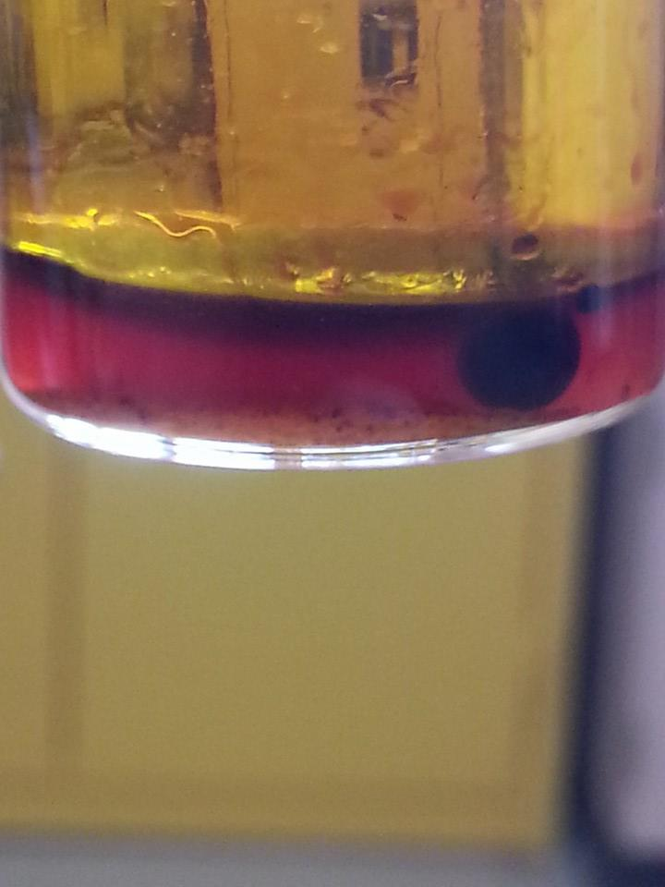
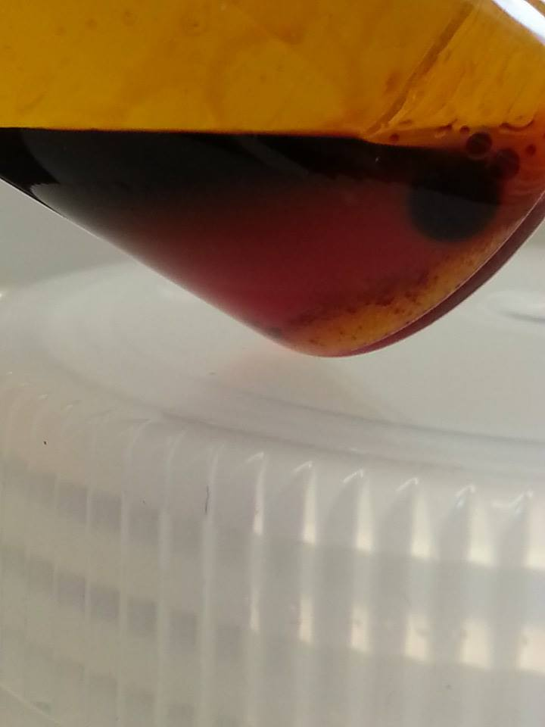
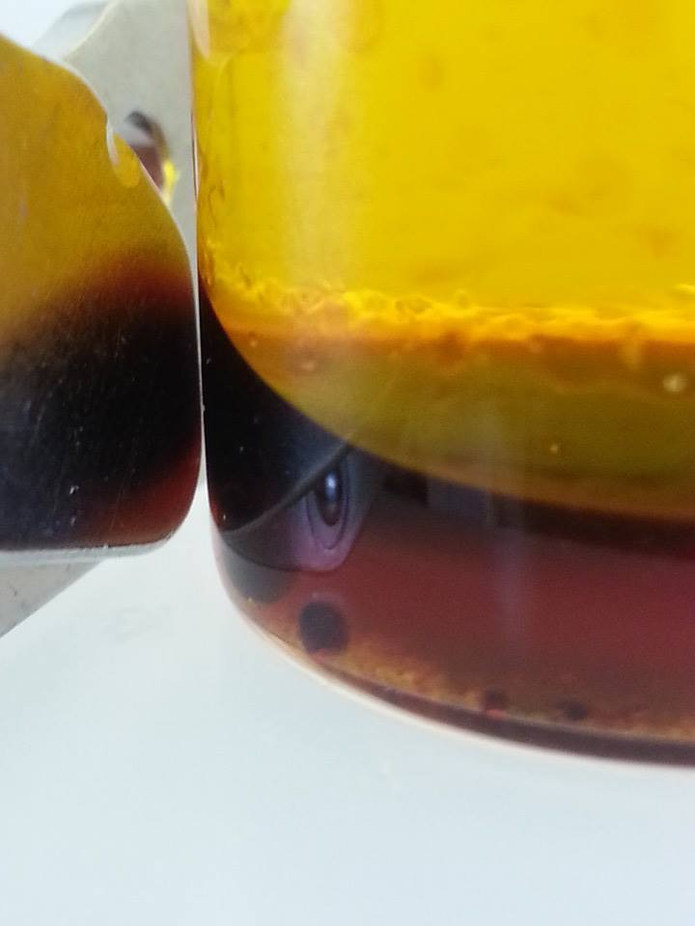
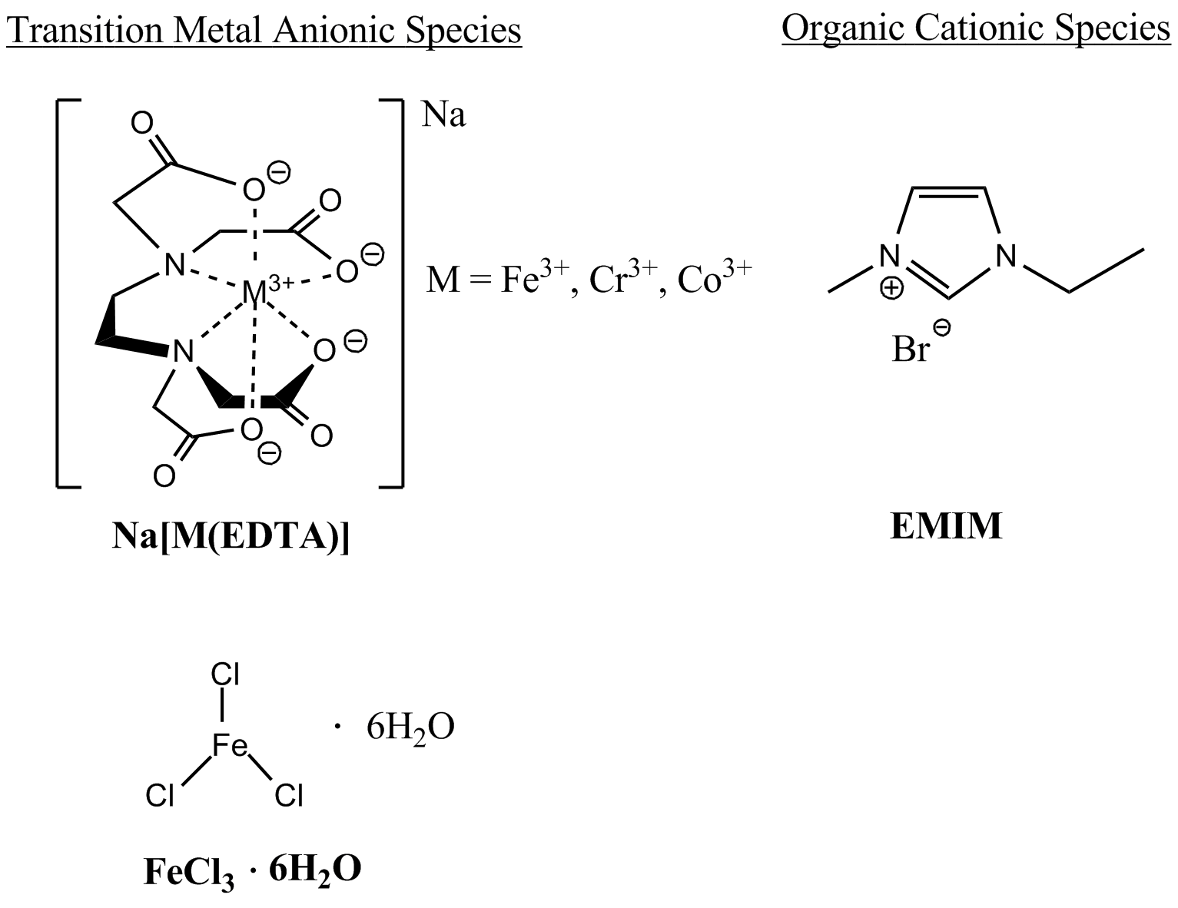
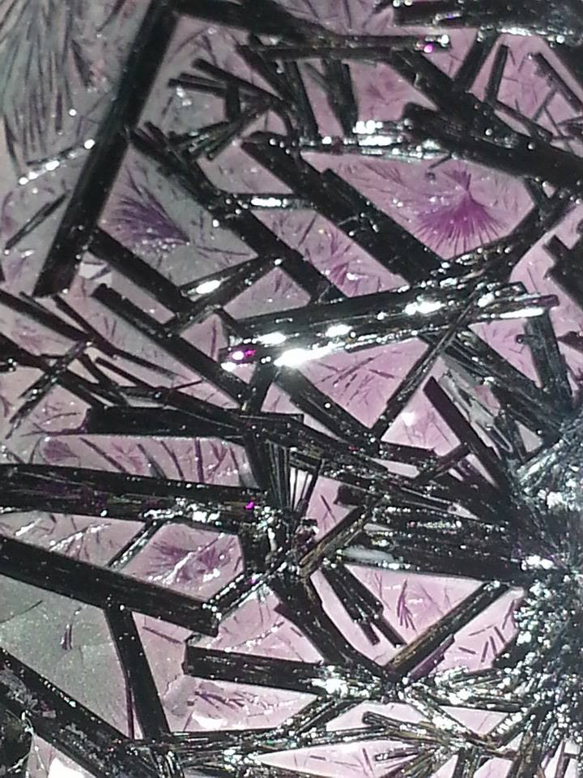
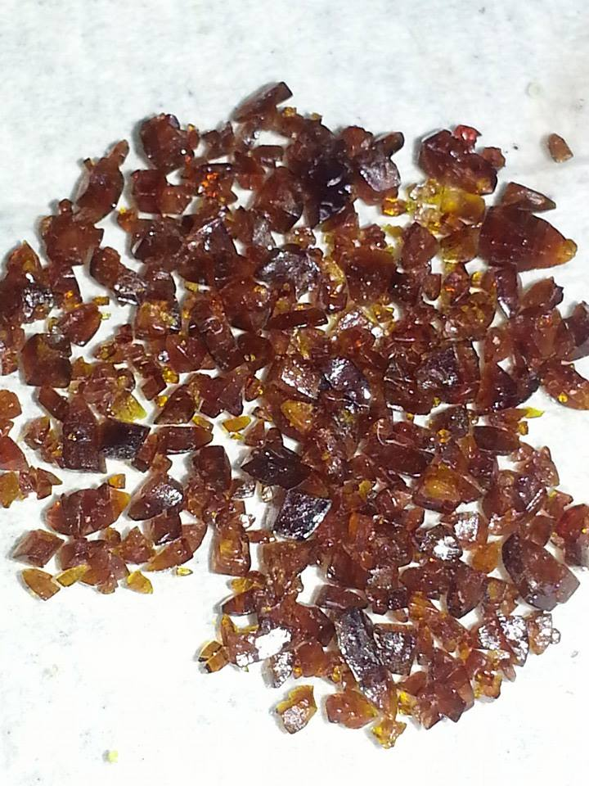
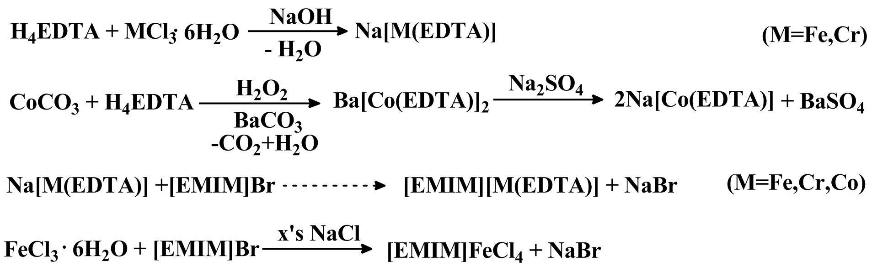
Synthesis of Magnetic Room Temperature Ionic Liquids
David Waste
Instructors: Roy Planalp, Lea Nyiranshuti, Christian Tooley
dws33@wildcats.unh.edu
Parsons Hall, 23 Academic Way, Durham NH 03824
Introduction
The magnetic room temperature ionic liquids (MRTILs) synthesized represent a class of ionic coordination complexes, created by the combination of a paramagnetic anionic metal complex and an organic cation to form a species which has the properties of both a liquid and an ionic compound at room temperature, while further being susceptible to a magnetic field.
These properties result in a liquid that exhibits high temperature stability, non-volatility, and high viscosity, making them ideal for applications such as powerful solvents, electrolytes in redox flow batteries, and sealants.¹ The properties of MRTILs are also easily controlled by the substituents on the organic component and metal counter ion.
Successful Synthesis of a MRTIL: Under instruction of a second reference paper⁴, the synthesis of [EMIM]FeCl₄ was completed by combining EMIM and FeCl·6H₂O in water. The resulting brown liquid showed low water solubility and responded to a magnetic field as described in the literature (Figure 2).
Figure 3. Pictures showing [EMIM]FeCl₄ MRTIL between aqueous and organic layers
and response to magnet.
Experimental
All reactions were carried out at room temperature in open air, and samples of [EMIM]FeCl₄ liquid were vacuum dried over night without loss of product, attributed to the non-volatility of the compound. X-ray crystallography using a Bruker SMART X2S was utilized to determine that the composition of the crystals shown in Figure 1 were indeed the Na[M(EDTA)] (M=Fe³⁺,Co³⁺) intended to be synthesized as reagents for the reaction to create [EMIM][M(EDTA)].
Further analysis to determine the presence of [EMIM][Co(EDTA)] was conducted by cyclic voltammetry. A weak reversible wave was obtained at 0.275 V vs. Ag/AgCl (0.1M acetate buffer), but proved inconclusive when compared to literature values¹.
Na[Co(EDTA)]
Na[Fe(EDTA)]
Figure 1. Metal anionic and organic cationic species used to synthesize MRTILs.
Future Work
Further experiments to successfully complete the synthesis of [EMIM][M(EDTA)] MRTILs may be attempted using varying solvents or extraction techniques. Until that time, further research may be carried out on MRTILs of the form [EMIM]MCl_{x} with other paramagnetic metal ions such as Cu²⁺ or Cr³⁺ and different organic counter ions such as [BMIM]
Figure 2. Reactions conducted during course of experiment to produce [EMIM][M(EDTA)] and
[EMIM]FeCl₄ MRTILs.
Results and Discussion
Successful synthesis of starting materials, but no product obtained: Analysis by X-ray crystallography determined that the iron(III) and cobalt(III) salts produced in the initial part of the synthesis were indeed the intended complexes Na[Fe(EDTA)] and Na[Co(EDTA)] respectively ^{2,3}. However, reaction of Na[Co(EDTA)] with 1-Ethyl-3-methylimidazolium bromide (EMIM) in water (Figure 2) yielded no qualitative product, as shown by inability to dissolve resulting purple liquid in D₂O for ¹H NMR analysis. The color and apparent viscosity of this liquid do agree with the reference paper¹, suggesting that some [EMIM][Co(EDTA)] may have been produced. Attempted synthesis of [EMIM][Fe(EDTA)] and [EMIM][Cr(EDTA)] (Figure 2) yielded only starting materials.
Conclusions
The ease and simplicity of synthesizing compounds such as [EMIM]FeCl₄ show a promising start to the creation of a specific field that utilizes the combination of the properties of room temperature ionic liquids and magnetic susceptibility of paramagnetic metal ions for a variety of uses in other chemical syntheses and applications.
Acknowledgments
I would like to thank Roy Planalp for his help for his help in organization and advice in making this experiment possible, Christian Tooley and Lea Nyiranshuti for their insight, overview of the experiment, and help in running analytical techniques, Jonathan Briggs for his execution and expertise in X-ray crystallography, and the UNH Department of Chemistry for funding this project
References
1. Branco, A.; Branco, L.C.; Pina, F. Electrochromic and magnetic ionic liquids. Chemical Communications, 2011, 47, pp. 2300-2302.
2. Mathews, M. Space groups of some coordination compounds of cobalt. Acta Crystallographica , 1961, 14 (9), pp. 1007.
3. Solans, X., et al. Acta Crystallographica, 1984, C40, pp. 635-8.
4. Satoshi Hayashi, Hiro-o Hamaguchi. Discovery of a Magnetic Ionic Liquid [bmim]FeCl4. Chemistry Letters, 2004, 33 (12).

