Slide 1
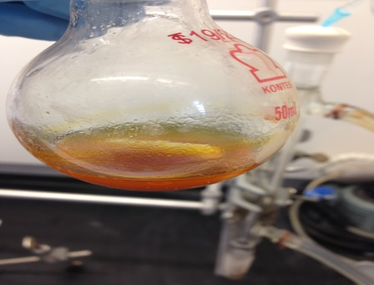
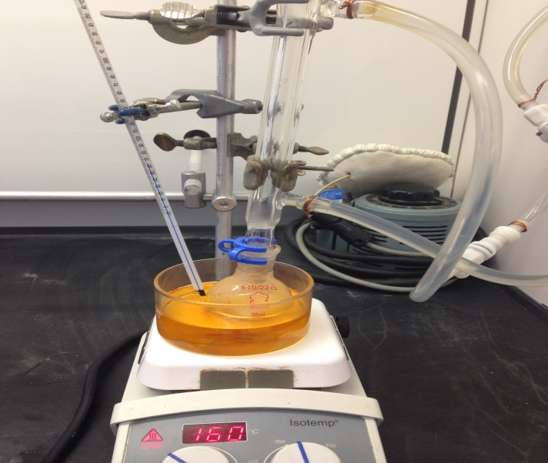
Iron-Catalyzed Direct Arylation through an Aryl Radical Transfer Pathway
Austin Power, Dr. Roy Planalp, Christian Tooley, and Lea Nyiranshuti
adc54@wildcats.unh.edu; Parsons Hall, 23 Academic Way, Durham NH 03824
Introduction
Cross-coupling is a type of reaction which bonds two hydrocarbons through aid of a metal catalyst. Most metal catalysts contain more expensive transition metals such as Rhenium, Paladium, and Ruthenium. While using these is very effective in cross coupling reactions, their use is not cost effective in industry. Iron has recently been found to be a cheap solution to this problem. It has been observed that some iron catalysts can successfully form the C-C bond in relatively high yields. The substance class to be prepared is of diaryl molecules that are bound by a new single C-C bond between the two arenes.
Iron catalysts are used in other processes in chemistry, the most famous of which would be the Haber-Bosch Process¹ which produces ammonia used in fertilizer. Iron is also used in the Fischer-Tropsch² process to convert carbon monoxide and hydrogen to hydrocarbons for fuels. Iron compounds are also used in water purification and sewage treatment, dyeing clothing, and as an additive in animal feed.
One other reaction was run using durene instead of benzene as the aryl compounds. Durene has more steric hindrance due to its 4 methyl groups at positions 1, 2, 4, and 5 around the ring. It was run using the same reaction scheme. This reaction was done before the original was found to work. No product was recovered.
Experimental
A 50 milliliter round bottom flask was equipped with a stir bar. Fe(OAc)₂ (0.025 mmol, 5 mol%), bathophenanthroline (0.05 mmol, 10 mol%), and crushed dry KOt-Bu (1.0 mmol, 2 equiv) were added to the flask and flushed with nitrogen. To a separate vial was added the iodobenzene (0.5 mmol, 1 equiv). The iodide was diluted in benzene (50 mmol, 100 equiv) and added to the reaction vessel. The reaction was stirred vigorously at room temperature for 20 minutes and then at 80 ºC for 20 hours. Following cooling, 2 mL of CH2Cl2/hexanes (1:1) was added, and the solution was filtered through a celite pad. The pad was then rinsed with 15 mL of CH2Cl2/hexanes (1:1). The combined solution was concentrated and the crude mixture was purified via column chromatography and monitored using thin layer chromatography to afford the biphenyl products.
Figure 2: Round bottom flask with contents after 20 hour reaction
Results and Discussion
The experiment was attempted 4 times using iodobenzene and benzene. After the 20 hour reaction was completed, the crude product attempted to be purified using column chromatography. Thin-layer chromatography and ¹H NMR was used to analyze the products. The column was monitored using thin-layer chromatography. A retention factor value of .37 was reported in the original paper³ to be the biphenyl product. All 4 columns didn’t produce a retention factor equal or close to the one reported in the paper. A color change can be seen over the 20 hour reaction although this may not be from the reaction happening. Fe(OAc)₂, the catalyst used, is a brown solid which doesn’t dissolve immediately in nonpolar solvents but does overtime with heat and stirring. The color change cannot be directly related to a reaction happening because the catalyst is formed again after the reaction.
¹H NMR was taken of the crude product which showed some possible peaks that could possibly be product. The expected biphenyl product would have peaks at 7.64-7.50 (m, 4H), 7.47 (t, 4H) and 7.43-7.34 (m, 2H) ppm. The peaks at 7.43 and 7.26 ppm are due to solvents. The large peak at 7.43 ppm makes it hard to decipher the possible peaks that could be product. A set of medium peaks near 7.37 ppm could possibly be the multiplet of the biphenyl product and there is another set of peaks around 7.60 ppm which could be the other multiplet of the biphenyl product.
Scheme 1 shows the mechanism of the cross coupling reaction. It is thought to happen through a three step process. The reaction is iron catalyzed and uses a series of radical processes to form the diaryl compound. The iron catalyst performs an oxidative addition with the aryl iodide. This is followed by a transmetallation step which puts both coupling reactants on the catalyst. The final step involves a reductive elimination which regenerates the iron catalyst and produces the organic product.
Figure 3: Experimental Apparatus for reaction
Future Work
Continued work on the cross-coupling reaction to produce the biphenyl product. The same reaction scheme using larger aryl compounds would be further researched and tested to see if steric hindrance has any effect on percent yield.
Figure 4: Proposed reaction schemes
Conclusions
Iodobenzene and benzene were attempted to be cross-coupled using an iron catalyst. The reactants and products were separated using column chromatography and monitored using thin-layer chromatography. No product was recovered, but ¹H NMR showed that some product formed with peaks in the region 7.7-7.3 ppm. The reaction could be done in a dry box to ensure that any water in the air doesn’t react with any of the reactants or at higher temperatures.
Acknowledgments
I would like to thank the Department of Chemistry, UNH, for funding. Also, Professor Roy Planalp, Christian Tooley, and Lea Nyiranshuti.
Figure 1: ¹H NMR spectrum of crude product
Scheme 1: Proposed mechanism of iron catalyzed cross coupling
References
Kemsley, J. “SYNTHESIS: Iron complex that emulates Haber-Bosch catalyst offers new mechanistic insights”. Chem. Eng. News, 2011, 89 (46), p 5
Kobe, K. “The Fischer-Tropsch and related synthesis”. J. Chem. Educ., 1952, 29 (10), p 531
Vallee, F., Mousseau, J. Charette, A. “Iron-Catalyzed Direct Arylation through an Aryl Radical Transfer Pathway”. J. Am. Chem. Soc. 2010, 132 (5), pp 1514–1516

