Slide 1
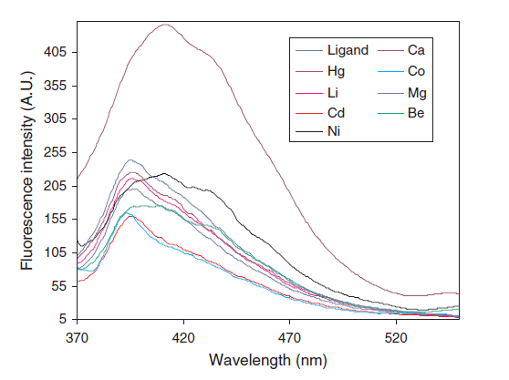
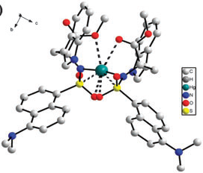
Syntheses of Hypersensitive, Water-Soluble Mercury Probes
An Easy and Effective Way to Detect Aqueous Metals
Max Bilodeau, Dr. Roy Planalp, Lea Nyiranshuti , and Christian Tooley
mhr29@wildcats.unh.edu; Parsons Hall, 23 Academic Way, Durham NH 03824
Introduction:
The presence of mercury in water is an extremely detrimental problem for the environment, and for any organism that uses the contaminated water supply as a source of nourishment or for other human activities. Because of this health risk, mercury ion detectors are of great importance in areas where water toxicity due to metal presence may be high, or where there are non-adequate sources of water treatment. Areas of the works where metal-waste dumping is common, where water treatment is a luxury that cannot be afforded or where mercury levels are known, or suspected, to be higher than what is safe would benefit from a cheap and quick detector for mercury. The detector that is to be synthesized is a fluorescent complex, known to react strongly with mercury, and not with other metal ions that are or could be present in a water supply¹. This allows for a reduction of false-positive reporting of toxic levels of mercury, when the culprit metal, that set off the sensor, is less dangerous to the health of a population subsisting off the water supply.
Experimental:
In this experiment, the sensor complex, dansyl-L-tryptophan methyl ester, (1), is synthesized from dansyl chloride and L-tryptophan methyl ester. This synthesis yields an amino acid complex that, when in contact with Hg²⁺ ions is fluorescent under an ultraviolet light source. The synthesized complex is purified using column chromatography to yield the purest form of the detector, removing any impurities and over or under-reacted reagents. The reaction progression is monitored using TLC chromatography during synthesis, checking the creation of the product against the starting amino acid.¹
The synthesis of N,N-bis(salycylidene)-naphthylene-1,8-diamine, (2), is performed by combination of ethanol solutions of salicylaldehyde and 1,8-diaminonaphthalene. The synthesis generates a yellow solid, which is put into an ethanol/water solution and titrated with aqueous metal ions to reveal fluorescence spectra. The solution of the fluorophore is then titrated with small amounts of metallic ion solutions to determine the fluorescence intensity of the probe when in contact with these metallic ions. The intensities of the fluorescent spectra are used to indicate the fluorophore's proclivity of detecting mercury ions at a lower concentration, and with a greater intensity, than other metallic ions.²
Results and Discussion:
The synthesis of the metal ion-sensing probes was designed to produce fluorescent data when introduced to solutions of metallic ions. Due to synthesis problems and time constraints, this data was not available for collection. However, the theoretical data is presented herein. As is shown, both sensors (1) and (2) show a greater fluorescent response toward mercury ions than other metal ions in solution.
Figure 2: Fluorescent response of (2) with metal ions²
Figure 3: Crystal structure of (1) interacting with a Hg²⁺ ion.¹
Figure 1: Synthesis of Dansyl-L-Tryptophan(1) methyl ester and N,N-bis(salycylidene)-naphthylene-1,8-diamine (2)
Future Work:
The goal of these experiments was to synthesize an effective, high-sensitivity and water-soluble probe for mercury in water supplies. The sensitivity toward mercury, over other metals, is the key distinguishing factor of these probes. To determine whether the synthesized probes function along these lines, fluorescent testing of various metal ions is planned to determine whether or not there is affinity for mercury, rather than other ions. Spectral data, provided by the experiments that were followed, displays a much greater sensitivity for mercury over other ions, and a greater fluorescent intensity, as well. Fluorimetry of various metal ions is planned to determine detection limits of the probe with these metals, and the difference in detection limits between mercury and the other metals. To test probe (1), titration of the probe in a HEPES buffer solution is planned with 1.0x 10⁻⁶ M solutions of Hg²⁺, Ni²⁺, Fe²⁺, Ca²⁺, Mn²⁺ and Zn²⁺. Comparison to the theoretical fluorescent data is proposed to determine whether the synthesized probe functions as designed. Probe (2) is to be tested on 1.0x 10⁻⁴ M solutions, and subsequent dilutions of Hg²⁺, Co²⁺, Cu²⁺, Ca²⁺, Ni²⁺ and Zn²⁺. Comparison to theoretical fluorescent data for this probe is also proposed, to determine whether ideal behavior is being followed. Sensitivity of each probe toward the mercury (I) ions, Hg⁺, is another avenue to be explored at a future day, when a synthesized product is available for use.
Conclusions:
Although synthetic formation of probes (1) and (2) was unsuccessful in this setting, their applications should be further explored. Metallic waste and water clean-up is not to be taken lightly. With these two probes, a quick and easily detectable fluorescent method of mercury ion detection is proposed. These probes have the ability to test quickly and effectively suspect water sources for harmful metal ions. Testing of the probes sensitivity toward Hg⁺, in addition to the high-sensitivity already calculated for Hg²⁺ is suggested at a later point.
Acknowledgments:
Thanks to Dr. Planalp for project suggestion, to Christian and Lea to all of their in-lab help, and to the Dept. of Chemistry at UNH for funding .
References:
Hong-Wei, L.; Yue, L.; “An Easily prepared, hypersensitive, water-soluble probe for Mercury (II) ions.” Chem. Commun., 2009, 4453-4455.
Hosseini, M., et al.; “Selective Recognition of Mercury in Waste Water Based on Fluorescence Enhancement Chemosensor.” Sensor Lett., 2010, 8, 6.

