Slide 1
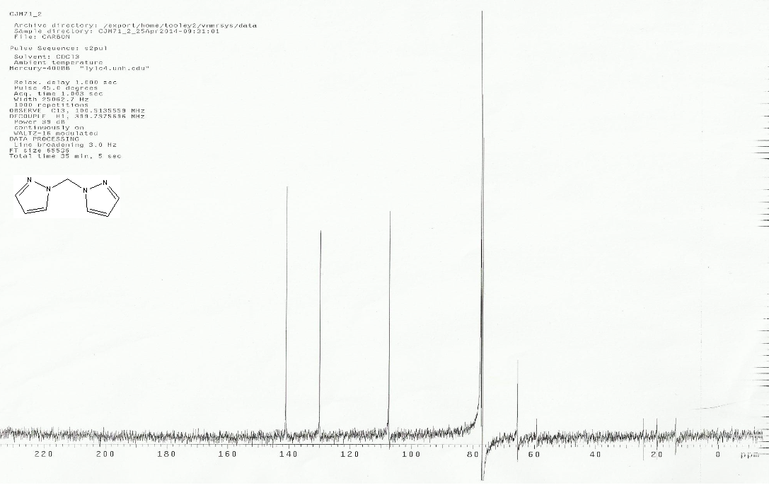

Anti-Cancer Drug and its ability to be used in biological systems
Colin Milmore, Dr. Roy Planalp, Lea Nyiranshuti, Christian Tooley
cjw82@wildcats.unh.edu; Parsons Hall, 23 Academic Way, Durham NH 03824
Cancer in Humans
New Hampshire ranked in the top twelve states by incident rate cancer rates among all types falling in the range of 467.8 to 510.7 per 100,000 from 1999-2010¹. Cancer is clearly a problem that everyone would like to completely rid the world of, but science has only come so far. The problem with cancer cells is that it is basically a group of cells that have lost their ability to die like normal cells resulting in unchecked growths. The best medicines humans have to combat cancer are drugs that enter cells and trigger something called programmed cell death (PCD).
In PCD pathway triggered by copper complexes known as paraptosis, where vacuoles form in the cytoplasm along with mitochondria swelling causing the cell to loose vitality. Paraptosis does not posses DNA and nucleus fragmentation like the more commonly found response apartosis, triggered by most anti-cancer drugs regiments². Though the actual mechanism of how copper complexes trigger PCD depends on ligand back bones, the easier to under understand and test in a lab in the absence of testable cells is how to make a cell want to uptake a foreign molecule.
Experimental²
Organic Synthesis
First the organic ligand, Bis(1H-pyrazol-1-yl)methane, was synthesized from pyrazole dissolved in CH₂Cl₂ and added to a 12.5M solution of NaOH in water and brought to reflux overnight. The organic phase was separated from the aqueous and the aqueous was washed with diethyl ether. All the organic phases were combined and removed by rotation evaporation in a warm water bath.
Adding Cu(II) to the ligand:
This reaction was carried out in a scintillation vial. CuCl₂ was dissolved in 5mL of methanol and mg of the ligand was dissolved in methanol and the two solutions were mixed and the light green precipitate was collected on vacuum filtration. For x-ray crystallography analysis the solid collected was dissolved in the minimum amount of methanol and allowed a slow crystallization by methanol gas diffusion into an ether bath for a week.
Log P determination
This test though typical for drugs by mixing compounds in 1:1 water-octanol solution and determining the fraction present in each by UV-Vis spectroscopy and fairly easy to carry out. Due to small yields of copper(II) complexes however left the issue of how to get a few crystals that were basically stuck inside a scintillation vial . Since the compound showed great solubility in water, 100μl of water was added to the sample and from that solution two 40μl aliquots were added to 3 ml of water and to 3 ml solution of 1-octanol so as for both to contain the same concentration. Each solution was analyzed by UV-Vis spectroscopy to determine relative concentration. The two solutions were mixed toughly and each layer was analyzed by UV-Vis again to obtain the new concentrations and then logp.
Results and Discussion
Three copper(II) complexes were attempted to be synthesized. However due to lack of success and time constraints in the organic work up steps only one copper(II) complex was created.
The only ligand back bone that was Bis(1H-pyrazol-1-yl)methane and was analyzed by proton and carbon NMR.
Then the ligand –metal complex was analyzed by IR spectroscopy
The logp test, a test to see how willing a molecule will dissolve in an organic system over a aqueous one, of the complex in both water and 1-octanol lacked definitive peaks against the noise reported y the Cary 50 UV-Vis spectrometer. Therefore is was impossible to tell concentrations of the molecule in each phase.
1
1
2
1
4
3
2,3,4
4
3
4
3
2
1
2
3
2
1
4
3
4
Pyrazole
Impurity
Figure 4. Full reaction scheme
Figure 1. H¹ NMR: From literature, classifying peak of the product are at 6.26 ppm which indicates the presence of the methylene bridge between the nitrogen’s . Also peaks at 7.65 and 7.56 ppm from the aromatic hydrogens.
Figure 2. Carbon NMR in CDCl₃
Future Work
Due to time constraints determining Log P of more compounds was not possible. For practical information on better anti-cancer drug design many copper complexes should be synthesized and evaluated. These additional compounds could include the molecules that were unable to be made for this project.
The scale on which the reported reactions should be increased so as to be able to properly mass the metal complexes and the logp can be determined quantitatively.
Conclusions
Making the copper (II) complex on the scale chosen was a major factor in why it did not yield the desired end results of the project. Perhaps future development s in the field of organic synthesis or cancer drug research will allow for purchasing of cheaper organic ligand backbones will allow for most cost effective larger scales necessary for this projects success.
Figure 3. IR spectroscopy of metal-ligand complex.
Acknowledgments
A big thank you to the Miller and Zercher research groups for lending value chemicals for this project. Special thanks to the Department of Chemistry, UNH, for funding.
References
1. U.S. Cancer Statistics Working Group. United States Cancer Statistics: 1999–2010 Incidence and Mortality Web-based Report. Atlanta (GA): Department of Health and Human Services, Centers for Disease Control and Prevention, and National Cancer Institute; 2013. Available At: www.cdc.gov/uscs.
2. Tardito, Saverio, Irene Bassanetti, Chiara Bignardi, Lisa Elviri, Matteo Tegoni, Claudio Mucchino, Ovidio Bussolati, Renata Franchi-Gazzola, and Luciano Marchiò. "Copper Binding Agents Acting as Copper Ionophores Lead to Caspase Inhibition and Paraptotic Cell Death in Human Cancer Cells." Journal of the American Chemical Society 133.16 (2011): 6235-242. Print.

