Slide 1


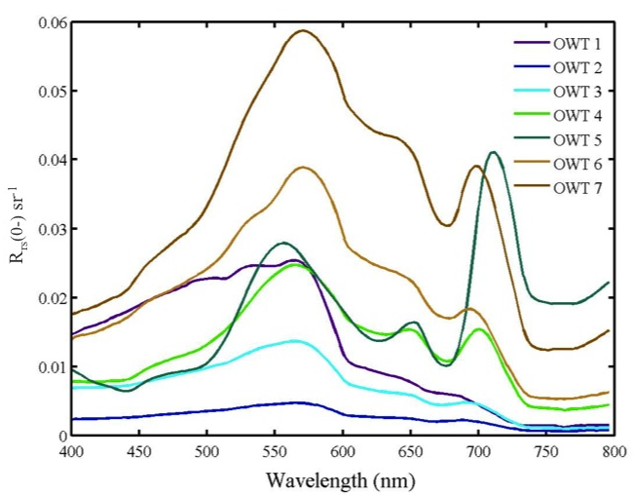
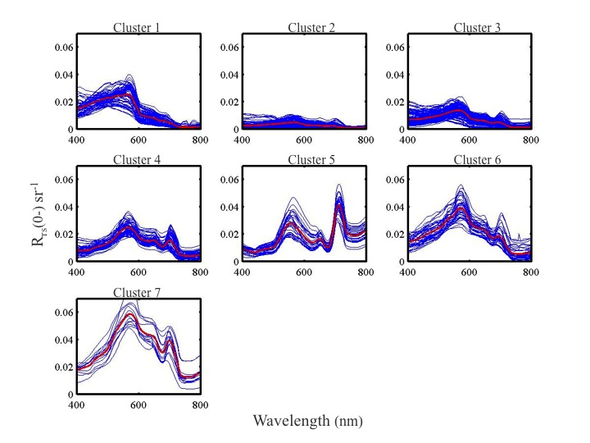
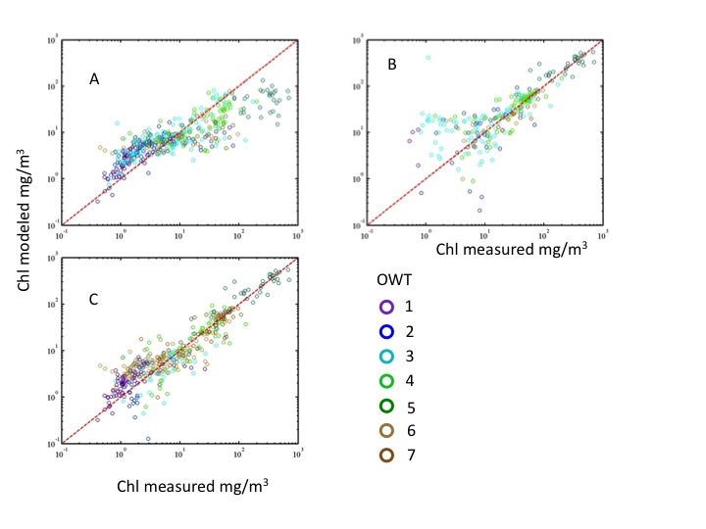
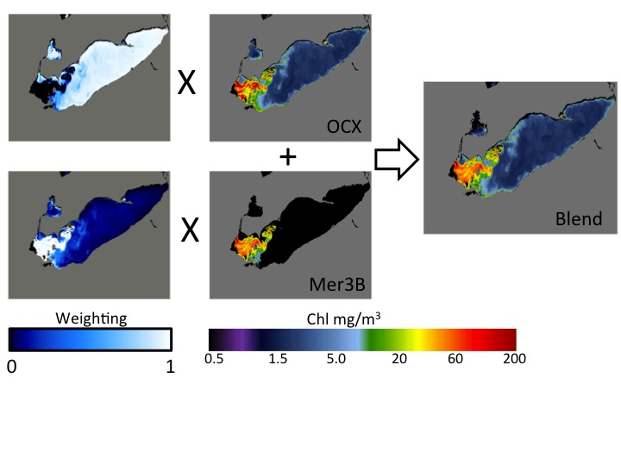
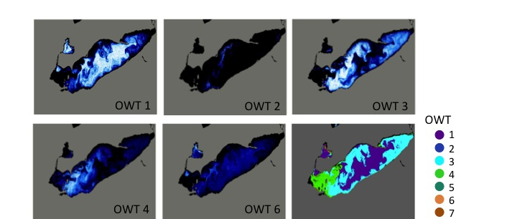
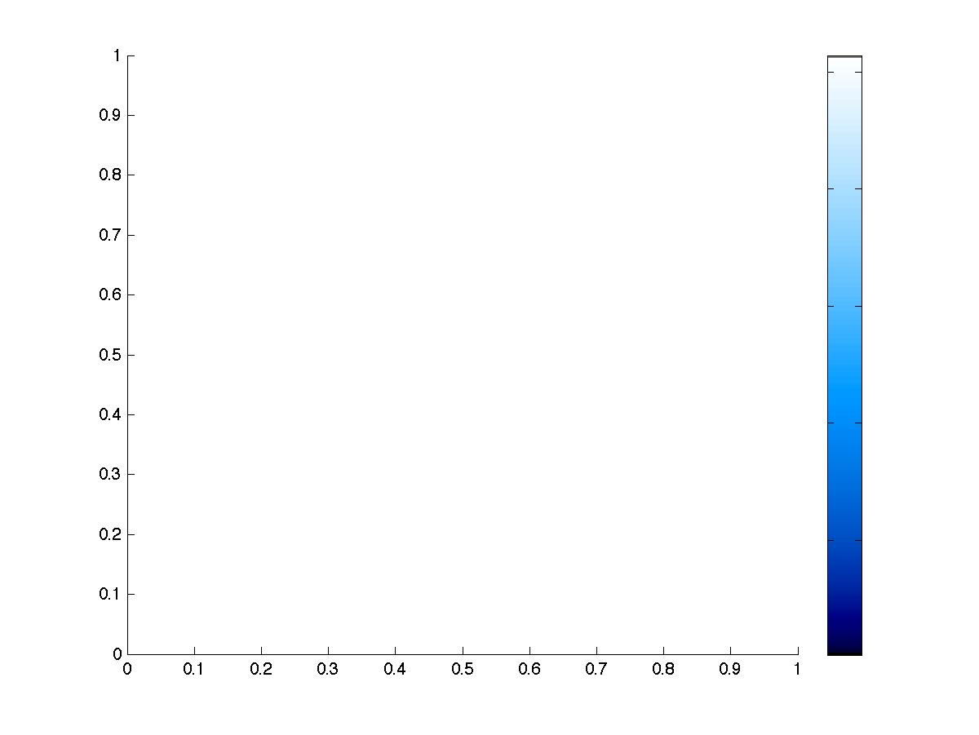
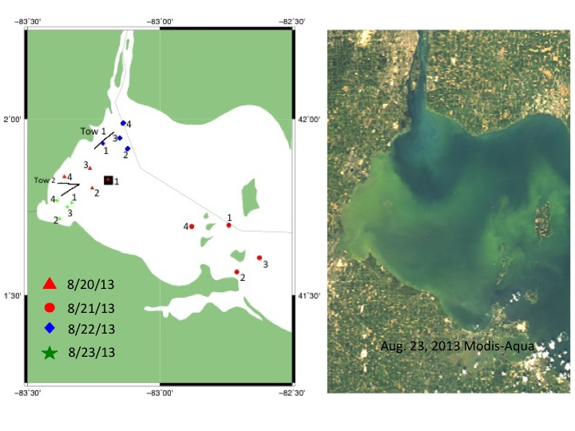
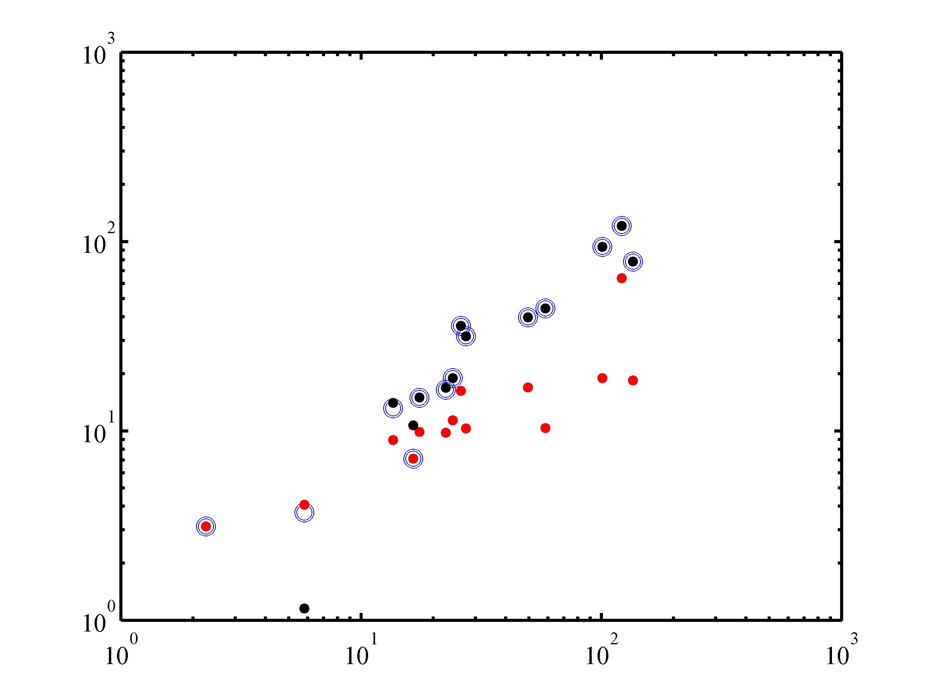
A framework for selecting and blending retrievals from bio-optical algorithms in lakes and coastal waters
based on remote sensing reflectance for water quality assessment
Timothy Moore¹, Colleen Mouw², James Sullivan³, Mike Twardowski³, Antonio Ruiz-Verdu⁴, Mark Dowell⁵ and Shane Bradt¹
1 - Ocean Process Analysis Laboratory, University of New Hampshire, Durham, NH; 2 - Dept. of Geological & Mining Engineering & Sciences, Michigan Technological University, MI; 3 – Western Environmental Technologies Labs, Narragansett, RI
timothy.moore@unh.edu
Introduction
Bio-optical algorithms perform to varying levels of accuracy depending on the nature of the water environment and how the algorithm was tuned. This is especially true when considering the optical differences between traditional open ocean algorithms (low chlorophyll and optical complexity) and coastal/lake environments (high chlorophyll and optical complexity). A classification system is needed to differentiate when and where to apply algorithms tuned for different environments. Here, we present a scheme for blending the chlorophyll retrievals from multiple bio-optical algorithms. The goal was not to advocate or promote any single algorithm, but to use existing algorithms as case studies for the proposed classification framework. Specifically, we aimed 1) to identify unique optical water types based on remote sensing reflectance for turbid coastal and inland waters; 2) to evaluate the best chlorophyll algorithm for each water type found, and 3) to apply the full method of integrating chlorophyll retrievals from algorithms suited for different optical conditions into a blended and seamless product on ocean color imagery.
Table 2. Chlorophyll characteristics of each water type.
Results
Blue/green (OC4) and red/NIR (Meris 3-Band) Chl algorithms do not perform evenly over the range of chlorophyll in the in situ data (0.1 to 1000 mg/m3) (Figure 2, Table 3).
The OC4 algorithm shows better performance in water types 1, 2, 3 and 6. The Meris 3-band algorithm shows better performance in types 4, 5 and 7 (Table 3).
Overall performance improves significantly over the whole chlorophyll range when combined (from 0.47 and 0.446 to 0.30).
Extending to satellite imagery, membership maps for optical water types can be generated (Figure 4).
Memberships form the weights for chlorophyll retrievals from each of the algorithms (Figure 5).
Independent in situ data from Lake Erie confirm method (Figure 6). RMS significantly reduced over the whole range of Chla.
Figure 2. Mean spectral reflectance of the 7
lake/coastal Optical Water Types (OWTs).
Table 3. RMS error of modeled chlorophyll and measured chlorphyll. The two chlorophyll models evaluated for the standard NASA OC4 (blue/green ratio) and the Meris 3-band (red/NIR band height). * - indicates negative modeled chlorophyll values not included in RMSE.
Figure 1. Cluster analysis of hyperspectral reflectance data revealed 7 clusters as optimal. Red lines indicate the mean vector. Means and covariance matrices from each cluster were used to construct the membership function.
Figure 3. Modeled chlorophyll a concentration versus measured values color-coded by OWT. A: OC4 versus measured; B: Meris 3-band versus measured; C: Blended chlorophyll versus measured as selected from Table 3.
Membership
Methods
Cluster analysis of in situ hyperspectral reflectance data to separate data into subsets (Figure 1, Table 1).
Reflectance data were sorted by cluster: mean and covariance calculated to represent the Optical Water Types (Figure 2). Table 2 shows chlorophyll distributions.
OC4 and Meris 3-band chlorophyll algorithm were applied to reflectance data, and sorted by water type (Figure 3).
RMS error was calculated for each algorithm and optical water type (Table 3).
Best performing algorithm was assigned for that water type and blended into a continuous algorithm (Figure 3).
Blended algorithm approach was applied to a MERIS image over Lake Erie (Figure 4, 5).
Independent data used to confirm results in Lake Erie (Figure 6).
1
Figure 5. Memberships for OWTs 1, 2 ,3 and 6 are combined for weighting the retrieval from the blue/green chlorophyll algorithm, and memberships for OWTs 4, 5 and 7 are combined to weight the output of the red/NIR algorithm. All weights are normalized to the membership sum. The weighted chlorophyll products are simply added together (blended) into one single image product.
0.5
0
Figure 4. A MERIS image from Sep. 3, 2011 classified to the 7 OWTs using the fuzzy membership function. Membership to each OWT represent the degree of similarity between the pixel and the mean vector for that OWT (Figure 2). The dominant OWT (OWT with the highest membership) is shown in the last panel.
Summary
Chlorophyll algorithms do not perform evenly over the range of environmental conditions found in coastal and lake waters.
The Optical Water Type framework provides a mechanism to select preferred algorithms for specific optical conditions, leading to overall improved accuracy over a large range of typical lake/coastal water conditions.
Blending retrievals from multiple algorithms can be accommodated by the OWT scheme for satellite ocean color data.
Further study is needed to assess performance for a variety of lakes and coastal systems.
Table 1. Data set sources and station distribution for analysis. All station data contained hyperspectral above-water reflectance and chlorophyll measurements.
RMS (OC4) = 0.47
RMS (Mer3B) = 0.23
RMS (blend) = 0.16
In situ Chla (mg/m3)
In situ Chla (mg/m3)
Figure 6. Left: Map of station data collected in Lake Erie in 2013, including hyperspectral Rrs and Chla. Right: Chlorophyll algorithm results from data collected in Lake Erie 2013. Legend: open circles - blended Chla, black points – Mer3B model, red points – OC4 model.
Acknowledgment: This work is funded by NIH/NSF Grant R01 ES021929-02.

